Slide 1
Effective Leadership and Management in Nursing Ninth Edition
Chapter 10
Communicating Effectively

Slide 2
Learning Outcomes
Identify the factors that influence communication.
Describe how difference in gender, generation, culture, and organization can affect communication.
Explain how communication content and medium selection vary according to the situation (context), goals, and relationship of those involved.
Explain what principles must be followed for collaborative communication to take place.
Develop a plan to improve your communication skills.

Slide 3
Key Terms
communication
channels of communication
diagonal communication
downward communication
lateral communication
continued on next slide

Slide 4
Key Terms
negative inquiry
synchronous and asynchronous channels
upward communication

Slide 5
Introduction
Communication
A complex, ongoing, dynamic process in which the participants simultaneously create shared meaning in an interaction
Process in which individuals employ symbols (both verbal and nonverbal) to establish and interpret meaning within their environment
Simple, but not easy

Slide 6
Learning Outcome One
Identify the factors that influence communication.

Slide 7
Communication
In any one situation, we are trying to achieve at least three goals simultaneously.
Instrumental
Relational
Identity
In any particular interaction, we are trying to build or maintain a relationship.
continued on next slide

Slide 8
Communication
Transactional Model of Communication
All participants are influenced by:
Past experiences.
The present situation.
The contexts in which the interaction is occurring.
The communication process is dynamic.
Ever moving forward
The communication process is also irreversible.
continued on next slide

Slide 9
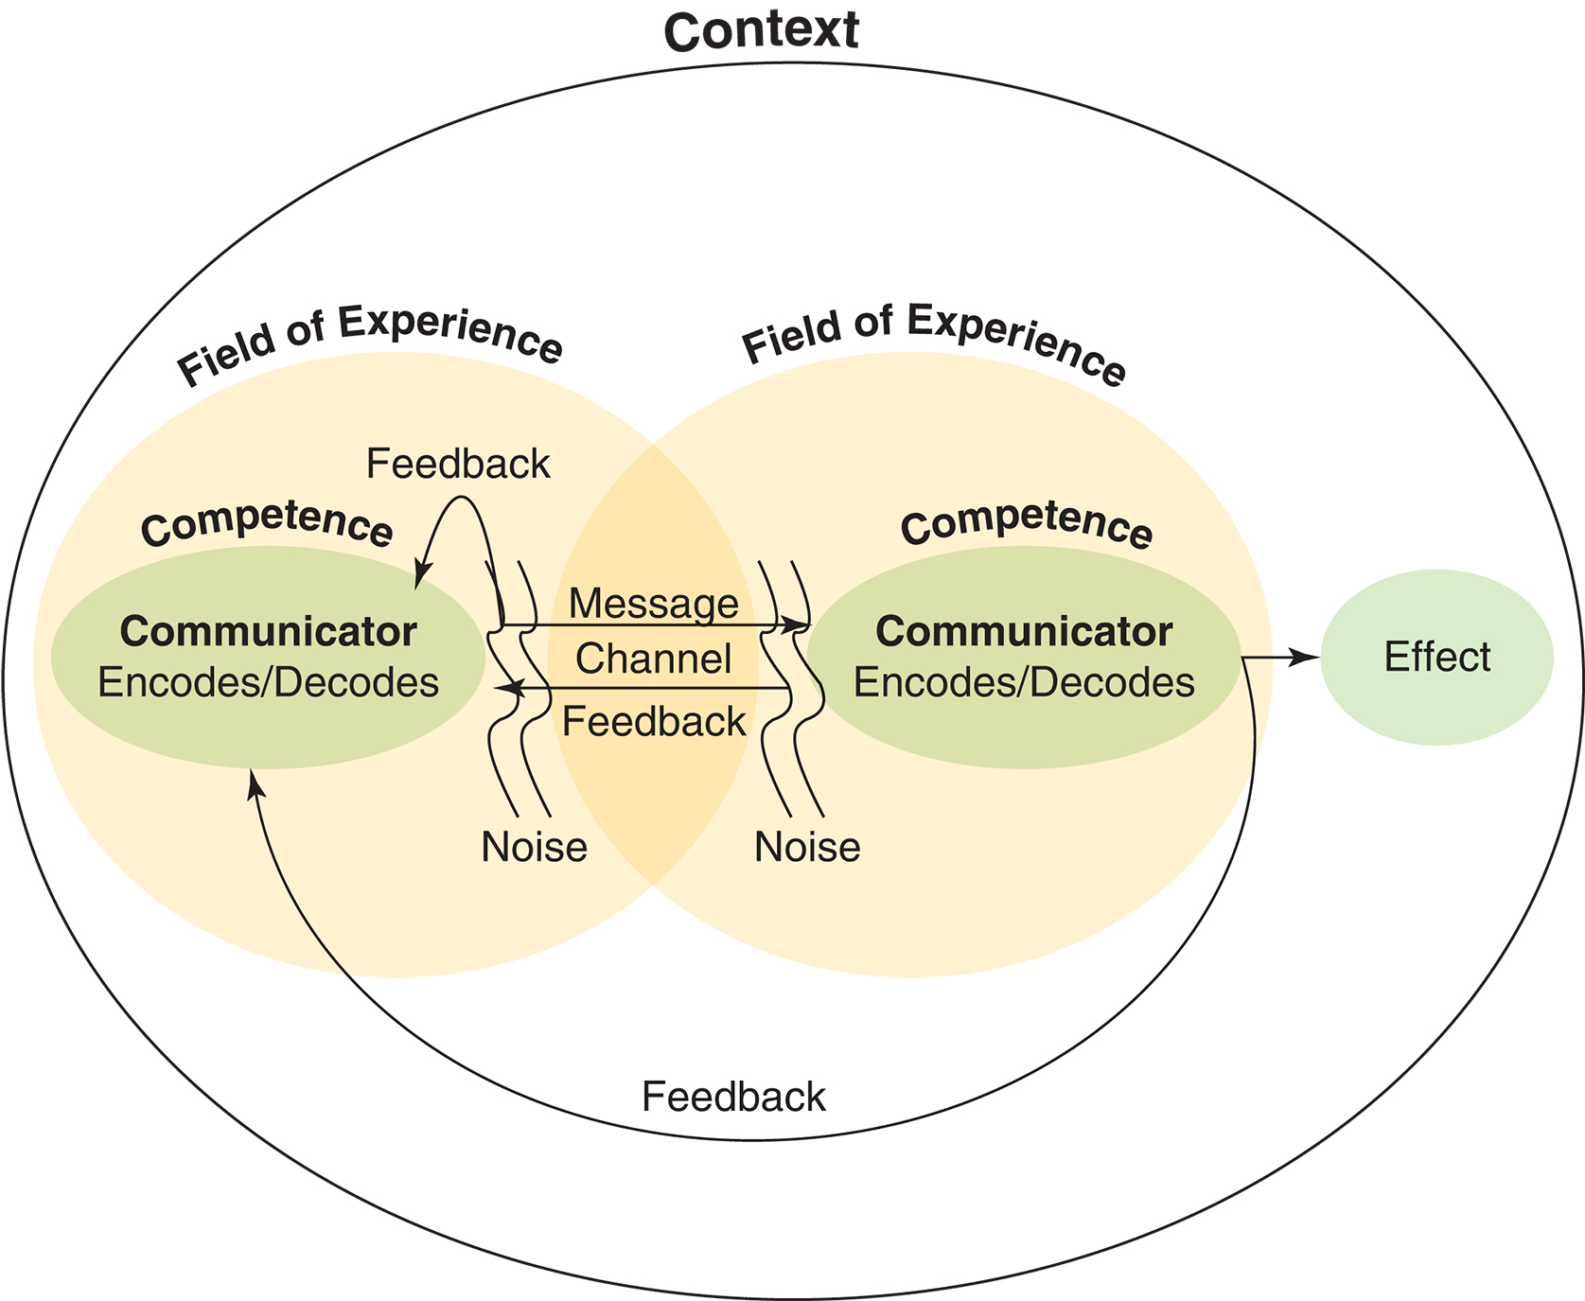
Figure 10-1 Transactional Model of Communication.

Slide 10
Communication
Channels of Communication
May be described on a continuum with synchronous and asynchronous channels as endpoints
Synchronous
Rapid feedback, multiple cues, natural language, and personal focus
Face-to- face, telephone, voicemail, and video
Asynchronous
Slower feedback, fewer cues, less naturally occurring language, and less personal focus
Email, postal mail, discussion board posts
continued on next slide

Slide 11
Communication
Channels of Communication
Channels with more to less information, or cues, are ranked here from more synchronous to less synchronous:
In person
By phone
Voice mail
Text
Email
Postal mail
Posting on social media websites, including blogs
continued on next slide

Slide 12
Communication
Nonverbal Messages
Head or facial agreement or disagreement
Eye contact
Tone
Volume
Inflection
Gestures of the shoulders, arms, hands, or finger
Body posture and position
Dress and appearance
Timing
Environment
continued on next slide

Slide 13
Communication
Nonverbal Messages
Nonverbal communication may be more powerful than spoken words and can influence the meaning of the words.
The following are other common causes of unclear messages:
Using inadequate reasoning
Using strong, judgmental words
Speaking too quickly or too slowly
Using unfamiliar words
Spending too much time on details
continued on next slide

Slide 14
Communication
Nonverbal Messages
Messages become less clear when the recipient:
Is busy or distracted.
Bases understanding on previous unsatisfactory experience with the sender.
Has a biased perception of the meaning of the message or the messenger.
continued on next slide

Slide 15
Communication
Directions of Communication
Downward communication
Manager to staff
Is often directive.
Upward communication
Occurs from staff to management
Often involves reporting pertinent information to facilitate problem solving and decision making
continued on next slide

Slide 16
Communication
Directions of Communication
Lateral communication
Occurs between individuals or departments at the same hierarchical level
Diagonal communication
Involves individuals or departments at different hierarchical levels
Grapevine
Rumors and gossip
continued on next slide

Slide 17
Communication
Effective Listening
Being a good listener, however, involves more than just hearing words and watching body language.
Barriers to effective listening include:
Preconceived beliefs.
Lack of self-confidence.
Flagging energy.
Defensiveness.
Habit.

Slide 18
Learning Outcome Two
Describe how difference in gender, generation, culture, and organization can affect communication.

Slide 19
Effects of Differences in Communication
Gender Differences in Communication
Men and women communicate differently.
Using gender-neutral language helps bridge the gap between men's and women's ways of communicating.
Men and women can improve their ability to communicate with one another.
Neither men nor women should raise their voices no matter what the provocation.
Finish what you are saying before you leave a conversation.
continued on next slide

Slide 20
Effects of Differences in Communication
Generational and Cultural Differences in Communication
Generational differences affect communication styles.
Cultural attitudes, beliefs, and behaviors also affect communication.
Misunderstanding results from people's lack of understanding of one another's cultural expectations.
Understanding the cultural heritage of employees and learning to interpret cultural messages are essential to communicating effectively with staff from diverse backgrounds.
Personal and professional cultural enrichment training is recommended.
What applies to one individual will not be true for everyone else in that culture.
continued on next slide

Slide 21
Effects of Differences in Communication
Differences in Organizational Culture
Customs, norms, and expectations within an organization shape behavior.
Poor communication can be a source of job dissatisfaction.
Violating the organization's communication rules can result in repercussions.

Slide 22
Learning Outcome Three
Explain how communication content and medium selection vary according to the situation (context), goals, and relationship of those involved.

Slide 23
The Role of Communication in Leadership
Leaders who engage in open, two-way communication are seen as informative.
Communication is enhanced when the manager listens carefully and is sensitive to others.
A major underlying factor is an ongoing relationship between manager and employees.
Successful leaders are able to persuade others and enlist their support.
continued on next slide

Slide 24
The Role of Communication in Leadership
Employees
Good communication is the adhesive that builds and maintains an effective work group.
Techniques for giving direction include
Know the context of the instruction.
Get positive attention.
Give clear, concise instructions.
Verify through feedback.
Provide follow-up messages.
continued on next slide

Slide 25
The Role of Communication in Leadership
Administrators
Working effectively with an administrator is important because this person directly influences personal success in a career and within the organization.
Managing a supervisor is a crucial skill for nurses.
Managing upward is successful when power and influence move in both directions.
Understand the superior's position from her or his frame of reference.
continued on next slide

Slide 26
The Role of Communication in Leadership
Administrators
Influencing Your Supervisor
Nurses need to approach their supervisor to exert their influence on a variety of issues and problems.
Timing is critical.
Consider the impact of your ideas on other events occurring at that time.
continued on next slide

Slide 27
The Role of Communication in Leadership
Administrators
Influencing Your Supervisor
What can be done if, in spite of careful preparation, your supervisor says no?
Negative inquiry
"I don't understand"
Do not interrupt or become defensive or distraught.
Remain diplomatic.
Managers often succeed in influencing supervisors through persistence and repetition.
Especially if supporting data and documentation are supplied
continued on next slide

Slide 28
The Role of Communication in Leadership
Administrators
Taking a Problem to Your Supervisor
Go with a goal to problem-solve together.
Have some ideas about solving the problem.
Keep an open mind.
continued on next slide

Slide 29
The Role of Communication in Leadership
Administrators
Taking a Problem to Your Supervisor
Find an appropriate time to discuss a problem.
Schedule an appointment if necessary.
State the problem succinctly.
Explain why it is interfering with work.
Listen to your supervisor’s response, and provide more information if needed.
If you agree on a solution, offer to do your part to solve it. If you cannot discover an agreeable solution, schedule a follow-up meeting or decide to gather more information.
Schedule a follow-up appointment, if appropriate.
continued on next slide

Slide 30
The Role of Communication in Leadership
Administrators
If All Else Fails
Sometimes no matter what you do, working with your supervisor seems nearly impossible.
As a manager, you are charged with supporting your supervisor.
If working with that person is too difficult for you to manage your work satisfactorily, you may have to transfer elsewhere or leave.
continued on next slide

Slide 31
The Role of Communication in Leadership
Coworkers
Coworkers often share similar concerns.
Can provide support in difficult situations
There may also be competition or conflicts.
Should interact on a professional level, even in conflict
continued on next slide

Slide 32
The Role of Communication in Leadership
Medical Staff
Communication may be difficult for the nurse manager.
Relationship of physician and nurse has been that of superior and subordinate.
Staff have considerable power because of their ability to attract patients to the organization.
Everybody in the organization has their own cultural, gender, and generational backgrounds.
continued on next slide

Slide 33
The Role of Communication in Leadership
Other Healthcare Personnel
The manager needs considerable skill to communicate effectively with diverse personnel, recognize their commonalities, and deal with their differences.
continued on next slide

Slide 34
The Role of Communication in Leadership
Patients and Families
Keep the following principles in mind:
The patient and family are the principal customers of the organization.
Most individuals are unfamiliar with medical jargon.
Maintain privacy and identify a neutral location for dealing with difficult interactions.
Make special efforts to find interpreters if a patient or family does not speak English.
Recognize cultural differences in communicating with patients and their families.

Slide 35
Learning Outcome Four
Explain what principles must be followed for collaborative communication to take place.

Slide 36
Collaborative Communication
Collaboration is central to patient safety.
Processes critical to ensuring collaboration with physicians and other members of the healthcare team:
Ensuring quality decisions
Promoting team synergy
continued on next slide

Slide 37
Collaborative Communication
To support greater collaboration between nurses and physicians and to improve the product of nursing service—patient care—keep these principles in mind:
Respect physicians as persons, and expect them to respect you.
Consider yourself and your staff equal partners with physicians in health care.
Build the staff's clinical competence and credibility.
Actively listen and respond to physician complaints as customer complaints.
continued on next slide

Slide 38
Collaborative Communication
To support greater collaboration between nurses and physicians and to improve the product of nursing service—patient care—keep these principles in mind:
Consider implementing Team Strategies and Tools to Enhance Performance and Patient Safety (TeamSTEPPS).
Use every opportunity to increase your staff's contact with physicians.
Establish a collaborative practice committee on your unit.
Serve as a role model to your staff in nurse-physician communication.
Support your staff in participating in collaborative efforts by your words and actions.

Slide 39
Learning Outcome Five
Develop a plan to improve your communication skills.

Slide 40
Enhancing Your Communication Skills
Consider your relationship to the receiver
Craft your message, including your goal and how to answer responses.
Decide on the medium, based on your relationship, the content, and the setting.
Check your timing.
continued on next slide

Slide 41
Enhancing Your Communication Skills
Deliver your message.
Attend to verbal or written responses.
Reply appropriately.
Conclude when both parties’ messages have been understood.
Evaluate the communication process.

