Slide 1
Effective Leadership and Management in Nursing Ninth Edition
Chapter 6
Managing and Improving Quality

Slide 2
Learning Outcomes
Describe how total quality management, continuous quality management, Six Sigma, Lean Six Sigma, and DMAIC address quality.
Delineate efforts to improve the quality of healthcare.
Explain how nurses are involved in reducing risks.

Slide 3
Key Terms
continuous quality improvement (CQI)
DMAIC
Hospital Consumer Assessment of Healthcare Providers and Systems (HCAHPS)
incident reports
indicator
continued on next slide

Slide 4
Key Terms
just culture
Lean Six Sigma
outcome standards
pay for performance (P4P)
process standards
continued on next slide

Slide 5
Key Terms
quality management
reportable incident
risk management
root-cause analysis
Six Sigma
continued on next slide

Slide 6
Key Terms
spaghetti diagram
structure standards
total quality management (TQM)
value-based purchasing (VBP)

Slide 7
Learning Outcome One
Describe how total quality management, continuous quality management, Six Sigma, Lean Six Sigma, and DMAIC address quality.

Slide 8
Quality Management
Concept of quality management is one in which problems are prevented and improvement of care and quality is sought.
A quality management program is based on an integrated system of information and accountability.
Systems can provide the data needed to enable organizations to track activities and outcomes.
continued on next slide

Slide 9
Quality Management
Total Quality Management
A management philosophy that emphasizes a commitment to excellence throughout the organization
Four core characteristics include:
Focus on customer/patient.
Involve the total organization.
Use quality tools and statistics for measurement.
Identify key processes for improvement.
continued on next slide

Slide 10
Quality Management
Total Quality Management
"You can’t manage what you can’t (or don’t) measure."
Dr. W. Edwards Deming
Applied the scientific method to develop a model called the PDCA (Plan, Do, Check, Act) cycle

Slide 11
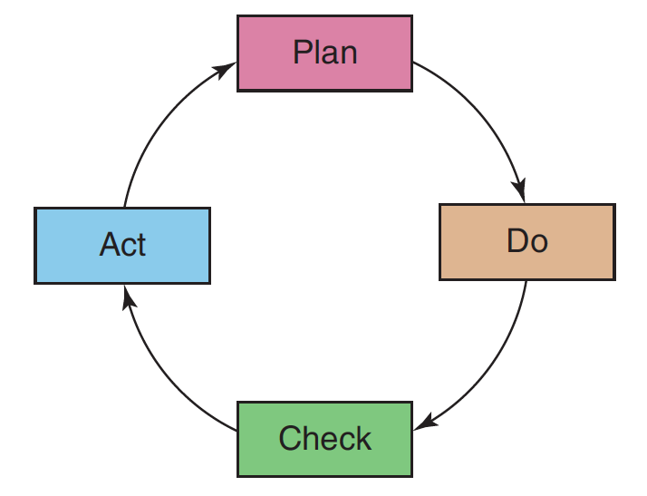
Figure 6-1 PDCA cycle.

Slide 12
Quality Management
Continuous Quality Improvement
Process to improve quality and performance
Used to systematically investigate ways to improve patient care
Involves evaluation, actions, and mind-set to strive for excellence
continued on next slide

Slide 13
Quality Management
Components of Quality Management
Plan identifies processes and systems that:
Represent the goals and mission of the organization.
Identifies customers.
Specifies opportunities for improvement.
Quality management plan includes written statements that define a level of performance or a set of conditions.
continued on next slide

Slide 14
Quality Management
Components of Quality Management
Standards relate to three major dimensions of quality care:
Structure standards
Relate to the physical environment, organization, and management of an organization
Process standards
Connected with the actual delivery of care
Outcome standards
Involve the end results of care that has been given
continued on next slide

Slide 15
Quality Management
Six Sigma
Uses quantitative data to measure progress
Six Sigma is a measure, a goal, and a system of management.
As a measure
Sigma is the Greek letter (Σ) for standard.
As a goal
One goal might be accuracy.
As a management system
Involves management to a greater extent in monitoring performance and ensuring favorable results
continued on next slide

Slide 16
Quality Management
Six Sigma
System has six themes:
Customer (patient) focus
Data driven
Process emphasis
Proactive management
Boundaryless collaboration
Aim for perfection, but tolerate failure
continued on next slide

Slide 17
Quality Management
Lean Six Sigma
Focuses on improving process flow and eliminating waste
Waste occurs when the organization provides more resources than are required.
Focuses on identifying steps that have little or no value to patient care and cause unnecessary delays
Provides tools that can be used with Six Sigma system
continued on next slide

Slide 18
Quality Management
DMAIC Method
Acronym for define, measure, analyze, improve, and control
Six Sigma process improvement method
Steps in the method are:
Define measures that will indicate success.
Measure baseline performance.
Analyze results.
Improve performance.
Control and sustain performance.

Slide 19
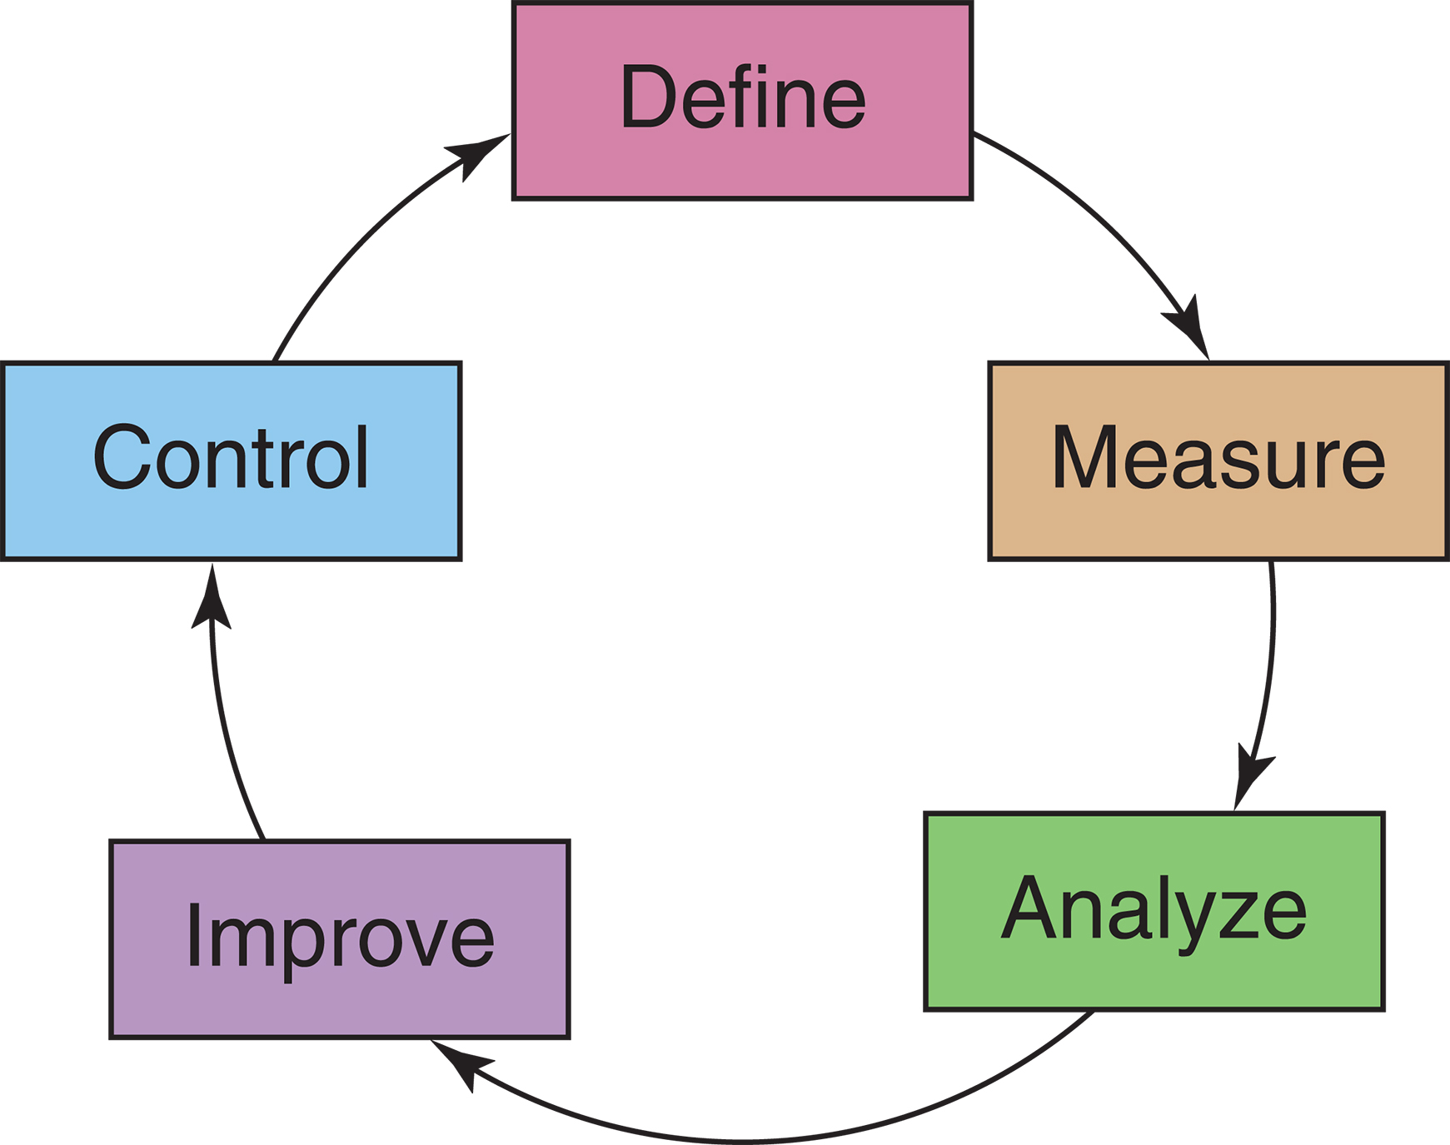
Figure 6-2 DMAIC: The Six Sigma Method. Adapted from DMAIC tools: Six Sigma training tools. Retrieved October 21, 2011, from www.dmaictools.com

Slide 20
Quality Management
DMAIC Method
Spaghetti diagram is a drawing of the actual work flow in a specified area at a point in time.
The spaghetti diagram in Figure 6­3 identifies the movements of a nurse aide trying to room four patients.
By tracing the exact movements of a staff member, managers can identify wasted time and energy and put processes in place to reduce this waste.

Slide 21
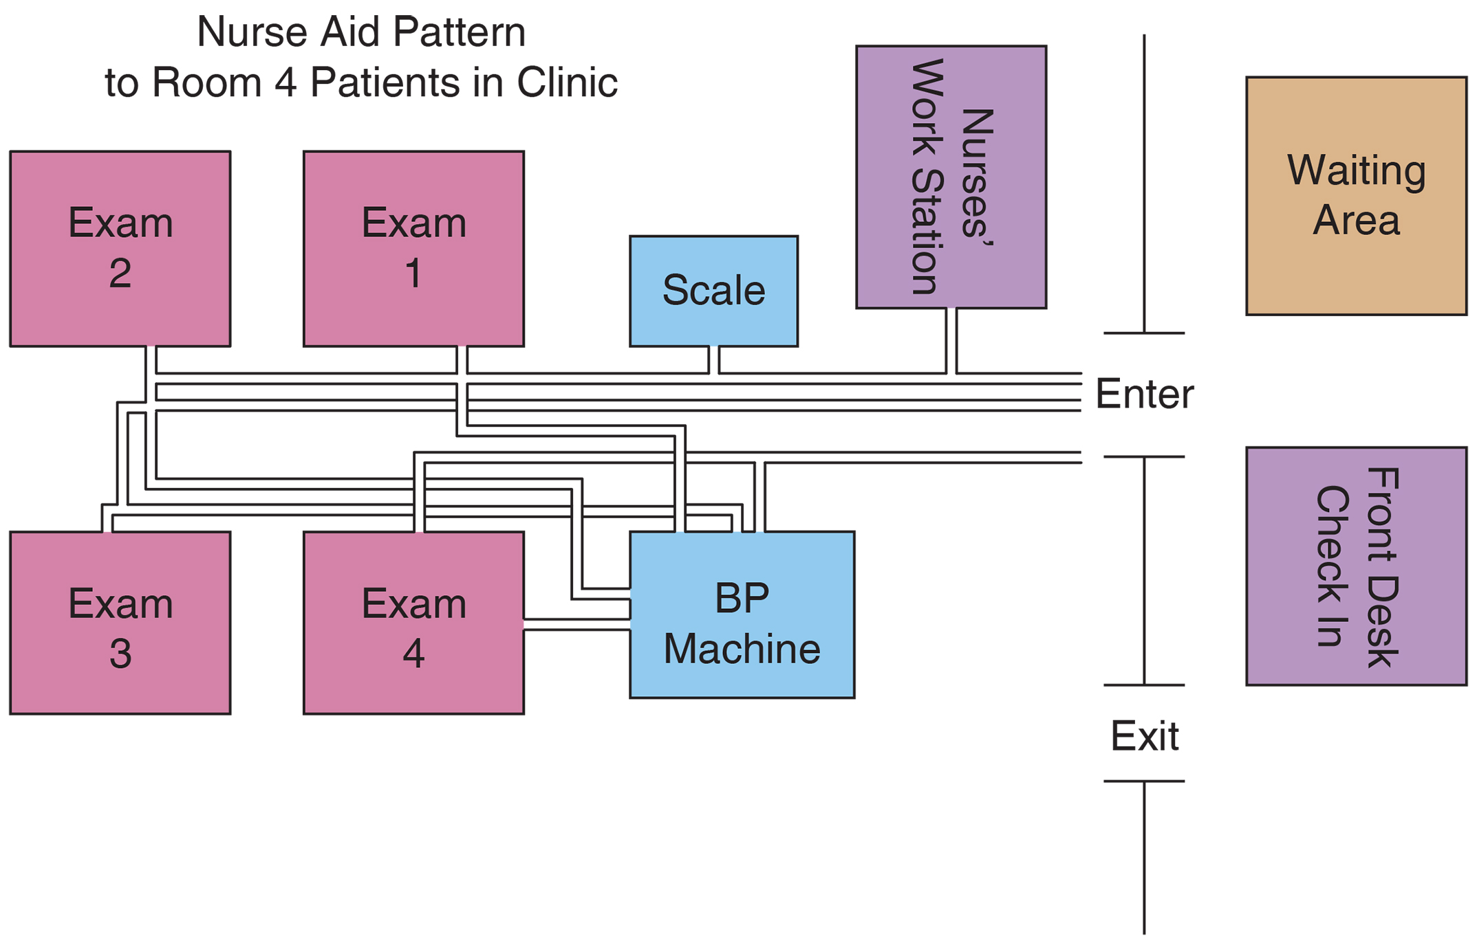
Figure 6-3 Spaghetti diagram.

Slide 22
Learning Outcome Two
Delineate efforts to improve the quality of healthcare.

Slide 23
Improving Quality of Care
National Initiatives
National Quality Forum
Nonprofit organization
Focuses on building consensus on performance goals and standards for measuring and reporting them
Institute for Healthcare Improvement (IHI)
Offers programs to assist organizations in improving the quality of care
Joint Commission has adopted mandatory national patient safety goals.
continued on next slide

Slide 24
Improving Quality of Care
National Initiatives
Institute of Healthcare Improvement (IHI) goals
No needless deaths
No needless pain and suffering
No helplessness in those served or serving
No unwanted waiting
No waste
continued on next slide

Slide 25
Improving Quality of Care
National Initiatives
Joint Commission mandatory patient safety goals
Identify patients correctly
Improve staff communication
Use medicines safely
Prevent infection
Check patient medicines
Identify patient safety risks
Prevent mistakes in surgery
continued on next slide

Slide 26
Improving Quality of Care
National Initiatives
ACA
Changed the way that healthcare organizations are paid for healthcare
Specifies that healthcare organizations be paid for the value of their care
Three federal agencies developed an instrument to measure patient satisfaction across institutions.
Hospital Consumer Assessment of Healthcare Providers and Systems (HCAHPS)
continued on next slide

Slide 27
Improving Quality of Care
Evidence-based practice
Stems from the concept that using research to decide on clinical treatments would improve quality of care
EBP is most reliable when the research study includes a rigorous design.
continued on next slide

Slide 28
Improving Quality of Care
Electronic medical records (EMR)
Mandated in the ACA
Instant access to identical records:
Improves accuracy
Reduces redundancies
Decreases errors
Speeds communication
continued on next slide

Slide 29
Improving Quality of Care
Dashboards
Electronic tools that can provide real-time data or retrospective data
Known as a scorecard
May report on hospital census or patient satisfaction results
Useful to guide staffing and match staffing with patient outcomes
continued on next slide

Slide 30
Improving Quality of Care
Rounding
Proactive strategy that has been shown to reduce falls and call light occurrences
Requires the nurse or aide to check pain, potty, position, and possessions every hour
4P rounding
continued on next slide

Slide 31
Improving Quality of Care
Reducing medication errors
Studies have shown that when nurses are interrupted during medication preparation, a 25% rate of injury­causing errors occurs.
Strategies to reduce medication errors include:
Use of a sash or vest that the nurse dons to prepare medications
Computerized prescriber order entry (CPOE)
Electronic medication administration record (eMAR)
Remote order review by pharmacists
Automated dispensing at the bedside
Bar code administration
Smart pumps
Unit doses

Slide 32
Learning Outcome Three
Explain how nurses are involved in reducing risks.

Slide 33
Risk Management
Purpose is to identify, analyze, and evaluate risks.
Develop a plan for reducing the frequency and severity of accidents and injuries
A continuous daily program of detection, education, and intervention
Involves all departments of the organization
continued on next slide

Slide 34
Risk Management
Risk management program has these responsibilities:
Identifies potential risks for accident, injury, or financial loss
Reviews current organization­wide monitoring systems, evaluates completeness, and determines additional systems needed
Analyzes the frequency, severity, and causes of general categories and specific types of incidents
Reviews and appraises safety and risk aspects of patient care procedures and new programs
continued on next slide

Slide 35
Risk Management
Risk management program has these responsibilities:
Monitors laws and codes related to patient safety, consent, and care
Eliminates or reduces risks as much as possible
Reviews the work of other committees
Identifies needs for patient, family, and personnel education
Evaluates the results of a risk management program
Provides periodic reports
continued on next slide

Slide 36
Risk Management
Nursing’s Role in Risk Management
Chief nursing administrator must be committed to the program.
Attitude will influence the staff and their participation.
High-risk areas in healthcare fall into five general categories:
Medication errors
Complications from diagnostic or treatment procedures
Falls
Patient or family dissatisfaction with care
Refusal of treatment or refusal to sign consent for treatment
continued on next slide

Slide 37
Risk Management
Incident Reports
Used to analyze the severity, frequency, and causes of occurrences within the five risk categories
Accurate and comprehensive reporting on both the patient’s chart and in the incident report is essential.
Protect the organization and caregivers from litigation.
Incident reporting is often the nurse’s responsibility.
continued on next slide

Slide 38
Risk Management
Incident Reports
Reportable incident
Should include any unexpected or unplanned occurrence that affects or could potentially affect a patient, family member, or staff
Attention should be paid to the adequacy of the form as well as to the data required.
continued on next slide

Slide 39
Risk Management
Incident Reports
Reporting incidents involves the following steps:
Discovery
Notification
Investigation
Consultation
Action
Recording
continued on next slide

Slide 40
Risk Management
Examples of Risk
Medication errors
Diagnostic procedure
Medical-legal incident
Patient or family dissatisfaction with care
continued on next slide

Slide 41
Risk Management
Root­cause Analysis
Method to work backward through an event to examine every action that led to the error or event that occurred
Simplified method
Patient
What patient factors contributed to the event?
Personnel
What personnel actions contributed to the event?
Policies
Are there policies for this type of event?
continued on next slide

Slide 42
Risk Management
Root­cause Analysis
Simplified method
Procedures
Are there standard procedures for this type of event?
Place
Did the workplace environment contribute to the event?
Politics
Did institutional or outside politics play a role in the event?
continued on next slide

Slide 43
Risk Management
Root­cause Analysis
Peer Review
Purpose is to review an incident, determine if clinical standards were met or not, and propose an action plan to prevent a future occurrence.
Appropriate in the following situations:
An adverse patient outcome has occurred.
A serious risk or injury to a patient occurred.
A failure to rescue incident occurred
continued on next slide

Slide 44
Risk Management
Role of the Nurse Manager
Nurse manager plays a key role in the success of any risk management program.
Individualize care
Distraught, dissatisfied, complaining patient is a high risk.
A satisfied patient or family is a low risk.
Once an incident has occurred, the following are the important factors:
Recognition of the incident
Quick follow­up and action
Personal contact
Immediate restitution (where appropriate)
continued on next slide

Slide 45
Risk Management
Role of the Nurse Manager
Handling complaints
First step is to listen to the person, to identify concerns, and to help defuse the situation.
If the requested resolution exceeds the nurse manager’s authority, the nurse manager should seek the assistance of a nurse administrator or hospital legal counsel.
All incidents must be properly documented.
continued on next slide

Slide 46
Risk Management
Role of the Nurse Manager
A caring attititude
One of the most important ways to reduce risk is to instill a sense of confidence in both patients and families.
Created environmentally and professionally
The manager should be certain to thank staff for reporting adverse incidents.
continued on next slide

Slide 47
Risk Management
Creating a Blame­free Environment
Just culture
Allows reporting of errors without fear of undue retribution
Provides an environment in which employees can question policies and practices, express concerns, and admit mistakes without fear of retribution
Errors can be categorized as follows:
Human errors
At­risk behaviors
Reckless behaviors
continued on next slide

Slide 48
Risk Management
Blame-Free Environment
Nurse manager is in a key position.
Identify problems
Encourage a culture of safety and quality

