Slide 1
Effective Leadership and Management in Nursing Ninth Edition
Chapter 21
Managing Absenteeism, Reducing Turnover, Retaining Staff

Slide 2
Learning Outcomes
Explain absenteeism and how to manage it.
Describe how nursing turnover affects the organization.
Examine what organizations can do to improve retention of nurses.

Slide 3
Key Terms
absence culture
absence frequency
attendance barriers
engagement
involuntary absenteeism
continued on next slide

Slide 4
Key Terms
involuntary turnover
retention
salary compression
total time lost
turnover
continued on next slide

Slide 5
Key Terms
voluntary absenteeism
voluntary turnover

Slide 6
Learning Outcome One
Explain absenteeism and how to manage it.

Slide 7
Absenteeism
Absenteeism in healthcare organizations is both pervasive and expensive.
Working shorthanded can create both physical and mental strain.
continued on next slide

Slide 8
Absenteeism
A Model of Employee Attendance
Two kinds
Voluntary
Absenteeism under the employee’s control
Involuntary
Largely outside of the employee’s control
continued on next slide

Slide 9
Absenteeism
A Model of Employee Attendance
Absenteeism measured in terms of:
Total time lost
Number of scheduled days an employee misses
Absence frequency
Total number of distinct absence periods, regardless of duration

Slide 10
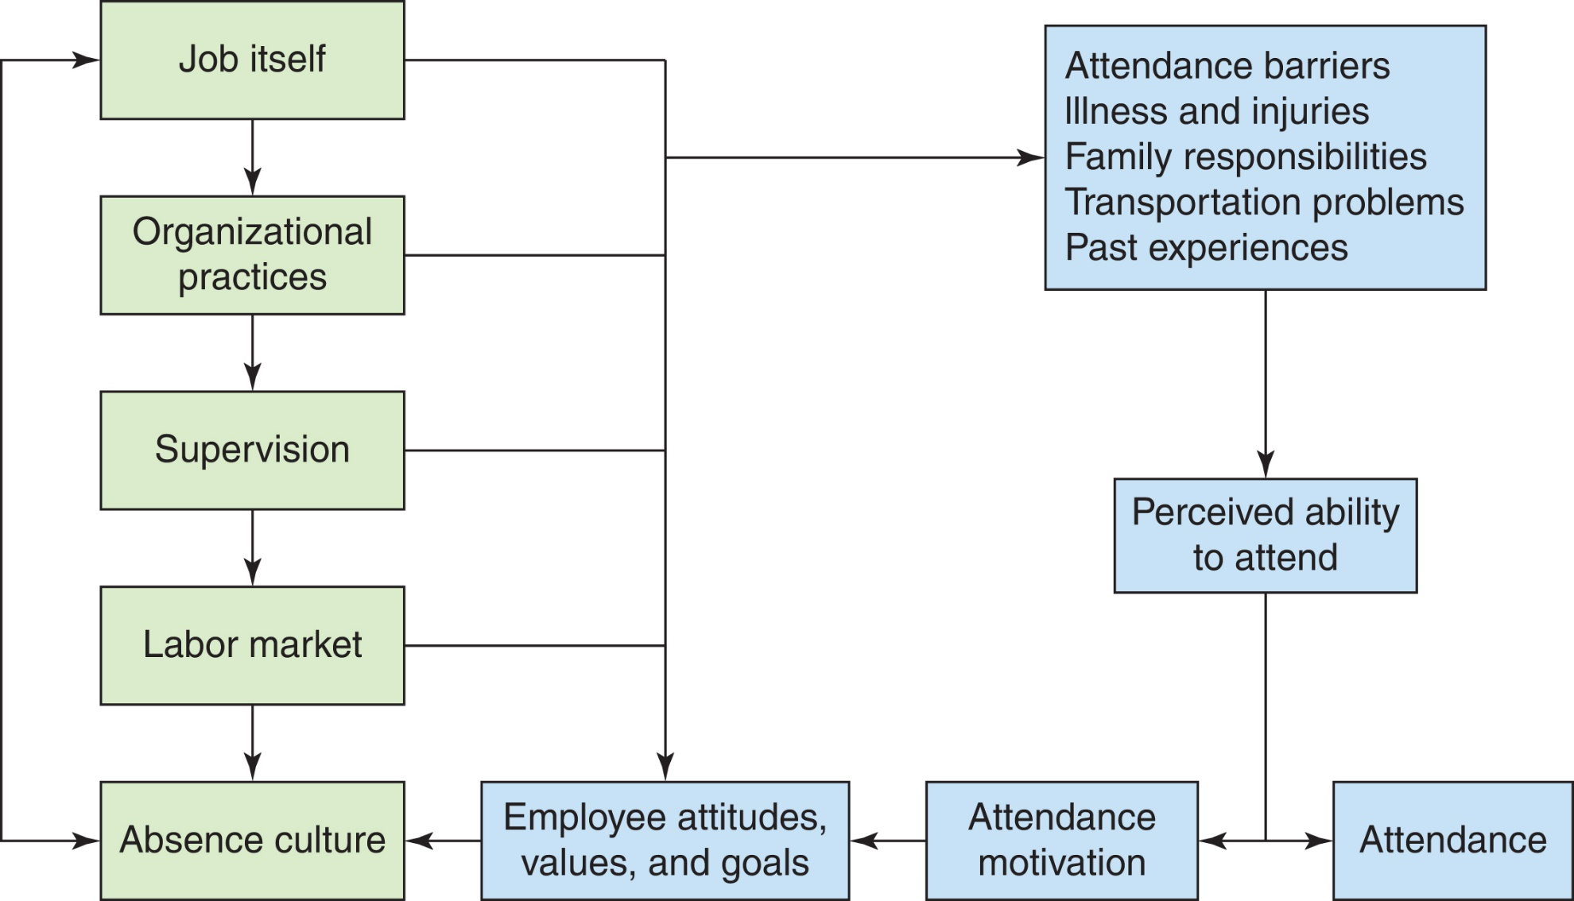
Figure 21-1 A diagnostic model of employee attendance.

Slide 11
Absenteeism
Employee motivation to attend is affected by:
The job itself
Attendance barriers
Organizational practices
Absence culture
General attitude toward and tolerance of absenteeism
Generational differences
Management
Labor market
Personal characteristics
continued on next slide

Slide 12
Absenteeism
Managing Employee Absenteeism
Absence patterns can answer such questions as the following:
Is absenteeism equally distributed across all nurses?
In comparison to other units, does your area of responsibility have a high absenteeism rate?
Are most absences of short or long duration?
Does the absenteeism have a consistent pattern?
continued on next slide

Slide 13
Absenteeism
Managing Employee Absenteeism
Encourage staff’s motivation to attend.
Job enrichment
Stress reduction
Making excellent attendance the norm
Advancement opportunities
Improved coworker relations
continued on next slide

Slide 14
Absenteeism
Managing Employee Absenteeism
Encourage staff’s motivation to attend.
Selecting employees who will be satisfied and committed
Role modeling
Discussing attendance during performance appraisal
Rewarding good attendance
Enforcing absenteeism policies
continued on next slide

Slide 15
Absenteeism
Absenteeism Policies
Most organizational policies allow employees to accrue paid sick days.
An approach for managing absenteeism is substituting personal days for unused sick days.
Employee no longer has to lie to use days off.
Nurse manager may have time to plan for a replacement.
continued on next slide

Slide 16
Absenteeism
Selecting Employees and Monitoring Absenteeism
Strategies for dealing with employees with excessive absences include:
Set expectations with each new employee.
Give her or him the attendance policy in writing.
Clarify any questions.
Monitor each individual’s attendance, and document it.
Intervene early and consistently, coaching and dealing with policy or procedure violations as appropriate.
continued on next slide

Slide 17
Absenteeism
Selecting Employees and Monitoring Absenteeism
Strategies for dealing with employees with excessive absences include:
Be sure to reward staff who have good attendance.
Ensure any organizational rewards are delivered.
Give your personal reward through feedback in performance appraisals.
Be a role model for good attendance yourself.
continued on next slide

Slide 18
Absenteeism
Family and Medical Leave
Family and Medical Leave Act (FMLA)
All public employers and all private employers employing 50 or more individuals must provide eligible employees with leave of up to 12 weeks during any 12-month period.
Serious illness, birth or adoption of a child, placement of a foster child into the household, or care of a seriously ill child, spouse, or parent.
Allows eligible employees to maintain health insurance coverage while on leave.
Allows them to return to the same or equivalent position at the end of the leave period.

Slide 19
Learning Outcome Two
Describe how nursing turnover affects the organization.

Slide 20
Reducing Turnover
Turnover
Number of staff members who vacate a position.
Retaining both experienced nurses and new graduates is essential.
continued on next slide

Slide 21
Reducing Turnover
Cost of Nursing Turnover
Cost of hiring a new nurse or temporarily replacing a nurse is sizable.
Effects on nurses who remain at job:
May have to work longer hours or simply work harder
Can cause both physical and mental strain
May result in additional departures
May begin a cycle of nurses leaving, resulting in a turnover spiral.
If temporary replacements are used, problems can result as the work flow of the unit is disturbed.
Communication patterns within the unit are disrupted.
continued on next slide

Slide 22
Reducing Turnover
Turnover Factors
Did the employee leave of her or his own accord, or was the person asked to leave?
Was the employee who left performing at an exceptional or mediocre level?
Did the employee leave for career development or because of dissatisfaction with the organization?
Will the employee be easy or difficult to replace?
continued on next slide

Slide 23
Reducing Turnover
Positive aspects of turnover
Performance may improve.
Newly hired nurses may be more enthusiastic.
Long-running conflicts between people may be reduced or eliminated.
Administration may be challenged to improve work environment.
continued on next slide

Slide 24
Reducing Turnover
Causes of Turnover
Voluntary turnover
Occurs when an employee chooses to leave an organization
Involuntary turnover
Termination of employment by the employer
Poor performance
Change in organizational structure
Staff cuts
continued on next slide

Slide 25
Reducing Turnover
Understanding Voluntary Turnover
Traditionally, organizations have attempted to determine the reasons for voluntary turnover through two sources:
Asking the exiting employee’s supervisor why the employee is leaving
An exit interview
Departing employees may not give honest answers in their exit interviews.
Turnover is a direct function of a nurse’s perceptions of both the ease and the desirability of leaving the organization.
continued on next slide

Slide 26
Reducing Turnover
Understanding Voluntary Turnover
Ease of movement depends on:
Education.
Area of specialization.
Age.
Geographic mobility.
Contacts at other hospitals.
Transportation.
continued on next slide

Slide 27
Reducing Turnover
Understanding Voluntary Turnover
External forces also have an effect on ease of movement, such as the following:
Job openings at other organizations
Non-healthcare organizations hiring nurses for nursing or non-nursing positions
The economy

Slide 28
Learning Outcome Three
Examine what organizations can do to improve retention of nurses.

Slide 29
Retaining Staff
Job satisfaction is affected by various facets of the work environment.
Relationships with nurse manager, staff, patients, and physicians
Shift worked
Fit between nurse values and institutional culture
Expectations of practice setting
Compensation level
Equal and fair distribution of rewards and punishments
continued on next slide

Slide 30
Retaining Staff
Job Satisfaction
Patient satisfaction
Found to be linked to nurses' job satisfaction
Employee engagement
Degree to which an employee is inspired by, willing to invest effort for, likely to recommend, and plans to remain in an organization
Healthy work environment
continued on next slide

Slide 31
Retaining Staff
Job Satisfaction
Criteria for healthy work environment
Skilled communication
True collaboration
Effective decision making
Appropriate staffing
Meaningful recognition
Authentic leadership
continued on next slide

Slide 32
Retaining Staff
Improving Salaries
Salary compression
Results in salaries of long-term employees being at or below that of less-experienced nurses
Pay scales must reflect achievement and accomplishment.
continued on next slide

Slide 33
Retaining Staff
Retention Strategies
To retain nurses, the Children’s Hospital of Philadelphia implemented the following five strategies:
On-boarding
Employee rounding
Social networking
Employee recognition
"Stretch" assignments
continued on next slide

Slide 34
Retaining Staff
Retention Strategies
Recognizing staff performance
Provide personalized, immediate feedback for a job well done.
Write a personal note acknowledging an employee’s good performance.
Publicly recognize an employee’s good performance
Encourage staff to post notes on the bulletin board.
Design a bulletin board to highlight one employee.
continued on next slide

Slide 35
Retaining Staff
Retention Strategies
Additional retention strategies
Provide a realistic job preview to new hires.
Facilitate movement within the organization.
Improve work environment.
Coordinate with other managers to influence organizational policies.
Adapt to turnover rate.
Manage beliefs about why a nurse left.
Provide human resources with a preferred list of replacement workers.

