Slide 1
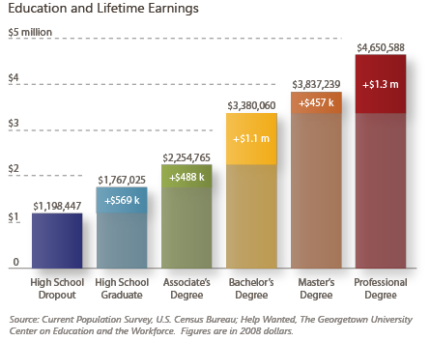
Notes:
Person who made a difference: you, the student by making an investment.

