Slide 1
Effective Leadership and Management in Nursing Ninth Edition
Chapter 4
Leading, Managing, Following

Slide 2
Learning Outcomes
Differentiate between leaders and managers.
Evaluate different theories that explain leadership.
Explore how followership is essential to leadership.
Explain why nurses need to learn management skills.
Describe the management roles that nurses fill in practice.

Slide 3
Key Terms
charge nurse
clinical nurse leader (CNL)
controlling
directing
emotional intelligence
continued on next slide

Slide 4
Key Terms
first-level manager
followership
formal leadership
informal leadership
leader
continued on next slide

Slide 5
Key Terms
manager
organizing
planning
quantum leadership
servant leadership
continued on next slide

Slide 6
Key Terms
shared leadership
transactional leadership
transformational leadership
staff nurse

Slide 7
Introduction
Nurse managers need a body of knowledge and skills distinctly different from those needed for nursing practice.
Few nurses have the education or training necessary to be managers.
Today, all nurses are managers, not in the formal organizational sense but in practice.

Slide 8
Learning Outcome One
Differentiate between leaders and managers.

Slide 9
Leaders and Managers
Leader
Anyone who uses interpersonal skills to influence others to accomplish a specific goal
Exerts influence by using a flexible repertoire of personal behaviors and strategies

Slide 10
Leaders and Managers
Functions of leaders
Achieve consensus within the group about goals
Maintain structure that facilitates accomplishing goals
Supply information that helps provide direction and clarification
Maintain group satisfaction, cohesion, and performance

Slide 11
Leaders and Managers
Manager
An employee who is responsible and accountable for efficiently accomplishing the goals of the organization
Focuses on coordinating and integrating resources
Has authority, responsibility, accountability, and power defined by the organization

Slide 12
Leaders and Managers
Functions of managers
Clarify the organizational structure
Choose the means to achieve goals
Assign and coordinate tasks
Evaluate outcomes and provide feedback

Slide 13
Leaders and Managers
Leadership
Formal
Practiced by a nurse with legitimate authority described in a job description
e.g., nurse manager, supervisor, coordinator, case manager
Depends on personal skills
May be reinforced by organizational authority and position

Slide 14
Leaders and Managers
Leadership
Informal
Exercised by a staff member who does not have a specified management role
Influence the efficiency of work flow is exercising leadership skills
Informal leadership depends primarily on one’s knowledge, status and personal skills.

Slide 15
Learning Outcome Two
Evaluate different theories that explain leadership.

Slide 16
Leadership Theories
Traditional Leadership Theories
Trait theories
Inborn traits of successful leaders
Behavioral theories
Leaders made through education, training, and life experience.
Contingency theories
Suggest managers adapt their leadership styles relative to changing situations; ranging from authoritarian to permissive

Slide 17
Leadership Theories
Contemporary Leadership Theories
Quantum leadership
Based on the concepts of chaos theory
Posits reality is constantly shifting, and levels of complexity are constantly changing
Employees become directly involved in decision making as equitable and accountable partners.
Managers assume more of an influential facilitative role, rather than one of control.
Leadership becomes a shared activity, requiring the leader to possess excellent interpersonal skills.

Slide 18
Leadership Theories
Contemporary Leadership Theories
Transactional leadership
Based on the principles of social exchange theory
Individuals engage in social interactions expecting to give and receive social, political, and psychological benefits or rewards.
Aimed at maintaining equilibrium by:
Performing work according to policy and procedures
Maximizing self-interests and personal rewards
Emphasizing interpersonal dependence
Routinizing performance

Slide 19
Leadership Theories
Contemporary Leadership Theories
Transformational leadership
Emphasizes the importance of interpersonal relationships
Focuses on merging the motives, desires, values, and goals of leaders and followers into a common cause
Leaders appeal to individuals’ better selves rather than these individuals’ self-interests.
Transformational leadership may be a natural model for nursing managers.

Slide 20
Leadership Theories
Contemporary Leadership Theories
Shared leadership
Based on empowerment principles of partici- pative and transformational leadership.
Assumes a well-educated, highly professional, dedicated workforce is comprised of many leaders
Examples of shared leadership in nursing include the following:
Self-directed work teams
Shared governance
Co-leadership

Slide 21
Leadership Theories
Contemporary Leadership Theories
Servant leadership
Based on the premise that leadership originates from a desire to serve
In the course of serving, one may be called to lead.
Servant leaders embody three characteristics:
Empathy
Awareness
Persuasion

Slide 22
Leadership Theories
Contemporary Leadership Theories
Emotional leadership
Emotional intelligence involves personal competence; includes:
Self-awareness.
Self-management.
Social competence.
Nurses are aptly suited to this direction in leadership that emphasizes emotions and relationships with others as a primary attribute for success.

Slide 23
Learning Outcome Three
Explore how followership is essential to leadership.

Slide 24
Followership: An Essential Component of Leadership
Followership
Interactive and complementary to leadership
The follower is an active participant in the relationship with the leader.
Followers are powerful contributors to the relationship with their leaders.
The nurse may be a leader at one moment and become a follower soon afterward.
An effective follower must maintain credibility and trust with the leader.

Slide 25
Learning Outcome Four
Explain why nurses need to learn management skills.

Slide 26
Traditional Management Functions
Functions of Nurse Managers
Planning
Four-stage process to achieve the following:
Establish objectives (goals).
Evaluate the present situation and predict future trends and events.
Formulate a planning statement (means).
Convert the plan into an action statement.

Slide 27
Traditional Management Functions
Functions of Nurse Managers
Planning
Can be contingent or strategic
Contingency planning
Manager identifies and manages problems that interfere with getting work done.
May be reactive in response to a crisis or proactive
Strategic planning
Refers to the process of continual assessment, planning, and evaluation to guide the future

Slide 28
Traditional Management Functions
Functions of Nurse Managers
Organizing
Process of coordinating the work to be done
Involves
Identifying the work of the organization
Dividing the labor
Developing the chain of command
Assigning authority

Slide 29
Traditional Management Functions
Functions of Nurse Managers
Directing
Process of getting the organization's work done
Manager coaches and counsels to achieve the organization’s objectives.

Slide 30
Traditional Management Functions
Functions of Nurse Managers
Controlling
Compares actual results with projected results
Establishing standards of performance
Determing means of measuring performance
Evaluating performance
Providing feedback

Slide 31
Learning Outcome Five
Describe the management roles that nurses fill in practice.

Slide 32
Nurse Managers in Practice
Nurse Manager Competencies
AONE Areas of Competency for All Nurse Managers
Communication and Relationships-Building
Knowledge of the health care environment
Leadership Skill
Professionalism
Business skills

Slide 33
Nurse Managers in Practice
Nurse Manager Competencies
AONE Areas of Competency for All Nurse Managers
Communication and Relationships-Building
Effective communication
Relationship management
Influence of behaviors
Ability to work with diversity
Shared decision making
Community involvement
Medical staff relationships
Academic relationships

Slide 34
Nurse Managers in Practice
Nurse Manager Competencies
AONE Areas of Competency for All Nurse Managers
Knowledge of the health care environment
Clinical practice knowledge
Patient care delivery models and work design knowledge
Health care economics knowledge
Health care policy knowledge
Understanding of governance
Understanding of evidence-based practice

Slide 35
Nurse Managers in Practice
Nurse Manager Competencies
AONE Areas of Competency for All Nurse Managers
Knowledge of the health care environment
Outcome measurement
Knowledge of and dedication to patient safety
Understanding of utilization/case management
Knowledge of quality improvement and metrics
Knowledge of risk management

Slide 36
Nurse Managers in Practice
Nurse Manager Competencies
AONE Areas of Competency for All Nurse Managers
Leadership Skills
Foundational thinking skills
Personal journey disciplines
The ability to use systems thinking
Succession planning
Change management

Slide 37
Nurse Managers in Practice
Nurse Manager Competencies
AONE Areas of Competency for All Nurse Managers
Professionalism
Personal and professional accountability
Career planning
Ethics
Evidence-based clinical and management practice
Advocacy for the clinical enterprise and for nursing practice
Active membership in professional organizations

Slide 38
Nurse Managers in Practice
Nurse Manager Competencies
AONE Areas of Competency for All Nurse Managers
Business skills
Understanding of health care financing
Human resource management and development
Strategic management
Marketing
Information management and technology

Slide 39
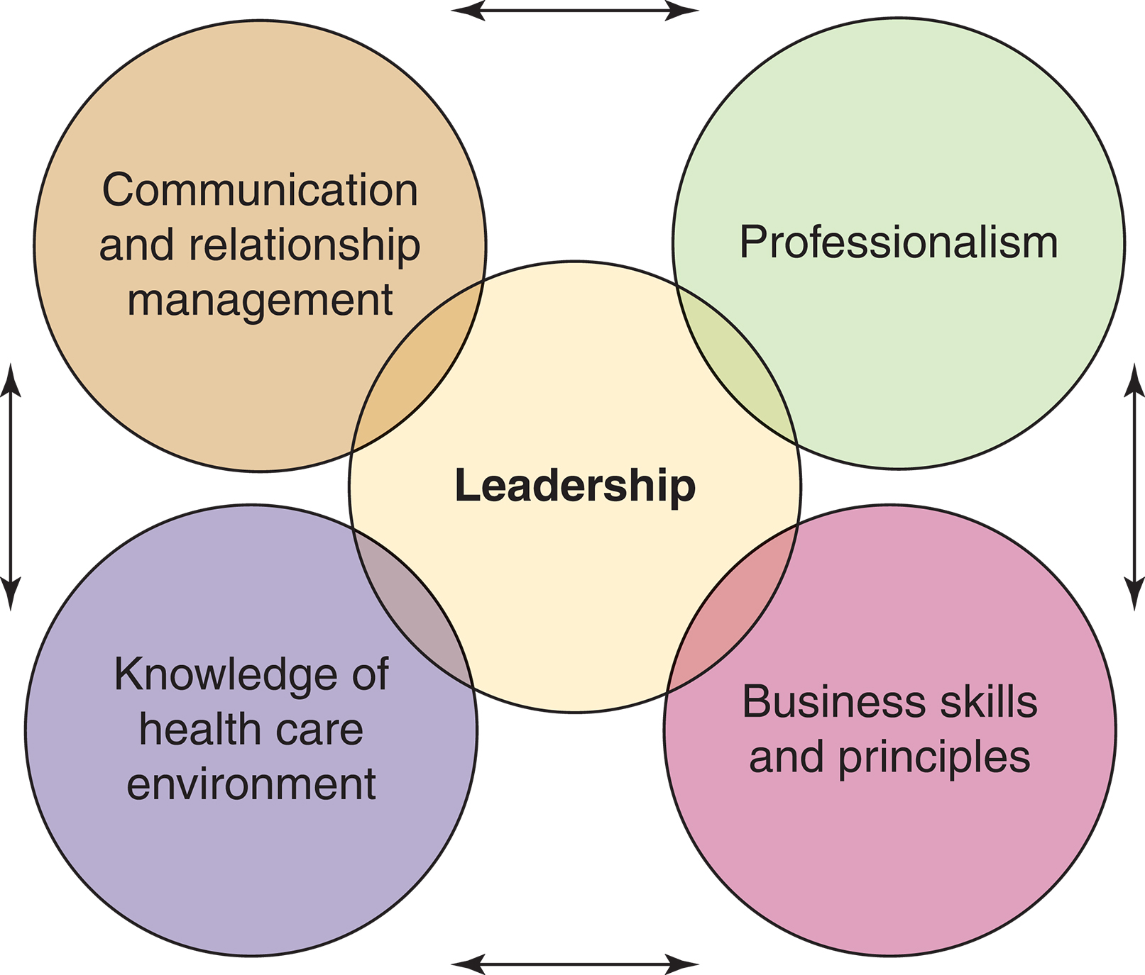
Figure 4-1 Core of leadership competencies. Source: Copyright © 2005 by the American Organization of Nurse Executives. Address reprint permission requests to aone@aha.org.

Slide 40
Nurse Managers in Practice
Staff Nurse
Supervises LPNs, other professionals, and assistive personnel
First-level Management
Responsible for supervising work of nonmanagerial personnel and day-to-day activities of a specific work unit or units
Usually head nurse, nurse manager, or an assistant manager

Slide 41
Nurse Managers in Practice
Charge Nurse
Expanded staff nurse role with increased responsibility
Functions as a liaison to the nurse manager
Responsibilities are confined to a specific shift or task
Has limited authority
Has considerable power to build or break the culture of the unit

Slide 42
Nurse Managers in Practice
Clinical Nurse Leader
Lateral integrator of care responsible for a specified group of patients within a unit of the healthcare setting
Coordinates care at the bedside and supervises the healthcare team
Use of role has improved patient outcomes and reduced costs.

