Slide 1
Effective Leadership and Management in Nursing Ninth Edition
Chapter 3
Delivering Nursing Care

Slide 2
Learning Outcomes
Differentiate the models of nursing care delivery systems and the disadvantages of each.
Describe the attributes of integrated models of care.
Compare three evolving models of care and explain why care delivery systems will continue to evolve.

Slide 3
Key Terms
critical pathways
patient-centered care
patient-centered medical home (PCMH)
practice partnership
synergy model of care

Slide 4
Introduction
Wherever nursing care is delivered, it must be organized to ensure quality care in an era of cost containment.
A delivery system must utilize specific nurses and groups of nurses, optimizing their knowledge and skills and at the same time ensuring that patients receive appropriate care.
No small challenge.

Slide 5
Learning Outcome One
Differentiate the models of nursing care delivery systems and the disadvantages of each.

Slide 6
Traditional Models of Care
Total Patient Care
Original model of nursing care delivery
RN works directly with the patient, family, physician, and other healthcare staff.
Advantages
Continuity of care is assured.
Communication with the patient, family, physician, and staff from other departments is fostered.
Disadvantages
RNs perform tasks that could be done more cost-effectively by less skilled persons.
continued on next slide

Slide 7
Traditional Models of Care
Functional Nursing
Needs of a group of patients are separated into tasks that are assigned to registered nurses (RNs), licensed practical nurses (LPNs), or unlicensed assistive personnel (UAPs).
RNs assess patients.
Other staff give baths, make beds, take vital signs, and administer treatments.
Used infrequently in acute care facilities, and only occasionally in long-term care facilities.
continued on next slide

Slide 8
Traditional Models of Care
Functional Nursing
Advantages
Staff become efficient at performing assigned tasks
Disadvantages
Uneven continuity
Lack of holistic understanding of patient
Problems with follow-up
continued on next slide

Slide 9
Traditional Models of Care
Team Nursing
Team of nursing personnel provides total care to a group of patients.
RN leads team.
Other RNs, LPNs, and UAPs provide patient care to all patients under the direction of the team leader.
Skills in delegating, communicating, and problem solving are essential.
Open communication between team leaders and the nurse manager is also important.
continued on next slide

Slide 10
Traditional Models of Care
Team Nursing
Advantages
LPNs and UAPs perform tasks that do not require RN's expertise
Care is more easily coordinated
Saves steps and time
continued on next slide

Slide 11
Traditional Models of Care
Team Nursing
Disadvantages
Time needed for communicating, supervising, and coordinating team members
Affect of changes in team leaders, members, and assignments on continuity of care
Total patient not considered by any one person
Role confusion and resentment
Less control for nurses over assignments
Possibility of unequal assignments
continued on next slide

Slide 12
Traditional Models of Care
Primary Nursing
Decentralized decision making by staff nurses is the core principle.
Nursing is a knowledge-based professional practice, not just a task-focused activity.
RN maintains a patient load of primary patients.
Actual care is given by the primary nurse and/or associate nurses (other RNs).
Successfully implemented by identifying one nurse who was assigned to coordinate care and with whom the family and physician could communicate, and other nurses or UAPs assisted in providing care.
continued on next slide

Slide 13
Traditional Models of Care
Primary Nursing
Advantages
Knowledge-based practice model
Decentralization of decisions, authority, and responsibility
24-hour accountability
Improved continuity and coordination of care
Increased nurse, patient, and physician satisfaction
continued on next slide

Slide 14
Traditional Models of Care
Primary Nursing
Disadvantages
Excellent communication required
Accountability of associate nurses
Patient transfers disrupt continuity of care
Compensation and legal responsibility for staff nurses
Unwillingness of associates to take direction

Slide 15
Learning Outcome Two
Describe the attributes of integrated models of care.

Slide 16
Integrated Models of Care
Practice Partnerships
RN and assistant (UAP, LPN, or less experienced RN) agree to be practice partners.
Senior RN partner directs work of the junior partner within the limits of each partner’s abilities.
Designed to create synergistic energy as the two work in concert with patients.
Can be applied to primary nursing and used in other nursing care delivery systems
continued on next slide

Slide 17
Integrated Models of Care
Practice Partnerships
Advantages
Improved continuity of care and accountability for care
Disadvantages
Decreased ratio of RNs to nonprofessional staff
Potential for junior team members to assume too much responsibility

Slide 18
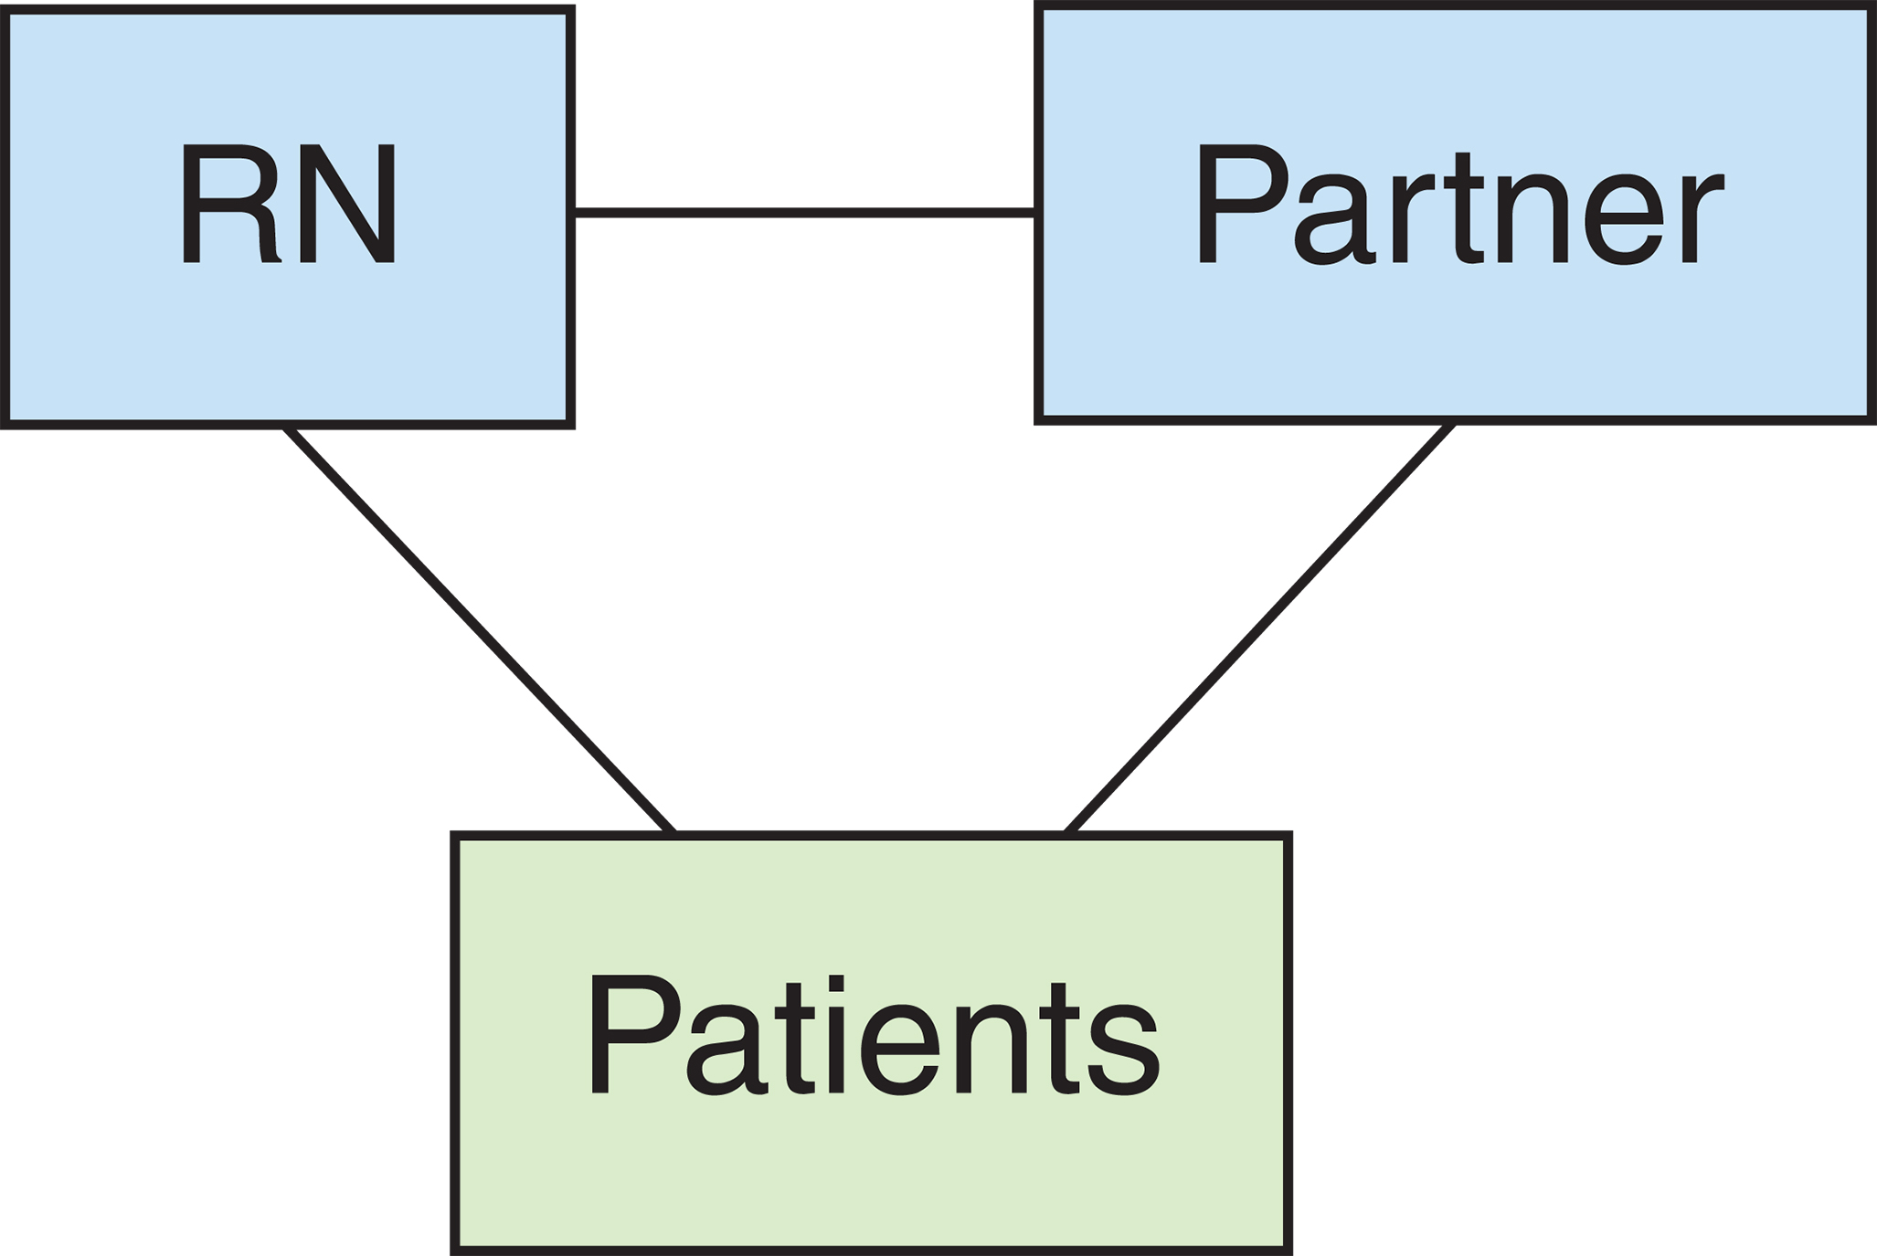
Figure 3-1 Practice partnerships.

Slide 19
Integrated Models of Care
Case Management
Model for identifying, coordinating, and monitoring implementation of services needed to achieve desired patient care outcomes within a speci- fied period of time
Specific patient diagnoses that represent high-volume, high-cost, and high-risk cases are selected.
Collaborative practice team is established.
Includes clinical experts from appropriate disciplines.
continued on next slide

Slide 20
Integrated Models of Care
Case Management
Advantages
All professionals equal team members
Members take ownership of patient outcomes
Disadvantages
Requires qualified nurse case manager, team collaboration, and quality management system
Established critical pathways needed
continued on next slide

Slide 21
Integrated Models of Care
Case Management
All members of the collaborative practice team:
Agree on the final draft of the critical pathways.
Take ownership of patient outcomes.
Accept responsibility and accountability for the interventions and patient outcomes associated with their disciipline.

Slide 22
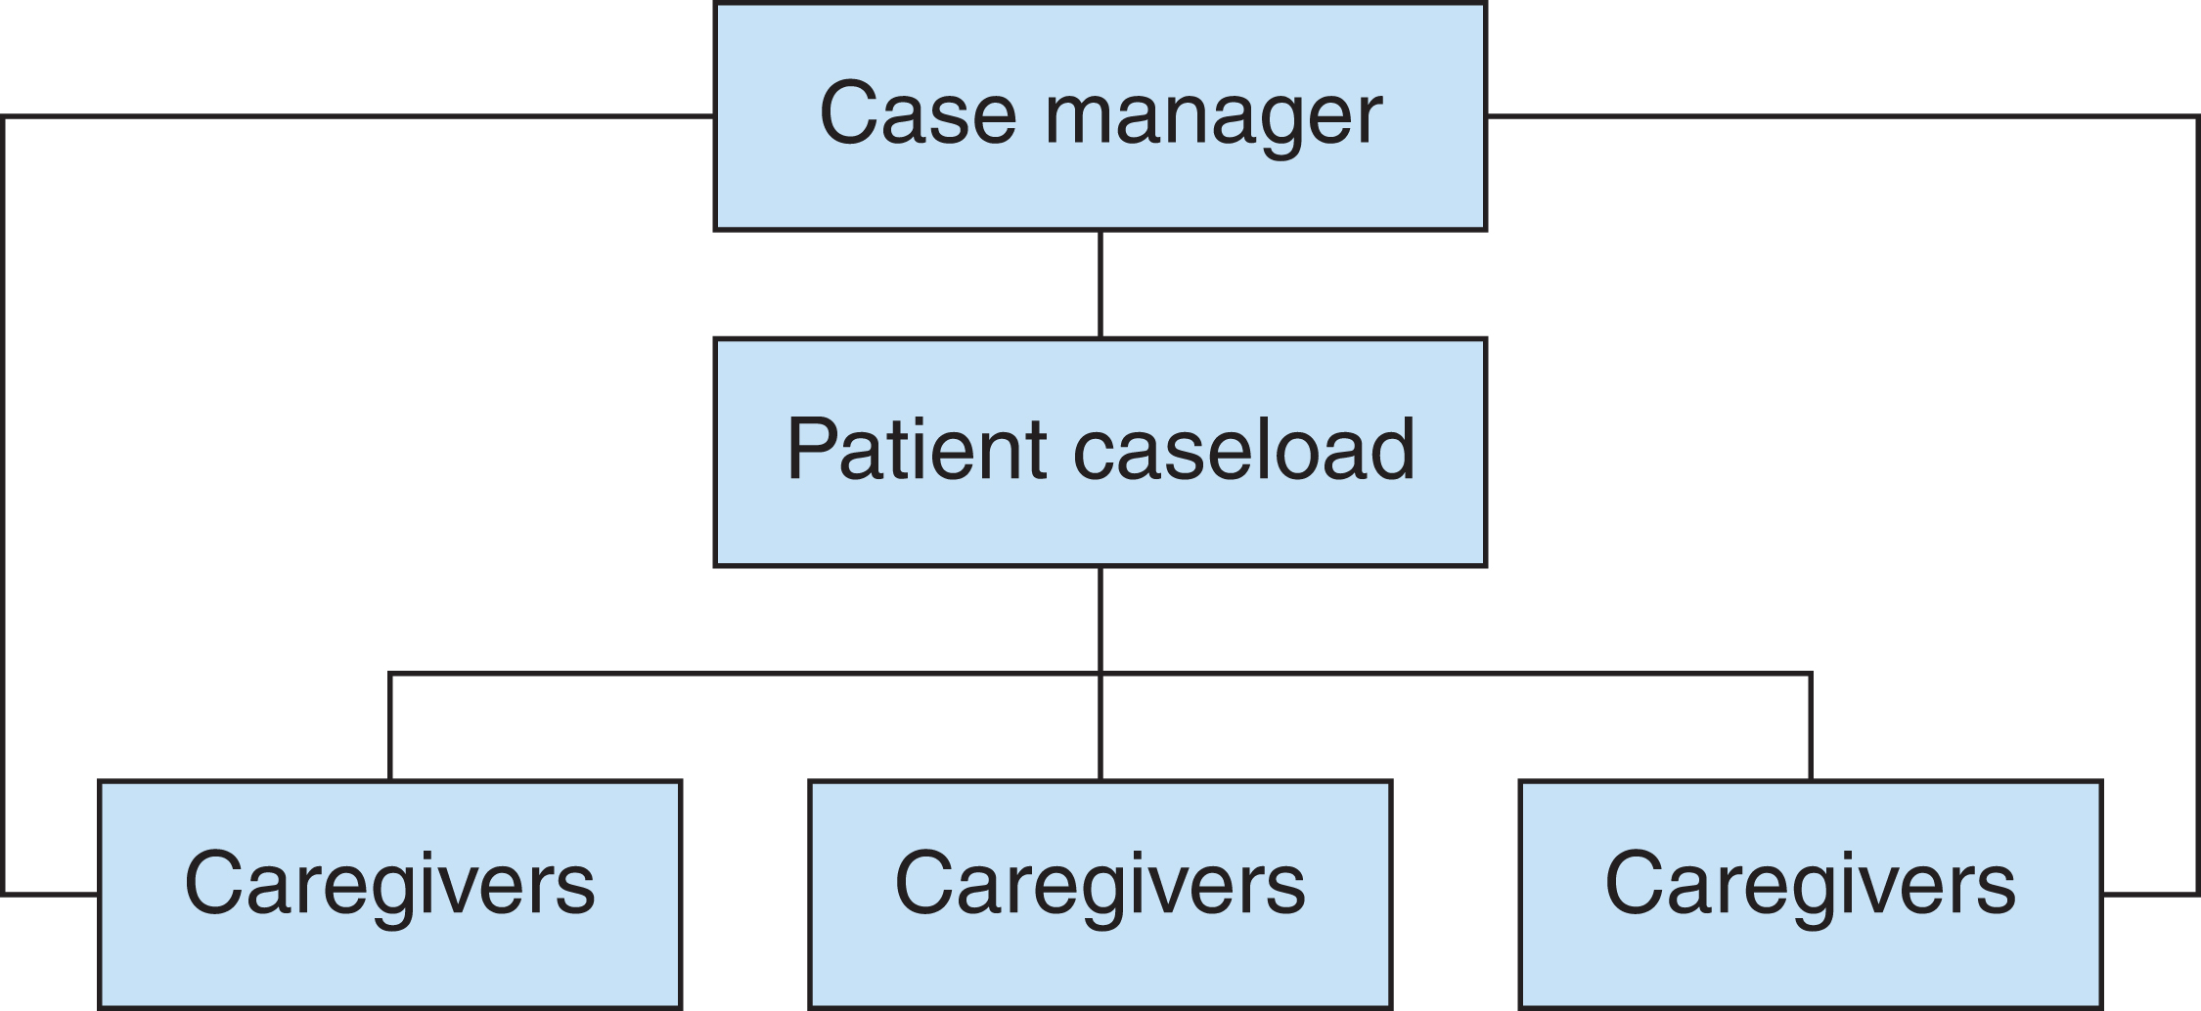
Figure 3-2 Case management.

Slide 23
Integrated Models of Care
Critical Pathways
Also known as critical paths, care pathways, milestone maps, and progression of care
Provide direction for managing the care of an individual patient during a stipulated time period
Use resources appropriate to the care needed and thus reduce cost and length of stay
Must include a means to determine whether the outcome has been met and to easily identify variances
continued on next slide

Slide 24
Integrated Models of Care
Critical Pathways
Advantages
Accommodate unique characters, conditions of patients
Reduce costs
Disadvantages
May need revision

Slide 25
Learning Outcome Three
Compare three evolving models of care and explain why care delivery systems will continue to evolve.

Slide 26
Evolving Models of Care
Patient-centered Care
Nurse coordinates a team of multifunctional, unit-based caregivers.
All patient care services are unit-based.
Focused on:
Decentralization
Promotion of efficiency and quality
Cost control
continued on next slide

Slide 27
Evolving Models of Care
Patient-centered Care
Typical team consists of:
Patient care coordinators (RNs)
Patient care associates or technicians
Perform delegated patient care tasks
Unit support assistants
Provide environmental services
Can assist with hygiene and ambulation needs
continued on next slide

Slide 28
Evolving Models of Care
Patient-centered Care
Typical team consists of:
Administrative support personnel
Maintain patient records
Transcribe orders
Coordinate admission and discharge
Assist with general office duties
Nurse manager’s role in patient-centered care requires considerable time.
continued on next slide

Slide 29
Evolving Models of Care
Patient-centered Care
Advantages
Promotes efficiency, quality, and cost control
Disadvantages
Requires considerable time for nurse manager
Demands a strong leader to manage staff
continued on next slide

Slide 30
Evolving Models of Care
Synergy Model of Care
Conceptualizes nursing practice based on the needs and characteristics of patients
Patient characteristics include:
Resiliency
Vulnerability
Stability
Complexity
continued on next slide

Slide 31
Evolving Models of Care
Synergy Model of Care
Patient characteristics include:
Resource availability
Participation in care
Participation in decision making
Predictability
continued on next slide

Slide 32
Evolving Models of Care
Synergy Model of Care
Patient characteristics are matched with nurse competencies including:
Clinical judgment
Advocacy and moral agency
Caring practices
Collaboration
continued on next slide

Slide 33
Evolving Models of Care
Synergy Model of Care
Patient characteristics are matched with nurse competencies including:
Systems thinking
Response to diversity
Facilitation of learning
Clinical inquiry
When patients’ characteristics and nurses’ competencies match, synergy is the outcome.
Synergy model helps meet standards for Magnet certification.
continued on next slide

Slide 34
Evolving Models of Care
Patient-centered Medical Home
Goals of a PCMH include:
Coordinate care across settings and providers.
Supervise transitions between providers and hospitals.
Monitor care given by a variety of providers.
Develop personal relationships with individual patients.
Adapt care to unique patient needs.
Follow up each encounter of care and revises or refers as necessary.
continued on next slide

Slide 35
Evolving Models of Care
Patient-centered Medical Home
Advanced practice nurses are especially suited to lead a PCMH team.
Centers for Medicare & Medicaid Service included nurse practitioners and clinical nurse specialists as primary care providers.
continued on next slide

Slide 36
Evolving Models of Care
No delivery system is perfect or permanent.
Change caused by:
Reimbursement changes.
Demands for quality.
Technological changes.

