Slide 1
Effective Leadership and Management in Nursing Ninth Edition
Chapter 2
Designing Organizations

Slide 2
Learning Outcomes
Differentiate between reductive and adaptive organizational theories.
Describe traditional and emerging structures in healthcare organizations.
Choose a practice setting based on a preferred professional practice model.
continued on next slide

Slide 3
Learning Outcomes
Explain how the ownership of and complex relationships among healthcare organizations impact nursing.
Discuss how the organizational environment and culture affect workplace conditions.

Slide 4
Key Terms
accountable care organization (ACO)
bureaucracy
capitation
chain of command
diversification
continued on next slide

Slide 5
Key Terms
Hawthorne effect
health home
horizontal integration
integrated healthcare networks
line authority
continued on next slide

Slide 6
Key Terms
medical home
mission
organization
organizational culture
organizational environment
continued on next slide

Slide 7
Key Terms
philosophy
redesign
retail medicine
service-line structures
shared governance
continued on next slide

Slide 8
Key Terms
span of control
staff authority
throughput
values
vertical integration
vision statement

Slide 9
Introduction
When individuals come together to fulfill a common aspiration, organizations are formed.
In healthcare, individuals form organizations to care for the ill and infirm or to advance health and well-being.
Organizations almost always begin small, with structures that are easy to navigate.
Organizational partnerships have a defined mission, purpose, and goals.
continued on next slide

Slide 10
Introduction
Philosophy
A sometimes written statement that reflects the organizational values, vision, and mission
Values
Beliefs or attitudes one has about people, ideas, objects, or actions that form a basis for the behavior that will become the culture
continued on next slide

Slide 11
Introduction
Vision statement
Describes the future state of what the organization is to become through the aspirations of its leaders
Mission
A broad, general statement of the organization’s reason for existence

Slide 12
Learning Outcome One
Differentiate between reductive and adaptive organizational theories.

Slide 13
Reductive and Adaptive Organizational Theories
Purpose of a theory-derived organization is to design work and optimize human talent in a manner that best accomplishes the aspirational goals of the organization.
continued on next slide

Slide 14
Reductive and Adaptive Organizational Theories
Reductive Theory
Classical approaches to organizations, focuses heavily on:
Nature of the work to be accomplished.
Creating structures to achieve the work.
Dissecting the work into component parts.
Leaders who use this model aim to:
Subdivide work.
Specify tasks to be done.
Fit people into the plan.
continued on next slide

Slide 15
Reductive and Adaptive Organizational Theories
Reductive Theory
Built around four elements:
Division and specialization of labor
Organizational structure
Chain of command
Span of control
continued on next slide

Slide 16
Reductive and Adaptive Organizational Theories
Reductive Theory
Division and specialization of labor
Dividing work reduces the number of tasks that each person carries out.
Ties proficiency and specialization together.
Division of work and specialization economically benefit the owner.
continued on next slide

Slide 17
Reductive and Adaptive Organizational Theories
Reductive Theory
Organizational structure
Delineates work group arrangements based on the concept of departmentalization.
Means to:
Maintain command
Reinforce authority
Provide a formal communication network
continued on next slide

Slide 18
Reductive and Adaptive Organizational Theories
Reductive Theory
Chain of command
Depicted on an organizational chart through job titles listed in magnitude of authority and responsibility.
Gives the appearance of orderliness and clarity around who is in charge
Line authority
Person holding supervisory authority over other employees
Staff authority
Individuals yield considerable expertise to advise and influence others.

Slide 19
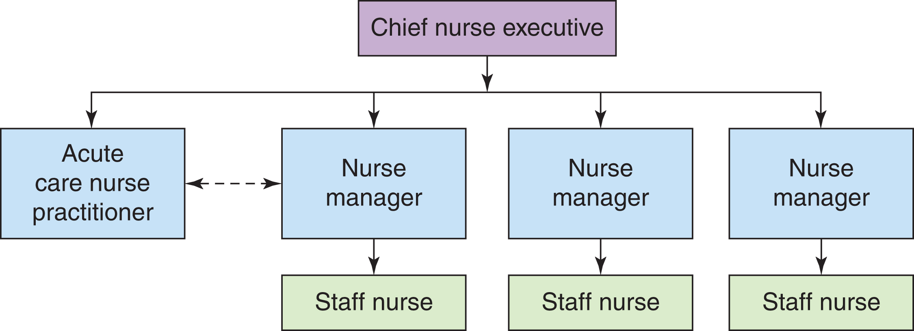
Figure 2-1 Chain of authority.

Slide 20
Reductive and Adaptive Organizational Theories
Reductive Theory
Span of control
Addresses the issue of effective supervision expressed by the number of direct reports to someone with line authority.
Complex organizations have numerous highly specialized departments.
Centralized authority results in a tall organizational structure with small differentiated work groups.
Less complex organizations have flat structures.
Authority is decentralized, with several managers supervising large work groups

Slide 21
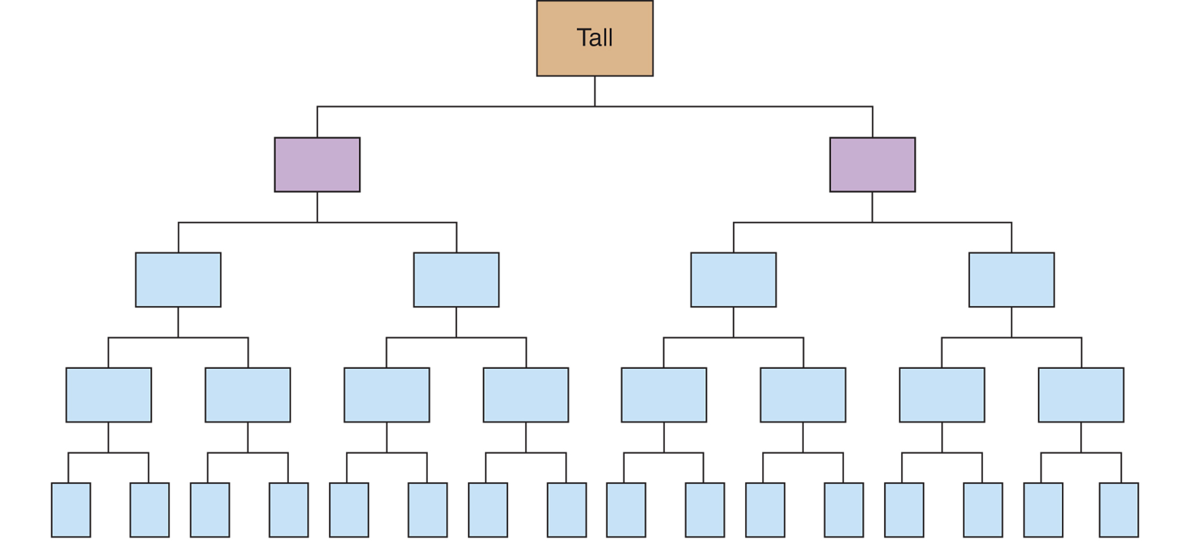
Figure 2-2 Contrasting spans of control. From Longest, B. B., Rakich, J. S., & Darr, K. (2000). Managing health services organizations and systems (4th ed.). Baltimore: Health Professions Press, p. 124. Reprinted by permission.
continued on next slide

Slide 22
Figure 2-2 (continued) Contrasting spans of control. From Longest, B. B., Rakich, J. S., & Darr, K. (2000). Managing health services organizations and systems (4th ed.). Baltimore: Health Professions Press, p. 124. Reprinted by permission.

Slide 23
Reductive and Adaptive Organizational Theories
Reductive Theory
Reductionist theory uses the mission of the organization to structure and design work.
Traditional design of medicine is based on this model.
Primary care physician oversees holistic concerns of patient.
Specialists are called in to detail each subcomponent part.
Most hospital organizations still orchestrate their clinical services and departments using this model.
continued on next slide

Slide 24
Reductive and Adaptive Organizational Theories
Humanistic Theory as a Bridge
Major premise of humanistic theory is that people:
Desire social relationships.
Respond to group pressure.
Search for personal fulfillment in work settings.
continued on next slide

Slide 25
Reductive and Adaptive Organizational Theories
Humanistic Theory as a Bridge
Hawthorne effect
Tendency for people to perform in an expected manner because of special attention and focused, unintentional interactions.
Individuals cannot be coerced or bribed to do things they consider unreasonable.
Formal authority does not work without willing participants.
continued on next slide

Slide 26
Reductive and Adaptive Organizational Theories
Adaptive Theories
Interplay among structure, people, technology, and environment led to perceiving organizations as adaptive systems.
Consequently, rules developed about how organizations thrived or were challenged.
Systems Theory
Contingency Theory
Chaos Theory
continued on next slide

Slide 27
Reductive and Adaptive Organizational Theories
Adaptive Theories
Systems Theory
A system is interrelated parts arranged in a unified whole.
Systems can be open or closed.
Organization is a recurrent cycle of input-throughput-output.
The manager is the catalyst for the process.
continued on next slide

Slide 28
Reductive and Adaptive Organizational Theories
Adaptive Theories
Systems Theory
Each healthcare organization:
Requires human, financial, and material resources
Designs services to treat illness, restore function, provide rehabilitation, and protect or promote wellness
Throughput today is commonly associated with access to care, and how patients enter and leave the healthcare system.
continued on next slide

Slide 29
Reductive and Adaptive Organizational Theories
Adaptive Theories
Contingency Theory
Developed to explain performance is enhanced by matching the organization's structure to its environment.
Environment includes people, objects, and ideas outside the organization that influence it.
Optimal form of the organization depends on the environment in which it operates.
continued on next slide

Slide 30
Reductive and Adaptive Organizational Theories
Adaptive Theories
Chaos Theory
Linked to the field of complexity science; inspired by quantum mechanics
Concept of cause and effect is rarely predictable in work settings where the stakes are high, multiple variables interact, and predictive outcomes are not feasible.
Organizations are living, self-organizing systems that are complex and self-adaptive.
Principles that ensure flexibility, fluidity, speed of adaptability, and cultural sensitivity are emerging.
Such as those found in virtual organizations

Slide 31
Learning Outcome Two
Describe traditional and emerging structures in healthcare organizations.

Slide 32
Organizational Structures and Shared Governance
Functional Structure
Employees grouped in departments by specialty.
In a functional nursing structure, all nursing tasks fall under nursing service.
Functional structures tend to centralize decision making because the functions converge at the top of the organization.
continued on next slide

Slide 33
Organizational Structures and Shared Governance
Service-line Structure
Also are called product-line or service-integrated structures
Clinical services are organized around patients with specific conditions.
Appropriate when environmental uncertainty is high, the populations serviced are high volume and have specific needs, and the organization requires frequent adaptation and innovation to distinguish itself.

Slide 34
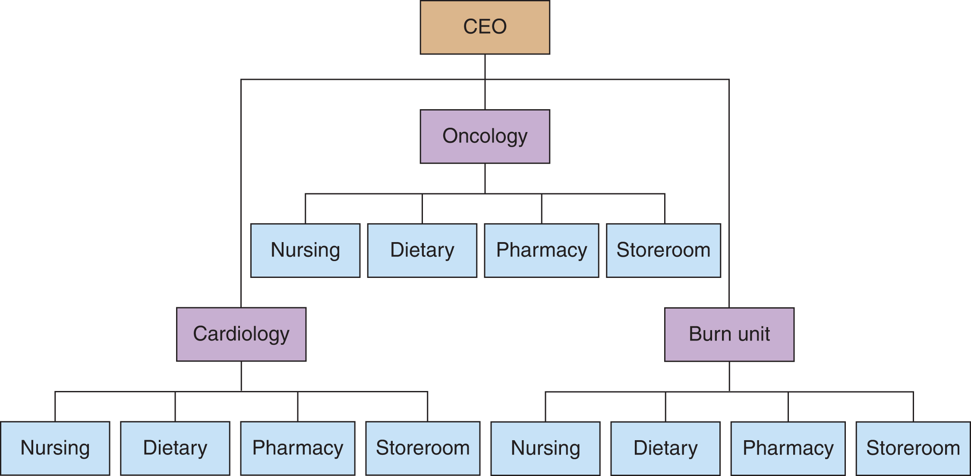
Figure 2-3 Service line structure.

Slide 35
Organizational Structures and Shared Governance
Service-line Structure
Service lines coexist with functional structures.
A nurse may work in a service line as an oncology nurse but also have ties to the functional area of nursing.
Service goals receive priority under this organizational structure.
Employees see the service outcomes as the primary purpose of their organizational position.
Most common structures found in academic health science centers and larger urban organizations
continued on next slide

Slide 36
Organizational Structures and Shared Governance
Matrix Structure
Integrates product and functional structures in one overlapping structure
Manager is responsible for both the function and the product line.
Appropriate in a highly uncertain environment that changes frequently but also requires organizational expertise
Major weakness is dual authority.
Can frustrate and confuse departmental managers and employees
continued on next slide

Slide 37
Organizational Structures and Shared Governance
Parallel Structure
Unique to health care
Involves two lines of authority:
Authority of the organization
Authority of its medical staff
Becoming less successful as healthcare organizations integrate into newer models
continued on next slide

Slide 38
Organizational Structures and Shared Governance
Shared Governance
Nursing response to organizational structures
Represents the voice of the nursing profession in healthcare agencies
Gives nurses a forum in which to shape nursing practice within the healthcare organization
Requires nurses to be accountable to the latest standards and knowledge in the field
continued on next slide

Slide 39
Organizational Structures and Shared Governance
Shared Governance
Decisions are made by consensus rather than by the manager’s order or majority rule.
Allows staff nurses an active voice in problem solving
Unit councils
Divisional councils
Human factors can impede implementation of the model.
Lack of leadership, lack of staff or manager understanding of shared governance, or the absence of knowledgeable mentors.

Slide 40
Learning Outcome Three
Choose a practice setting based on a preferred professional practice model.

Slide 41
Healthcare Settings
Settings for the delivery of healthcare include:
Primary care
Acute care hospitals
Home healthcare organizations
Long-term care organizations
continued on next slide

Slide 42
Healthcare Settings
Primary Care
Considered to be the location where the patient goes for preventive and basic care services
Gatekeeper for access to specialized services
Delivered in neighborhood clinics, provider offices, ambulatory care, emergency departments, and public health clinics
Retail medicine is now available in many pharmacies and large retail chains as a convenient walk-in clinic.
continued on next slide

Slide 43
Healthcare Settings
Acute Care Hospitals
Most hospitals are acute (short-term or episodic) care facilities.
May be classified as general or special-care facilities
Many also serve as teaching institutions.
Role of nurse may differ from teaching to nonteaching hospital.
New groups in hospitals include hospitalists and intensivists.
Hospitalist manages the care of hospitalized patients on behalf of the primary care provider.
continued on next slide

Slide 44
Healthcare Settings
Home Healthcare
Intermittent, temporary delivery of healthcare in the home by skilled or unskilled providers
Primary service provided by home care agencies is nursing care.
May offer services other than nursing such as physical therapy, medical equipment technicians, and social workers
continued on next slide

Slide 45
Healthcare Settings
Long-term Care
Facilities constitute a range of service levels known as assisted living services.
Provide professional nursing care and rehabilitative services
May be freestanding or part of a hospital
Many of these facilities are now a bridge from acute care to home, with a limited length of stay.
Long-term care industry is heavily regulated.

Slide 46
Learning Outcome Four
Explain how the ownership of and complex relationships among healthcare organizations impact nursing.

Slide 47
Ownership and Complex Healthcare Arrangements
Ownership of Healthcare Organizations
Private
Usually owned by corporations or religious entities
Government
Operated by city, county, state, or federal entities
Voluntary (not for profit)
Investor owned (for profit)
Sectarian
Religious affiliations
Nonsectarian

Slide 48
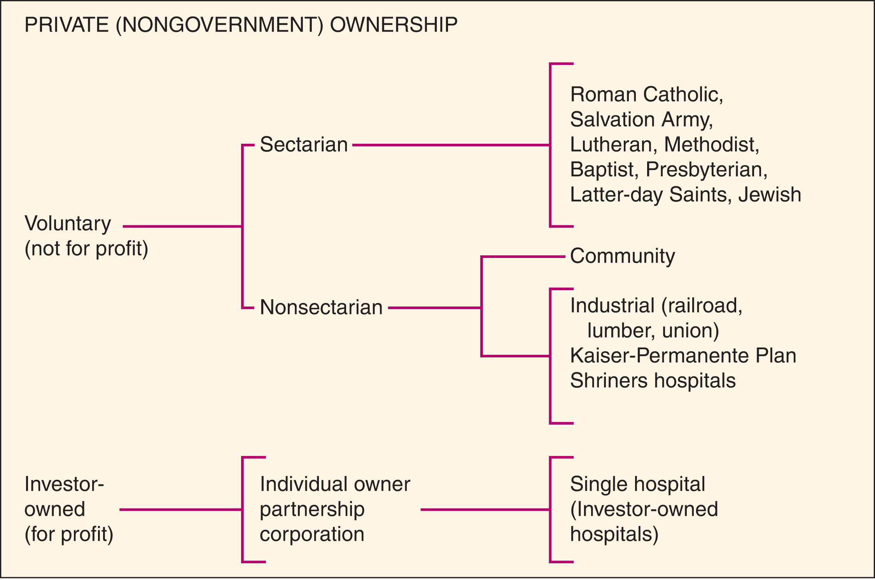
Figure 2-4 Types of ownership in healthcare organizations. From Longest, B. S., Rakich, J. S., & Darr, K. (2000). Managing Health Services Organizations and Systems (4th ed.). Baltimore: Health Professions Press, p. 173. Reprinted by permission.
continued on next slide

Slide 49
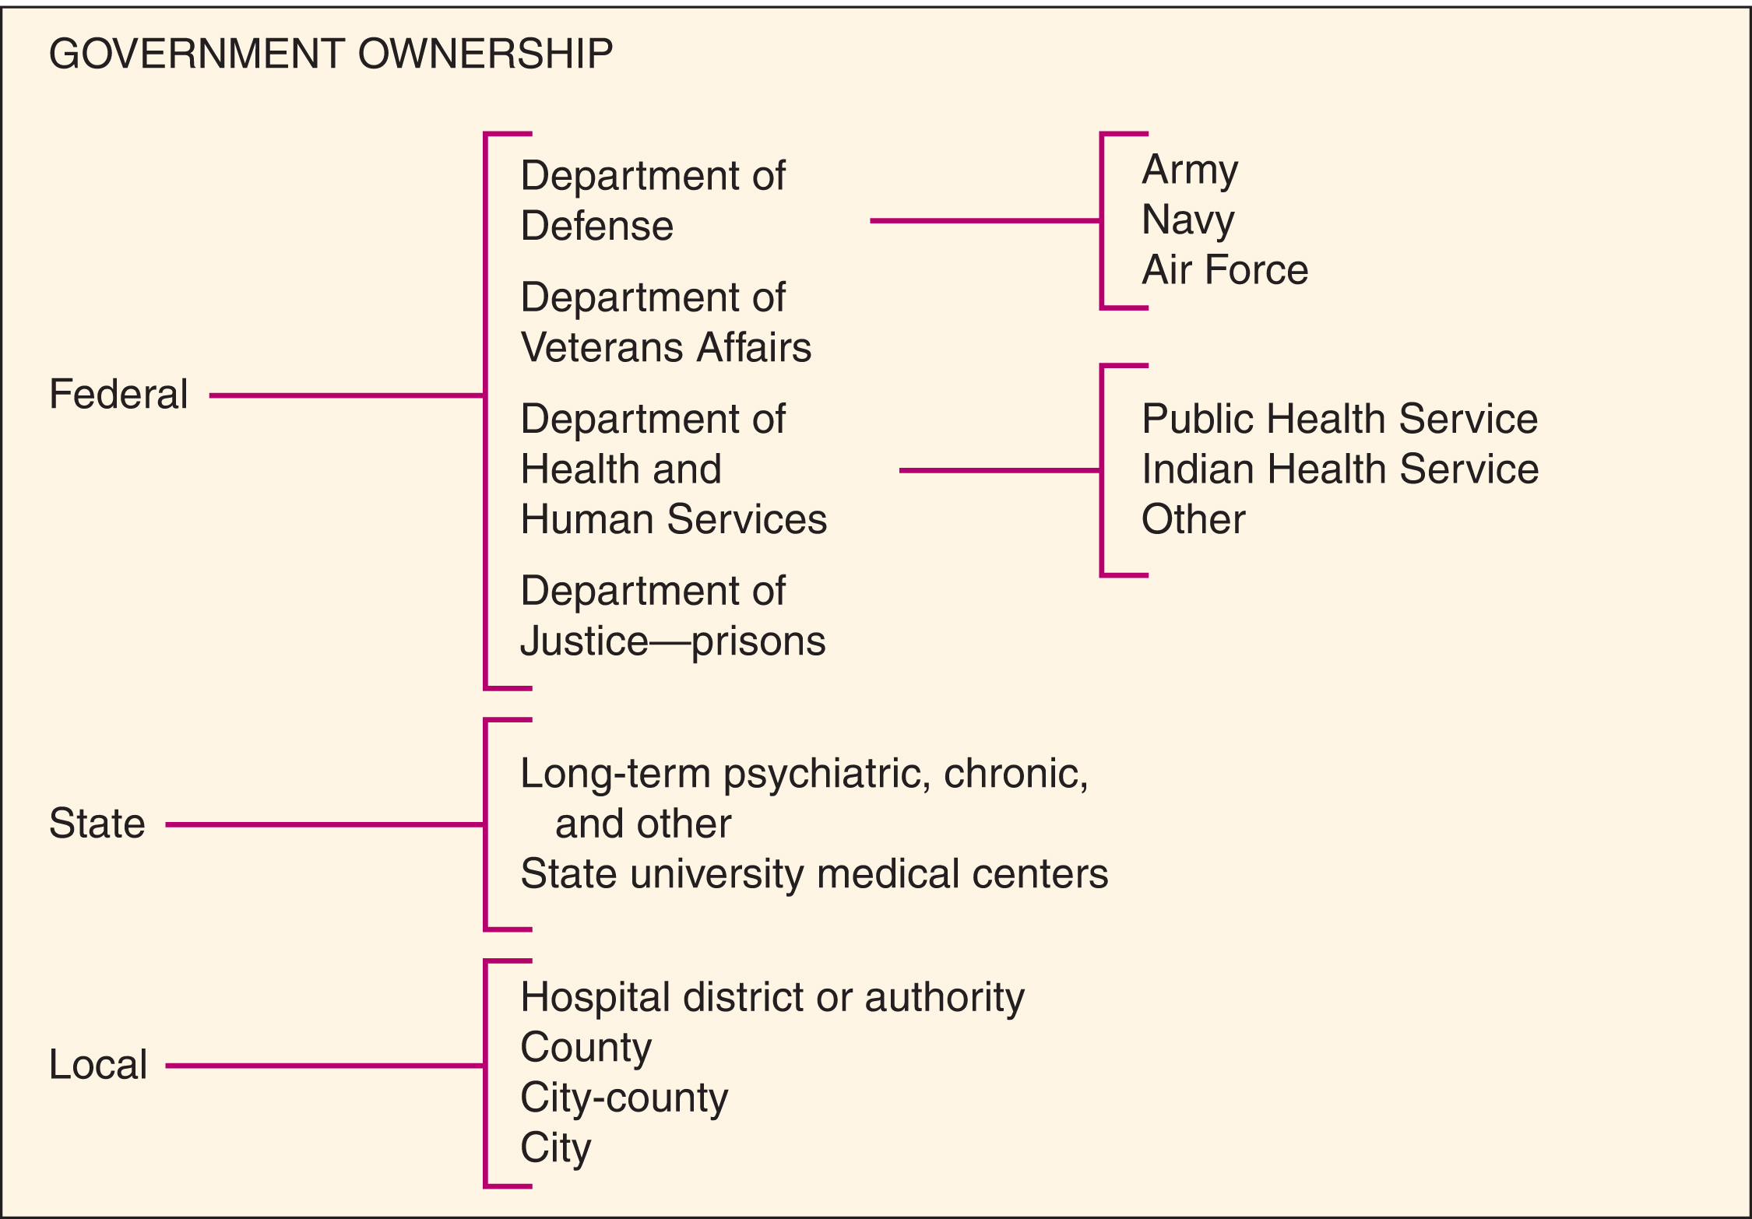
Figure 2-4 (continued) Types of ownership in healthcare organizations. From Longest, B. S., Rakich, J. S., & Darr, K. (2000). Managing Health Services Organizations and Systems (4th ed.). Baltimore: Health Professions Press, p. 173. Reprinted by permission.

Slide 50
Ownership and Complex Healthcare Arrangements
Healthcare Networks
Integrated healthcare networks originally emerged as organizations sought to survive in today’s cost-conscious environment.
Network systems provide:
A continuum of care.
Geographic coverage for buyers of healthcare services.
Acceptance of risk in taking a fixed payment for providing healthcare for all persons in selected group.
continued on next slide

Slide 51
Ownership and Complex Healthcare Arrangements
Healthcare Networks
Goal is to interact with and keep patients in the setting that:
Incurs the lowest cost,
Promotes health, and
Reduces expensive hospital stays.
continued on next slide

Slide 52
Ownership and Complex Healthcare Arrangements
Interorganizational Relationships
Horizontal integration
Arrangements between or among organizations that provide the same or similar services.
e.g., all hospitals provide comparable services

Slide 53
Figure 2-5 Horizontal integration.

Slide 54
Ownership and Complex Healthcare Arrangements
Interorganizational Relationships
Vertical integration
Arrangement between or among dissimilar but related organizations to provide a continuum of services
e.g. an affiliation of a health maintenance organization with a hospital, pharmacy, and nursing facility

Slide 55
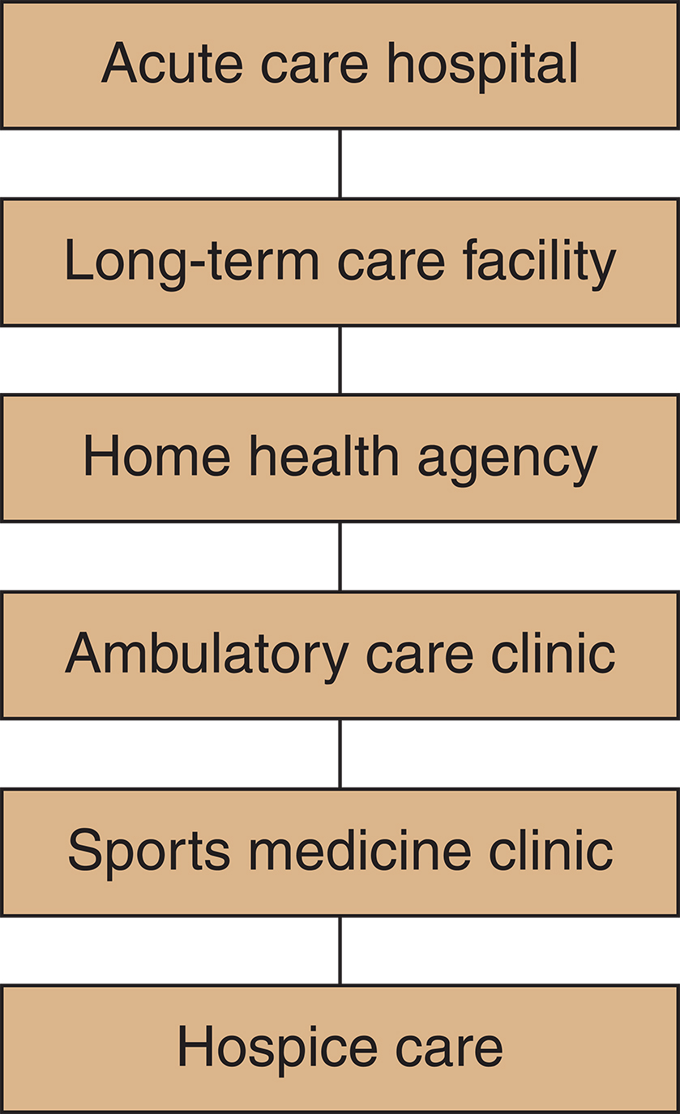
Figure 2-6 Vertical integration.

Slide 56
Ownership and Complex Healthcare Arrangements
Interorganizational Relationships
Arrangements using horizontal and vertical integration can be found today.
Affiliations
Consortia
Alliances
Mergers
Consolidations
Agencies under the umbrella of a corporate network

Slide 57
Figure 2-7 Corporate health care network.

Slide 58
Ownership and Complex Healthcare Arrangements
Diversification
Expansion of an organization into new arenas
Two common types
Concentric diversification
Organization complements its existing services by expanding into new markets or broadening the types of services it currently has available.
Conglomerate diversification
Expansion into areas that differ from the original product or service
continued on next slide

Slide 59
Ownership and Complex Healthcare Arrangements
Diversification
Joint venture
Partnership in which each partner contributes different areas of expertise, resources, or services to create a new product or service.
Joint ventures between healthcare organizations, physicians, researchers, and others are becoming increasingly common.
Healthcare organization as financier and manager is the general partner.
Physicians are limited partners.
continued on next slide

Slide 60
Ownership and Complex Healthcare Arrangements
Managed Healthcare Organizations
System in which a group of providers is responsible for delivering services through an organized arrangement with a group of individuals
Health maintenance organizations (HMOs)
Preferred provider organizations (PPOs)
Point-of-service plans (POS)
continued on next slide

Slide 61
Ownership and Complex Healthcare Arrangements
Managed Healthcare Organizations
Health maintenance organizations (HMOs)
Geographically organized system
Agreed-on package of services provided to enrollees at a fixed monthly fee
Capitation
Patients are required to choose providers within the network.
continued on next slide

Slide 62
Ownership and Complex Healthcare Arrangements
Managed Healthcare Organizations
Preferred provider organizations (PPOs)
Organization contracts with independent practitioners to provide enrollees with established discounted rates
Point-of-service plans (POS)
Considered to be an HMO—PPO hybrid
Enrollees may use the network of managed care providers or go outside the network.
Use of a provider outside the network usually results in additional costs.
continued on next slide

Slide 63
Ownership and Complex Healthcare Arrangements
Accountable Care Organizations
ACO consists of a group of healthcare providers that provide care to a specified group of patients.
More flexible than an HMO.
Consumers are free to choose providers from outside the network.

Slide 64
Learning Outcome Five
Discuss how the organizational environment and culture affect workplace conditions.

Slide 65
Redesigning Healthcare
Redesign
Includes strategies to better provide safe, efficient, quality healthcare
Adopting a patient-centered care model
Focusing on specific service lines
Applying lean thinking
Establishing a flat, decentralized organizational structure
continued on next slide

Slide 66
Redesigning Healthcare
Redesign
Health home or medical home
Considers the population it serves
Designs its services to attract patients to a “home” where they are known over time as a co-partner in maintaining health
Goal is to provide continuous, accessible, and comprehensive care.
continued on next slide

Slide 67
Redesigning Healthcare
Redesign
Health home or medical home
Challenges include:
Lack of training for health professionals.
Poor communication between and among providers and patients.
Multiple demanding needs of patients with chronic health problems.
Fair compensation for primary care services.
continued on next slide

Slide 68
Redesigning Healthcare
Redesign
Lean thinking
Focuses on the system rather than on individuals
Concentrates on interventions that improve outcomes
Disregards those that have little or no effect
Lean principles
Promote unit-based decision making
Empower staff to create and implement process improvements in a timely manner
continued on next slide

Slide 69
Redesigning Healthcare
Organizational Environment and Culture
Organizational environment
Systemwide conditions that contribute to a positive or counterproductively in work setting
continued on next slide

Slide 70
Redesigning Healthcare
Organizational Environment and Culture
Organizational environment
American Association of Critical-Care Nurses (AACN) identified characteristics of a healthy work environment:
Skilled communication
True collaboration
Effective decision making
Appropriate staffing
Meaningful recognition
Authentic leadership
continued on next slide

Slide 71
Redesigning Healthcare
Organizational Environment and Culture
Organizational environment
An organization in which nursing leaders are innovative, creative, and energetic will tend to move and/or operate in a fast-moving, goal-oriented fashion.
continued on next slide

Slide 72
Redesigning Healthcare
Organizational Environment and Culture
Organizational culture
Comprises basic assumptions and values held by members of the organization
Unstated "rules of the game"
Varies among institutions, subcultures, and countercultures
Subculture is a group that has shared experiences or like interests and values.
Nurses form a subculture within healthcare environments.

