Slide 1
FCE Volunteer Recruitment
(Student Names)

Slide 2
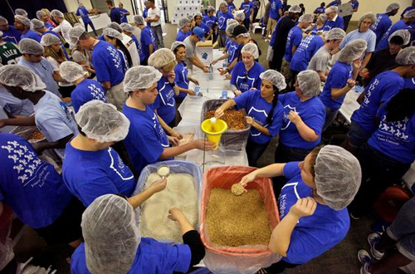
Table of Contents
Objective
Background
How to Recruit Volunteers
How to Maintain Volunteers
References

Slide 3
Objective
To improve volunteer recruiting methods for Feeding Children Everywhere

Slide 4
Background
Founded in 2010 following the earthquake in Haiti
Provide hand-packed lentil-casseroles as meals
Hunger Projects: volunteers package meals
Meals are sent to 4 continents across the globe and to food crisis centers throughout the US
Headquarters in California, Connecticut, and Florida
Notes:
Feeding Children Everywhere was founded in 2010 following the earthquake in Haiti. Today they have grown to providing meals to 4 continents across the globe and to food crisis centers throughout the US. They work with many international organizations to deliver to the food to needy areas. There are currently three headquarters, one in California, in Connecticut, and right here in Orlando, Florida.
Main volunteer job is Hunger Projects, an event where volunteers gather in assembly line productions to package the meals.

Slide 5
Press play on video or click: https://www.youtube.com/watch?v=oXwI0xdjP4I

Slide 6
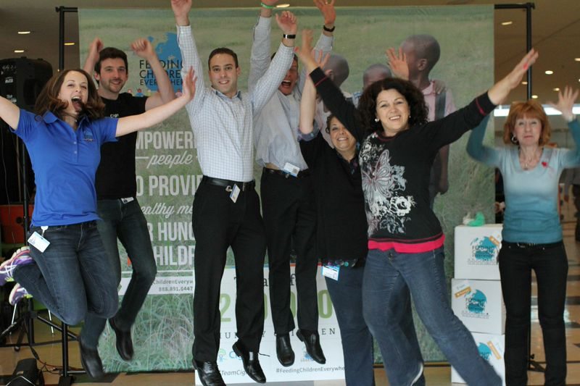
How Do We Recruit More Volunteers?
Marketing
Diversifying volunteer opportunities
Reaching out to the community
Warm Body Recruitment
Brochures
Posters
Speaking engagements
Word of mouth
Social media
Concentric Circles Recruitment
Friends
Families
Neighbors
Notes:
Marketing: Advertising the non-profit
Diversifying: Creating different volunteer jobs
Reaching out: Getting to the community
FCE has limited social media presence, that needs to change
Concentric Circles Recruitment: Finding volunteers within your own network: your friends, your families, and your neighbors.

Slide 7
Marketing: Making FCE Appealing
Highlight current successes
20 million meals to over 10 million children
Charity rating of 90.67 on Charity Navigator
94% of funds go to food
6% of funds go to administrative costs
FCE’s vision is that every child will have sustainable access to food by 2020
Highlight that volunteers at FCE are valued
Internships
Opportunities for advancement
Notes:
Let prospective volunteers know that FCE values any kind of volunteer, how supportive they are, and how you can become a critical member of the organization. Key volunteers, internships, opportunities for advancement

Slide 8
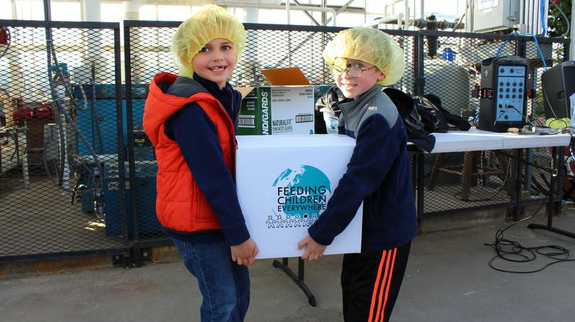
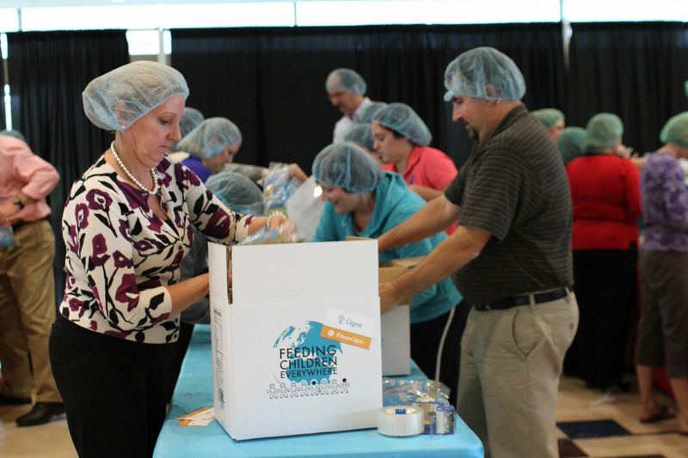
Targeting Demographics
Young adults
Motivated by self-interests
Resume building
Networking
Building relevant skills
Personal development
Families
Motivated by family activities
For Hunger Projects, anyone between the ages of 3-103 can volunteer
Older adults
Motivated by social responsibilities
Want to contribute to community
Corporations/Organizations
Teamwork building
Leadership skills
Notes:
Values for volunteering: altruism, personal development, community concern, ego enhancement, and social adjustment
We have to appeal to the motivations of each demographic.
Young Adults: Motivated more by self-interests, it needs to be mutually beneficial. Highlight the fact that they can use their experience on their resumes, network, building relevant skills, and personal development.
Families: Gives them an activity for everyone to do together since the age range is so vast. Develops altruism in children.
Older Adults: Generally retired and are motivated by social responsibilities and greater concern for society. Also gives them an activity to do and something to leave behind.
Corporations/Organizations: Great teamwork building exercises. Can develop their own hunger projects inside the organization.

Slide 9
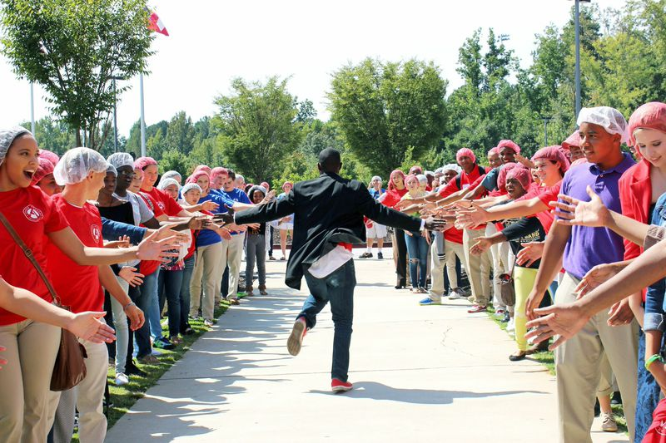
Diversifying Volunteer Opportunities
Have a variety of positions available with varying time demands
Social Media
Content Creators
Recruitment
Utilize volunteer’s expertise, knowledge, and professional skills
Notes:
Recruiting volunteers for other reasons than just hunger projects
Social Media: Have dedicated volunteers to run social media campaigns
Content Creators: Have volunteers specifically for making content, videos, blogs, brochures, posters
Recruitment: Have volunteers who are reaching out to the community and recruiting.
It’s important to utilize a volunteer’s expertise, knowledge, and professional skills.

Slide 10
Social Media Volunteers
Universities
Marketing majors
Public Relations majors
Small Businesses
Marketing firms who can volunteer their consulting hours
Sponsors who can spread the word
Notes:
You can find volunteers for your social media group by looking into colleges and universities. Offer internships for running social media campaigns. You’ll find relevant people in majors such as marketing and public relations.
Small businesses can also offer their consulting services, or sponsor hunger projects in an effort to get the word out

Slide 11
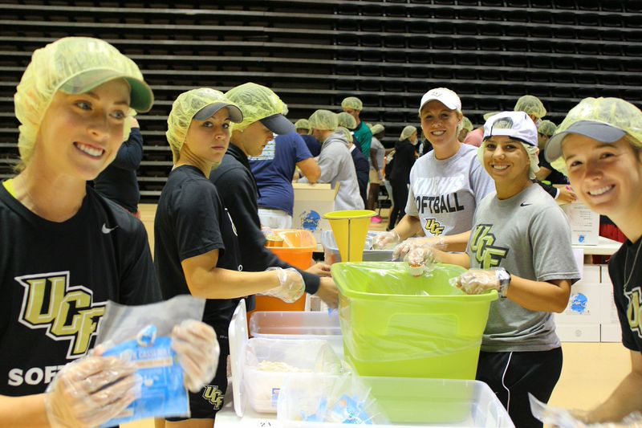
Content Creators Volunteers
Universities/Colleges
Film majors
Graphics design majors
Students can obtain relevant experience
Blogging
YouTube videos
Posters
Brochures
Notes:
FCE has a very low presence in content in terms of youtube and blogs. Content creators can blog about locations in the world FCE has donated meals to, how it has improved communities, and hunger projects they’ve recently organized. They can also create videos of hunger projects, promotional videos discussing the organization, what it’s all about, etc. They can develop posters and brochures to be given out in various communities.

Slide 12
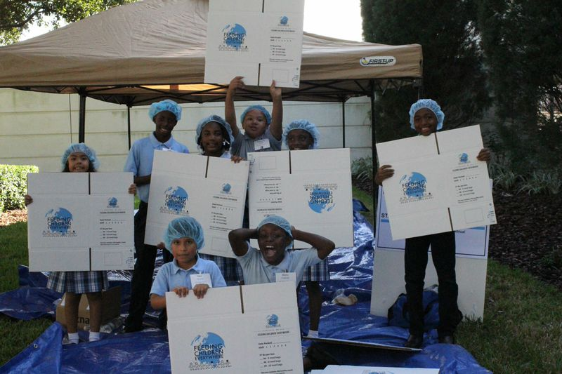
Recruitment Volunteers
Reach Out Initiative: Volunteers who reach out to the community
Nursing Homes
High schools/colleges
Religious organizations
Sports Teams
Boys and Girls Club
Big Brother/Big Sister
Girl Scouts/Boy Scouts
Eagle Scouts
YMCA
Concentric circles recruitment
Notes:
Have a group of volunteers dedicated to recruiting more volunteers, especially in demographics we are currently lacking in such as older adults.
The Reach Out Initiative can visit nursing homes, talk to them about the organization, ask them if they’d like to participate. They can visit high school volunteer programs such as key club, college organizations such as volunteer UCF. Reach out to religious organizations such as churches to organize more hunger projects. And once again, concentric circles recruitment, looking into your own network, such as your friends, families, and neighbors.

Slide 13
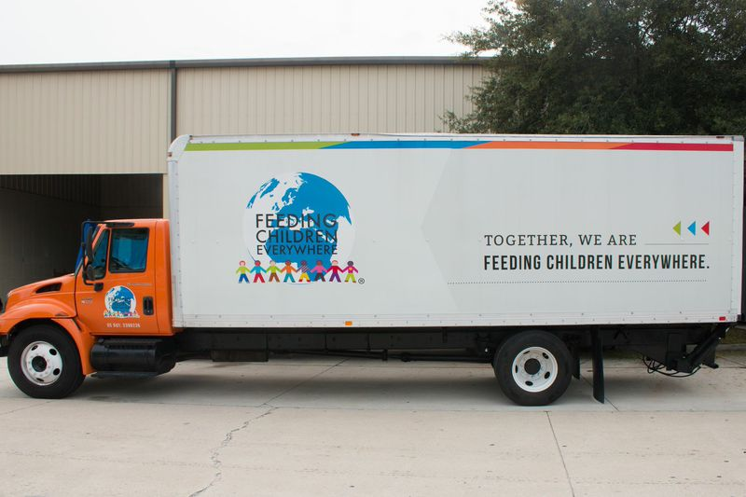
Maintaining Volunteers
Creating a supportive environment
Connectedness
Volunteers must feel like they are part of the group, that they share similar values, respect, trust, and goals
Uniqueness
Let volunteers know they have talents that contribute to the organization
Power
Volunteers must feel like they are making a difference in the world
Remunerating
Notes:
Remunerating: Incentives, such as accolades for long term volunteers
Remunerating refers to compensation such as recognition, pay, rewards, etc.

Slide 14
Summary
Appeal to Volunteers
Highlight FCE successes
Appeal to the motivations of each demographics
Diversify volunteer opportunities
Keep your volunteers happy!

Slide 15
References
Boezeman, E., & Ellemers, N. (2008.). Volunteer recruitment: the role of organizational support and anticipated respect in non-volunteers' attraction to charitable volunteer organizations. Journal of Applied Psychology, 1013-1026.
Collective Wisdom. (2014). Retrieved November 1, 2014, from http://www.energizeinc.com/wisdom/recruit/techniques.html
Feeding Children Everywhere. (2014.). Retrieved November 1, 2014, from http://www.feedingchildreneverywhere.com/
Fritz, J. (2014). 3 ways to recruit volunteers for your nonprofit. Retrieved from http://nonprofit.about.com/od/volunteers/a/recruitvols.htm
Lee, Y., & Brudney, J. (2012). Participation in formal and informal volunteering: Implicationsfor volunteer recruitment. Nonprofit Management and Leadership, 159-180.
Peggy O. Shields (2009) Young Adult Volunteers: Recruitment Appeals and OtherMarketing Considerations, Journal of Nonprofit & Public Sector Marketing, 21:2, 139-159.

