Slide 1
Biodiversity
Chapter 47

Slide 2
Biodiversity
Biodiversity is a measurement of the number of species present in a given area
Biosphere, biome, ecosystem
Types of biodiversity
Species biodiversity
The number of species, along with their abundance, in a given area
Species are interconnected, losing even one impacts many others
Genetic biodiversity
Genetic variation present in individuals in a given population or species
Losing genetic diversity means that populations, or species, are unable to evolve in response to natural selection
Ecosystem biodiversity
Number of different ecosystems in a given area
Ecosystem extinction means the loss of populations, loss of genetic diversity of species, and loss of production and services of the ecosystem

Slide 3
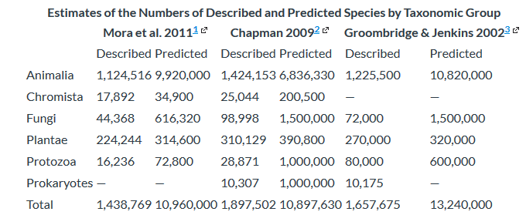
Species Diversity
Only a small percentage of organisms on Earth have been described and named
Less than 20%
17,000-20,000 species/year are being described and named
Would take 500 years to name them all
We do not even know what we are losing to extinction

Slide 4
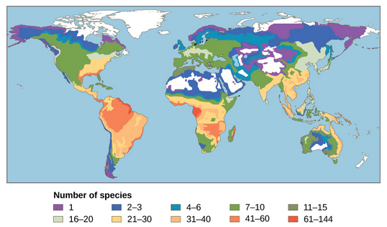
Patterns of Biodiversity
Biodiversity is not evenly distributed on Earth
Think about the different biomes and their ability to support life
Biomes near the equator have greater biodiversity than biomes in the far north or far south
Equatorial biomes:
Receive more annual sunlight
Have consistent annual temperatures
Have large annual precipitation
Have been around longer
Increased heterogeneity
High rate of endemism
They are “hotspots” of biodiversity
Knowledge of species is low
At high risk of loss of biodiversity

Slide 5
Biodiversity through Geologic Time
Speciation and extinction rates determine the biodiversity over time
Macroevolutionary birth and death
Increased speciation = more species
Increased extinction = fewer species
There have been five major extinction events on Earth
Sudden and dramatic loss of biodiversity
Greater than 50% of all species went extinct

Slide 6
Five Mass Extinctions
Ordovician-Silurian
450 mya
Life was almost exclusively in oceans
85% of species extinct
Caused by glaciation followed a million years later by extreme warming
Devonian
375-360 mya (series of small extinction events)
Affected marine species, not terrestrial
70-80% of species extinct
Cause not understood
Permian
251 mya
Largest extinction event on Earth
96% marine species extinct, 70% terrestrial species extinct
Caused by extensive and extended volcanic eruptions
Runaway global warming
Oceans became anoxic
Dramatically altered the course of evolution on Earth

Slide 7
Five Mass Extinctions
Triassic-Jurassic
205 mya
85% of species extinct
Cause unknown but occurred right before Pangaea broke apart
Cretaceous
65 mya
All dinosaurs extinct except theropod clade
Birds are descendants of theropods
Caused by asteroid impact off Yucatan Penisula
Debris from impact blocked sunlight for years
Caused also by volcanic activity
Released sulfur in atmosphere
Mammals became dominant species following this extinction

Slide 8
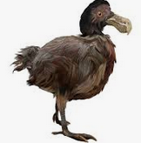
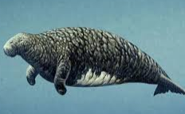
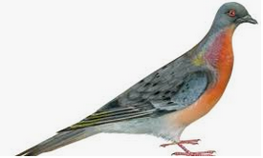
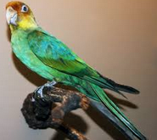
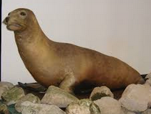
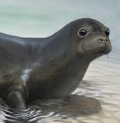
Anthropogenic Extinctions
Holocene
6th extinction (not mass extinction, yet)
400 years ago to present
Coincides with expansion of European colonies around the world
Here are just a few species lost:
Dodo bird
1662
Lived on island, humans arriving to island hunted them to extinction
Stellar’s sea cow
1768
Related to manatees, lived on Northwest coast
Hunted for meat and oil
Passenger pigeon (1914), Carolina parakeet (1918), Japanese sea lion (1950), Caribbean monk seal (1952)
Extinction rate is increasing exponentially

Slide 9
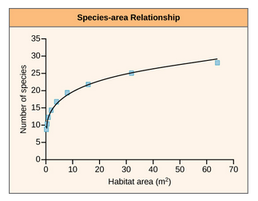
Present-Time Extinction Rates
Extinctions are happening unnoticed
We have not catalogued all species
Background extinction rate is one per million species/year
E/MSY
10 million species, means 10 per year
Current estimated extinction rate is 100E/MSY
By end of century: 1500E/MSY
Species-Area relationship
Estimates species extinction by habitat loss
Increased habitat loss means increased species extinct
90% habitat loss = 50% species extinct
1000E/MSY
Endemic species-Area relationship
500E/MSY

Slide 10
Measuring Biodiversity
We need one global database for all described and named species
All known species need to be entered into database
Verification of species
Newly described and named species need to be entered into database
DNA Barcoding
Sequences area of rapidly evolving genome
Eukaryotes, use mitochondrial DNA
Plants, use chloroplast DNA
Fungus, use internal transcribed spacers in RNA
We also need to understand which species are threatened with extinction and to what degree they are threatened

Slide 11
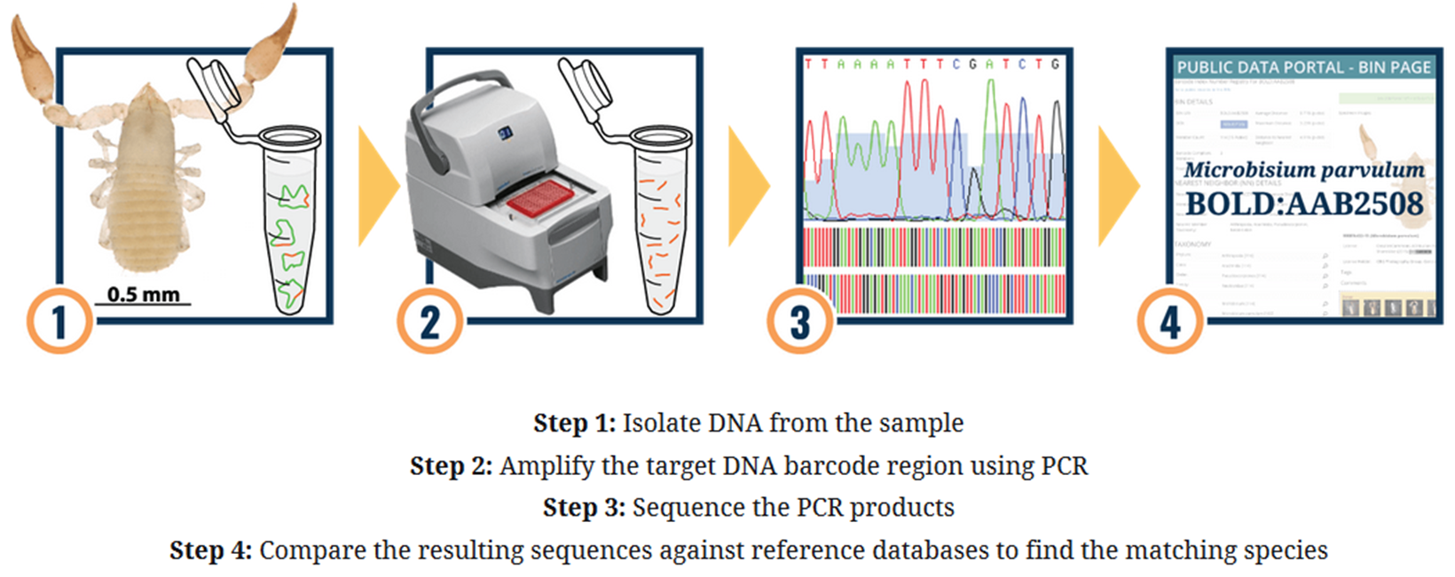
Taken from International Barcode of Life (https://ibol.org)

Slide 12
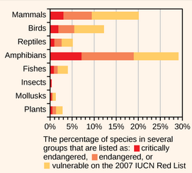
Conservation Efforts
International Union for Conservation of Nature (IUCN)
Global authority on species conservation
Monitors threats to species
Classifies species as critically endangered, endangered or vulnerable
Convention on International Trade in Endangered Species of Wild Fauna and Flora (CITES)
Illegal pet trade threatens many species
CITES prevents capture and transporting of 33,000 species
Only as good as individual country’s ability to prosecute traders
Endangered Species Act (ESA) and Migratory Bird Treaty Act (MBTA)
ESA protects species that are listed as critically endangered or endangered
MBTA protects 800 species of birds
Illegal to kill, disturb, and transport birds or parts of birds

Slide 13
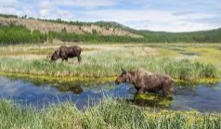
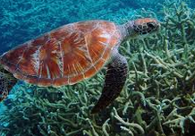
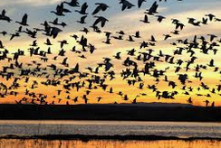
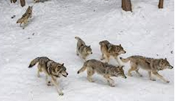
Conservation in Preserves
Create wildlife and ecosystem preserves
Area of land protected from development
Some are protected from hunting, others are not
Hunting is necessary if no apex predators
Size and quality are important
Animals have territory ranges
Animals and plants have ecosystem requirements
Can’t expect to polar bears to do well in a preserve in the Amazon
Connectivity to other preserves is paramount
Gene flow
Large, high quality, interconnected preserves work best
Expensive to purchase
Developers want quality land
Politics plays a role

Slide 14
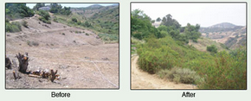
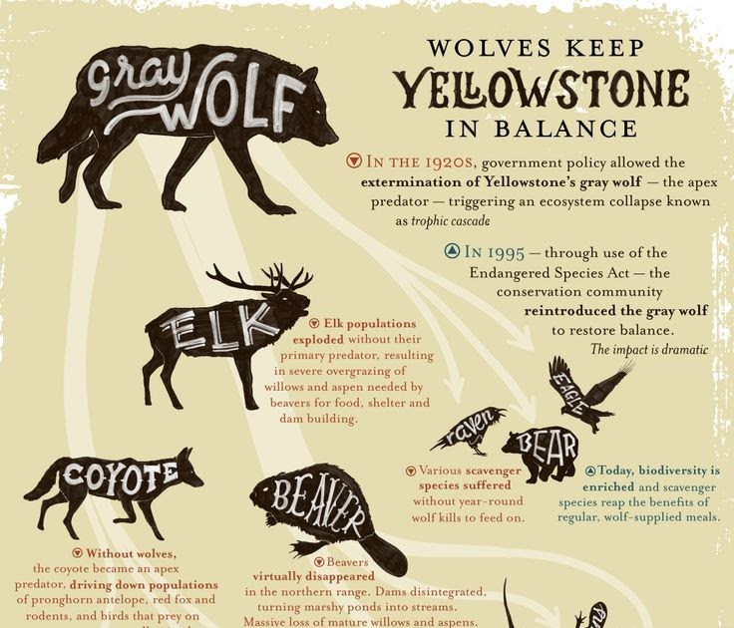
Habitat Restoration
Restoring dead or damaged ecosystems improves the ecosystem for all organisms within it
Reintroducing wolves to Yellowstone National Park
Wolves are a keystone species
They maintain diversity in an ecosystem
Need to identify keystone species in all ecosystems
Protect them
Watch video: How Wolves Change Rivers
https://www.youtube.com/watch?v=ysa5OBhXz-Q
Reintroducing wolves started a cascade of changes
Keep in mind that there are other factors at play in Yellowstone
Hunting
Trout declines
Rainfall

Slide 15
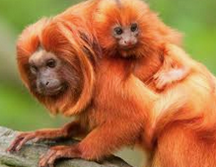
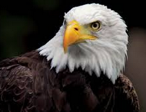
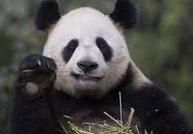
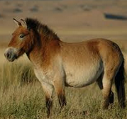
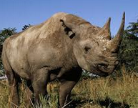
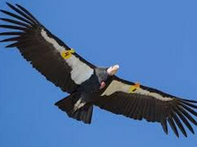
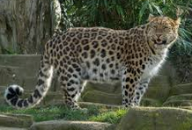
Captive Breeding Programs
Zoos and aquariums help conservation efforts with captive breeding programs
Animals (or their semen) are transferred between zoos to increase genetic diversity
Genetic specialists manage global breeding programs
Panda, California Condor, Bald Eagle, Przewalski’s Horse, Golden Lion Tamarin, Amur Leopard, Black Rhino

