Slide 1
Ecology of Ecosystems
Chapter 46

Slide 2
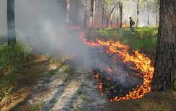
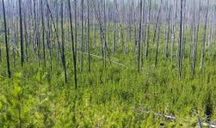
Ecology of Ecosystems
Ecology is the study of interactions between living organisms and their environment
Competition for limited resources
Components of physical environment
Ecosystems have many complex, dynamic parts
Disturbance changes the ecosystem
Some disturbances are natural, cyclic processes
Fire, rainfall, drought
Some disturbances are unnatural, anthropogenic (human caused) processes
Deforestation, pollution, burning fossil fuels
A healthy ecosystem is in equilibrium with all organisms in balance with the abiotic and biotic components.
In response to disturbance, ecologists measure
Resistance (remain in equilibrium in spite of disturbance)
Resilience (the speed of recovery after a disturbance)

Slide 3
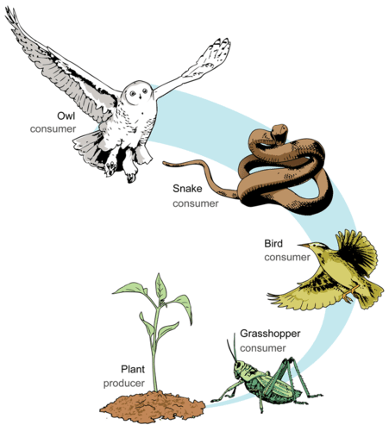
Food Chains
A Food Chain is a linear sequence of energy movement through organisms
One single path
Primary producers → primary consumers → secondary consumers → tertiary (apex) consumers
Each organism in the chain occupies a trophic level
Primary producers are photosynthetic organisms
Plants, algae, phytoplankton
Primary consumers each the primary producers
Herbivores
Secondary consumers each the primary consumers
Carnivores
Tertiary consumers eat carnivores

Slide 4
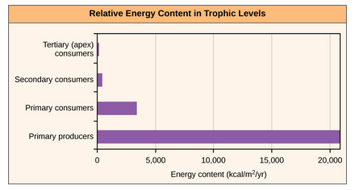
Food Chains and Energy Availability
The length of a food chain is limited by energy
Energy is lost as heat at each trophic level
After several trophic levels, the amount of energy available is reduced
The result in fewer top predators
But food chains are too simple to accurately explain how energy is transferred through organisms
Example: some organisms are eaten by more than one predator
A holistic model is more descriptive
Food Webs

Slide 5
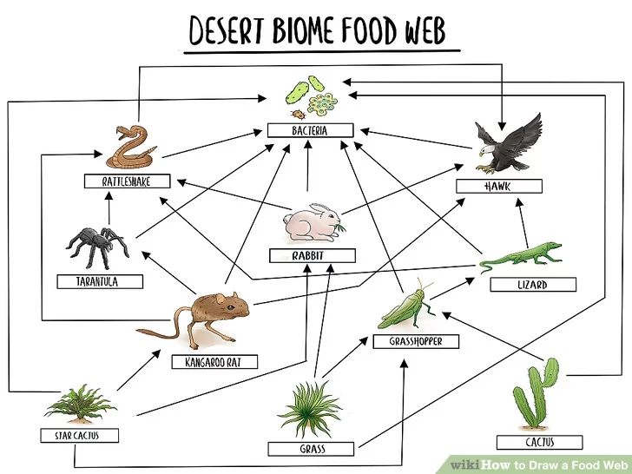
Food Webs
A Food Web accounts for all of the interactions between different species within the ecosystem
More accurate and descriptive
There are two types of food webs:
Grazing food web
Has photosynthetic organisms at the base
Detrital
Has decomposers at the base
Both food webs are present in ecosystems

Slide 6
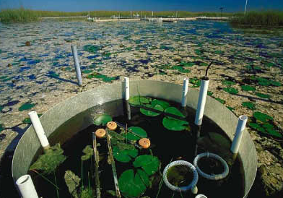
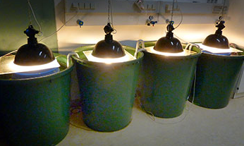
Ecosystem Dynamics
Ecosystem Dynamics studies the changes in ecosystems due to disturbances
A Holistic Ecosystem Model quantifies the competition, interactions and dynamics of an ecosystem
Best type of study but expensive and time-consuming
Unethical to alter an ecosystem just to study it
Mesocosm Model
Partitions off part of ecosystem
Pro: In-situ (in place) study
Con: partitioning organisms changes the dynamics
Microcosm Model
Recreates ecosystem
Pro: ease of study
Con: removing organisms changes the dynamics

Slide 7
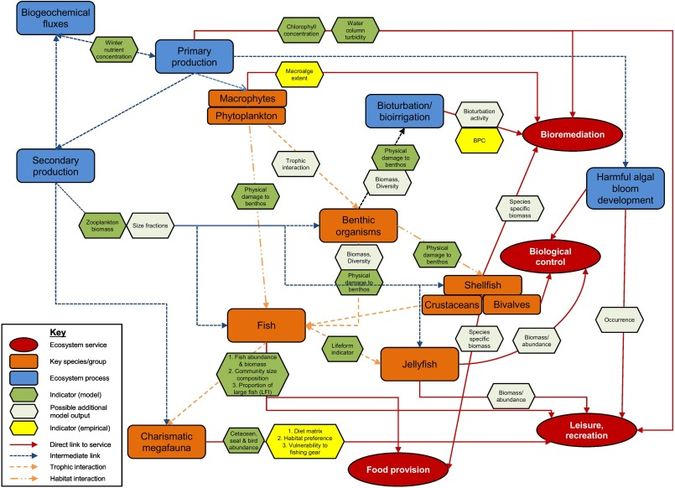
Ecosystem Modeling
Ecosystem Modeling uses data obtained from ecosystem dynamics studies
Three types of ecosystem modeling:
Conceptual
Uses flow charts to show interactions between organisms and between organisms and environment
Cannot predict how ecosystem will respond to disturbances
Analytical
Uses mathematical formulas to predict how ecosystem will respond to disturbances
Simulation
Uses complex computer algorithms to model ecosystem
Predicts how ecosystem will respond to disturbances
Conceptual Model

Slide 8
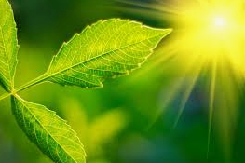
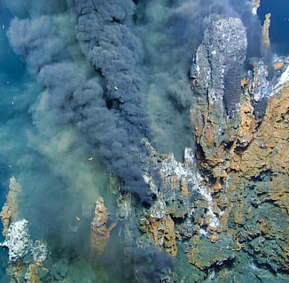
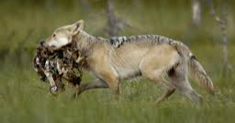
Energy in a Food Web
All organisms need energy
Metabolism requires ATP to assemble macromolecules
It is important to understand energy acquisition and transfer through an ecosystem
Energy is acquired in three ways
Photosynthesis
Convert solar energy to chemical energy
Chemosynthesis
Convert inorganic molecules to chemical energy
Heterotrophy
Consume living or previously living organisms to obtain energy

Slide 9
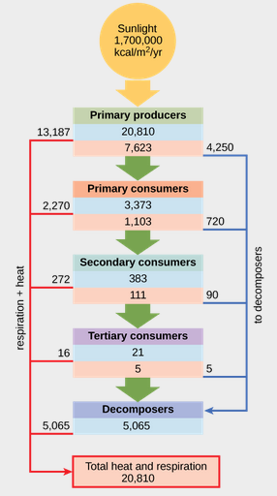
Trophic Level Productivity
Ecosystem productivity is the percentage of energy entering the ecosystem as biomass at each trophic level
Biomass is the measurement of living and previously living organisms within a trophic level
Different ecosystems have different amounts of biomass
Rainforest versus Subtropical desert
Primary producers bring energy into an ecosystem
Gross primary productivity
Net primary productivity is the amount of energy available to the next trophic level
After accounting for energy requirements of current level
Gross primary productivity
Net primary productivity

Slide 10
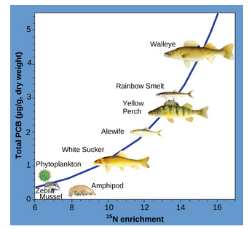
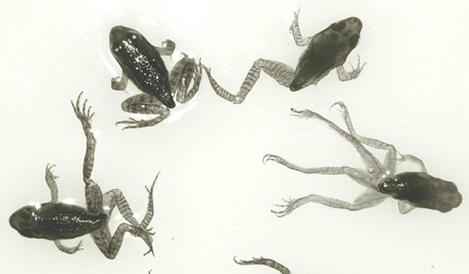
Biological Magnification
Biological Magnification is the increasing concentration of toxic substances in organisms at each trophic level
Higher trophic level, greater concentration of toxic substance
Called bioaccumulation
Mercury and PCBs in fish
Hormone-altering pollution and amphibians

Slide 11
Biogeochemical Cycles
Chemicals that make up living organisms cycles through ecosystem
Carbon (found in all organic molecules)
Oxygen (found in water and organic molecules)
Hydrogen (found in water and organic molecules)
Nitrogen (found in proteins and nucleic acids)
Phosphorous (found in nucleic acids)
Sulfur (found in proteins)
These chemicals exist for long periods of time in air, water, soil
Chemistry and geology play a role in nutrient recycling between biotic and abiotic components

Slide 12
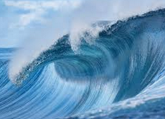
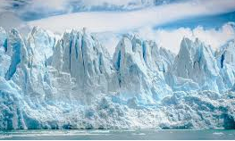
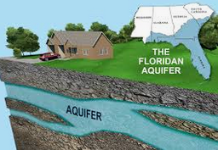
Hydrologic Cycle
97.5% of water on Earth is saltwater
Of the remaining 2.5%, 99% is unavailable as ice or groundwater, only 1% is available as liquid water on the surface of Earth
Hydrologic (water) cycling is one of the most important biogeographical cycles
Water is stored for long periods of time in oceans, in ice, and underground
All inaccessible to terrestrial organisms
The following processes affect Earth’s hydrology:
Evaporation/Sublimation
Condensation/Precipitation
Subsurface water flow
Surface runoff
Streamflow

Slide 13
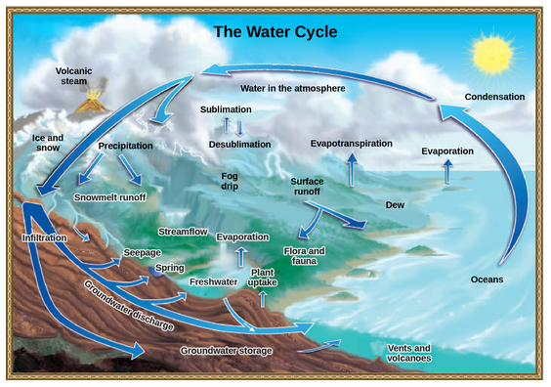
Hydrologic Cycle
Hydrologic cycle driven by sun warming surfaces
Evaporation of liquid surface water
Sublimation of solid surface water
Transfers water to atmosphere
Water condenses in clouds and falls to Earth as precipitation
Transfers water back to Earth’s surface
Rain and snowmelt will
Evaporate again
Remain on surface as liquid
Permeate into groundwater
Rain and surface runoff cycle minerals from land to water

Slide 14
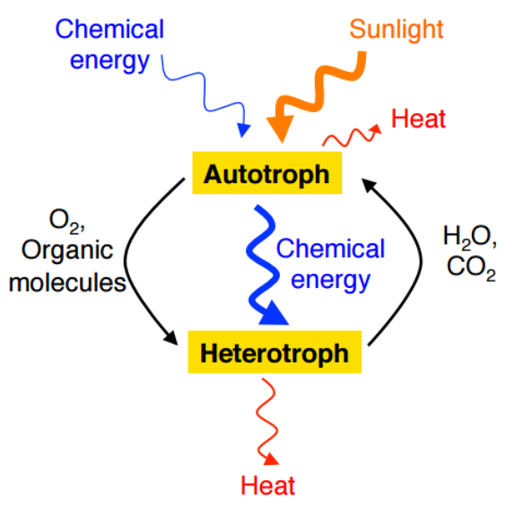
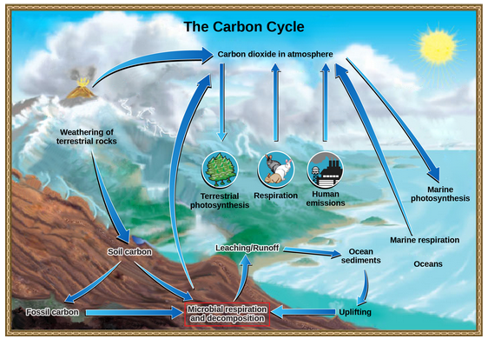
Carbon Cycle
Carbon makes up all organic molecules
Two interconnected carbon sub-cycles
Carbon exchange between living organisms
Fast turnover
Exchange between autotrophs and heterotrophs
Autotrophs use carbon to build glucose
Oxygen is waste product of photosynthesis
Heterotrophs consume glucose created by autotrophs
Carbon dioxide is waste product of cellular respiration
Carbon cycling through geologic processes
Exchange of carbon between atmosphere and ocean
CO₂ used by photosynthetic organisms, CO₂ in atmosphere dissolves in ocean to form carbonic acid
On land, decomposing organisms and weathering of rocks deposit Carbon in soil
Carbon deposited in water by runoff
Carbon on land enters atmosphere
Naturally from volcanic eruptions & animal respiration
Unnaturally from burning of fossil fuels

Slide 15
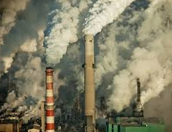
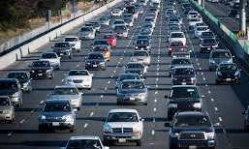
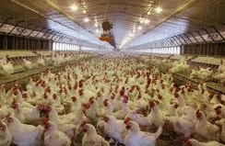
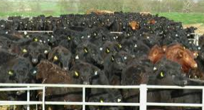
Human impact on Carbon Cycle and Climate Change
Carbon naturally enters the atmosphere through volcanic eruptions and respiration of animals
Humans increase amount of carbon entering atmosphere by burning fossil fuels and animal husbandry
Fossil fuels are reserves of stored of carbon
Called carbon sink
Eventually, over time, some fossil fuels enter atmosphere through volcanic eruptions
Burning fossil fuel exponentially speeds up the amount of carbon entering the atmosphere
Carbon also enters atmosphere through respiration of animals
Humans raise large number of animals for consumption
More than would be supported on Earth naturally
Those animals contribute to increased carbon (and methane) entering the atmosphere
Both of these anthropogenic sources of carbon are leading to climate change!

