Slide 1
Excretory System
Chapter 41

Slide 2
The Excretory System
The human body must maintain homeostasis of many things including water and solute concentration
Remember that a solution is a homogenous mixture of solvent (water) and solute(s).
In mammals, the solutes are
Anions: chloride (Cl⁻), carbonate (CO₃⁻²), bicarbonate (HCO₃⁻), and phosphate(PO₃⁻)
Cations: sodium (Na⁺), potassium (K⁺), calcium (Ca⁺²), magnesium (Mg⁺²)
Osmoregulation is the maintenance of solute and water balance in bodily fluids
Bodily fluids are comprised of water, electrolytes and non-electrolytes
Electrolytes disassociate into ions in water
Non-electrolytes do not disassociate into ions in water
Blood plasma, cell cytosol, and interstitial fluid are all types of bodily fluids

Slide 3
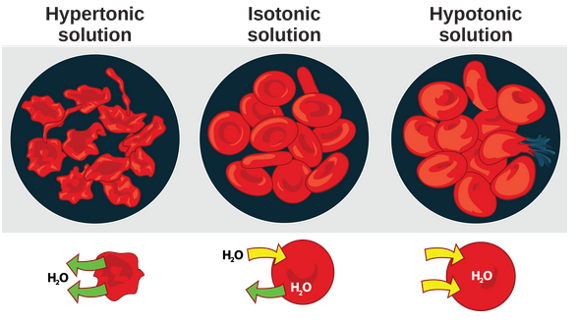
The Excretory System
All bodily membranes are permeable
They selectively allow certain solutes and water to diffuse
The two sides of a membrane tend to be isotonic, if possible
Remember tonicity:
A cell is approximately 1% solute and 99% water
A cell placed in a hypertonic (high solute) solution will lose water
A cell placed in a hypotonic (low solute) solution will gain water
A cell placed in an isotonic (equal) solution will gain and lose water in equilibrium

Slide 4
The need for osmoregulation
Animals consume food and water and they also pant/sweat, urinate and defecate
This all changes the osmotic pressure in the body
Osmoregulation helps ensure that the body is properly hydrated and is able to release waste products
Without osmoregulation, toxic waste products build up and water is out of balance
Water balance affects blood pressure
Mammal excretory system regulates osmotic pressure and electrolyte concentrations

Slide 5
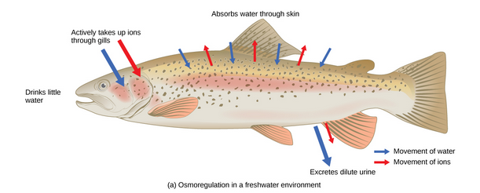
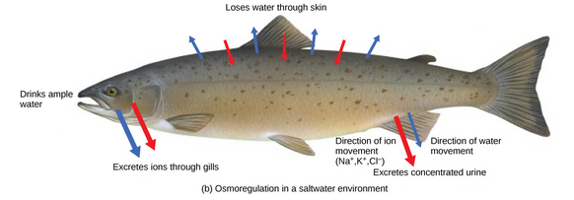
Osmoregulators and Osmoconformers
Osmoregulators are animals that osmoregulate to control the solute and water concentration in their body
Fish are osmoregulators
Fish living in fresh water must have strategies to maximize water loss
Fish living in salt water must have strategies to minimize water loss
Osmoconformers are animals whose body fluid concentrations conform to the water in which they live
Aquatic invertebrates are osmoconformers

Slide 6
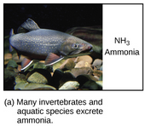
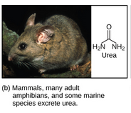
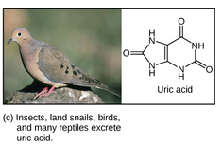
Nitrogenous Waste
Of the four macromolecules (carbohydrates, proteins, lipids, & nucleic acids), both proteins and nucleic acids contain nitrogen
During catabolism of proteins and nucleic acids
Hydrogen, oxygen and carbon are stored in as carbs and lipids
Nitrogen is excreted from the body
Forms toxic ammonia – raises body fluid pH
Aquatic animals can excrete ammonia into the water
Terrestrial animals have mechanisms for dealing with ammonia
They detoxify the ammonia to urea or uric acid
Mammals produce urea
Reptiles, birds, and invertebrates produce uric acid

Slide 7
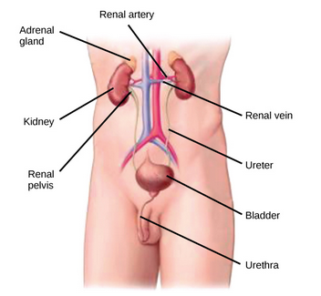
Kidneys are the osmoregulatory organ
Kidneys are bean-shaped organs located just below the liver
Two kidneys, one on the left side and one on the right side
Each kidney has an adrenal gland on top of it
Kidneys filter and purify blood
Responsible for osmoregulation
Excrete or reabsorb water
Excrete or reabsorb solutes
The filtrate produced by kidneys is urine
Urine exits the body through the urethra
In animals, entire volume of blood is filtered about 40 times per day

Slide 8
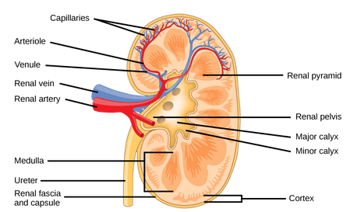
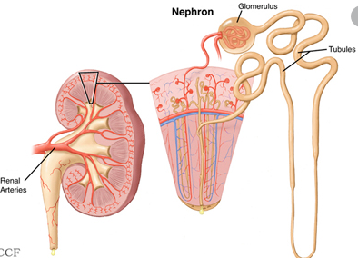
Kidneys Structure
Kidneys have three regions:
Outer cortex
Medulla (in the middle)
Renal pelvis in the hilum area
Hilum is where:
Arteries enter kidney and veins leave kidney
Nerves enter kidney
Ureters exit kidney
Nephrons are the “functional unit” of the kidney
Over 1 million nephrons in each kidney
Nephrons have three parts:
Renal corpuscle
Renal tubule
Associated capillary network

Slide 9
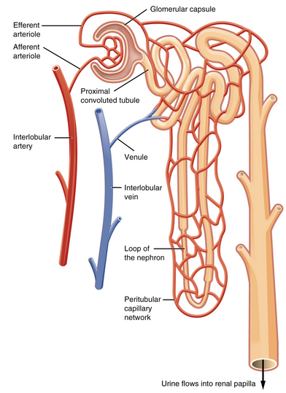
Nephron Structure and Function
Nephrons have three parts:
Renal corpuscle
Located in cortex
Is a network of capillaries called the glomerulus
The Bowman’s capsule surrounds the glomerulus
Filtrate from the glomerulus enters the Bowman’s capsule
Renal tubule
Proximal convoluted tubule (PCT)
Filtrate from Bowman’s capsule enters this tube
Loop of Henle (nephritic loop)
Filtrate from PCT enters Loop of Henle
Has descending loop that extracts water
Has ascending loop that extracts ions
Distal convoluted tubule (DCT)
Filtrate from Loop of Henle ascending loop enters DCT
Connects to ureter
Associated capillary network
Originates from the renal artery, supplies the nephron with blood to filter
Afferent arteriole enters the glomerulus
Efferent arteriole exits the glomerulus
This network surrounds the Renal Tubule

Slide 10
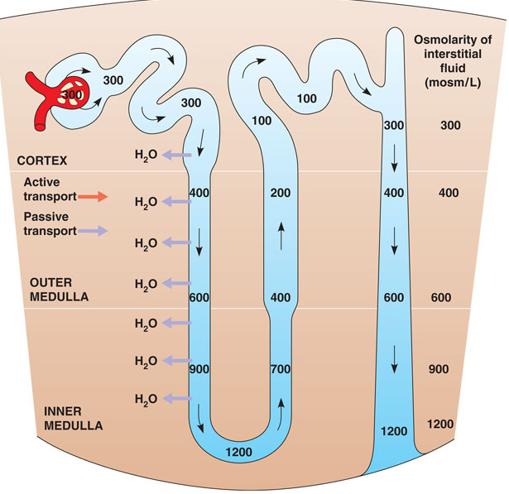
Kidney Function and Physiology
Kidneys filter blood in a 3-step process
First, nephrons filter blood that runs through the glomerulus
Almost all solutes are filtered out by glomerular filtration
Proteins are NOT filtered out in this filtration process
Next, filtrate is collected in the Renal Tubule
Most solutes are reabsorbed by the PCT in tubular reabsorption
In the Loop of Henle, filtrate continues the process of solute and water exchange
Water is reabsorbed in the descending loop
Ions are reabsorbed in the ascending loop
Last, solutes and wastes are excreted into the kidney tubules
Filtrate, also called urine at this point, enters the ureters and goes to the bladder

