Slide 1
Circulatory System
Chapter 40

Slide 2
The Circulatory System
All complex multicellular animals need a method of transporting nutrients throughout their bodies and removing waste products
Single-celled animals and very simple animals can rely on simple diffusion to accomplish these tasks
The circulatory system allows animals to transport nutrients (including oxygen) throughout their bodies and to remove waste
For mammals, the heart is the main organ of the circulatory system
Pumps blood throughout the body
Pumping is stimulated by electrical impulses from the brain
Pumping is regulated by hormones produced by the endocrine system
Gas exchange is the main purpose of the circulatory system
But nutrients, hormones, immune cells, etc. are all transported by the circulatory system
Different types of animals have different types of circulatory systems

Slide 3
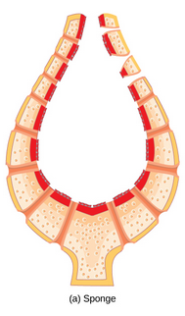
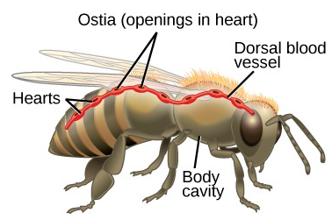
Circulatory Systems
Simple Diffusion
Small and simple animals can rely on simple diffusion to adequately transport nutrients throughout their tissues
Example: Sponges (Porifera) are only a few cell layers thick; cells of the spongocoel are in contact with water and the cells of the outer epidermis are in contact with water
Open Circulatory System
Blood is not enclosed in vessels
Not even true “blood” – called hemolymph – mixture of blood and interstitial fluid
Hemolymph fluid is pumped into the hemocoel
Multiple hearts
Heart beats and movement of animal circulates hemolymph to organs
Hemolymph reenters the hearts through ostia
Does not require as much energy as closed circulatory system
Arthropods and most mollusks

Slide 4
Circulatory Systems
Closed Circulatory System
Blood is enclosed in blood vessels (arteries, veins, capillaries)
Single heart that beats to pump blood
Blood circulates in one direction only
Vertebrates have closed circulatory system
Different vertebrates have different types of closed systems
Differences in structure of heart and circulation of blood
Single circuit blood flow: from heart to respiratory organ to body
Fish only
Double circuit flood flow: from heart to respiratory organ, back to heart, then out to body
Amphibians, reptiles, mammals

Slide 5
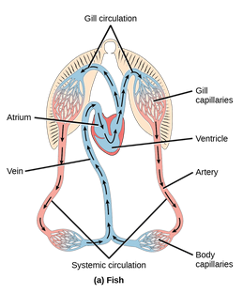
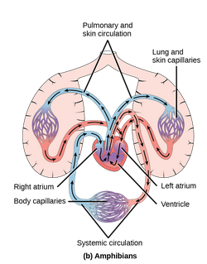
Vertebrate Circulatory Systems
Fish
2 chambered heart
One atrium and one ventricle
Single circuit: Blood flows from heart to gills to body, back to heart
Deoxygenated blood from body enters atrium, flows from atrium into ventricle. Ventricle pumps blood to gills where it is re-oxygenated (gill circulation). Blood flows from gills to body then returns back to atrium deoxygenated (systemic circulation)
Amphibians
3 chambered heart
Two atria and one ventricle
The right atria receives deoxygenated blood from body. Oxygenated blood from skin/lungs enters left atria. Then oxygenated blood and deoxygenated blood mix in the ventricle before being pumped to the body and back to the lung/skin
Double circuit: Blood flows from heart to lungs/skin, back to heart, then out to body

Slide 6
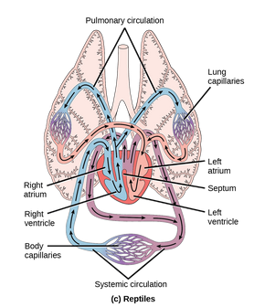
Vertebrate Circulatory Systems
Reptiles
3 chambered heart
Two atria and one ventricle
Double circuit: Blood flows from heart to lungs back to heart, then out to body
Deoxygenated blood from body enters right atrium and then goes to the ventricle. Ventricle pumps blood into the lungs where it is re-oxygenated (pulmonary circulation). Oxygenated blood flows from the lungs to the left atrium and back into the ventricle again. Oxygenated and de-oxygenated blood are both in ventricle but little mixing occurs due to a partial septum and difference in pressure in the atria compared to the ventricle. Oxygenated blood is then pushed to the aorta and out to the body (systemic circulation)
Exceptions: Alligators and crocodiles have primitive 4 chamber heart

Slide 7
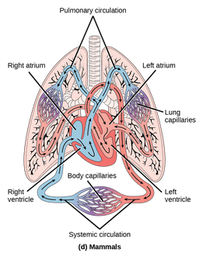
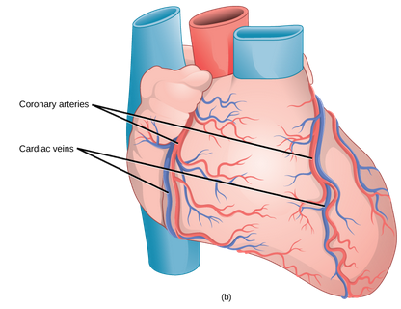
Mammalian Circulatory Systems
Mammals
4 chambered heart
Two atria and two ventricles
Oxygenated blood and deoxygenated blood are kept completely separate
Deoxygenated blood from the body enters the right atrium then goes to the right ventricle. Blood is then sent to the lungs where it is oxygenated (pulmonary circulation). It returns back to the heart, entering the left atrium and then the left ventricle. From the left ventricle, it enters the aorta and goes out to the body (systemic circulation)
Deoxygenated blood stays on the right side of the heart, oxygenated blood on the left side of the heart
The coronary circulation supplies blood to the heart itself heart
Blockages in this system cause heart attacks

Slide 8
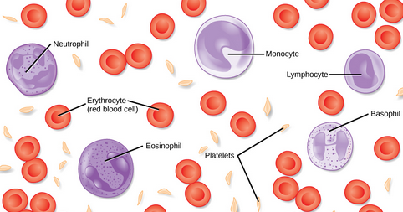
Blood
Hemoglobin is responsible for carrying oxygen and distributing it to cells
But, blood is more than just hemoglobin
Blood includes the liquid plasma, the blood cells and platelets
Plasma is the proteins, water, salt, lipids, platelets
Serum is the plasma but no platelets
Red blood cells carry oxygen (and carbon dioxide)
White blood cells are responsible for immune response
Platelets are responsible for clotting
Blood maintains homeostasis by maintaining pH, temperature, osmotic pressure,
Blood supports growth by distributing nutrients and growth hormones, and by removing waste
Blood protects the body by transporting clotting factors and immune cells

Slide 9
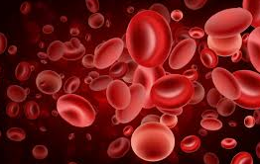
Red Blood Cells
Erythrocytes (“red cells”)
Carry oxygen and carbon dioxide
Created in bone marrow (by stem cells)
In mammals, red blood cells do NOT have nucleus
All other animals’ red blood cells do have a nucleus
Small size and large surface area allows for rapid diffusion of oxygen and carbon dioxide
Have glycolipids and glycoproteins
Lipids and proteins that have short carbohydrate segments attached
ABO blood groups
Live for approximately 120 days
Recycled by macrophages (type of white blood cell)

Slide 10
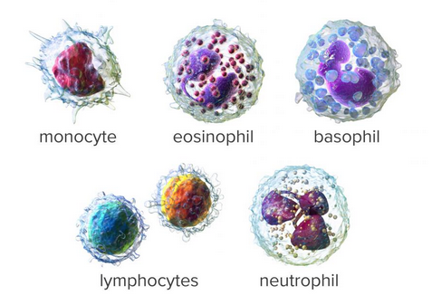
White Blood Cells
Leukocytes (“white cells”)
Make up 1% of cells in blood
They are the immune response cells
Identify and attack bacteria, fungus, viruses, foreign objects
They are produced continuously in lymph nodes and spleen
Some live for hours/days, others for years
Have nuclei and no hemoglobin
There are two main types of white blood cells:
Granulocytes
Agranulocytes
Identified by appearance of granules and nucleus

Slide 11
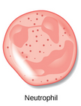
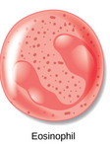
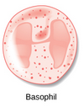
Granulocytes
Have lobed nucleus
Have granular inclusions in cytoplasm
First responders during injury or illness
Three main types:
Neutrophils
Most common type of white blood cell
They fight bacterial infections
Eosinophils
Associated with parasite infection, allergies, cancer
Basophils
Associated with inflammatory reactions and parasites

Slide 12
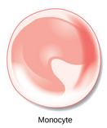
Agranulocytes
Have large nucleus
No granular inclusions in cytoplasm
Adaptive immune response
This includes “memory”
Two main types:
Monocytes
Differentiate into macrophages and dendritic cells
Lymphocytes
B cells, T cells and Natural Killer cells are all lymphocytes
B cells destroy bacteria and their toxins
T cells attack fungus, bacteria, transplanted cells, cancer
Natural Killer cells attack microbes and cancer cells

Slide 13
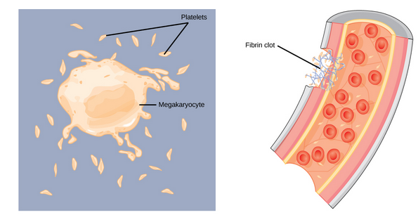
Platelets and Coagulation Factors
In the event of injury, blood must clot to seal wound and prevent blood loss
Thrombocytes (platelets) are small cell fragments that are attracted to sites of injury
Adhere to wound and release their contents
This attracts other platelets to the wound
Attracts other coagulation factors to the wound
Thrombocytes are created by large cells called megakaryocytes
These break up into pieces that become platelets
Platelets convert fibrinogen (water-soluble) into fibrin (non-water-soluble)
This is a blood clot
Coagulation factors require vitamin K

Slide 14
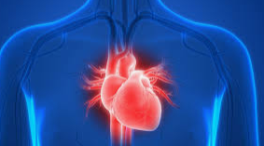
The Human Heart
Human heart is asymmetrical
Right side sends blood to lungs
Pulmonary circulation
Right side is smaller than left side
Left side sends blood to body
Systemic circulation
Left side is larger than right side
Four chambers
Two atria and two ventricles
One atria and ventricle on each side
Atria receive blood, ventricles pump blood out

Slide 15
The Human Heart
Deoxygenated blood enters the right atrium through
Superior vena cava
From brain and upper body
Inferior vena cava
Lower body
The right atrium pumps deoxygenated blood into the right ventricle
Tricuspid valve prevents backflow of blood from right ventricle into right atrium
The right ventricle pumps blood through the semilunar valve into the pulmonary artery into the lungs
Semilunar valve prevents backflow from pulmonary artery into right ventricle
Blood is re-oxygenated in the lungs
Pulmonary veins pump oxygenated blood back to the heart, into the left atrium
The left atrium pumps blood through the mitral valve into the left ventricle
Mitral valve prevents backflow from left ventricle into left atrium
The left ventricle then pumps blood to the aorta which takes the oxygen-rich blood to the body
The aortic valve prevents backflow from the aorta into the left ventricle

Slide 16
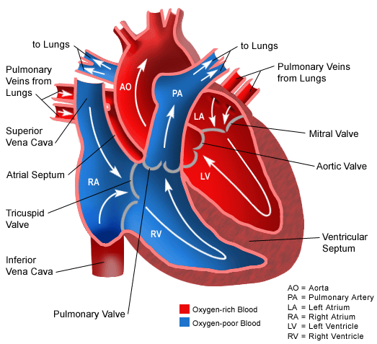
The Human Heart

Slide 17
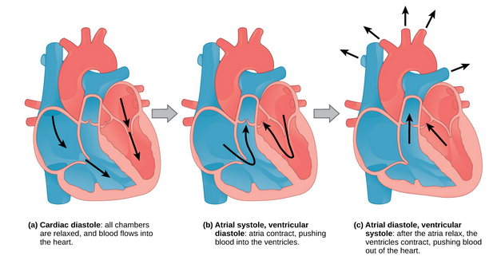
The Human Cardiac Cycle
The cardiac cycle is the filling and emptying of the heart
Human heart beats 100,000 times per day!
In each cycle, or beat, the heart contracts (systole) to push blood out into the body
Then the heart relaxes (diastole) and blood fills the heart
The atria contract at the same time forcing blood into the ventricles at the same time
The beating is controlled by an internal pacemaker
Uses electrical signals to time the beating
Electrical signals and mechanical action are coordinated

