Slide 1
musculoskeletal System
Chapter 38

Slide 2
Three different skeletal designs
Hydrostatic skeleton
Uses water pressure within the coelom
Movement is provided by muscles around the coelom
Contraction action called peristalsis
Used by some invertebrates (echinoderms, annelids)
Exoskeleton
Hard external skeleton surrounding animal (arthropods, bivalves)
Composed of chitin and calcium carbonate
Muscles attach to points inside the exoskeleton
Must be shed as invertebrate grows
Endoskeleton
Hard, mineralized bones within soft tissues (vertebrates)
Support of body and protection of internal organs
Movement is through contraction of muscles attached to bones
Divided into axial skeleton and appendicular skeleton

Slide 3
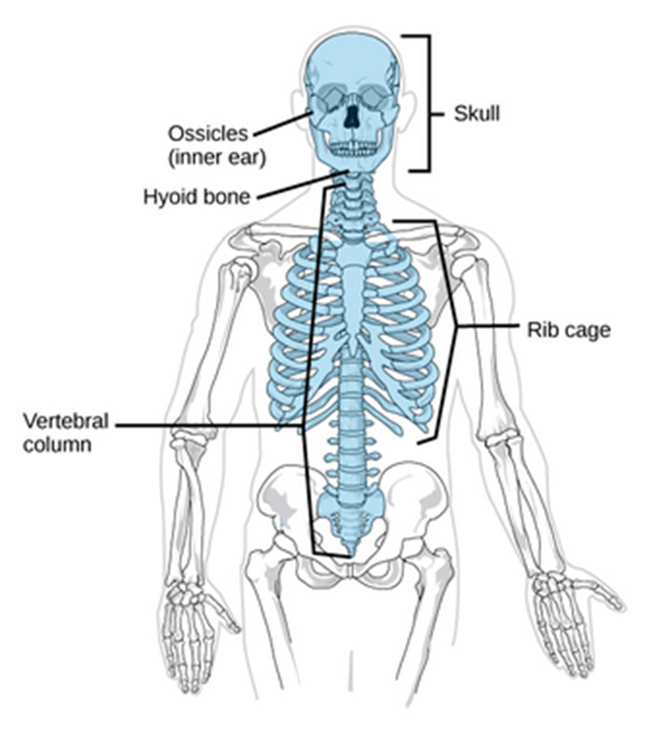
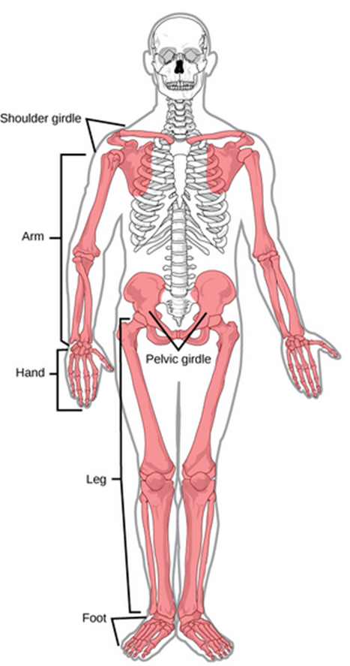
Human Axial and Appendicular Skeletons
Axial Skeleton
Appendicular Skeleton
The axial skeleton includes the skull, vertebral column and rib cage
Provides support and protection for the brain, the spinal cord and organs in the ventral body cavity
Provides muscle attachment sites for movement of head, neck, and trunk
Bones of the upper and lower limbs
Upper limbs for grasping/manipulating
Lower limbs for locomotion
Includes Pectoral (shoulder) Girdle and Pelvic (hip) Girdle

Slide 4
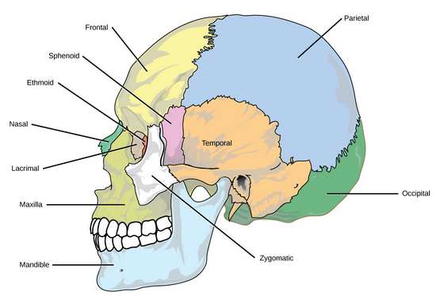
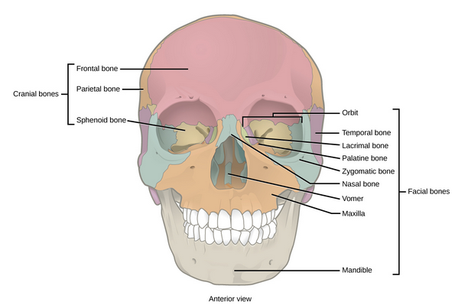
The Skull
Protects the brain and supports face
22 bones, including 8 cranial bones and 14 facial bones
Cranial bones enclose the brain and are attachment sites for muscles controlling head and neck
Cranial bones are tightly fused together and do not move
The auditory ossicles are located in the middle ear and transmit sounds from the air to the cochlea
Smallest bones, found only in mammals
Facial bones form the face and provide cavities for eyes, nose, mouth
Facial bones protect entrances to digestive & respiratory systems

Slide 5
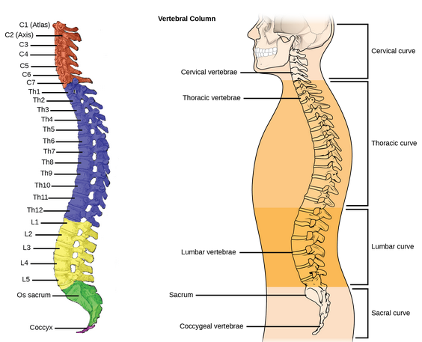
The Vertebral Column
Surrounds and protects spinal cord, supports head, attachment point for ribs and muscles of the back and neck
26 bones
24 vertebrae
7 cervical vertebrae
12 thoracic vertebrae
5 lumbar vertebrae
Sacrum
Coccyx
Intervertebral disks are found between each vertebrae
Joint that allows movement of spine
Cushions vertebrae from impact of walking, running, etc.
Holds vertebrae together

Slide 6
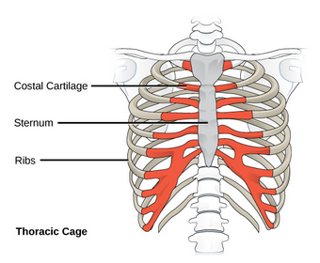
The Thoracic (Rib) Cage
Skeleton of the chest
Includes ribs, sternum, thoracic vertebrae, and costal cartilages
Surrounds and protects organs of the thoracic cavity
Heart
Lungs
Provides support for pectoral girdle and upper limbs
Is attachment site for muscles of back, chest, neck, and shoulders

Slide 7
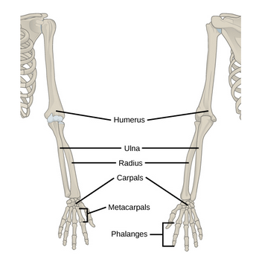
Human Pectoral Girdle and Upper Limbs
Pectoral Girdle
Point of attachment of upper limbs to axial skeleton
Clavicle
Collarbone
anterior
Scapula
Shoulder blade
posterior
Upper limbs
30 bones in three regions
Arm (shoulder to elbow)
Humerus
Forearm (elbow to wrist)
Ulna and radius
Wrist and hands
Carpus (wrist)
8 bones
Metacarpus (palm)
5 bones
Phalanges (fingers)
14 bones

Slide 8
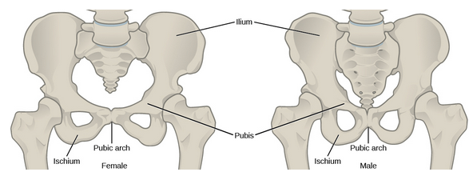
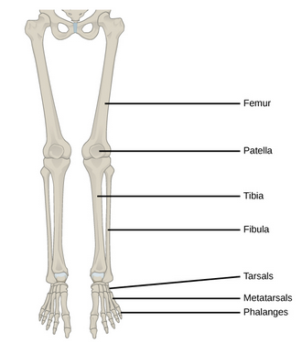
Human Pelvic Girdle and Lower Limbs
Pelvic Girdle
Point of attachment of lower limbs to axial skeleton
Supports weight of body
Responsible for locomotion
Attached to axial skeleton by ligaments
Two large hip bones
Fusion of ilium, ischium, and pubis
Together called pelvis
Female pelvis is wider and shallower than male pelvis
Lower limbs
Thigh
Femur
Kneecap
Patella
Leg
Tibia and fibula
Ankle
Tarsals
Foot
Metatarsals and phalanges

Slide 9
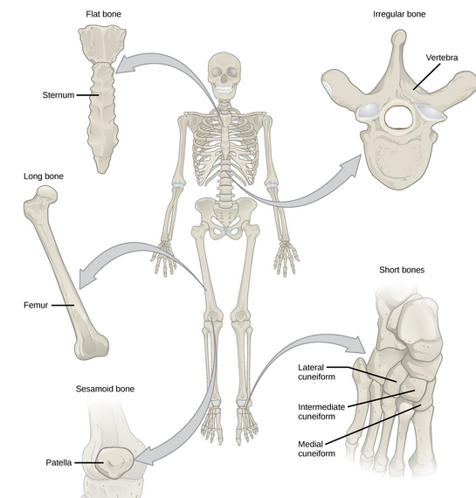
Bone and bone types
Bone is the osseous connective tissue of the endoskeleton
Includes specialized cells, matrix of mineral salts, and collagen fibers
Calcification is a deposition of mineral salts on the collagen fiber that crystallizes into hardened tissue
Human bones are classified by their shape
Long bones (femur)
Short bones (wrist bones)
Flat bones (sternum)
Sutural bones (skull bones)
Sesamoid bones (patella)
Irregular bones (vertebrae)

Slide 10
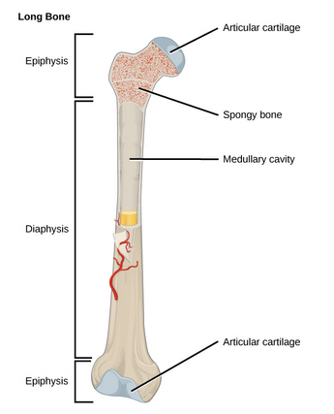
Long Bones
Long bones have a shaft and two ends
Diaphysis – shaft
Contains bone marrow
Epiphysis – end
Covered in cartilage
Contain red bone marrow
Produces blood cells
Most limb bones are long bones

Slide 11
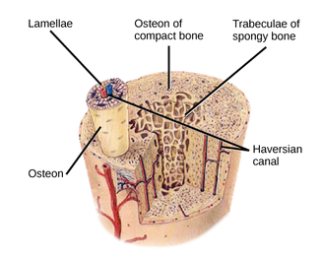
Bones and Bone Tissue
Bones are considered organs because they have different tissue types
Blood, connective, nerve, bone tissues
Two types of bone tissue
Compact Bone Tissue
Hard external layer, surrounding medullary cavity
Strength and protection
Includes Osteons and Haversian canals
Osteons are cylindrical structures of lamellae, mineral matrix, surrounding Haversian canals
Run parallel to axis of bone
Haversian canals contains blood vessels and nerve fibers
Spongy Bone Tissue
Forms inner layer of bones
Does not contain osteons
Contains trabeculae
Lamellae arranged as rods
Red bone marrow is found between trabeculae
Produces red blood cells

Slide 12
Cell Types in Bones
Osteoblasts
Responsible for bone formation
Synthesize and secret bone matrix tissue and collagen
Osteoclasts
Responsible for bone reabsorption
Enzyme catalyzed
Releases calcium into blood
Osteocytes
Mature bone cells
Cannot divide
Maintain normal bone structure by recycling mineral salts in matrix
Osteoprogenitor
Squamous cells that divide to produce daughter cells that become osteoblasts
Repair fractures

Slide 13
Bone Development and Growth
Osteogenesis (ossification) is bone formation by osteoblasts
Ossification begins 6 weeks after fertilization, continues until age 25
After age 25, bones can grow in thickness but not length
Bone grows in length by adding bone tissue at the epiphyseal plate
Bone grows in width by adding bone tissue to the surface of bones
Stress on bones increases width
Bone remodeling is the replacement of old bone by new bone
Involves tissue deposits by osteoblasts and tissue absorption by osteoclasts
Turnover rate is 5-7% per week
Requires parathyroid hormone, growth hormone, calcitonin
Fractured bone take many months to repair

Slide 14
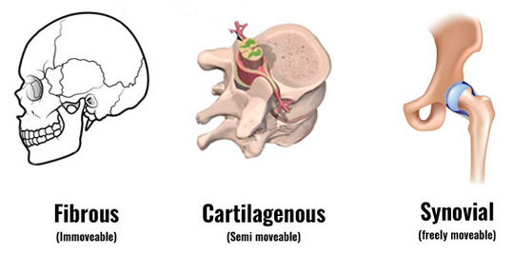
Joint Structure
A joint is the place where two bones meet
Joints are responsible for movement and stability
Joints are classified based on their structure and their function
Three different types of structural joints:
Fibrous
Bone connected by fibrous connective tissue
No space between bones
No movement of bone
Example: Sutures in skull
Cartilaginous
Bones are connected by cartilage
No space between bones
Very little movement of bone
Example: Connect ribs to sternum
Synovial
Have fluid-filled space between bones
Lubricates, reduces friction
Greatest amount of movement
Example: Hip joint

Slide 15
Muscle and Muscle Tissue
Muscle cells are specialized contraction cells
Facilitate movement and body processes
Three types of muscle tissue
Cardiac
Heart muscle
Involuntary
Heartbeat
Striated
Intercalated disks
One nucleus per cell
Skeletal
Attach to bone and skin
Voluntary movement
walking
Striated cells
Actin and myosin
Multiple nuclei per cell
Smooth
On walls of hollow organs and around passages
Involuntary
Digestion
No striations
One nucleus per cell

Slide 16
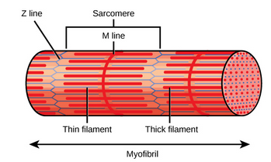
Skeletal Muscle Fiber Structure
Skeletal muscle fiber is a muscle cell
Very large – up to 30 cm!
Sarcolemma: plasma membrane surrounding muscle cell
Site of action potential triggering muscle contraction
Sarcoplasm: cytoplasm of muscle cell
Myofibrils are long cylindrical fibers inside muscle fiber cells
Parallel configuration
Can have hundreds inside one muscle fiber cell
Made up of actin (thin) and myosin (thick)
Give striated appearance of Actin light I-bands and Myosin dark A-bands
Center of each I-band is Z line
Divides myofibril into smaller units called sarcomeres
Center of each A-band is M line
M line holds myosin in parallel arrangement

Slide 17
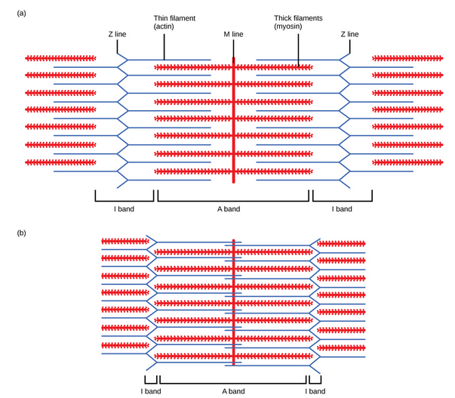
Sliding Filament Theory of Muscle Contraction
The Sliding Filament Theory states that the myosin of the thick filament combines with the actin of the thin filament, causing the filaments to slide past each other
Myosin has a head structure that interacts with specific active sites on the actin filament, forming a bond called a crossbridge
Myosin has ATP sites to power this reaction
The actin filament has tropomyosin regulatory protein that prevents and regulates interaction between actin and myosin

Slide 18
Crossbridge Muscle Contraction

Slide 19
Stimulation of Muscle Contraction
Electrical signal travels down a nerve cell releasing acetylcholine into synapse
Acetylcholine binds to receptor on sarcoplasm, causing action potential in muscle cell
Action potential enters the cell through T-tubule at the z-line
Action potential releases Ca++ from sarcoplasmic reticulum
Ca++ flows into sarcoplasm, binds to troponin-tropomyosin molecules located in the actin active site
This exposes the actin active site
The myosin head binds with actin active site, creating crossbridge. Muscle contracts and shortens
After action potential has passed, calcium gates close & calcium is removed from sarcoplasm
Calcium releases from troponin-tropomyosin molecules, causing active site to be covered again
No active site means no crossbridge can form so muscle relaxes

Slide 20
Excitation-Contraction Coupling

