Slide 1
Respiratory System
Chapter 39

Slide 2
The Respiratory System
All aerobic animals need oxygen to carry out cellular respiration
Carbon dioxide is the waste product
ATP energy is produced
Animals absorb oxygen from the air or water and release carbon dioxide into the air or water
Oxygen in the air (or water) must enter the animal’s tissue and be transported to all cells. The carbon dioxide waste produced by those cells must be transported from the cells to be released into the water or the air
The respiratory system provides a mechanism for animals to obtain oxygen and dispose of carbon dioxide
Different types of animals employ different respiratory systems depending on their body structure and the environment in which they live

Slide 3
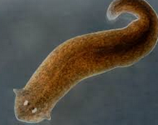
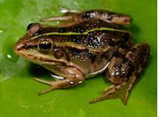
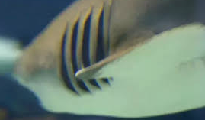
Types of Respiratory Systems
Simple diffusion
Unicellular animals, very small animals and flat-bodied animals, such as flatworms, can use simple diffusion to obtain oxygen and remove carbon dioxide.
Oxygen diffuses into their cells from the water and carbon dioxide is removed from their cells by diffusion into the water
Skin
Earthworm’s and amphibian’s skin is their respiratory organ
Capillaries just under the skin diffuse oxygen from the air and release carbon dioxide into the air
Skin must remain moist for diffusion to occur
Gills
Animals that live in water must also obtain oxygen from and release carbon dioxide into the water
Oxygen concentration is water is very low ~ 0.6% compared with 21% oxygen concentration in air

Slide 4
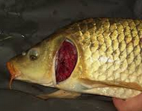
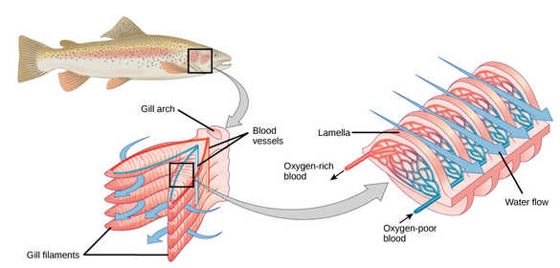
Gills as Respiratory Organ
Gills
Gills are the respiratory organs of most aquatic animals. Gills are thin tissue filaments with extensive folding
Increased surface area ensures that enough oxygen can be absorbed from oxygen-poor water
Remember, diffusion occurs from high concentration to low concentration
Oxygen-poor blood flows counter current to water flow across gills
Although dissolved oxygen is in low concentration in water, it is at a much higher concentration than the oxygen-poor blood
Therefore, oxygen diffuses from water into the blood
Carbon dioxide is removed in the opposite way: carbon dioxide diffuse from high concentrations in the blood to low concentration in the water

Slide 5
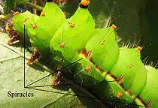
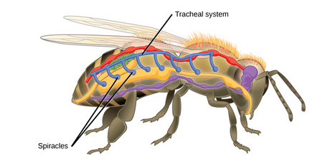
Tracheal Respiratory Organs
Tracheal Systems
In insects, the respiratory system is NOT connected to the circulatory system (blood)
The blood does not transport oxygen or carbon dioxide
Insects have a tracheal system which is network of tubes that carry oxygen
Efficient and direct for active animals
Insects have openings called spiracles along their thorax and abdomen
Spiracles allow air to enter the insect body and allow carbon dioxide to leave the insect body
Insects can increase the air flow into their body by body movement

Slide 6
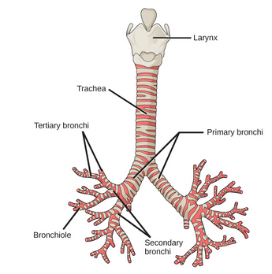
Mammalian Pulmonary System
Pulmonary System
Mammals inhale air through their nasal cavity
Nasal cavity warms the air and adds moisture
The air flows through the pharynx and larynx and then into the trachea
The trachea funnels inhaled air into the lungs and exhaled air out of the lungs
The trachea divides into two major branches, called primary bronchi
All bronchi tubes are lined with smooth muscle and hyaline cartilage
Smooth muscle can contract to push air out of the lungs (cough)
The inside has goblet cells to produce mucus and ciliated cells to remove particles in the air
Each primary bronchus branches into secondary bronchi which branch into tertiary bronchi which branch into bronchioles
Each bifurcation, or branch, leads to a smaller passage

Slide 7
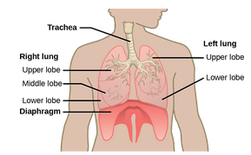
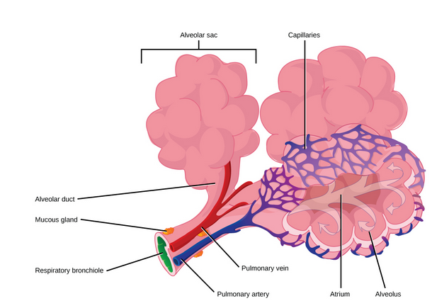
Mammalian Pulmonary System
Lungs and Aveoli
The trachea branches into primary bronchi – one in each lung
The right and left lungs are not identical
The right lung is larger and has three lobes, the left lung is smaller and has two lobes
The diaphragm lies just below the lungs and facilitates breathing
In the lungs, the air is diverted into the smaller and smaller bronchi passages
The terminal bronchioles divide into microscope respiratory bronchioles
These further divide into alveolar ducts
Each alveolar duct connects to an alveolar sac
Gas exchange only occurs in the alveoli
They are in direct contact with capillaries of the circulatory system
Capillaries surround the alveoli to ensure oxygen diffusion into the blood and carbon dioxide diffusion out of the blood
This arrangement ensures increased surface area in the lungs

Slide 8
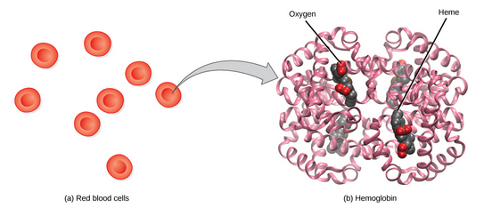
Transport of Oxygen in Blood
Oxygen dissolves in the blood but only 1.5% of oxygen is actually transported as dissolved oxygen in the blood
98.5% of oxygen is carried by hemoglobin in red blood cells
Called erythrocytes
Hemoglobin is a large protein made up of four subunits
Two alpha and two beta subunits
Each subunit surrounds a heme group that contains iron and bind oxygen
Each red blood cell can carry four molecules of oxygen
Red blood cells that are oxygenated (arterial) are bright red
Red blood cells that are de-oxygenated (venous) are dark red

