Slide 1
endocrine System
Chapter 37

Slide 2
Overall Endocrine Control
The Endocrine system controls homeostasis in animals by
Production, secretion, and regulation of hormones
The Endocrine systems controls
Growth
Metabolism
Sexual Development
Communication between adjacent cells and cells in different parts of the body is necessary
Hormones are the messengers that guide the body to maintain homeostasis (or not, depending on situation)
Hormones are produced in specific endocrine cells and are secreted into the blood to reach target cells
Target cells have receptors that recognize hormones

Slide 3
Hormones
There are many different hormones present in animals but all hormones fall into one of three classes:
Lipid-derived
Amino acid-derived
Peptide
Only lipid-derived hormones can diffuse across the plasma membrane of their target cells
They are then able to move into the nucleus of the cell to facilitate the transcription/translation of specific proteins (called gene regulation)
Amino acid-derived hormones and peptide hormones cannot diffuse across the plasma membrane of their target cells
They bind to receptors on the outside of the plasma membrane

Slide 4
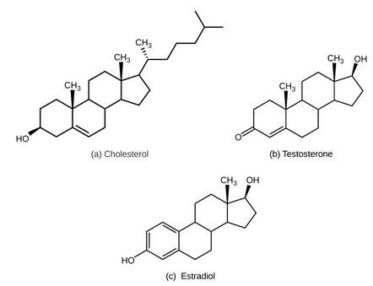
Lipid-derived hormones
Lipid-derived hormones are cholesterol derivatives
Cholesterol is building block
Steroid hormones
Either ketones (end in –one) or alcohols (end in –ol)
Can diffuse across plasma membrane of target cell
Are not water soluble
Transported in blood by transport proteins
Very long-lived
Examples: Testosterone and Estradiol

Slide 5
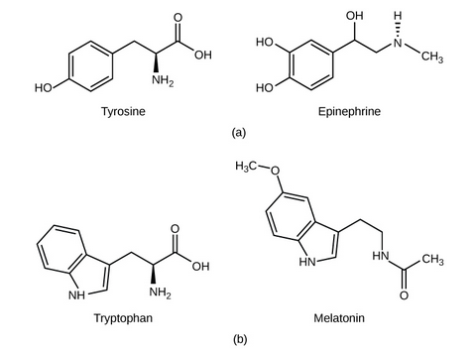
Amino acid-derived hormones
Amino acid-derived hormones are derived from one of two amino acids
Tyrosine
Tryptophan
Hormone name will end with -ine
Cannot diffuse across plasma membrane of target cell
Are water soluble
Have receptors on outside of target cell
Small, short-lived hormones
Examples: Epinephrine and Melatonin

Slide 6
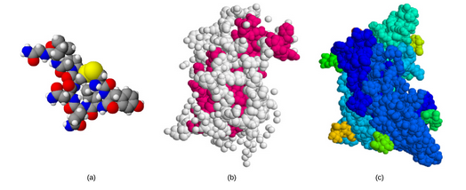
Peptide hormones
Peptide hormones are short polypeptide chains
Much larger than lipid-derived or amino-acid derived hormones
Includes both small protein hormones and large glycoprotein hormones
Cannot diffuse across plasma membrane of target cell
Are water soluble
Have receptors on outside of target cell
Examples: Growth hormone and Follicle-stimulating hormone

Slide 7
How Hormones Work
Hormones instigate changes in target cells by binding to specific receptors in/on target cells
Only affect target cells
Receptors for a specific hormone can be found on many different cells or on only a few cell types
Depends on hormone function
Individual cells may have receptors for just one hormone or for many different hormones
Number of receptors determine cell’s sensitivity
Number of receptors can change over time
Up-regulation: increased number of receptors in response to increase hormone level
Increased target cell activity
Down-regulation: decreased number of receptors in response to increase hormone level
Decreased target cell activity

Slide 8
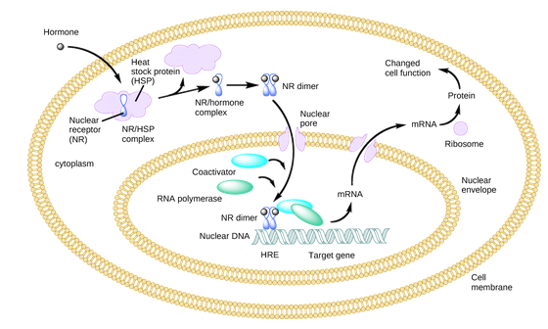
Intracellular Hormone Receptors
Lipid-derived hormones, once secreted from the cell that produced them, bind to transport proteins in blood
Once it reaches target cell, hormone releases from transport protein and diffuses across plasma membrane of target cell
Binds to intracellular receptors in cytoplasm
Allows hormone to diffuse through nuclear membrane
The hormone and receptor acts as a transcription regulator
Increases or decreases synthesis of mRNA
This affects the amount of protein produced
Proteins are used to change cellular function or to catalyze enzymatic reactions
This means that lipid-derived (steroid) hormones directly regulate cell processes

Slide 9
Plasma Membrane Hormone Receptors
Amino acid-derived hormones and polypeptide hormones cannot diffuse across the plasma membrane of target cell
They cannot and do not enter the cytoplasm of cell
They do not directly act on the cell’s DNA
They bind to membrane receptors on outer surface of plasma membrane
Binding to receptors initiates a signal pathway
Intracellular activity is regulated by signal pathway
First Messenger: hormone that binds to membrane receptor
Second Messenger: the intracellular molecule that is initiated when First Messenger binds to receptor

Slide 10
Cyclic AMP (cAMP) and Signal Transduction
Hormone (first messenger) binds to membrane receptor activates G protein
G protein (second messenger) is activated by binding GTP
Activated G protein activates enzyme adenylyl cyclase
Adenylyl cyclase converts ATP to cAMP
cAMP activates protein kinases
Transfer phosphate group from ATP to substrate
Phosphorylates the substrate
Once activated protein kinases catalyze many, many reactions
Small amount of hormone triggers large amount of cellular product
To stop activity, cAMP has to be deactivated by phosphodiesterase (PDE)
Negative feedback

Slide 11
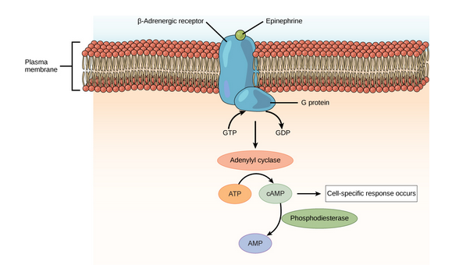
Cyclic AMP (cAMP) and Signal Transduction

Slide 12
Endocrine Glands
Endocrine and Nervous systems work together
Endocrine system cells secrete hormones that act on target cells to regulate growth, energy, reproduction, etc.
The Nervous system releases neurotransmitters (neurohormones) that regulate neurons, muscle cells and endocrine cells
In vertebrates, the Hyp0thalamus integrates endocrine and nervous systems
Hypothalamus receives input from body and brain to initial endocrine responses
Hormone secretion
Hypothalamus acts as an endocrine gland
Synthesizes hormones and transports them to posterior pituitary gland

Slide 13
Pituitary Glands
The Master Gland
Attached to hypothalamus by pituitary stalk
Two regions: anterior pituitary and posterior pituitary
Anterior pituitary gland
Produces seven hormones
Tropic hormones (they control function of other organs)
Growth hormone, prolactin, thyroid-stimulating hormone, melanin-stimulating hormone, adrenocorticotropic hormone, follicle-stimulating hormone, luteinizing hormone
Production of hormones is regulated by hypothalamus
Posterior pituitary gland
Part of the brain, structure is nerve fibers and neuroglial cells
Does not produce hormones
Stores hormones produced by hypothalamus
Antidiuretic hormone and oxytocin

Slide 14
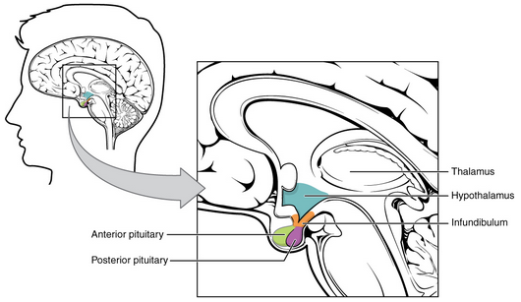

Slide 15
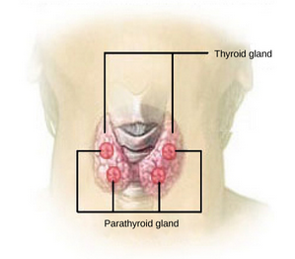
Thyroid and Parathyroid Glands
Located in neck
Thyroid cells synthesize thyroxine (T₄) and triiodothyronine (T₃) and calcitonin
Thyroid Stimulating Hormone (TSH), produced in anterior pituitary gland, stimulates the thyroid gland to release T₄ and T₃
Calcitonin helps regulate calcium concentrations in body
In bones, inhibits osteoclasts (release of calcium from bones)
In kidneys, stimulates calcium excretion
Both of these lower calcium levels
Parathyroid Glands
4-6 glands on posterior of thyroid gland
Produces parathyroid hormone (PTH)
Increases calcium levels when levels fall too low

Slide 16
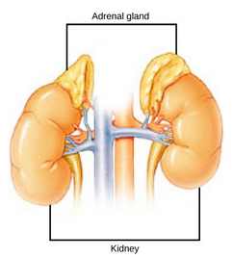
Adrenal Glands
One adrenal gland is located on the on top of each kidney
Each adrenal gland has an outer adrenal cortex and an inner adrenal medulla
Adrenal cortex
Layers of epithelial cells and capillary networks
Produces mineralocorticoids (aldosterone)
Regulates concentration of Na+ in sweat, urine, saliva
Produces glucocorticoids (cortisol, cortisone)
Stimulates synthesis of glucose and gluconeogenesis
Produces androgens
Sex hormones that promote masculinity
Adrenal medulla
Produces epinephrine (adrenaline) and norepinephrine (noradrenaline)
Increase heart rate, blood pressure, etc.
Stimulated by Sympathetic Nervous System
Fight or Flight

Slide 17
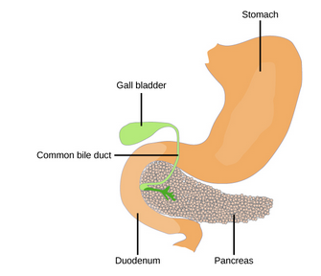
Pancreas
Located between stomach and small intestine
Contains exocrine cells (digestive enzymes) and endocrine cells (hormones)
Endocrine cells form clusters called islets of Langerhans
Islets have two cell types:
Alpha cells: produce glucagon
Beta cells: produce insulin
Regulate blood glucose levels
↓ Blood glucose level → alpha cells release glucagon
Raises blood glucose level by increasing rate of glycogen breakdown and glucose release from liver
↑ Blood glucose level → beta cells release insulin
Lowers blood glucose levels by increasing rate of glucose uptake by cells and by increasing glycogen production

Slide 18
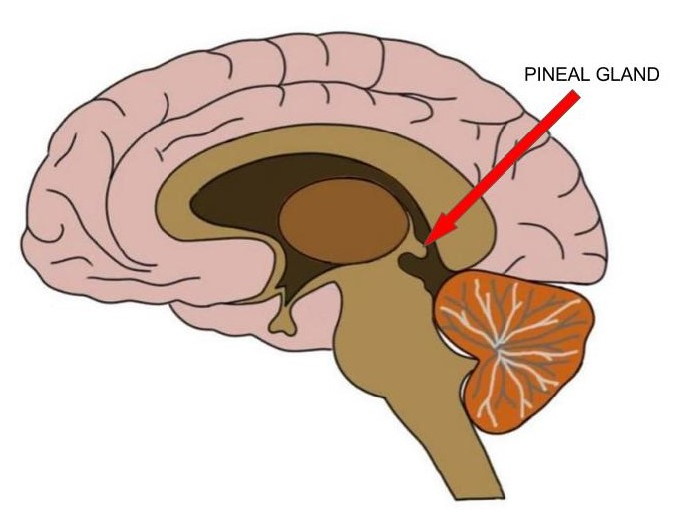
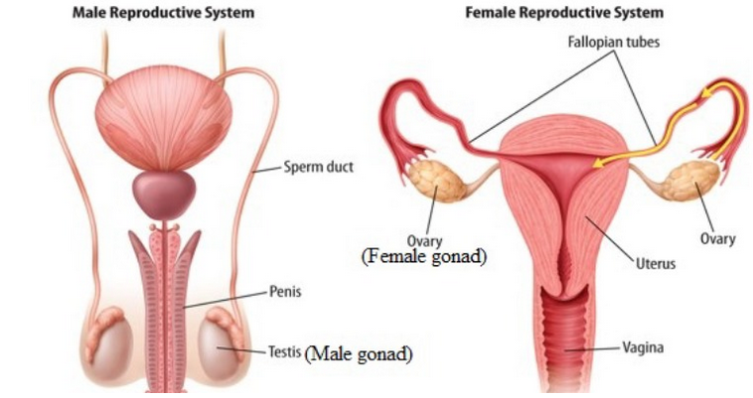
Pineal Gland and Gonads
Pineal Gland
Located in brain
Produces melatonin
Production is affected by photoperiod
Dark → more melatonin produced
Light → less melatonin produced
Gonads (testes and ovaries)
Produce steroid hormones
Testes: Androgens
Secondary sex characteristics and sperm production
Ovaries: Estradiol and Progesterone
Secondary sex characteristics and prepare body for pregnancy

Slide 19
Hormonal Regulation of Excretory System
Maintaining water balance is crucial in living organisms
Body water concentration is monitored by osmoregulators in hypothalamus
Detect concentration of electrolytes in body fluid
↑ Electrolyte concentration = water loss (increased blood osmolarity)
Perspiration, dehydration
Hypothalamus produces antidiuretic hormone (ADH)
Transported to and released by posterior pituitary
ADH regulates amount of water excreted by kidneys
Directs water reabsorption by kidneys
Concentrated urine
As blood osmolarity decreases, negative feedback mechanism reduces osmoregulator receptors in hypothalamus and ADH production decreases
Aldosterone, produced by adrenal cortex
Directs Na+ reabsorption and K+ secretion from extracellular fluid of kidney cells

Slide 20
Hormonal Regulation of Reproductive System
Regulation of reproduction requires many endocrine glands to work together
Pituitary, adrenal cortex, and gonads
During puberty, hypothalamus produces gonadotropin-releasing hormone (GnRH)
Stimulates production/release of follicle-stimulating hormone (FSH) and luteinizing hormones (LH)
Produced in anterior pituitary gland
Regulate gonads
FSH stimulates gamete production (sperm and egg)
LH stimulates hormone production by gonads (testosterone & estradiol and progesterone)
Anterior pituitary gland produces prolactin in females
Positive feedback mechanism for lactation
Negative feedback mechanism to end lactation with prolactin-inhibiting hormone (dopamine)
Posterior pituitary gland produces oxytocin
Positive feedback mechanism for childbirth
Positive feedback mechanism for milk ejection during suckling

Slide 21
Hormonal Regulation of Metabolism
Diabetes Mellitus is a condition in which the organism has high blood glucose levels
Approximately 10% of Americans have diabetes!
Many causes, depending on the type.
Beta cells, in pancreas, do not produce enough insulin or cells are insensitive to insulin and do not uptake glucose from blood
High blood glucose (hyperglycemia) levels:
Kidneys cannot reabsorb water properly
Dehydration
Kidney damage
Cause nerve damage to eyes and peripheral nervous system
Low blood glucose (hypoglycemia) levels occur if beta cells over-produce insulin
Low energy, can lead to death

Slide 22
Hormonal Regulation of Blood Calcium Level
Regulation of calcium is necessary for muscle contractions and neuron signal transmission
If Ca++ levels are too high, membranes become unresponsive
If Ca++ levels are too low, membranes become hyper-responsive
The Parathyroid Hormone (PTH) is released in response to low Ca++ levels
In bones, stimulates osteoclasts which reabsorb bone and release Ca++
In intestines, increases Ca++ absorption
In kidneys, stimulates Ca++ reabsorption
When Ca++ levels are high PTH production/secretion is inhibited

Slide 23
Hormonal Regulation of Growth
Hormones control Mitosis in cells
Growth Hormone (GH) is produced by anterior pituitary gland
Accelerates the rate of protein synthesis in skeletal muscles and bones
Growth Hormone is stimulated by Growth Hormone-Releasing Hormone (GHRH)
Growth Hormone is inhibited by Growth Hormone-Inhibiting Hormone (GHIH)
somatostatin

Slide 24
Hormonal Regulation of Stress
The Sympathetic Autonomic Nervous System has evolved “fight or flight” strategy
Increase in heart rate, blood pressure, etc.
Short-term stress stimulates increased blood glucose level by stimulating breakdown of glycogen to glucose
Short-term stress stimulates epinephrine and norepinephrine production to be released by the adrenal medulla
Long-term stress triggers release of adrenocorticotropic hormone (ACTH) from anterior pituitary gland
This stimulates adrenal cortex to release corticosteroids
Corticosteroids control transcription function in cells
Increases glucose synthesis
Inhibit immune response
Regulate iron and water balance

