Slide 1
Nervous & sensory systems
Chapters 35 & 36

Slide 2
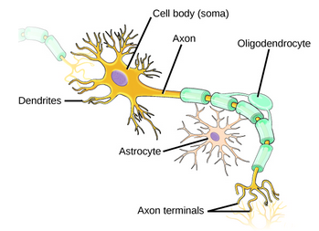
Neurons
The large cell in a neuron is the cell body
Has central nucleus
Projections from cell body are:
Dendrites – receive impulses
Axons – transmit impulses
Two types of glial cells
Astrocytes – regular chemical environment
Oligodendrocytes – insulate axon for better transmission
An individual nerve has both neurons and glial cells

Slide 3
Neuron Communication
Neurons have voltage difference across the plasma membrane
Voltage is different inside the neuron versus outside
The charge changes in response to stimulus
When there is no stimulus, the neuron is at rest
Remember that ions cannot simply diffuse through the plasma membrane
They need transport proteins called ion channels
They change shape to allow ions to come into/out of the cell
Voltage-gated ion channels change shape in response to changes in voltage across the cell
A neuron at rest is negatively charged
It is more negative inside the neuron than outside
-70 mV

Slide 4
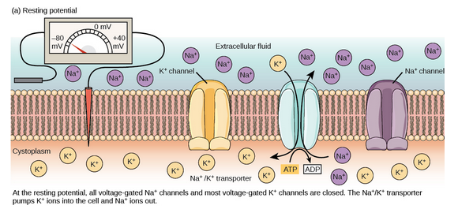
Resting potential

Slide 5
Neuron Action Potential
Neurons receive and send signals between them
When a neuron receives a signal, the ion channels open and allow positively charged ions into the neuron
The neuron goes from being negatively to positively charged
From -70 mV to +40 mV
This allows transmission of the signal through the neuron: from the cell body, along the axon, to the axon terminal
As the signal moves along the neuron, the neuron must reset back to the resting potential
Na+ ion channels close, K+ channels open
Inside neuron becomes more negatively charged again

Slide 6
Action Potential

Slide 7
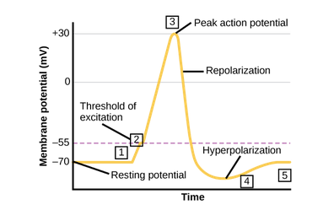
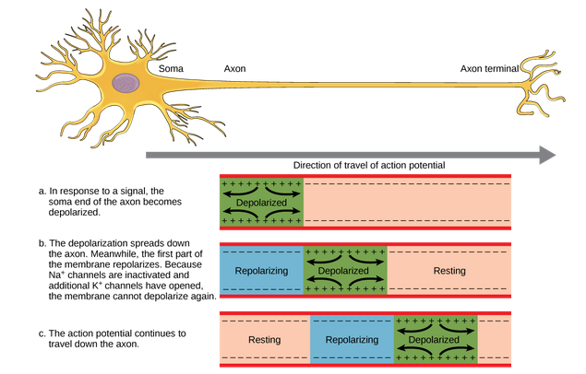
Action Potential Visualized

Slide 8
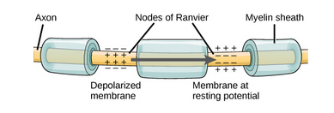
Signal Transmission and Glial Cells
Speed of signal transmission is determined by
Diameter of axon
Axon’s resistance to currency leakage
Glial cells produce a protein called myelin that insulate the axon
Gaps in the myelin are called Nodes of Ranvier
The action potential only has to generate at the nodes

Slide 9
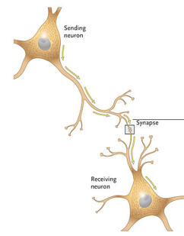
Synaptic Transmission
A synapse is the place where the signal is transmitted from the axon terminal of one neuron to the dendrite of another neuron
Neuron sending a signal is pre-synaptic
Neuron receiving a signal is post-synaptic
Two types of synapses
Chemical
Electrical

Slide 10
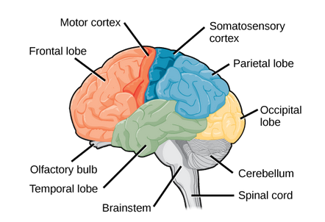
Central Nervous System
The Central Nervous System (CNS) is the brain and spinal cord
The brain includes the cerebral cortex which is made up of a left and right hemisphere
Each hemisphere is comprised of various lobes, each with individual functions
Frontal
Olfactory, planning movement, moving, attention, speech, decision
Parietal
Speech, reading, touch
Temporal
Interpreting sounds, memory
Occipital
sight

Slide 11
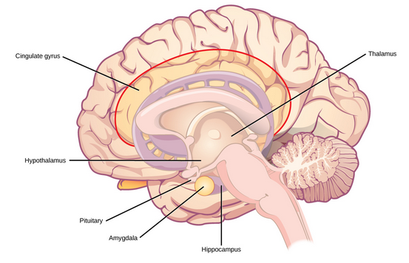
Central Nervous System
The brain also includes:
Basal Ganglia
Movement and posture
Thalamus
Receives sensory & motor input from body, consciousness, sleep, arousal
Hypothalamus
Controls the endocrine system
Homeostasis
Limbic System
Includes parts of thalamus, hypothalamus, and Amygdala
Emotion, fear, motivation
Cerebellum
Balance, movement
Brainstem
Connects brain to spinal cord
Controls blood pressure, alertness, heart rate, swallowing, etc.

Slide 12
Spinal Cord
Connects the brain stem to the body
Bundle of nerve tissue
Controls motor reflexes
Quick unconscious movement
Often for safety
Spinal nerves do not regenerate so spinal cord injuries often result in paralysis

Slide 13
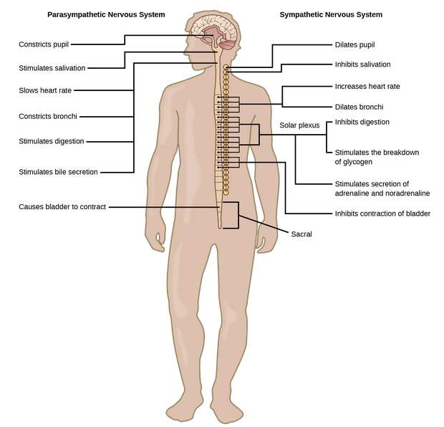
Peripheral Nervous System
Connects CNS to rest of body
Two systems
Autonomic Nervous System
Bodily function NOT under conscious control
Parasympathetic
Conserves energy, allows body to rest
Sympathetic
Responsible for fight or flight
Increased heart rate, increased blood pressure, decreased digestion
Motor System
Transmits sensory information to CNS
Send motor commands from CNS to muscles

