Slide 1
Digestive System
Chapter 34

Slide 2
Cellular Respiration Refresh
Animals consume food to maintain homeostasis
ATP is the energy currency of cells
The main source of ATP is carbohydrates, lipids and proteins
Glucose (the monomer that comprises carbohydrate polymers) is considered the primary source of fuel for cells
Glucose is converted to pyruvate in the cell cytoplasm (producing ATP and NADH) and then into Acetyl CoA in the mitochondria matrix (producing CO₂ and NADH). Acetyl CoA is oxidized during the Citric Acid Cycle to produce more ATP, NADH, and FADH₂
NADH and FADH₂ are electron storage molecules that hold the electrons released from the oxidation of food and take them to the Electron Transport Chain (ETC)
The ETC uses those electrons to build up a hydrogen ion gradient that is then used to create ATP.

Slide 3
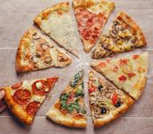
Neural Responses to Food
Just looking at, smelling, or even thinking about food initiates the process of digestion
There are three phases of digestion:
Cephalic phase
Gastric phase
Intestinal phase
Each phase prepares the body to receive food or helps the body ingest food, or stimulates the body to digest food
Negative Feedback Mechanisms help to push the body back toward the set point (no food) once each stage of the digestion process is complete

Slide 4
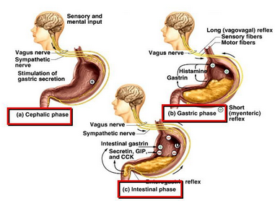
Cephalic Phase
This is the first phase of the digestive process
Controlled by neural response to food
Sight, smell, thought
Neural response triggers salivation and secretion of gastric juices
This is the central nervous system preparing the body to receive food
The digestive process begins with amylase enzymes in saliva

Slide 5
Gastric Phase
This is the second phase of the digestive process
Begins when food enters the stomach
Gastric juices and digestive enzymes are stimulated in the stomach
This phase is stimulated by:
Distention of the stomach
Decrease in pH of gastric juices
This is a positive feedback mechanism – low pH stimulates the response of more acidic gastric juices
Presence of undigested material (chyme)
These responses trigger powerful contractions in the intestines

Slide 6
Intestinal Phase
This is the third phase of the digestive process
Begins when chyme enters the small intestine
This triggers digestive secretions in the small intestine
This phase controls
The rate of gastric emptying
Coordination between other digestive organs such as the pancreas, liver, and gallbladder

Slide 7
Hormonal Responses to Food
The endocrine system controls the response of glands and the secretions of the proper hormones at the correct time
Stomach acid level is one of the key triggers for the endocrine system
During the gastric phase, the hormone gastrin is secreted in response to proteins in the consumed food
Gastrin stimulates the release of hydrochloric stomach acid, HCl
Once the food enters the intestines, the acidic environment does not need to be maintained so negative feedback mechanisms release the hormone somatostatin to stop the release of HCl
In the duodenum, secretions from the liver, pancreas, and gallbladder digest the chyme
To neutralize the acid, a hormone called secretin produces an alkaline bicarbonate solution
A secondary hormone called cholecystokinin (CCK) stimulates the pancreas and the gallbladder

Slide 8
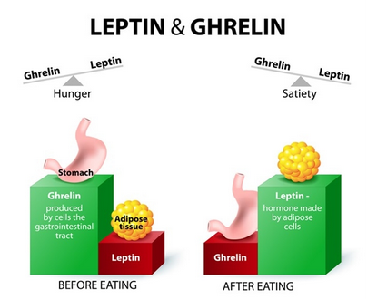
Appetite Regulation
Appetite is regulated by two hormones
Leptin
Ghrelin
Leptin is produced by fat cells in the intestinal tract and decreases appetite
This is appetite suppression
Leptin levels are high in individuals with higher fat levels
This should cause the individual to feel full and eat less
Some individuals become immune to high leptin levels and continue to feel hungry
Ghrelin is produced in the stomach and causes the organism to feel hungry and increases appetite
This is appetite stimulation
Ghrelin levels are high if a person is undereating and low if a person is overeating

