Slide 1
Animal form & function
Chapter 33

Slide 2
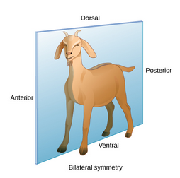
Animal Body Plan
An animal’s body plan limits its size, shape and ability to interact with the environment
Animals with an asymmetrical body plan are aquatic, sessile, filter feeders
Animals with a radial body plan are also aquatic but they are often motile and they either filter feeders or they actively search for food
They have no cephalization so their movement is not forward/backward oriented
Animals with a bilateral body plan can be aquatic, but it is important to keep in mind that all terrestrial animals have a bilateral body plan
They have cephalization so their movement is forward/backward
They are all motile and they all active search for food
Bilateral symmetry also means that an animal has an anterior, posterior, dorsal and ventral side

Slide 3
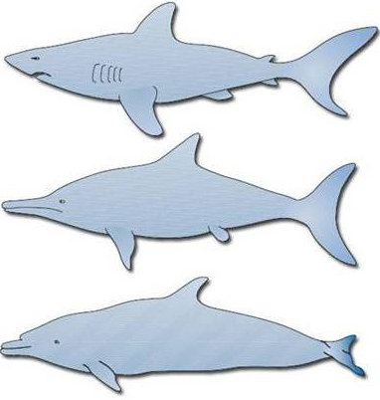
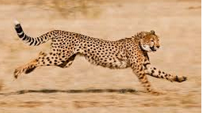
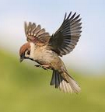
Bilateral Body Plan
Aquatic bilateral animals have a fusiform shape to minimize drag in water
Terrestrial animals are not constrained by drag since air is much less dense than water
Aquatic bilateral animals cannot swim as fast as the fastest land animals can run
Terrestrial animals are constrained by gravity
Birds have adaptations that make them light
Aquatic animals are not constrained by gravity

Slide 4
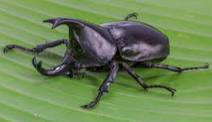
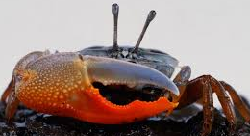
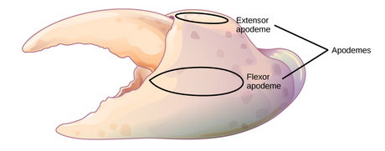
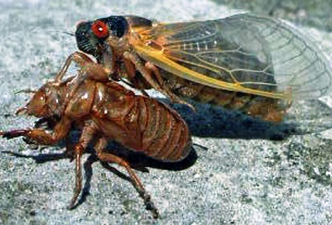
Animal Structural Support: Exoskeleton
Given that insects are the most populous of all bilateral animal species, we can say that most animals have an exoskeleton for support
An exoskeleton is a hard covering or shell that protects the animal and provides attachment sites for muscles
Exoskeletons are most often made of chitin or calcium carbonate
Ingrowths called apodemes are the sites of muscle attachment
Allow animals to move legs, claws, wings, etc.
To grow, these animals must molt
Having an exoskeleton limits an animals size
Doubling body size equals an 8x increase in weight

Slide 5
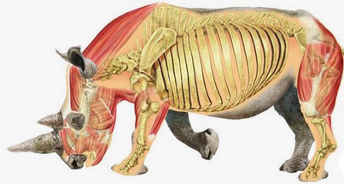
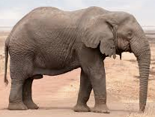
Animal Structural Support: Endoskeleton
All chordate animals have an endoskeleton
An endoskeleton is comprised of internal bone or cartilage that supports body weight and movement
Muscle attach to the endoskeleton to facilitate movement
Animals with an endoskeleton do not molt
They have determinant growth
As body size increases, bone and muscle increase
Speed and agility are a balance between body size and bone & muscle mass

Slide 6
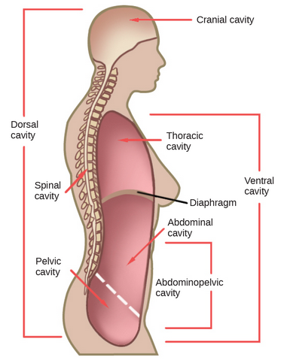
Animal Body Cavities
Bilateral animals have defined body cavities
The dorsal cavity contains two smaller cavities
Cranial cavity
Vertebral cavity
The ventral cavity contains several two smaller cavities
Thoracic cavity
Pleural cavity around the lungs
Cardiac cavity around the heart
Abdominopelvic cavity

Slide 7
Animal Bioenergetics
Animals obtain energy from the food they ingest
Carbohydrates, protein, and lipids are all converted to
ATP for immediate energy
Glycogen and fat for long-term energy storage
2nd Law of Thermodynamic states that energy cannot be converted from one form to another with 100% efficiency
In animals converting consumed macromolecules to ATP, glycogen or fat gives off energy in the form of heat
Animals use this heat to maintain thermal homeostasis
The amount of energy expended over a given time is called the Metabolic Rate (measured in joules or calories)
Basal Metabolic Rate in endotherms
Standard Metabolic Rate in ectotherms

Slide 8
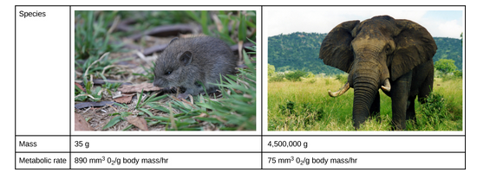
Body size and energy requirements
Small endotherms have greater surface area to body mass ratio than large endotherms
Small endotherms lose heat faster than large endotherms
Small endotherms have higher BMR than large endotherms
Per body weight
The more active an animal, the higher the BMR/SMR
The diet of an animal is determined by its BMR/SMR

Slide 9
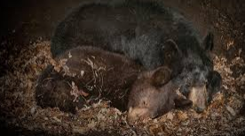
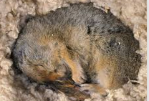
Environment and energy requirements
Animals in extreme environments adapt to seasonal temperature and/or food availability through torpor
Torpor is decreased activity and metabolism to conserve energy
Hibernation is a type of winter torpor
Animals hibernate during coldest time of year
Reduced body temperature
No food intake
Estivation is a type of summer torpor
Animals hibernate during times of extreme heat or decreased water availability
Desert animals hibernate during hottest time of year
Torpor can occur on a daily basis to help animals avoid the hottest or coldest times of the day

Slide 10
Animal Primary Tissues
Animals have four primary tissue types:
Epithelial
Connective
Muscle
Nervous
Similar tissue types combine to form organs and organs that perform similar functions are organized into organ systems
Digestive system consists of organs such as stomach, intestines, pancreas, and liver
All the organ systems working together create the organism

Slide 11
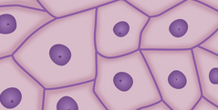
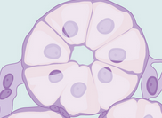
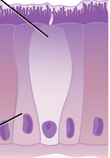
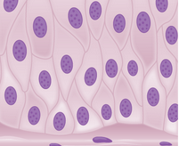
Epithelial Tissues
Epithelial tissues cover the outside of the animal and the outside of organs
They are classified by the cell shapes and the number of cell layers
Simple epithelial tissues are a single layer of cells
Stratified epithelial tissues are composed of multiple layers of cells

Slide 12
Connective Tissues
Connective tissue is a matrix of living cells and the nonliving substrate to which they are attached
The main cell type is a fibroblast
There are three different fiber types:
Collagen - strength
Elastic - flexibility
Reticular – protein
Examples:
Blood vessels, tendons, ligaments, bone, fat, blood

Slide 13
Muscle Tissues
Animals have three different types of muscle tissue:
Smooth
Skeletal
Cardiac
Muscle movement can be either voluntary or involuntary
Smooth muscle
Involuntary
Blood vessels, digestive tract
Reproductive tubes
Skeletal muscle
Voluntary
Muscles that move bones
Cardiac muscle
Involuntary
Muscles of the heart

Slide 14
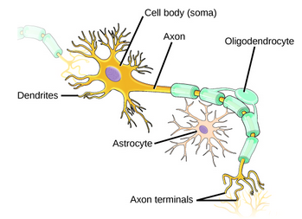
Nervous Tissues
Nervous tissues are able to receive and transmit electrical impulses to and from specific areas of the body
Main cell is a neuron
The large cell in a neuron is the cell body
Has central nucleus
Projections from cell body are:
Dendrites – receive impulses
Axons – transmit impulses
Two types of glial cells
Astrocytes – regular chemical environment
Oligodendrocytes – insulate axon for better transmission
An individual nerve has both neurons and glial cells

Slide 15
Epithelial Tissues
Epithelial tissues cover the outside of the animal and the outside of organs
They are classified by the cell shapes and the number of cell layers
Simple epithelial tissues are a single layer of cells
Stratified epithelial tissues are composed of multiple layers of cells

Slide 16
Connective Tissues
Connective tissue is a matrix of living cells and the nonliving substrate to which they are attached
The main cell type is a fibroblast
There are three different fiber types:
Collagen - strength
Elastic - flexibility
Reticular – protein
Examples:
Blood vessels, tendons, ligaments, bone, fat

Slide 17
Muscle Tissues
Animals have three different types of muscle tissue:
Smooth
Skeletal
Cardiac
Muscle movement can be either voluntary or involuntary
Smooth muscle
Involuntary
Blood vessels, digestive tract
Reproductive tubes
Skeletal muscle
Voluntary
Muscles that move bones
Cardiac muscle
Involuntary
Muscles of the heart

Slide 18
Nervous Tissues
Nervous tissues are able to receive and transmit electrical impulses to and from specific areas of the body
Main cell is a neuron
The large cell in a neuron is the cell body
Has central nucleus
Projections from cell body are:
Dendrites – receive impulses
Axons – transmit impulses
Two types of glial cells
Astrocytes – regular chemical environment
Oligodendrocytes – insulate axon for better transmission
An individual nerve has both neurons and glial cells

Slide 19
Animal Homeostasis
Animals have to constantly adjust their internal environment in response to their external environment
Called Homeostasis
Ensures body functions are maintained within specific ranges
All internal functions have a set point which is the homeostatic equilibrium
The body tries to maintain the set point
Homeostasis is controlled by Negative Feedback Loops
Positive Feedback Loops push the body further away from homeostasis

Slide 20
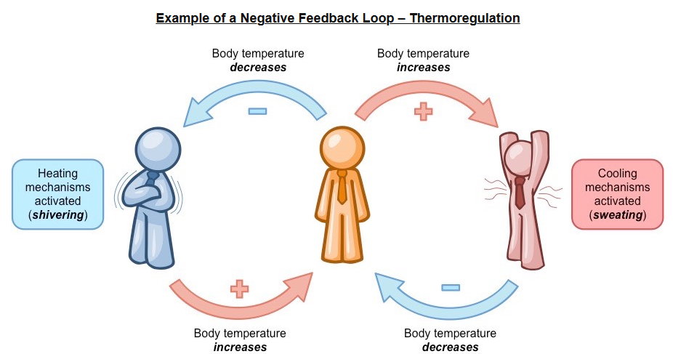
Negative Feedback Mechanism (Loop)
Negative Feedback Mechanism
Changes the direction of the stimulus (back towards the set point)
Maintains set point
Can increase or decrease stimulus
Thermoregulation
If core body temp decreases – animal shivers to produce heat
If core body temp increases – animal pants/sweats to remove heat

Slide 21
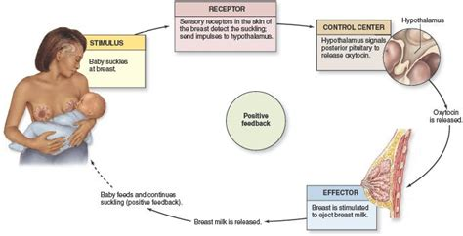
Positive Feedback Mechanism (Loop)
Positive Feedback Mechanism
Maintains the direction of the stimulus (pushes it further away from the set point)
Does NOT maintain the set point
Can increase or decrease stimulus
Lactation (producing milk)
Suckling by baby stimulates brain to release prolactin hormone
Prolactin stimulates mammary glands to produce milk
Milk production encourages baby to suckle
Suckling stimulates brain to release prolactin

Slide 22
Homeostasis and Thermoregulation
Ectothermic animals do not use metabolism to maintain their body temperature
They bask in the sun to raise body temperature or move away from the sun to lower body temperature
Endothermic animals use metabolism to maintain their body temperature
They can shiver to increase temperature or sweat/pant to decrease temperature
Homeothermic animals, whether endotherms or ectoderms, maintain a constant body temperature
Poikilothermic animals, whether endotherms or ectotherms, allow their body temperature to fluctuate depending on the environment

Slide 23
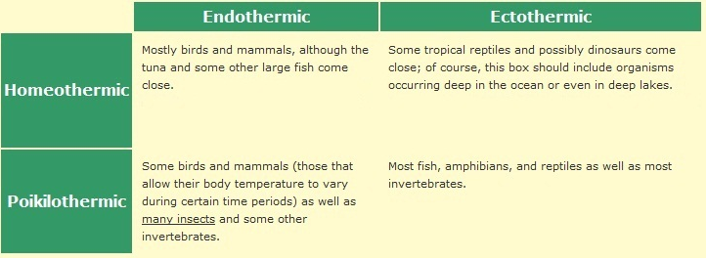
Homeostasis and Thermoregulation

