Slide 1
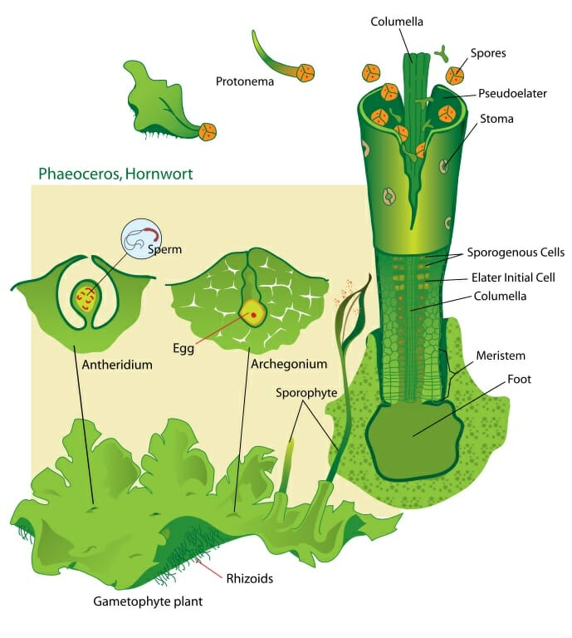
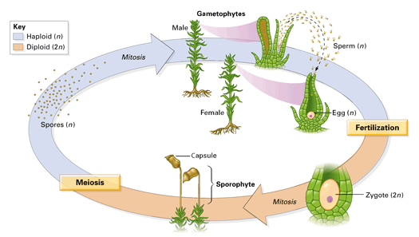

Slide 2
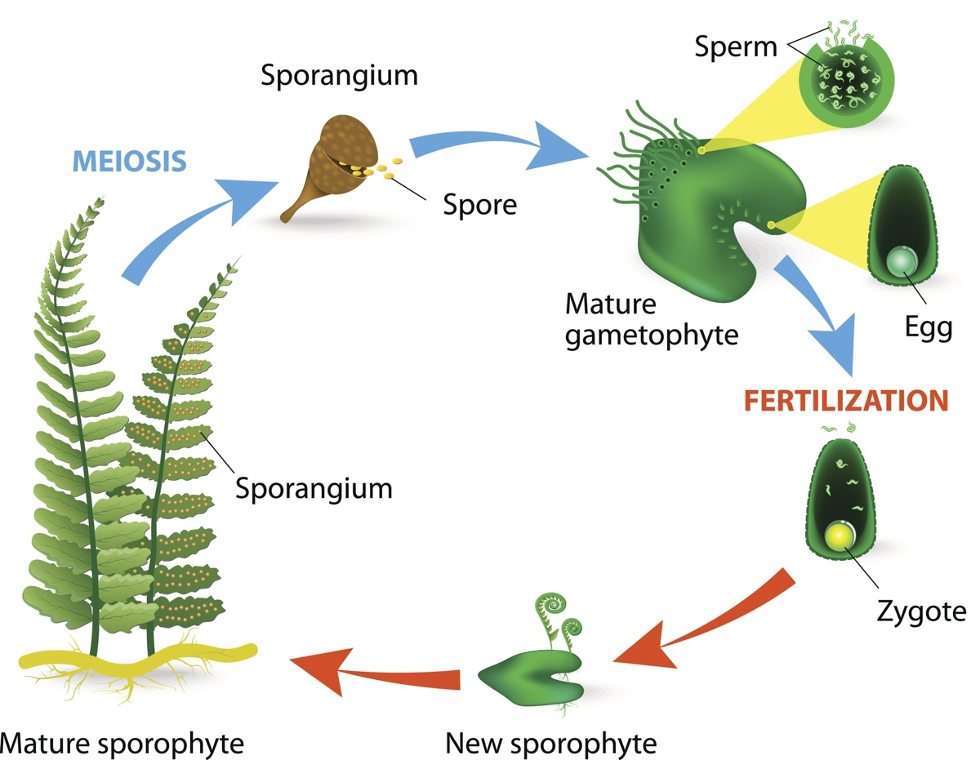

Slide 3
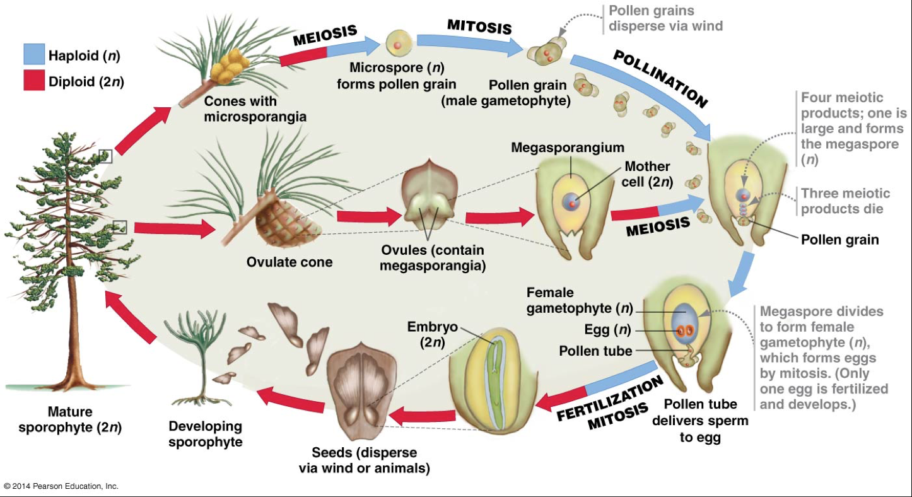

Slide 4
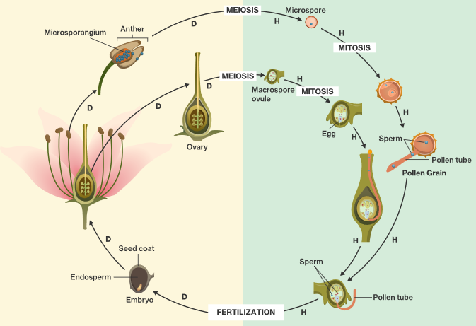
A
B
D
Megaspore
C

Slide 5
iClicker Question 2
A
Which of the following correctly describes letter B?
Diploid microspore undergoing meiosis to create haploid gametophyte
Haploid microspore undergoing mitosis to create haploid gametophyte
Haploid pollen undergoing mitosis to create generative cell and pollen tube cell
Diploid microspore undergoing mitosis to create haploid sperm
B
D
Megaspore
C

Slide 6
