Slide 1
Plant Reproduction
Chapter 31

Slide 2
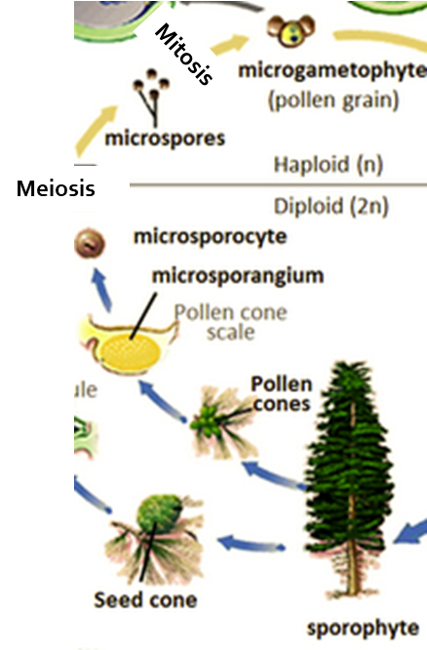
Gymnosperm Male Gametophyte
Male pollen cone contains microsporangia
Microsporangia are diploid (2n) and contain microsporocytes
Diploid cells that divide via meiosis to produce 4 haploid microspores
Each microspore “germinates” via mitosis to become the male gametophyte
Pollen
Each pollen grain contains two haploid cells
Pollen tube cell and generative cell

Slide 3
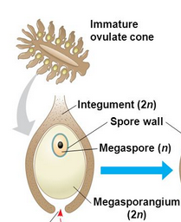
Gymnosperm Female Gametophyte
Female cone contains megasporangia
Megasporangia are diploid (2n) and contain megasporocytes
Diploid cells that divide via meiosis to produce 4 haploid megaspores
Only one megaspore “germinates” to become the female gametophyte
Other three become archegonium

Slide 4
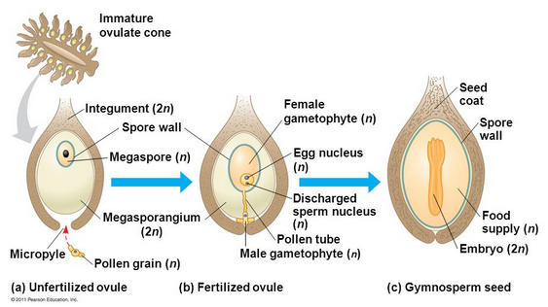
Gymnosperm Fertilization
Pollen grain lands on female cone
Tube cell germinates towards female gametophyte, creating pollen tube
Generative cell divides via mitosis to produce 2 sperm cells
1 fuses with egg
Gametophyte tissue becomes nutrition for embryo
Seed coat is from parent sporophyte (tree)
Embryo is new sporophyte

Slide 5
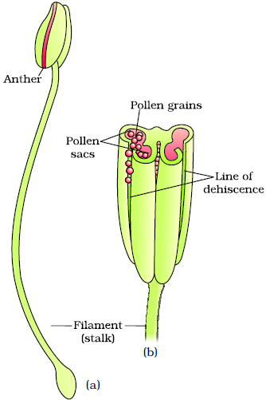
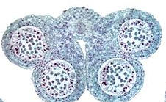
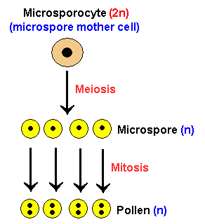
Angiosperm Male Gametophyte
Male flower is the stamen
Filament and anther
Anther contains microsporangia
Microsporangia are diploid (2n) and contain microsporocytes
Diploid cells that divide via meiosis to produce haploid (n) microspores
Each microspore “germinates” via mitosis to become the male gametophyte
Pollen
Each pollen grain contains two haploid cells
Pollen tube cell and generative cell

Slide 6
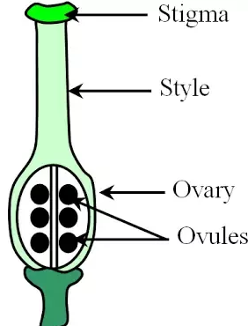
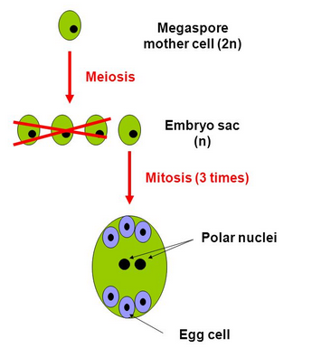
Angiosperm Female Gametophyte
Female flower is the carpel
Stigma, style, and ovary
Ovary contains megasporangia
Megasporangia are diploid (2n) and contain megasporocytes
Diploid cells that divide via meiosis to produce 4 haploid (n) megaspores
Only one megaspore lives
It “germinates” via mitosis to become female gametophyte
Megasporangia

Slide 7
Angiosperm Female Gametophyte
Megaspore divides 3 times via mitosis but without cytokinesis to produce 7 cells with 8 nuclei
3 cells migrate to the top pole and become anti-podal cells
3 cells migrate to bottom pole and become the egg and 2 synergids
The center cell contains 2 nuclei, called polar nuclei

Slide 8
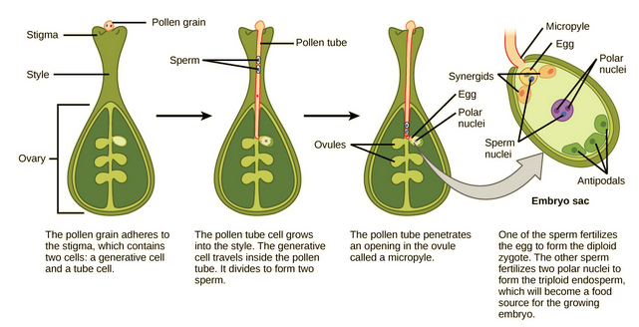
Life Cycle of an Angiosperm: Double Fertilization
When pollen attaches to the stigma, the pollen tube cell germinates from the pollen grain down through the style, and enters the ovule through the micropyle
While pollen tube is germinating, generative cell undergoes mitosis to produce 2 haploid sperm
Two sperm are deposited in the embryo sac
Double fertilization occurs
1 sperm and the egg fuse to form the diploid zygote (embryo seed)
1 sperm fuses with the 2 polar nuclei cell to form a triploid cell that will become the endosperm
Nutritive tissue for the embryo

Slide 9
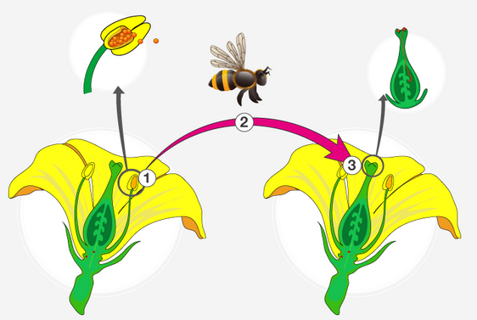
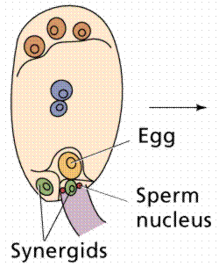
Pollination
Pollination is transfer of pollen from male to female
Gymnosperms, from male cone to female cone
Angiosperms, from male anther to female stigma
Fertilization is male sperm fusing with female egg
Plants have two types of pollination
Self-pollination
Transfer of pollen from male to female on same plant
Gymnosperms: male cone to female cone on same tree
Angiosperms: male flower to female flower on same plant
Cross-pollination
Transfer of pollen from male of one plant to female of a different plant

Slide 10
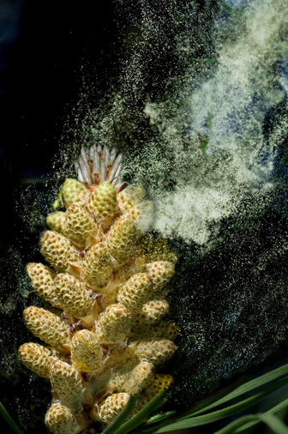
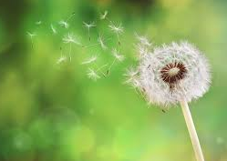
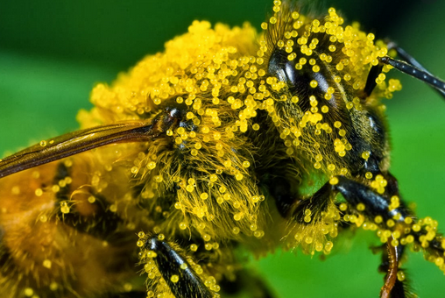
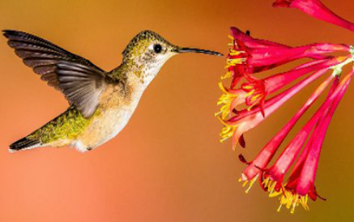
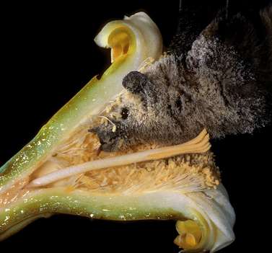
Pollination
Gymnosperms have only wind pollination
Angiosperms have
Wind pollination
Insect pollination
Bird pollination
Bat pollination

Slide 11
Asexual Reproduction
No investment of flower production, pollinator attraction, etc.
Offspring genetically identical to parent
Beneficial in an unchanging environment
Many root/stem modifications are for asexual reproduction
Bulbs - lily
Tubers - potato
Corms - garlic
Rhizomes/stolons – ginger, strawberries

