Slide 1
Plant structure and function
Chapter 30

Slide 2
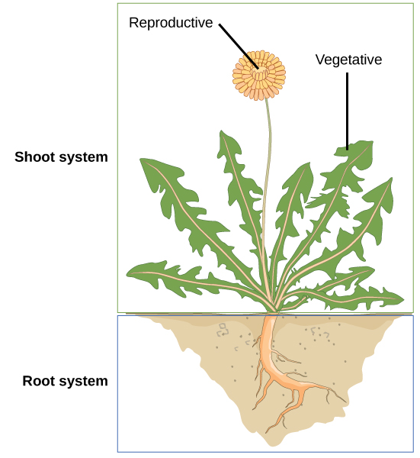
The Plant Body
Plant Organ Systems
Shoot system
Above ground
Vegetative
Stems and leaves
Photosynthesis
Reproductive
Flowers and fruits
Root system
Underground
Absorbs water and minerals
Provides structural support to the plant

Slide 3
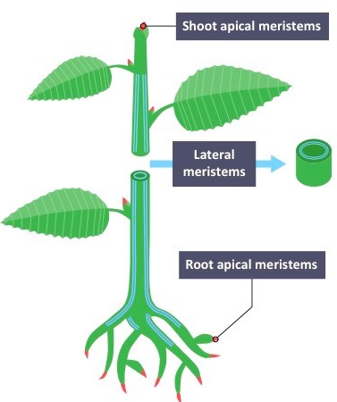
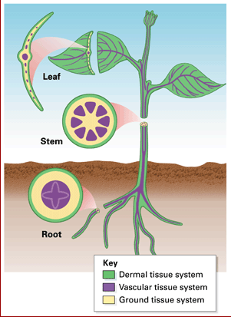
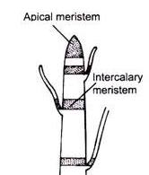
The Plant Body
Plant Tissue Systems
Non-meristematic tissue (permanent tissue)
Non-dividing, differentiated cells
Meristematic tissue
Actively dividing, undifferentiated cells
Apical meristem
Vertical growth
Lateral meristem
Growth in thickness
Intercalary meristem
In monocots, allows leaves to grow from the base
Meristematic tissue differentiate into one of three tissue types:
Dermal
Outer later that covers the plant
Vascular
Conducts water and sugars
Ground tissue
Site of photosynthesis, support, storage

Slide 4
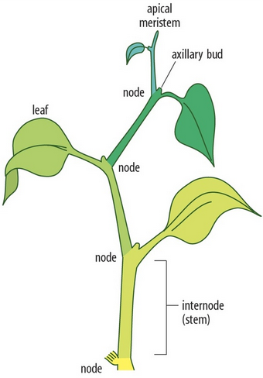
Plant Stems
Part of the Shoot System
Can be herbaceous (soft) or woody
Provide support to the plant, hold the leaves and flowers/fruit
May be unbranched or branched
Connects to Root System
Has nodes and internodes
The stem of the leaf is called the petiole
An axillary bud is typically located between the petiole and node

Slide 5
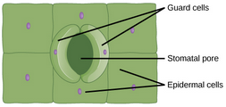
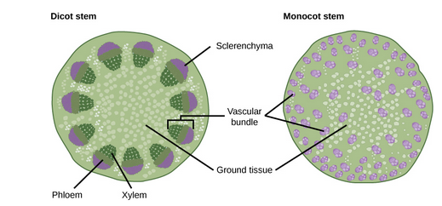
Stem Anatomy
Stems have all three tissue types
Dermal tissue
Epidermis
Single layer of cells
Cover/protect plant
Have stomata for gas exchange
Each stoma is surrounded by two guard cells
Control opening/closing
Vascular tissue
Xylem and Phloem in vascular bundle
Monocots – scattered
Eudicots – arranged in a ring
Vascular bundles in perennial plants grow together to form growth ring
Ground tissue
Interior of vascular tissue
Functions as storage/support

Slide 6
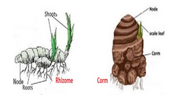
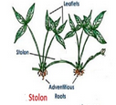
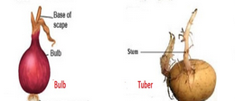
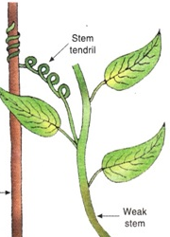
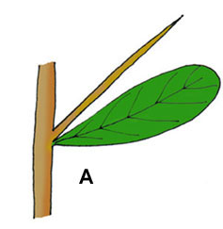
Stem Modifications
Some plants have modified stems
Underground modifications have two purposes:
Growth:
Rhizomes
Corms
Stolons
Storage
Tubers
Bulbs
Ariel modifications
Tendrils
For structural support
Thorns
protection

Slide 7
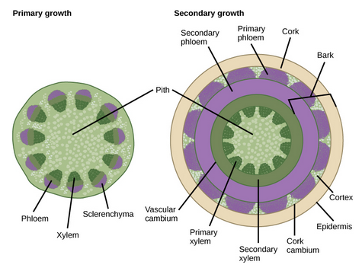
Primary and Secondary Stem Growth
Primary growth is vertical growth at shoot/root apical meristem
Secondary is growth in thickness due to lateral meristem
Only in woody plants
Vascular cambium located in between primary xylem and phloem
Divide to form secondary xylem/phloem
These cells reach the outer portion of the width of the plant
Secondary xylem cells contain lignin
Cork cambium
Outside vascular cambium
Creates cork cells with suberin
Seasonal growth of vascular cambium forms annual rings

Slide 8
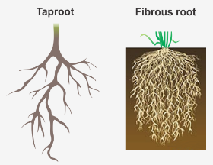
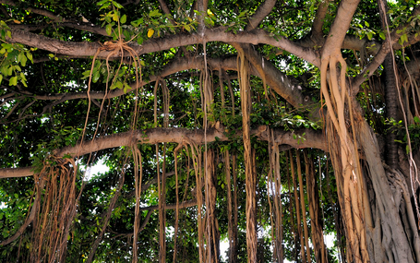
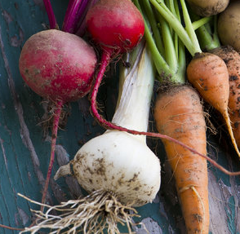
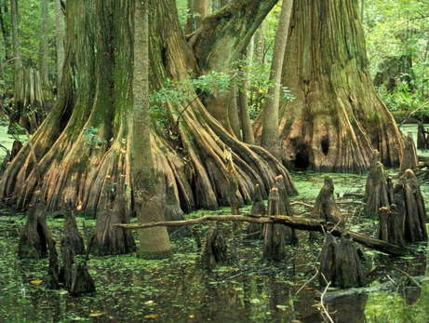
Plant Roots
Two types of roots
Monocots have fibrous root system
Close to the surface
Dense network of roots
Eudicots have tap root system
Main root that grows deep into soil
Lateral fibrous roots grow off tap root
Root modifications have two purposes
Underground storage
Carrots, parsnips, beets
Ariel roots for support /anchoring
Maybe for gas exchange?

Slide 9
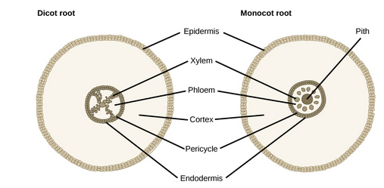
Root Anatomy
Roots have all three tissue types
Dermal tissue
Epidermis
Single layer of cells
Protect plant
Absorption of water
Root hairs increase surface area
More absorption
Vascular tissue
Vascular bundles located at the center of root
Monocots arranged in ring
Eudicots arranged in X shape
Ground tissue
Located between epidermis and vascular tissue
Used for storage, no photosynthesis

Slide 10
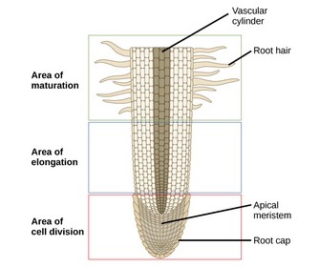
Primary Root Growth
Seed germinates and radicle becomes root system
Root tip is protected by root cap
Root is divided into three zones:
Cell Division
Closest to root tip
Actively dividing cells
Root growth
Elongation
Cells increase in length
Increases root length
Maturation
Where cells differentiate into specific types
Begins where first root hair emerges from root

Slide 11
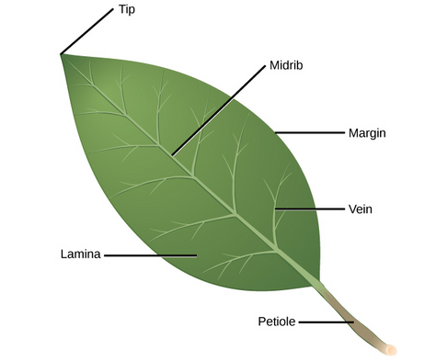
Leaf Structure
Leaf blade is called lamina
Lamina is connected to petiole which connects to stem
Outer edge of leaf is the margin
Midrib extends from petiole to leaf tip
Vascular tissue
Branches to form veins
Venation pattern
Monocots have parallel venation
Eudicots have reticulated venation

Slide 12
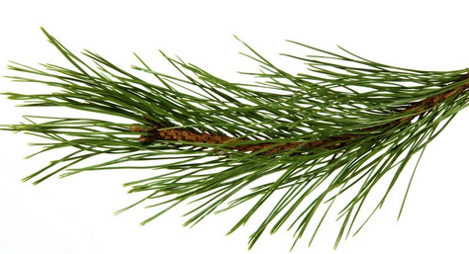
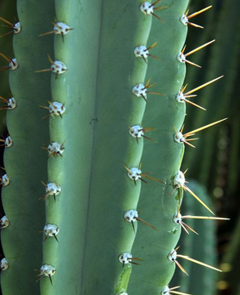
Leaf Structure Adaptations
Cold environment adaptations
Leaves are reduced in size and are needle shaped in conifers
Less surface area
Sunken stomata
Reduced water loss
Snow does not build up
Protects stems from breaking
Desert adaptations
Leaves are reduced to spines and have no chloroplasts
Defense
Stems are succulent and contain more chloroplasts
Aid in water conservation

Slide 13
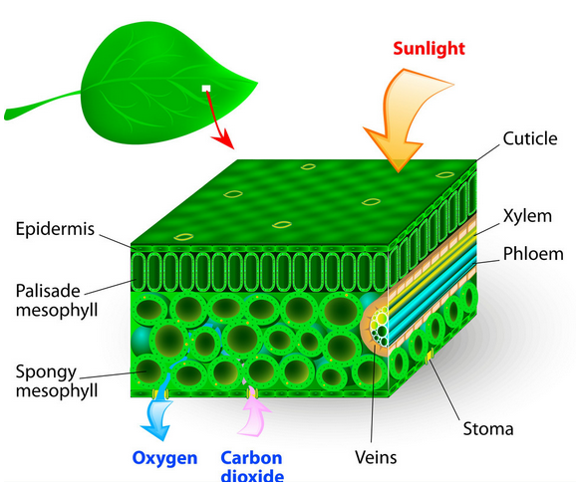
Leaf Anatomy
Leaves have all three tissue types
Dermal tissue
Epidermis
Single layer of cells on top and bottom of leaf
Cover/protect plant
Have stomata for gas exchange
Each stoma is surrounded by two guard cells
Control opening/closing
Ground tissue
Mesophyll tissue right below epidermis
Two types of mesophyll, both have chloroplasts
Palisade parenchyma
Vertical column shaped cell, tightly packed
Spongy parenchyma
Irregular shaped cell, loosely packed
Allows gas exchange
Vascular tissue
Xylem and Phloem in vascular bundle
Xylem comprised of vessel cells and tracheid cells

Slide 14
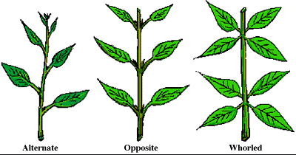
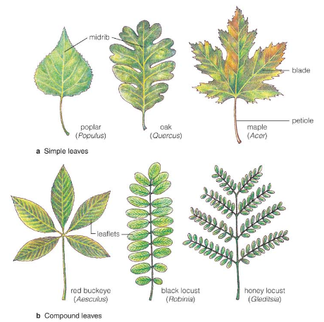
Leaf Arrangement and Form
Leaf Arrangement
Alternate: One leaf per node
Opposite: Two leaves per node
Whorled: Three or more leaves per node
Leaf Form
Simple leaf
Undivided leaf blade
Leaf blade divided into lobes but lobes do not touch midrib
Compound leaf
Completely divided leaf blade
Forms leaflets
Palmate
Leaflets branch from petiole
Pinnate
Leaflets branch from midrib

