Slide 1
Seed PLants
Chapter 26

Slide 2
Seed Plant Adaptations
Reproduction is not water-dependent
Sporophyte phase is dominant
Heterosporous
Megaspores (female, produce egg) and microspores (male, produce sperm)
Seeds
Female gametophyte: produces haploid egg and provides protection, nourishment to embryo
Pollen
Male gametophyte: produces and protects haploid sperm
These adaptations allowed seed plants to be most successful plants on Earth

Slide 3
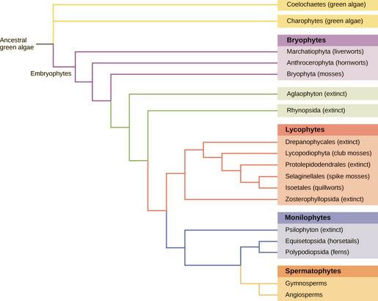
Seed Plant Phylogeny
Gymnosperms and Angiosperms are sister taxa
Gymnosperms (“naked seed”) appeared 390 mya
Conifers, Cyads, Gingkophytes, Gnetophytes
Angiosperms (“seed in a vessel”) appeared 200 mya
All flowering plants
Fertilization and embryo development occur inside plant ovary (fruit)
Mutualistic relationships with pollinators
Mutualistic relationships with animals as seed distributors

Slide 4
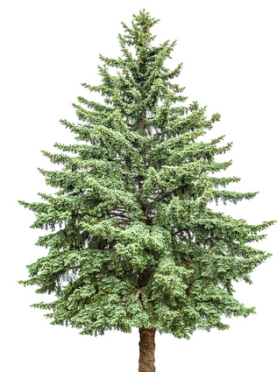
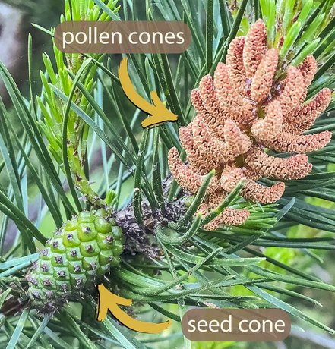
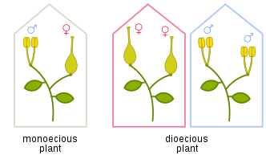
Gymnosperms
Naked seeds
Sheltered by woody leaves called sporophylls
Male and female gametes on separate organs (cones)
If male and female cones are on same plant, then it is
Monoecious (“one home”): male and female cones on same plant
Dioecious (“two homes”): male cones on one plant, female cones on separate plant
Pollination by wind
Tracheids
Perforated, lignified cells that transport water/minerals
Dominant xylem cell in gymnosperms
Adapted to live without water for part of the year
Can live in cold, dry regions
Conifers, Cycads, Gingkophytes, Gnetophytes

Slide 5
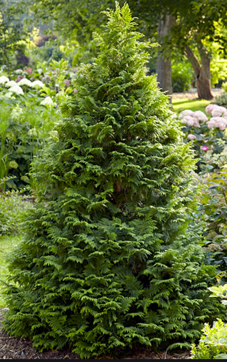
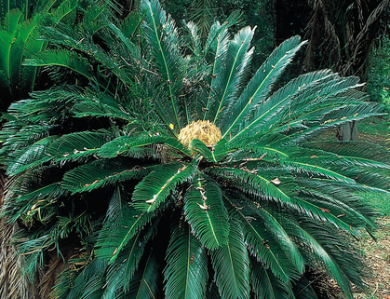
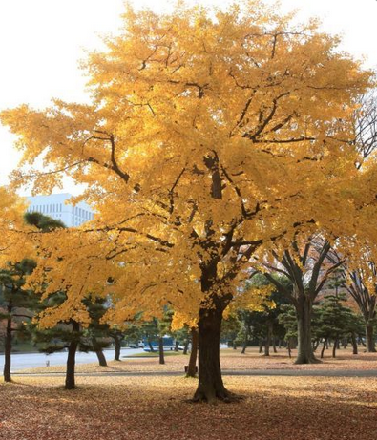
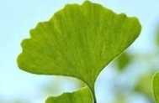
Gymnosperm Diversity
Conifers
Dominant phylum of gymnosperms
Reduce leaf shaped like needle
Adapted to cold, dry weather
Live at high altitudes
Cycads
Dominant during prehistoric times
Mistaken for palms (Sago palm)
Live in mild climates
Gingkophytes
Only one surviving species, Gingko biloba
Fan-shaped leaf
Gnetophytes
Unresolved phylogeny
Inhabit arid desert regions around the world

Slide 6
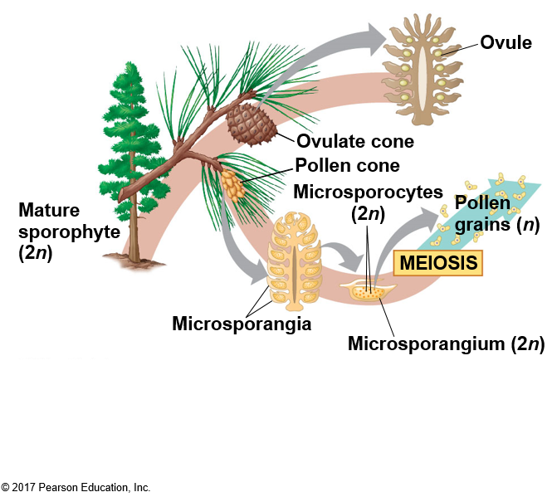
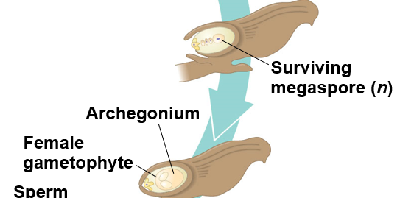
Life Cycle of a Conifer
The tree is the sporophyte (2n)
Heterosporous
microsporangia produce male microspores
megasporangia produce female megaspores
Microsporangia are located on small male pollen cones
Megasporangia are located on large female ovulate cones
Microsporocytes are diploid (2n) cells within the microsporangium
Produce haploid microspores via meiosis
These give rise to the male gametophyte, also called pollen
Pollen grains have two haploid cells surrounded by sporopollenin
Generative cell and pollen tube cell
Megasporocytes are diploid (2n) cells within the megasporangium
Produce 4 haploid cells via meiosis
Only one survives to become the megaspore which becomes the female gametophyte

Slide 7
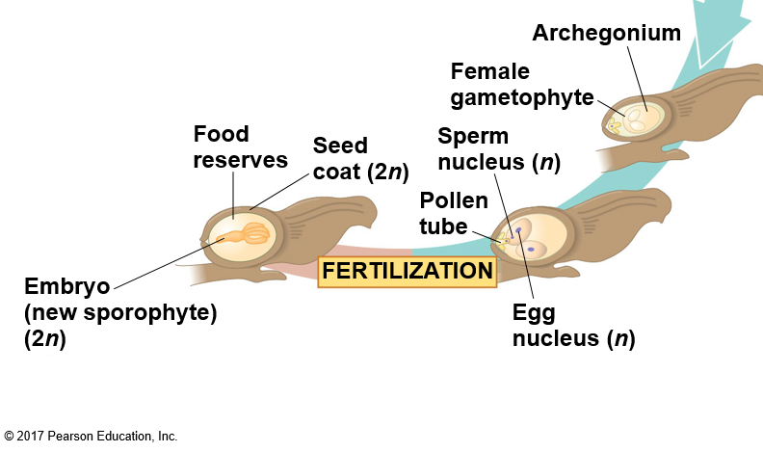
Conifer Fertilization
When the pollen grain lands at the base of the female scale, one haploid cell germinates towards the female gametophyte via the micropyle, creating a pollen tube
As the pollen tube grows, the generative cell in the pollen produces two haploid sperm via mitosis
One of the haploid sperm will fuse with the haploid egg
The diploid egg, now an embryo, will divide via mitosis to become the seed
It is enclosed in a seed coat from sporophyte tissue
The seed contains three generations of tissue:
Seed coat from the sporophyte
Nutritive tissue from the gametophyte
Embryo tissue (the new sporophyte)
This process takes up to two years!

Slide 8
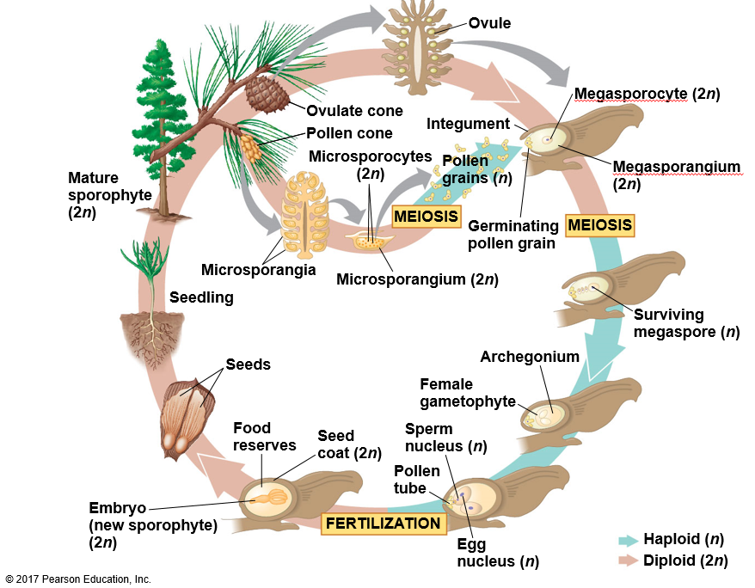
Conifer Reproduction

Slide 9
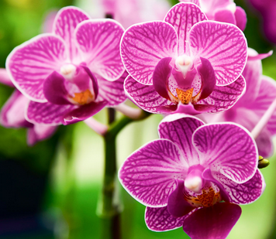
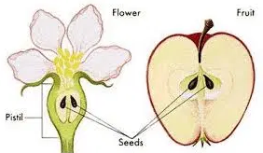
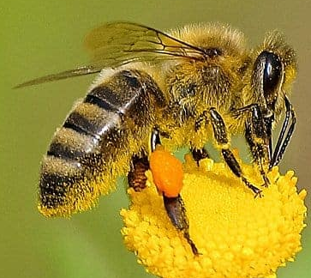
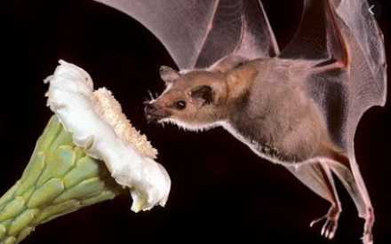
Angiosperms
Dominant terrestrial plant group
Two novel adaptations:
Flowers
Ensures pollination and protects embryo (seed)
Fruit
Embryo (seed) protection and dispersal
Can be monoecious or dioecious
Pollination by wind, insects, mammals
Vessel cells in xylem tissue
More efficient than tracheids at conducting water

Slide 10
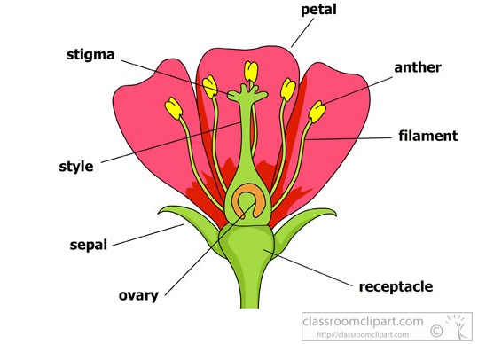
Angiosperm Flowers
Modified leaves organized around a central receptacle
Sepals, petals, carpels, and stamen
Sepals are photosynthetic (often green)
Petals display variety of colors to attract pollinators
Carpel is called gynoecium, female sex organ
Stigma, style, ovary
Stamen is called androecium, male sex organ
Anther, filament
Perfect flower have carpels and stamen
Monoecious
Imperfect flowers have carpels OR stamen
Dioecious

Slide 11
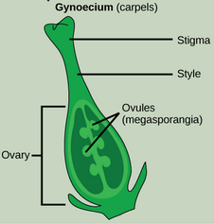
Gynoecium
The gynoecium is the innermost part of the flower where the egg will form
carpel
Plants can one or more carpels
Each carpel consists of a stigma, style, and ovary
Stigma is where pollen is deposited
Sticky surface to trap pollen
Style is the tube through which the pollen tube will grow
The ovary contains one or more ovules
Megasporangia
Each will eventually develop into a seed

Slide 12
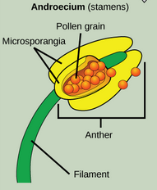
Androecium
The androecium are the stamen that surround the carpel
Stamen consist of filament and a anther
The filament is the thin stalk that supports the anther
The anther is sac-like structure where microsporangia are located
They will produce microspores which will develop into pollen grains

Slide 13
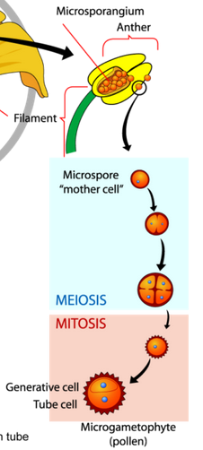
Life Cycle of an Angiosperm: Pollen production
The tree is the sporophyte (2n)
Heterosporous so microsporangia produce male microspores and megasporangia produce female megaspores
Microsporangia are located in the anthers
Microsporocytes are 2n cells within the microsporangium
Produce haploid microspores via meiosis
These give rise to the male gametophyte, also called pollen
Pollen grains have 2 haploid cells surrounded by sporopollenin
1 cell becomes the pollen tube cell
1 cell divides via mitosis to form two haploid sperm

Slide 14
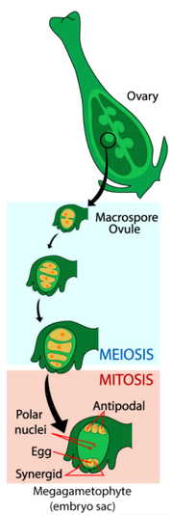
Life Cycle of an Angiosperm: Egg production
The tree is the sporophyte (2n)
Heterosporous so microsporangia produce male microspores and megasporangia produce female megaspores
Megasporangia are located in the ovule
Megasporocytes are 2n cells within the megasporangium
Produce 4 haploid megaspores via meiosis
Only the largest one survives to become the female gametophyte
It divides three times via mitosis to produce eight nuclei distributed among seven cells
Three cells are located at each pole of the embryo sac (this accounts for 6 of the 7 cells)
Three cells at one pole become the egg and 2 synergids (helper cells)
Three cells at the other pole become antipodal cells
The center cell contains two nuclei (polar nuclei), will become endosperm
So, the mature embryo sac contains:
1 egg, 2 synergids, 3 antipodal cells that degenerate and a central cell with 2 nuclei

Slide 15
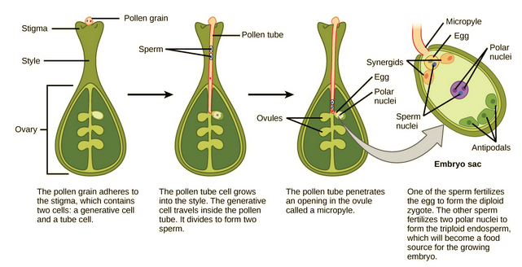
Life Cycle of an Angiosperm: Double Fertilization
When pollen attaches to the stigma, the pollen tube cell germinates from the pollen grain down through the style, and enters the ovule through the micropyle
Two sperm are deposited in the embryo sac
Double fertilization occurs
1 sperm and the egg fuse to form the diploid zygote (embryo seed)
1 sperm fuses with the polar nuclei cell to form a triploid cell that will become the endosperm
Nutritive tissue for the embryo

Slide 16
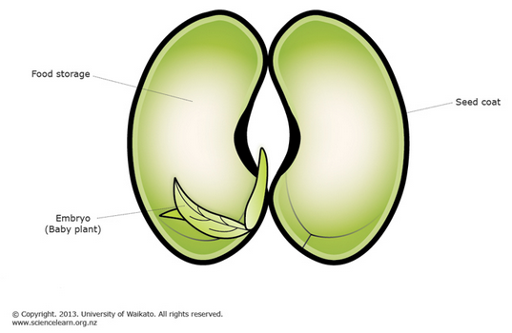
Life Cycle of an Angiosperm: The seed
The embryo seed develops to form a radicle (root) and either one or two leaf-like structures called cotyledons
The difference in the number of cotyledons is what separates the angiosperms into two groups:
Monocots (one cotyledon)
Eudicots (two cotyledons)
The seed itself has a tough outer layer called the seed coat, the endosperm food reserves for the embryo, and the embryo.

Slide 17
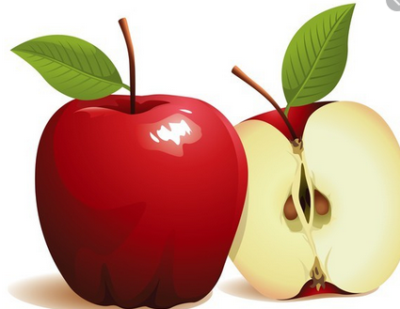
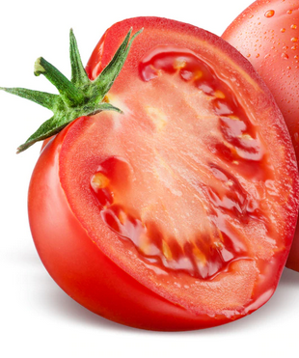
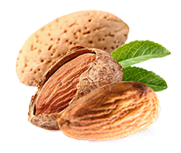
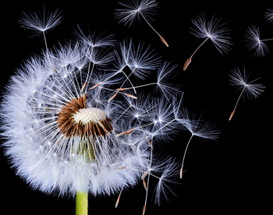
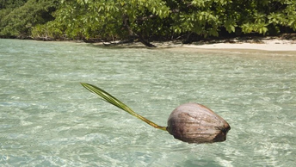
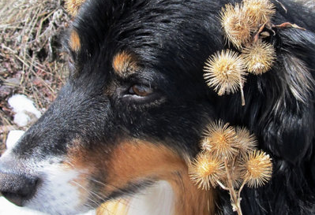
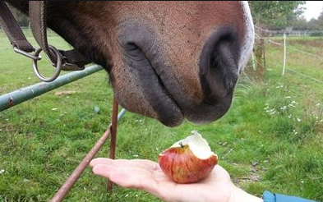
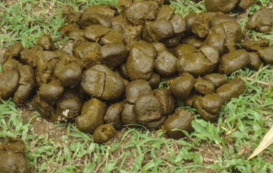
Life Cycle of an Angiosperm: The fruit
The walls of the ovary thicken to form the fruit
The seed is inside the ovary (fruit)
Fleshy fruits are berries, apples, tomatoes, eggplant, etc.
Dry fruits are grains such as rice, wheat, and nuts
Fruits are adaptations for seed dispersal
Wind carries small, light fruit (dandelions)
Water carries floating fruits (coconuts, mangrove seeds)
Fruits with burrs get stuck on animal fur and are transported over distance
Fruits as food, animals eat the fruits, poop out the seeds

Slide 18
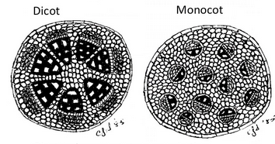
Diversity of Angiosperms
One phylum, Anthophyta
Three major groups:
Basal angiosperms (not going to cover these)
Monocots
Eudicots
Monocots and Eudicots have differences in;
Number of cotyledons
Type of flowers
Leaf venation
Type of roots
Location of vascular bundles
Vascular bundle: transport tissue structure with both xylem and phloem conductive tissue are present
Type of structural tissue

Slide 19
Monocots
One cotyledon
First leaf in seedling
Flower parts are in symmetry of 3 or 6
3 petals, 3 sepals
6 petals, 6 sepals
Leaf venation is parallel along the length of the leaf
Multiple, fibrous roots
Vascular bundles are scattered in stem and are organized in a ring in root
No true woody tissue
Woody tissue is secondary xylem – monocots do not have secondary xylem
Grasses, palms, rice, corn, banana, etc.

Slide 20
Eudicots
Two cotyledons
First leaves in seedling
Flower parts are in symmetry of 4 or 5
4 petals, 4 sepals
5 petals, 5 sepals
Or combination of 4, 5
Leaf venation is networked
One main tap root with smaller fibrous roots attached
Vascular bundles are organized in a ring in stem and root
Can have woody tissue
Woody tissue is secondary xylem – eudicots can have secondary xylem (wood)
Two-thirds of all angiosperms are eudicots
Apples, beans, oaks, roses, etc.

Slide 21
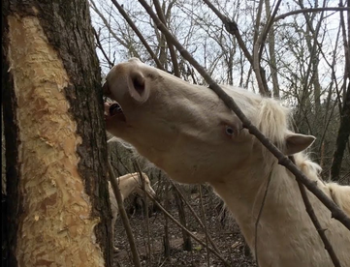
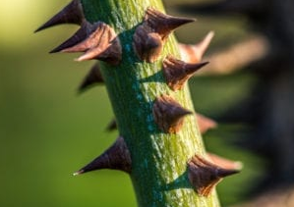
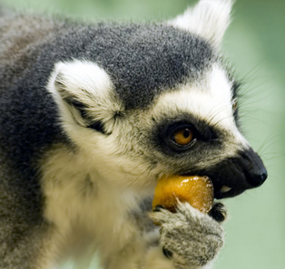
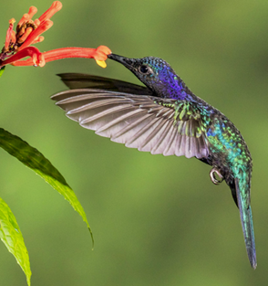
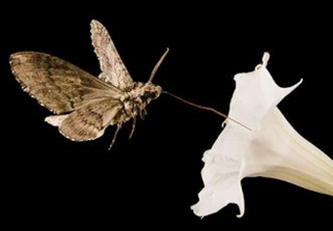
Angiosperms and Coevolution
Current hypotheses suggest that angiosperms and insects have evolved together over time
Herbivory of plants by insects and animals has contributed to coevolution
Examples of coevolution of herbivores and plant defenses strategies:
An evolutionary “arms race”
Unpalatable or toxic (animal taste buds change or they develop mechanisms to mitigate the toxin)
Thorns and spines (animals develop thick fur or long beaks)
Bark (animals develop strong teeth and jaws)
Plants also exploit animals!
Dispersal of seeds by herbivores – plants have evolved sweeter, juicier fruit to entice animals)
Pollination of plants by insects and other animals has also contributed to coevolution
80% of angiosperms depend on animals for pollination
Plants have evolved strategies for attracting animals to their flowers
Nectar and associated flower color
Fertile pollen and sterile pollen
These complex interactions have increased diversity in both plants and insects/animals

Slide 22
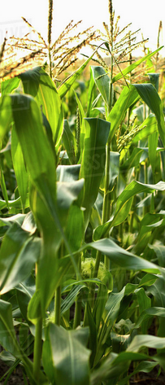
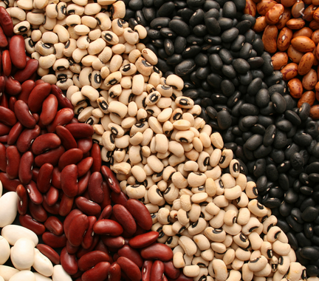
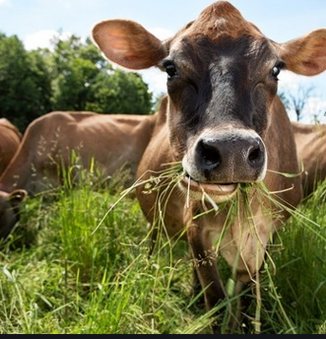
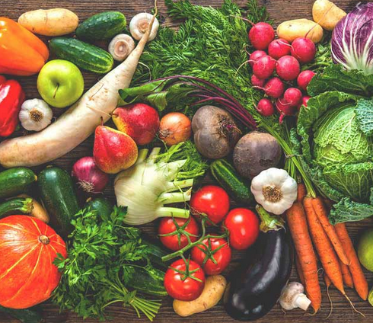
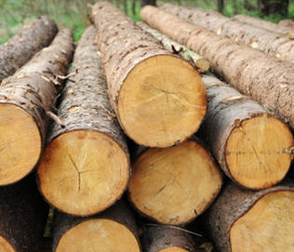
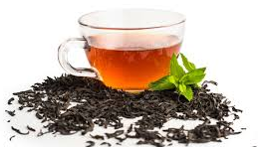
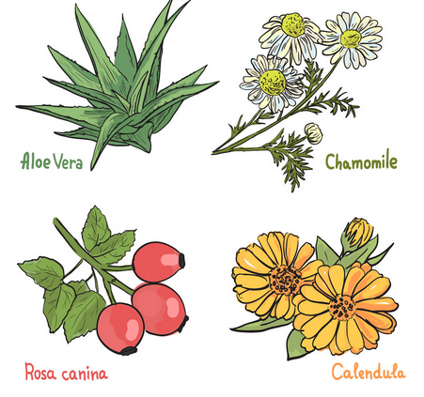
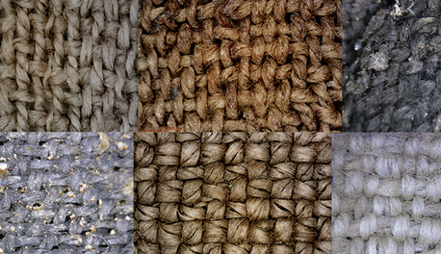
Seed Plants and Humans
100% of human diet is dependent upon seed plants
But, just a few staple crops are responsible for feeding the masses
Mostly “cereal” crops – high in carbohydrates
Rice, wheat, corn, potatoes
Beans, nuts, seeds provide protein and fats
Fruits and vegetables provide complex carbohydrates, vitamins, minerals, fiber
Leaves, flowers, and bark are dried and used in teas
Animals raised for human consumption eat plants
Wood provides structure and fuel and paper
Plant fibers are woven into cloth
Humans have used plants for medicinal purposes since for millennia

Slide 23
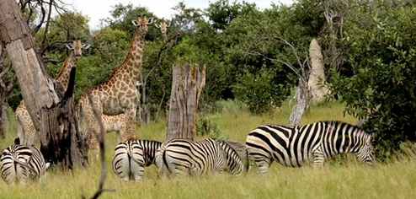
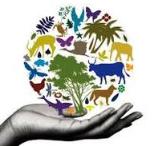
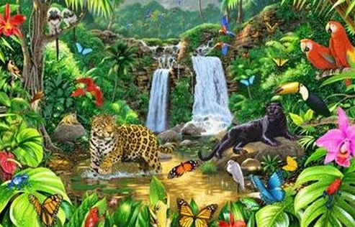
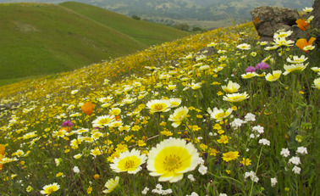
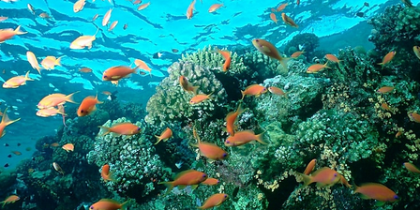
Plant Biodiversity
Provides for humans
Balances ecosystems
Protects and cleans water systems
Moderates climate
Provides shelter/food for animals
Plants and plant biodiversity are under attack
Human population keeps increasing
Need housing → more land developed
Need food → clearing wild lands to grow crops
Need energy → dams, increased drilling for oil, coal
Deforestation for wood
Plant extinction rate is high
Earth is an intricate system of interactions and balances
No plants = no animals = no humans

