Slide 1
Seedless PLants
Chapter 25

Slide 2
Aquatic Plants
No threat of desiccation
Water provides support – no need for structural support
Protected from UV rays – water filters rays
Gametes are transported through water
Gametes/Zygote not threatened with desiccation

Slide 3
Terrestrial environment
Disadvantages
Advantages
Threat of desiccation
UV rays
No structural support
Reproduction is water-dependent
Zygote is water-dependent
Sunlight is abundant
Carbon dioxide is abundant
No competitors for resources
No predators

Slide 4
First terrestrial plant strategies:
Live near water!
Develop tolerance to desiccation
Colonize humid environments
Stay small
Develop mechanism to protect against UV rays
Time
Natural selection will act on genetic variation present and select for beneficial traits

Slide 5
Adaptations to terrestrial life
Alternation of generations life cycle
Sporophyte stage that produces spores and a gametophyte stage that produces gametes
Apical meristem in roots and shoots
Allows vertical growth
Waxy cuticle on leaves and stem
Prevents desiccation
Lignin in vascular tissues (only present in vascular plants)
Structural support
Sporopollenin
Protects spores/pollen from desiccation

Slide 6
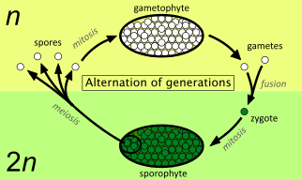
Alternation of Generations
All sexually reproducing organisms have diploid and haploid stages
In humans, our diploid stage is our multicellular body and our haploid stage is our unicellular gametes
Plants have multicellular diploid and haploid stages
Alternation of Generations describes the life cycle of organisms that have multicellular diploid and haploid stages
Multicellular, haploid gametophyte stage produces gametes via mitosis
Multicellular, diploid sporophyte stage produces spores via meiosis

Slide 7
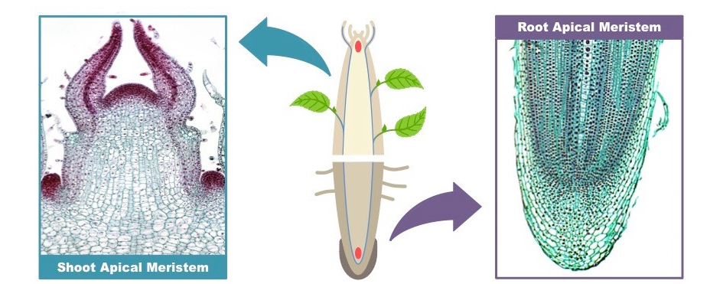
Apical Meristems
Meristem tissue is undifferentiated cells that continue to divide via mitosis
Meristem cells can develop into any type of cell
Similar to stem cells in animals
Apical meristems are located in the shoot tip and the root tip of plants
Allows vertical upward growth and vertical downward growth
Upward growth of the shoot allows plants access to the sun
Downward growth of the root allows plants to access water/minerals
Shoot apical meristem
Root apical meristem

Slide 8
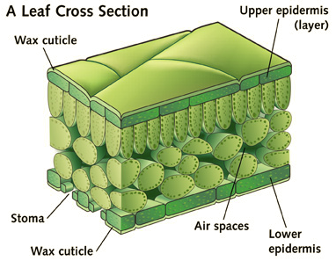
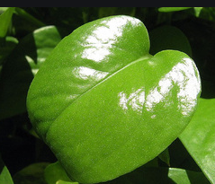
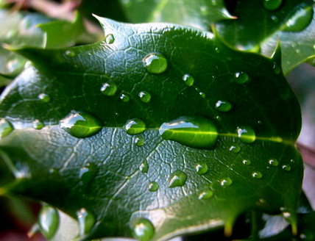
Waxy Cuticle
Epidermal tissue contains wax
Helps prevent water loss in land plants
Covers surface of leaves and stem

Slide 9
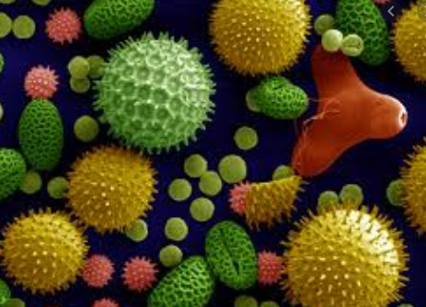
Sporopollenin
Biological polymer in plants
Most degradation resistant organic material
Makes up the cell wall in pollen and spores
Prevent desiccation of pollen, spores, and zygote

Slide 10
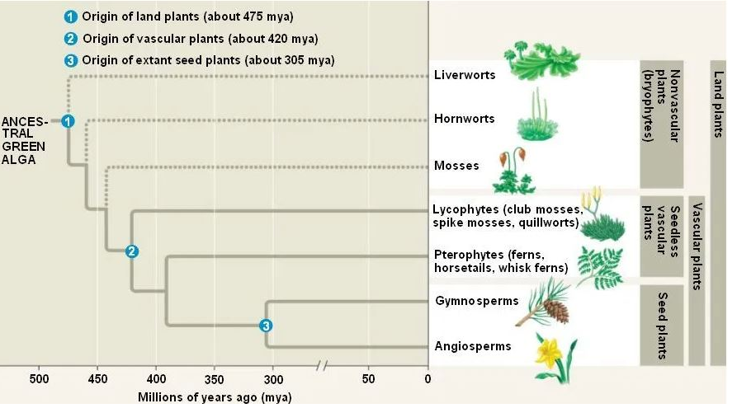
Nonvascular Seedless Plants
Bryophytes
Closest extant relative of earliest terrestrial plants
Nonvascular plants
No tracheids
Vascular tissue that transports water/minerals/products of photosynthesis
Liverworts, hornworts, mosses
Dominant Gametophyte (n) stage
Sporophyte (2n) is dependent

Slide 11
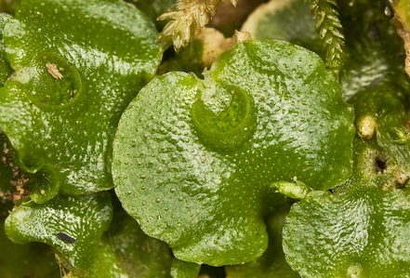
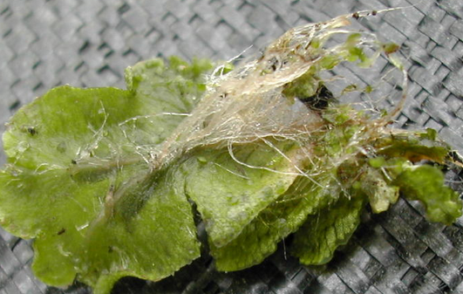
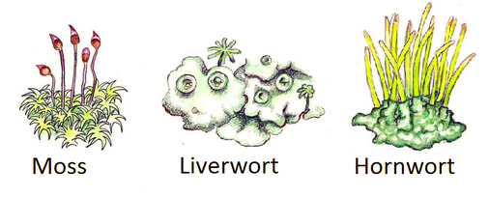
Bryophyte Structure
Nonvascular
Has thallus and rhizoids
No true leaves, stems, roots
Must remain very small
Male gametes swim so fertilization is water dependent
Zygote (sporophyte) remains attached to parent plant (gametophyte) and is dependent
Sporangium are sexual reproductive organs that produce haploid spores via meiosis

Slide 12
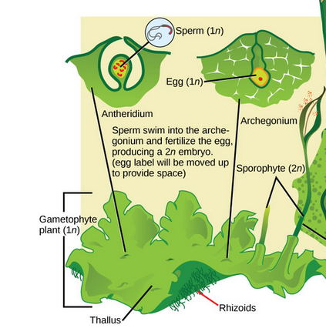
Bryophyte Life Cycle
Gametophyte (haploid) stage is dominant
Gametangia grow from the thallus
Archegonia produce eggs via mitosis
Antheridia produce sperm via mitosis
Sperm are released from antheridia and swim to archegonia
Diploid zygote grows inside archegonia, becomes sporophyte
Sporophyte has sporangia which produce haploid spores via meiosis
Homosporous
One type of spore, both male and female
Hornwort Life cycle

Slide 13
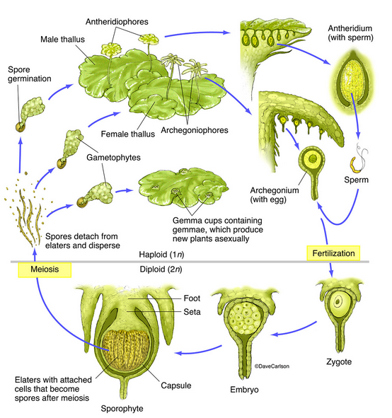
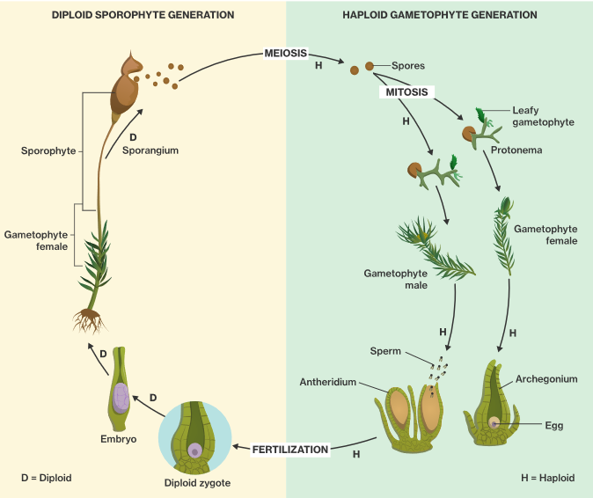
Liverwort Life cycle
Moss Life cycle

Slide 14
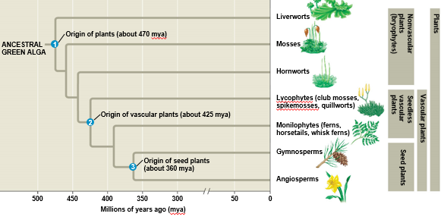
Vascular Seedless Plants
Lycophytes and Monilophytes
Novel adaptations (shared, derived traits):
Sporophyte (2n) is dominant stage
Gametophyte stage drastically reduced
Have leaves, roots, sporophylls
Have vascular conductive tissue
Xylem transports water
Phloem transports sugars, proteins, etc.
Allows plants to grow tall!
Male gametes swim so fertilization is still water dependent

Slide 15
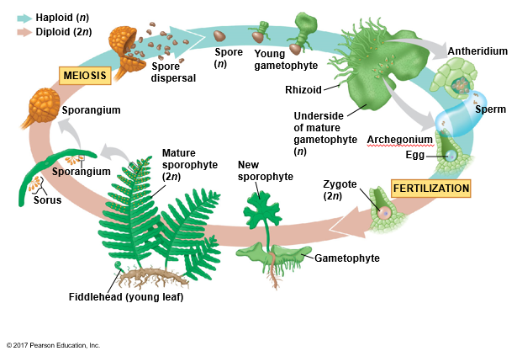
Vascular Seedless Plant Life Cycle
Zygote (sporophyte) grows from parent plant (gametophyte) but is independent and dominant
Two separate, independent life stages
Sporangium on sporophyte leaf produces haploid spores via meiosis
Spores germinate into haploid gametophyte
Archegonia and antheridia on gametophyte produce eggs/sperm via mitosis
Fertilization occurs inside archegonia, diploid zygote (sporophyte) is formed

Slide 16
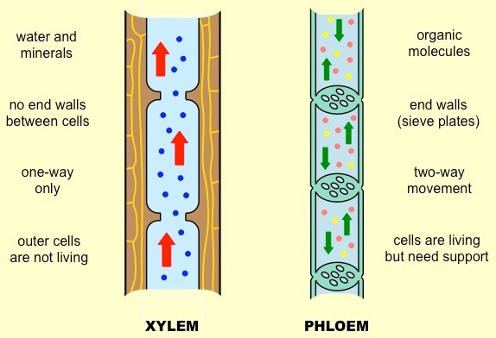
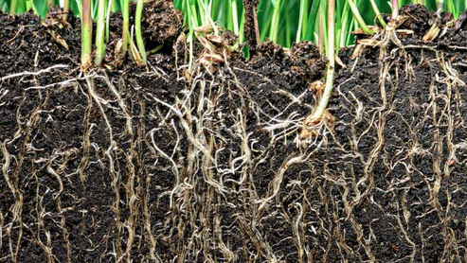
Vascular Seedless Plant Adaptations
Dominant sporophyte
Sporophyte is no longer dependent on gametophyte
Conductive vascular tissue
Xylem and phloem
Allows plant to transport water, food, minerals, nutrients
Lignin in xylem for strength and structural support
Allows plant to grow tall
Roots
Anchor plant to substrate
Absorb water and nutrients from soil
(Nonvascular plants had rhizoids only)

Slide 17
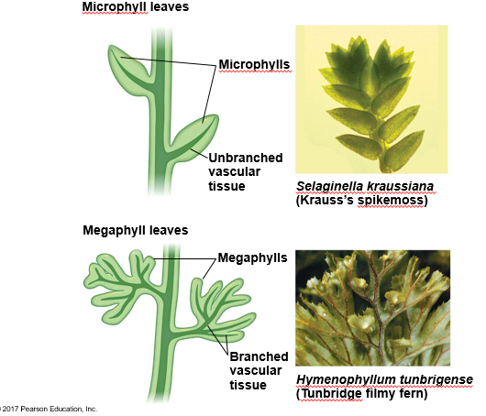
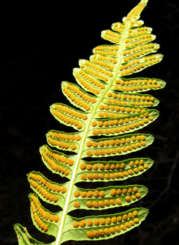
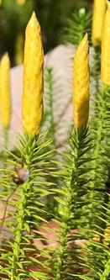
Vascular Seedless Plant Adaptations
Leaves
Increased surface area for greater photosynthetic efficiency
Microphylls
Spine shaped leaf with single unbranched vascular vein
Megaphylls
Larger leaf with branched vascular network
Sporophylls
Modified leaves with sporangia
Sori, clusters on underside of sporophyll
Strobili, cone-like structures formed from sporophylls
Sori
Strobili

Slide 18
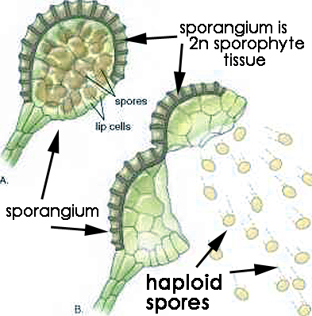
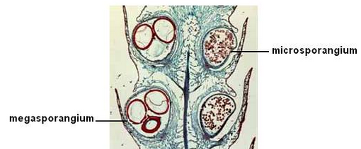
Sporangium
Sporangium: diploid structure that produces spores via meiosis
Most seedless vascular plants are homosporous
One type of spore that germinates into monoecious gametophyte
Both male and female on same plant
Some seedless vascular plants (and all seed plants) are heterosporous
Megasporangia produce megaspores which develop into female gametophytes
Microsporangia produce microspores which develop into male gametophytes

Slide 19
Types of sporangium

Slide 20
Terrestrial Plant Traits
Ancestral Traits
Nonvascular plant derived traits
Vascular plant derived traits
Eukaryotes
Cell wall
Photosynthesis
Alternation of Generations
Gametophyte dominant
Meristem tissue
Waxy cuticle
Sporopollenin
Sporophyte dominant
Conductive tissues
Broad leaves
Roots
Sporophylls
Heterospory in some
Trait is defined in Seed Plants

