Slide 1
Microbial Life: fungi
Chapter 23

Slide 2
Eukaryotes
All organisms that are NOT bacteria
Contain the following:
Nucleus with nuclear membrane
Mitochondria (and chloroplasts if photosynthetic)
Cytoskeleton of microtubules and microfilaments
Chromosomes of DNA organized around histones
Undergoes mitosis
Sexual reproduction

Slide 3
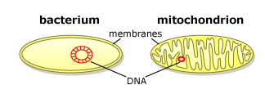
Endosymbiont theory
Mitochondria and chloroplasts were once free-living bacteria
Engulfed by large host cell
Coevolved together for millions of years and now cannot live apart
True symbiotic relationship
Structure of both mitochondria and chloroplasts support this
Two membranes
Contain their own circular DNA, ribosomes that translate their own proteins
They divide to create new mitochondria/chloroplasts
The host cell does not build new mitochondria/chloroplasts

Slide 4
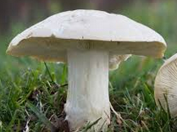
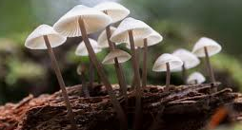
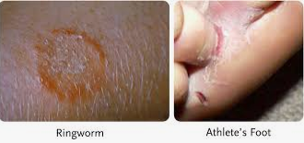
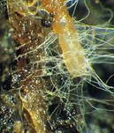
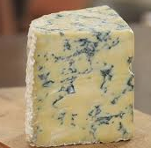
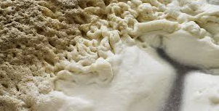
fungi
Fungi are eukaryotes
They have cells with nucleus and membrane-bound organelles
More closely related to animals than plants
Chitin in their cell walls
No photosynthetic pigments
No chloroplasts
Heterotrophic – they use carbon as a food source, they do not fix carbon to create glucose
Some are asexual but most have both sexual and asexual reproduction
They interact with other species
Can form mutualistic relationships
Can be parasitic
Humans use fungus in food/beer/wine production

Slide 5
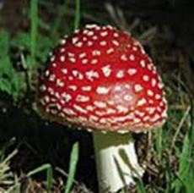
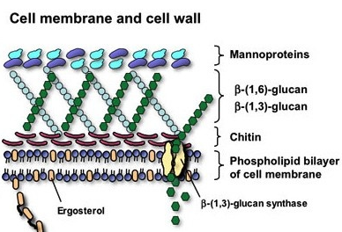
Fungal Cell structure
Cells have nucleus with chromosomes wrapped around histones
Have membrane-bound organelles
Have mitochondria
No chloroplasts, no chlorophyll
Have cellular pigments
Protect against UV light
Many fungal pigments are toxic
Have cell walls with chitin and glucans
Chitin is complex polysaccharide
Provides cellular strength
Also found in arthropods
Plasma membrane has ergosterol not cholesterol
They are nonmotile

Slide 6
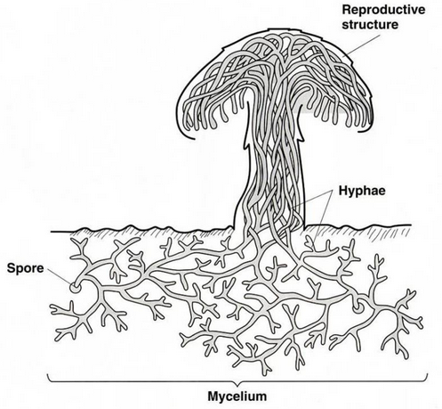
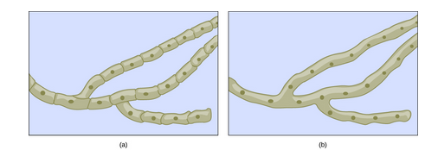
Fungal growth
Most fungi are multicellular but some are unicellular
Fungi have two morphological stages: Vegetative and Reproductive
Vegetative state produces hyphae, a haploid filamentous structure.
Collectively hyphae are called mycelium
Can grow on surface, underground, in liquid, in living organisms
Hyphae can either be divided into individual cells or can be one large structure with many nuclei (multinucleate)
Individual hyphae cells are divided by walls called septa
Nondivided hyphae are called coenocytic hyphae
Septated hyphae
Coencytic hyphae

Slide 7
Fungal nutrition
Fungi are heterotrophs
They consume organic compounds, they do not fix atmospheric carbon to create organic compounds
Fungi do not fix nitrogen they must consume it
They digest their food before they ingest it
Exoenzymes secreted from hyphae breakdown nutrients which are then transported into the hyphae (mycelium)
High surface-to-volume ratio to assist with ingestion
They store carbohydrates as glycogen not starch or cellulose
Most fungi are saprophytes
They consume decaying/decomposing organic matter
They can breakdown lignin and cellulose
They are good ecosystem recyclers
Some are parasitic on plants and animals
Some “hunt” worms and small insects

Slide 8
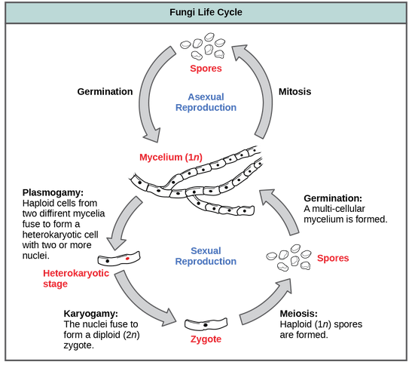
Fungal reproduction
Fungi reproduce sexually and/or asexually
Perfect fungi reproduce sexually and asexually. Imperfect fungi reproduce only asexually
They produce spores that disperse from the parent
Asexual reproduction
Fragmentation
Fragments of hyphae grow into new mycelium
Budding
Cytoplasm bulges, nucleus divides via mitosis, bud separates from mother cell
Spores
Produce haploid spores through mitosis than will develop into hyphae
Sexual reproduction
Plasmogamy
Two haploid cells fuse
Karyogamy
Haploid nuclei fuse to form diploid zygote
Meiosis
Produces spores that are released to environment

Slide 9
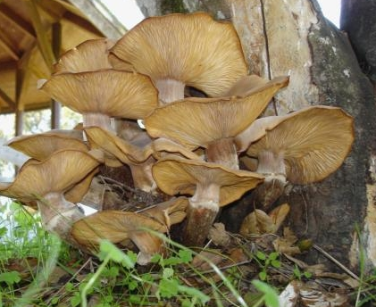
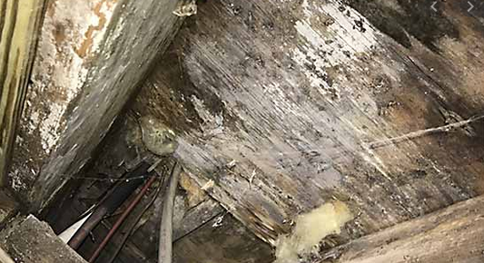
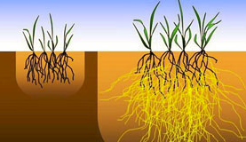
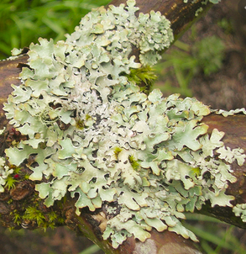
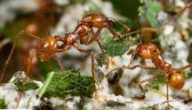
Fungal habitat
Although fungi can inhabit almost any environment, they prefer dark, moist areas – like a forest floor – that had decomposing organic material
They are saprophytes
Fungi perform an ecosystem service by releasing nitrogen and phosphorous from dead organic matter
Fungi can form mutualistic relationships with other organisms
With plants, with algae, and with animals
This are often ecosystem services

Slide 10
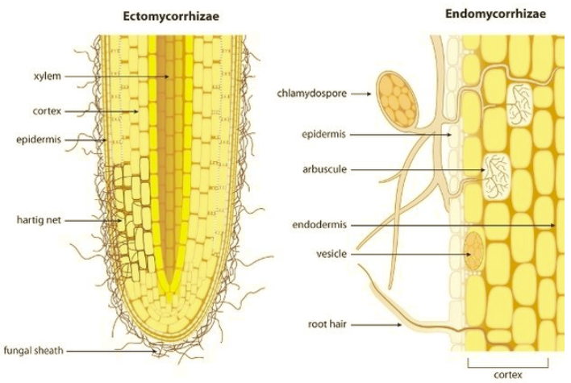
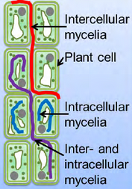
Mutualism with plants
Fungi and plants have two types of mutualistic relationships:
Mycorrhizae
Endophytes
Mycorrhizae occur when fungal hyphae interacts with vascular roots and help to channel water and dissolved nutrients to the plant roots
The plant provides the fungus with G3P or glucose that the fungus uses to create ATP
Ectomycorrhizae – hyphae surround the roots like a sheath
Endomycorrhizae – hyphae grow inside the roots in structures called arbuscules
Endophytes occur when fungus lives inside plant tissue
Does not damage plant
Fungus releases toxins to repel herbivores
Fungus releases chemicals that help the plant respond to environmental stress

Slide 11
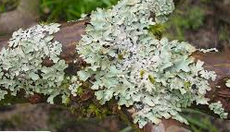
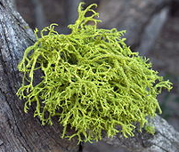
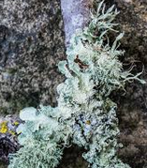
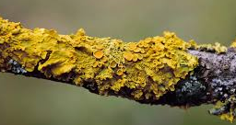
Mutualism with Algae
Lichens are a unique form of mutualism in which fungi and photosynthetic algae live in physical and physiological contact
The body of the lichen, called the thallus, is comprised of the fungal hyphae wrapped around the algae
Neither algae nor fungi can live without the other
The algae provides the fungus with carbon and carbohydrates
The fungus provides the algae with minerals, with protection against desiccation, and roots the lichen to a substrate
Lichens are sensitive to air pollution and serve as good pollution indicators
Lichens provide a winter food source to caribou and reindeer
Lichens provide habitat for small arthropods

Slide 12
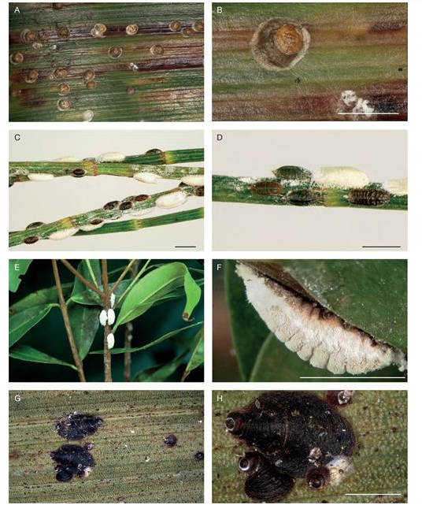
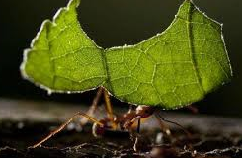
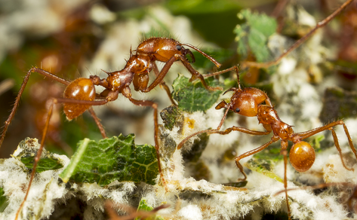
Mutualism with Animals
Fungus forms several types of mutualist relationships with arthropods
With scale insects, the fungus provides shelter for the tiny insects which protects them against predators
Leafcutter ants farm fungus
The ants bring pieces of leaves to their subterranean garden. Fungus grows on these leaves as they decompose.
The fungus digests the cellulose that the ants cannot
The ants kill competing fungal species
The ants eat the fungus

Slide 13
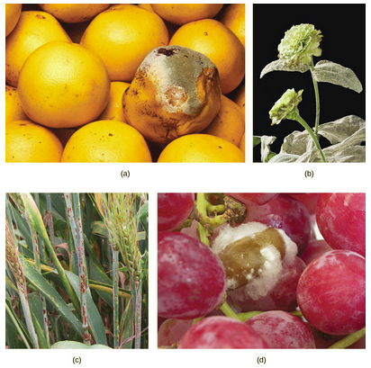
Plant Parasites and pathogens
Parasitism is a symbiotic relationship between two organisms in which one organisms benefits at the expense of the other
In addition to the mutualistic relationships between fungus and plants, there are also fungal pathogens that infect plants
Cause tissue decay and the plant death
Cause toxin build up in plant
Fungi are also responsible for food spoilage
Ergot is a disease of cereal crops
Destroys the plant
Produces alkaloids which are toxic to humans and animals
Lysergic acid – a precursor to LSD

Slide 14
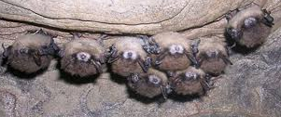
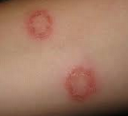
Animal and human parasites & pathogens
Fungus can also infect humans and animals
Mycotoxicosis is poisoning due to fungal toxins in food
Many animal and human fungal infections are superficial on the surface of the skin
White-Nose Syndrome in bats
Ringworm in humans/pets
Systemic mycoses affects internal organs
Enters body through inhalation of spores
Produces symptoms similar to tuberculosis
Very dangerous to immune compromised people
Mycetimus is poisoning due to ingesting poisonous mushrooms

