Slide 1
Microbial Life: prokaryotes
Chapter 22

Slide 2
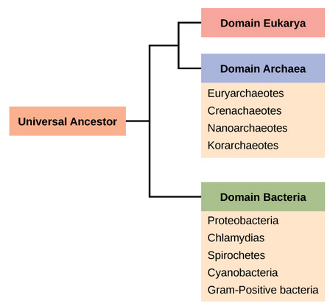
Prokaryote history
Two of the three Domains (Bacteria and Archaea) are prokaryotes
First appeared on Earth approximately 3.5 billion years ago
Only 1 billion years after Earth was formed
Several billion years before Eukaryotes appeared
They are ubiquitous – they are everywhere!
Even extreme locations such as the Dead Sea, Antarctica and the Arctic, deep sea hydrothermal vents, anoxic locations, radioactive locations
They are pioneers of new environments
They recycle nutrients
They live on and in us
They outnumber our own cells 10:1!
Prokaryotes are beneficial to life/organisms
Prokaryotes can also be harmful to life/organisms

Slide 3
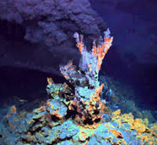
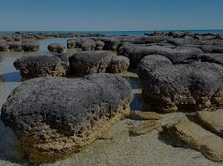
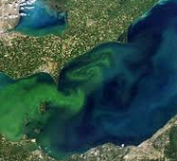
Ancient Prokaryotes
Earth’s ancient atmosphere was devoid of oxygen,and subject to intense solar radiation
Ancient prokaryotes lived in areas protected from the atmosphere
Deep underwater and beneath the surface of Earth
They first lived in colonial microbial mats near hydrothermal vents and volcanos
They were chemotrophs
Stromatolites are sedimentary structures that result from the presence microbial mats
Fossilized stromatolites have been found and stromatolites still exist today
It is thought that volcanic eruptions spewed prokaryotes to the surface
Those that adapted to the harsh environment thrived
Photosynthesis evolved approximately 0.5 billion years after prokaryotes
Cyanobacteria, blue-green algae, evolved from these first “terrestrial” prokaryotes
Photosynthesis oxygenated the atmosphere
Allowed other life to colonize earth
Created the ozone layer
Protection from solar radiation

Slide 4
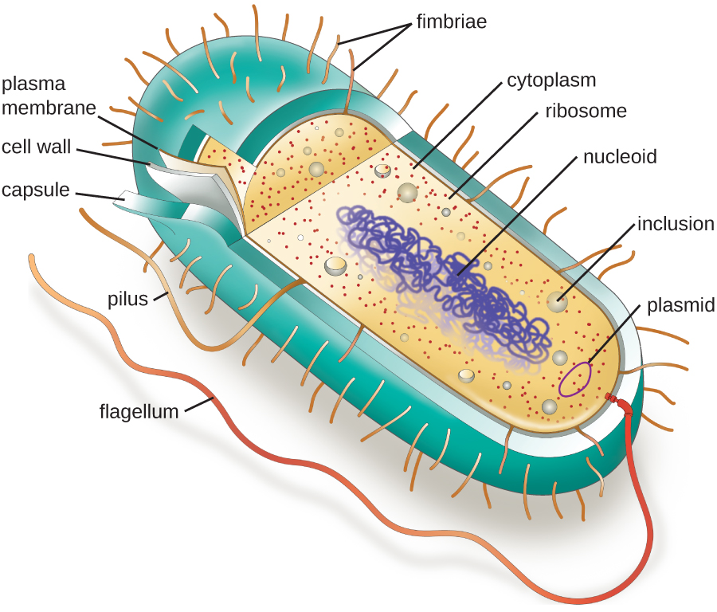
Prokaryote Structure
No membrane-bound organelles
Cell wall
Some species have a capsule outside the cell wall
Plasma membrane
One circular chromosome (double stranded DNA) located in nucleoid
Some have plasmids
Circular DNA “extra-chromosomomal” contains genes only used in specific, often extreme, situations
Ribosomes
Some have flagella/cilia for locomotion
Some have pili to attach to surface of other cells

Slide 5
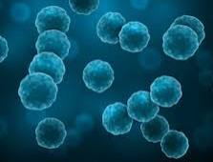
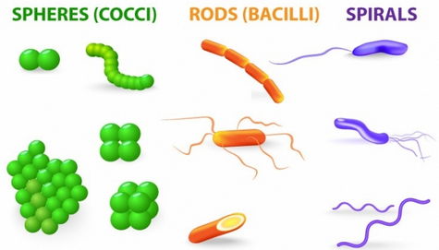
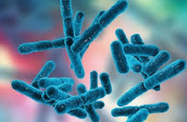
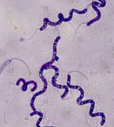
Prokaryote shapes
Prokaryotes come in one of three shapes or groups of those shapes
Coccus (pl. cocci)
spherical
Bacillus (pl. bacilli)
rod
Spirillus (pl. spirilli)
spiral

Slide 6
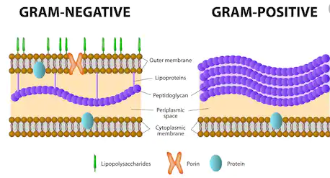
Prokaryotic cell wall
Bacterial cell walls contain peptidoglycan
Polysaccharide chains crossed linked by both L- and D- amino acids
Most amino acids are only L- amino acids
Bacteria are divided into two groups based on the composition of their cell wall
Gram positive
All Gram positive bacteria belong to the same phylum
Have thick cell wall
90% is peptidoglycan (other 10% is teichoic acid)
Gram negative
All other bacterial phyla are Gram negative
Have thin cell wall
Only 10% is peptidoglycan
Outside their cell wall is a layer of lipopolysaccharide and lipoproteins
Second lipid bilayer

Slide 7
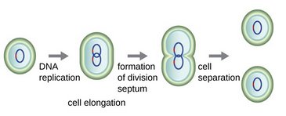
Prokaryotic reproduction
Bacteria reproduce asexually through binary fission
The single, circular chromosome is replicated, the bacteria grows and then pinches inward until it separates into two separate cells
Results in clones
What about genetic diversity or genetic recombination?
Bacteria Genetic Recombination
Transformation
Bacteria absorbs plasmid or chromosomal DNA shed by another bacteria
Transduction
Bacteriophages move bacterial DNA from one bacteria to another
Conjugation
DNA is transferred from one bacteria to another through the pilus
Can transfer plasmid or parts of chromosomal genome

Slide 8
Human Diseases and antibiotic resistance
Bacteria are both helpful and harmful to humans (and our pets and livestock)
E. coli in our intestines help with our digestion but E. coli in our stomach causes food poisoning
Lactobacillus plantarum helps improve our immune system
Streptococcus pneumonia causes pneumonia
Epidemic is a disease affecting a high percent of population in a specific area
Wuhan coronavirus
Pandemic is a widespread, worldwide, epidemic, kills millions of people worldwide
HIV/AIDS, Spanish Influenza, Cholera, Bubonic plague
Endemic is a disease that is always present but affects only small percentage of population
Chickenpox
We often treat viral infections and bacterial infections inappropriately

Slide 9
antibiotic resistance
Most antibiotics affect bacterial cell walls or bacterial cytoskeleton
Kills bacteria by destroying their cell wall or preventing them from reproducing
But any time a population of bacteria are exposed to antibiotics, some will naturally be resistant
Remember what you learned about natural selection, relative fitness, etc.
Resistant bacteria will live and reproduce resistant clones
Transformation, transduction, and conjugation allow bacteria to obtain resistant genes
Overuse of antibiotics causes antibiotic resistant bacteria!
We feed our livestock antibiotics
Doctors over-prescribe antibiotics or prescribe them for “colds”
Why?
Many scientists and medical professionals fear that we are entering a new era in which bacterial infections will once again devastate the human population

