Slide 1
Microbial Life: Viruses
Chapter 21

Slide 2
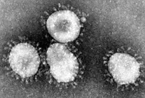
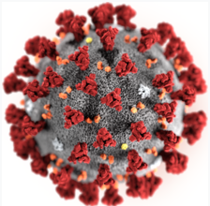
Wuhan coronavirus
9700 cases, 230 dead (mostly from secondary pneumonia)
What is coronavirus?
Virus that infects mammals and birds
In humans, causes respiratory problems
+ssRNA virus
No approved vaccine
Horizontal transmission
Likely “jumped species” from an animal to a human
Some reports are bat-human others are snake-human
All known human coronavirus are human-human transmission

Slide 3
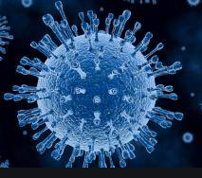
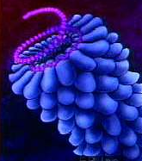
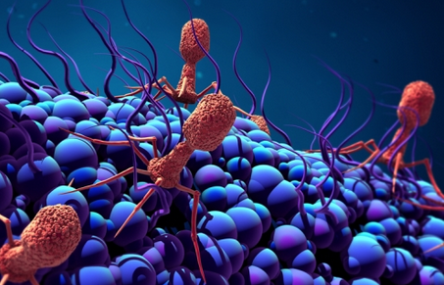
Are viruses alive?
Virus structure:
Nucleic acid surrounded by a protein coat called a capsid
No cellular organelles
No metabolism
Cannot grow
Cannot reproduce through mitosis or meiosis
Ancestry is unknown
No fossil record
Viral nucleic acid is inconsistent
Cannot be named in traditional Linnaean taxonomy

Slide 4
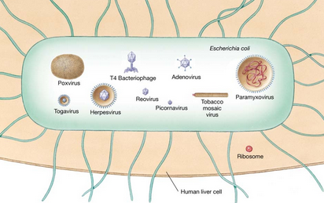
Are viruses alive?
Viruses are infectious structures
Infect bacteria, fungus, plants, animals
They are obligate parasites
They cannot metabolize or reproduce outside their host
First discovered in 1886
Tobacco Mosaic Disease (TMD)
Too small to see in light microscope, first visualized in 1930s with electron microscope
Viruses are tiny!
20 – 250 nm

Slide 5
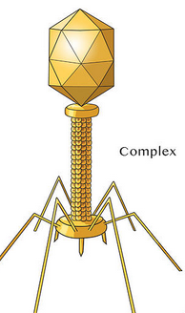
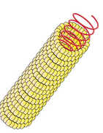
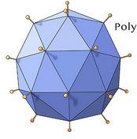
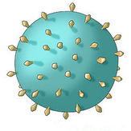
Viral Morphology
Viruses come in several different sizes and shapes but features are consistency in viral families
Viruses are made of only a few components
Viral nucleic acid
Capsid (protective protein)
The capsid proteins are coded for in the viral nucleic acid
Called capsomeres
Often have glycoprotein on their capsids to attach to host cells
Viral capsids are classified into one of four structure groups
Helical
Icosahedral
Enveloped
Head-and-tail
Viruses are also classified based on their type of nucleic acid

Slide 6
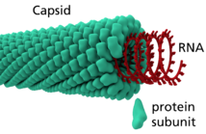
Helical viruses
Have protein capsid
Nucleic acid
Most plant viruses are helical viruses

Slide 7
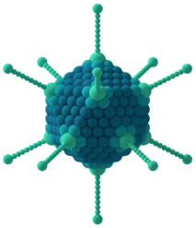
Icosahedral viruses
Have protein capsid
Spherical shape
Nucleic acid
Most common virus family
Adenovirus
Rhinovirus

Slide 8
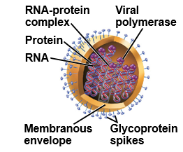
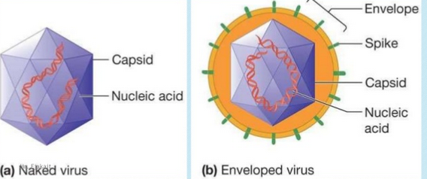
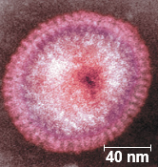
enveloped viruses
Have envelope from host cell membrane
Surrounds capsid
Spherical shape
Nucleic acid
Example: Flu, HIV

Slide 9
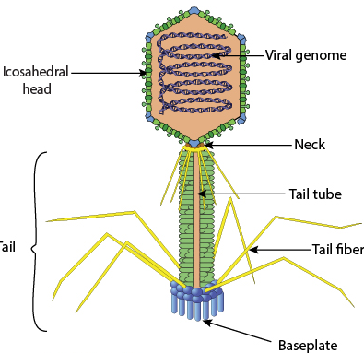
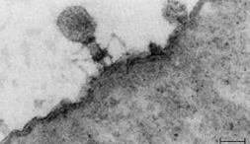
Head-and-tail viruses
Complex
Have icosahedral head
Nucleic acid
Helical tail
Most are bacteriophages
Infect bacteria

Slide 10
Types of nucleic acids
Viruses use DNA or RNA as their genetic material
Viral genome is contained within the viral core
Small genome, just genes for making
more DNA/RNA
Proteins for capsid
Proteins not available in host cell
Viral DNA can be single stranded or double stranded
Viral RNA can be single stranded or double stranded
Viral DNA/RNA can be linear or circular

Slide 11
DNA Viruses
The viral DNA directs the host cell’s replication enzymes to replicate more viral DNA
The viral DNA directs the host cells transcription/translation enzymes to translate/transcribe viral proteins
Human DNA viruses include:
Chickenpox
Herpes
HPV

Slide 12
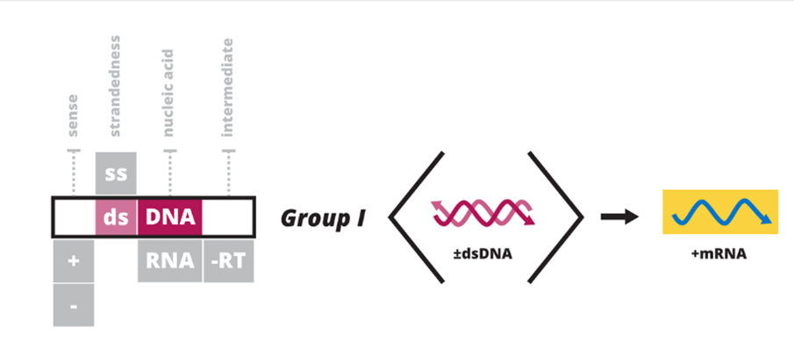
DNA Viruses
Group I: double stranded DNA (dsDNA)
Makes mRNA through regular cellular transcription/translation
Group II: single stranded DNA (ssDNA)
Must make intermediate dsDNA then makes mRNA

Slide 13
RNA Viruses
RNA virus genome is on RNA
The viral RNA encodes for replication enzymes (RNA polymerase) that replicate RNA into more RNA
Or, in retroviruses, the RNA encodes for enzymes that replicate the viral RNA into DNA
RNA polymerase is not a fastidious replication enzyme and often makes mistakes
RNA viruses mutate more frequently than DNA viruses
RNA viruses are able to rapidly adapt to their host
Human RNA viruses are HIV, flu, measles.

Slide 14
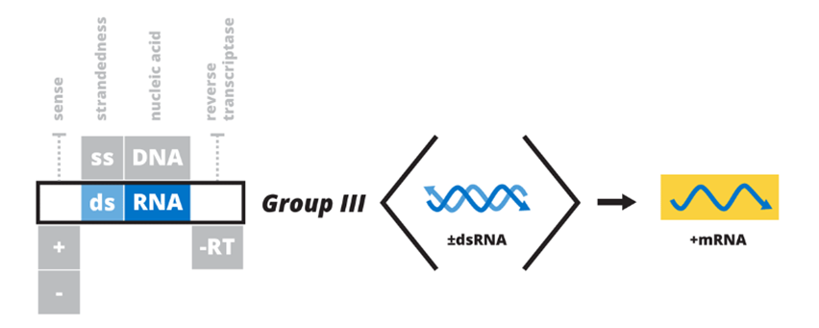
RNA Viruses
Group III: double stranded RNA (dsRNA)
mRNA is transcribed from dsRNA in a similar fashion a regular dsDNA
Group IV: +single stranded RNA (+ssRNA)
+ssRNA needs a complementary –ssRNA intermediate which can then be transcribed into mRNA

Slide 15
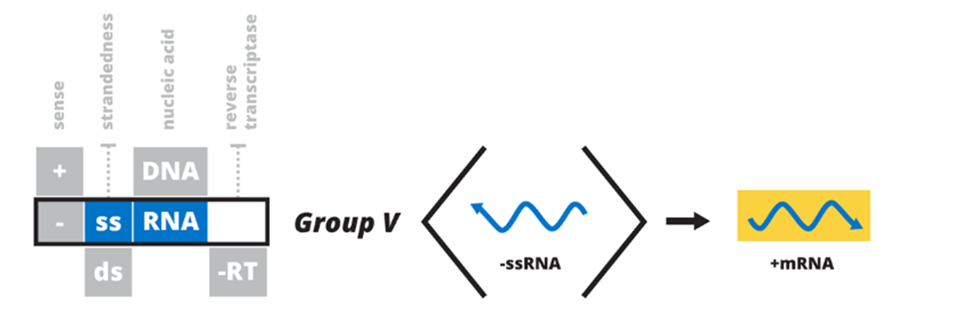
RNA Viruses
Group V: -single stranded RNA (-ssRNA)
mRNA can be transcribed directly from this
Does not require an intermediate

Slide 16
Retroviruses
Group VI: +ssRNA
Reverse transcription into ssDNA, the complementation to make dsDNA, then transcription to make mRNA
Group VII: dsDNA transcribed to +ssRNA, reverse transcribed to –ssDNA, then complementation to make dsDNA, then transcription to make mRNA

Slide 17
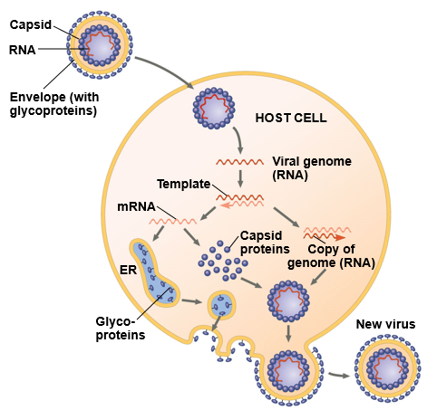
Viral lifecycle

Slide 18
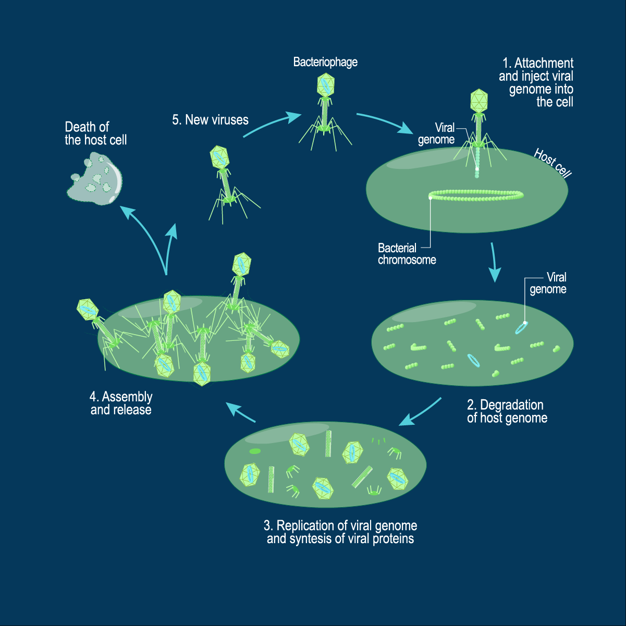
Lytic lifecycle
Host cell is destroyed in lytic lifecycle

Slide 19
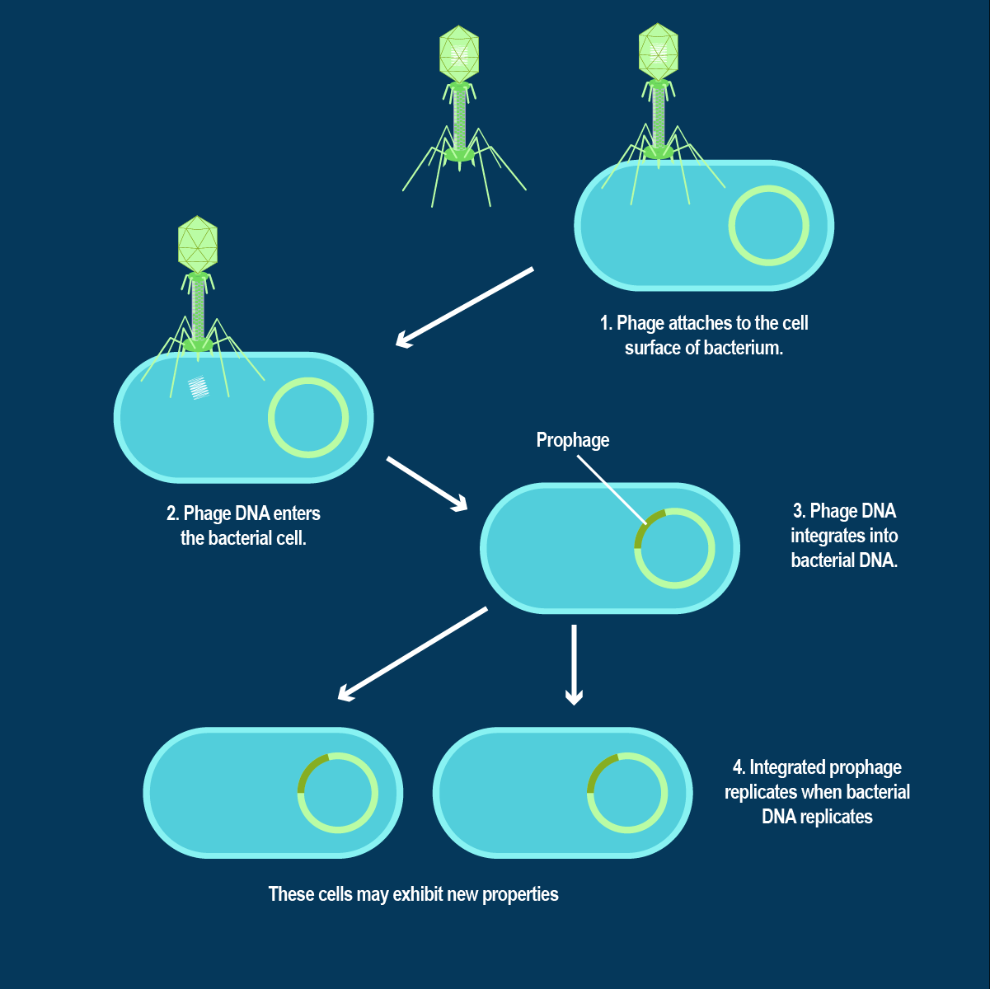
Lysogenic lifecycle
Host cell is not destroyed in the lysogenic cycle. Viral DNA becomes integrated with host DNA

Slide 20
Viruses and their hosts
Most viruses are extremely specific in which organisms they are able to infect
Smallpox virus only infects humans
Some have a broad host range
Rabies virus infects most mammals
Some viruses only infect bacteria
Called bacteriophages

Slide 21
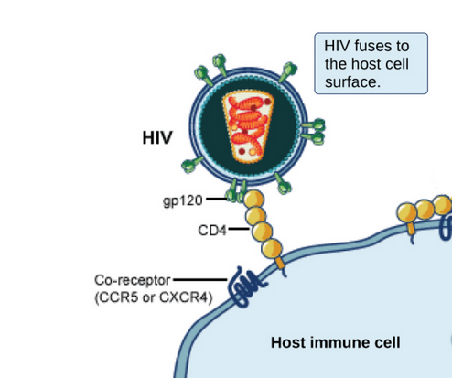
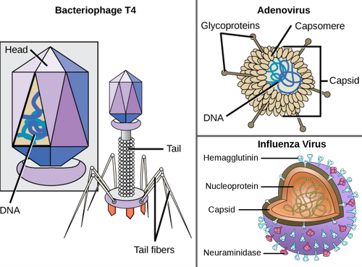
Viral glycoproteins
Viruses have glycoproteins on surface of capsid that recognize host cell receptors
These receptors have normal cellular functions
Cell-cell recognition
Enzymatic activity
Cell-cell anchors
Viruses have evolved to utilize these receptors
Viruses have a host range of organisms/tissues they can infect

Slide 22
Transmitting viruses
Horizontal transmission: from one organism to another
Vertical transmission: from parent to offspring
In plants, virus cannot penetrate cell wall unless the cell wall is damaged
So, in plants viral infections are secondary to mechanical damage
Animals do not have a cell wall so virus can more easily infect them
Receptor-mediated endocytosis
Animal cell unknowingly transport the virus into the cell
Viral capsid proteins can change shape to become transport proteins
Viral genome is transferred through

Slide 23
Viruses and vaccines
Vaccines work by teaching the immune system to recognize and build immunity to specific viruses
Vaccines work on viral infections
Antibiotics do NOT work on viral infections
Antibiotics only work on bacterial infections
There are many different types of vaccines, two most common are:
Live, attenuated
Living but weakened entire virus
Killed
Killed entire virus
Some vaccines use subunits of the virus (genome, capsids)
Some vaccines use synthetic viral proteins

