Slide 1
Determining evolutionary relationships
Chapter 20.2

Slide 2
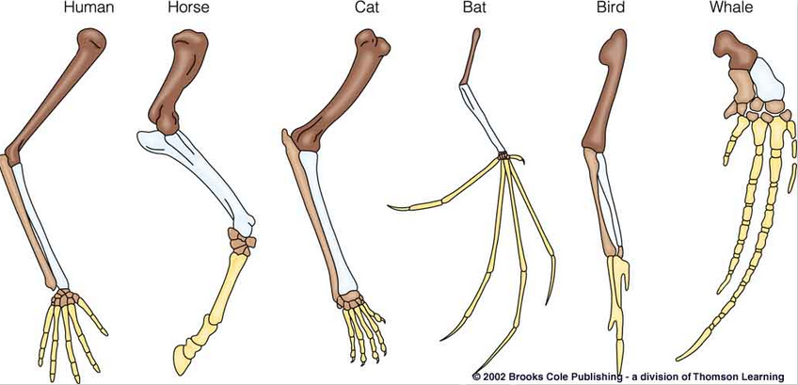
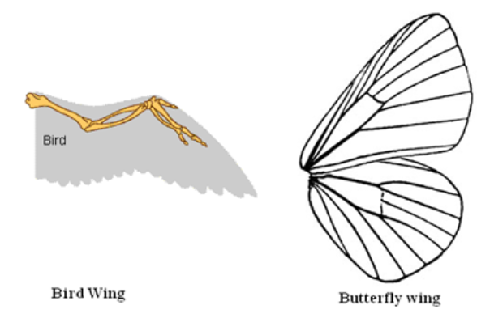
Homologous versus analogous traits
Homologous structures are physical or genetic traits that are similar due to a common ancestor
Called homologies
Similar structure, different function
Common ancestor
Analogous structures are similar physical or genetic traits that evolved separately in two (or more) organisms that do NOT share a common ancestor
Occur due to similar environmental conditions
Different structure. Same function
Not from common ancestor
Therefore similar traits in different organisms can be either homologous or analogous

Slide 3
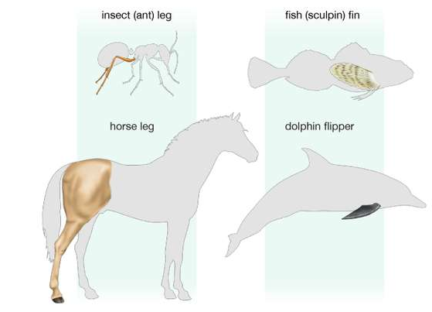
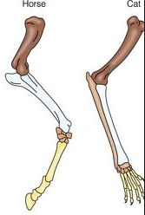
Analogous or homologous?

Slide 4
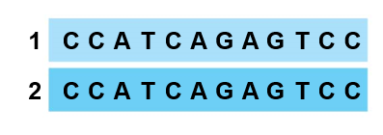
Molecular homologies
Analysis of comparable DNA segments from different organisms
If the genes in two organisms share many portions of nucleotide sequence, it is likely they are homologous
Neutral mutations accumulate at constant rate in both organisms
Adaptive mutations will accumulate faster
Ancestral DNA is identical in two different organisms right before speciation
Homologous structure

Slide 5
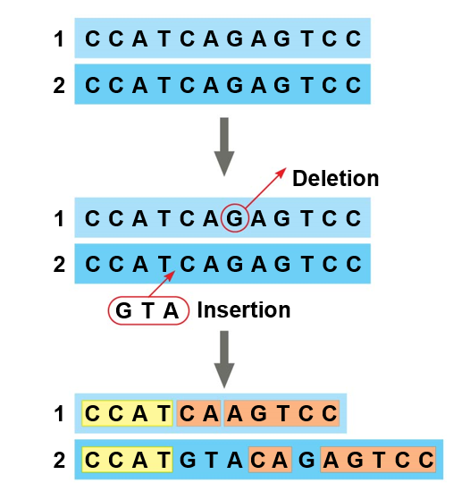
Molecular homologies
As two populations diverge from each other, mutations occur in DNA
Compare original DNA with new DNA to see mutations that occurred
No longer align
Mutations have accumulated
Still homologous

Slide 6
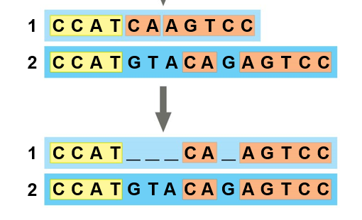
Molecular homologies
Molecular systematics uses computer programs to compare prior homologous regions
Similar to comparing the bones in the forelimb of a human, cat, whale

Slide 7
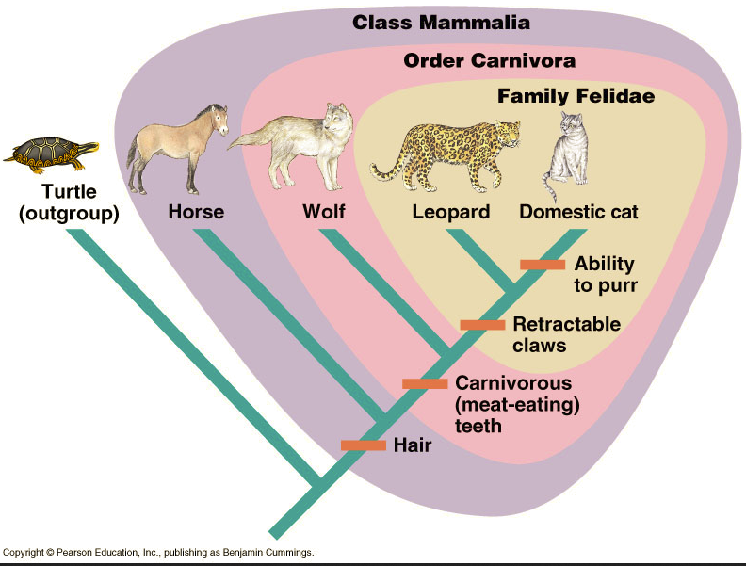
Outgroups in phylogenetic trees
An outgroup is a reference species that is closely related to the ingroup (the species being studied)
The outgroup diverged before the species of the ingroup
Comparisons between the outgroup and the species in the ingroup species help to resolve evolutionary relationships
Shared ancestral characters (present in the outgroup)
Shared derived characters (not present in the outgroup)

Slide 8
Building phylogenetic trees
In comparison with its ancestor, an organism has both shared and derived characters
A shared ancestral character is a character that originated in an ancestor of the taxon
Present in ancestor and descendants
A shared derived character is a novel evolutionary character
Not present in ancestor, only in descendants
Phylogenies are based on shared derived characteristics
This is a trait that was not present in the ancestral species
This trait is shared by the descendants
Keep in mind that these terms can be relative depending on how we are viewing our phylogenetic tree

Slide 9
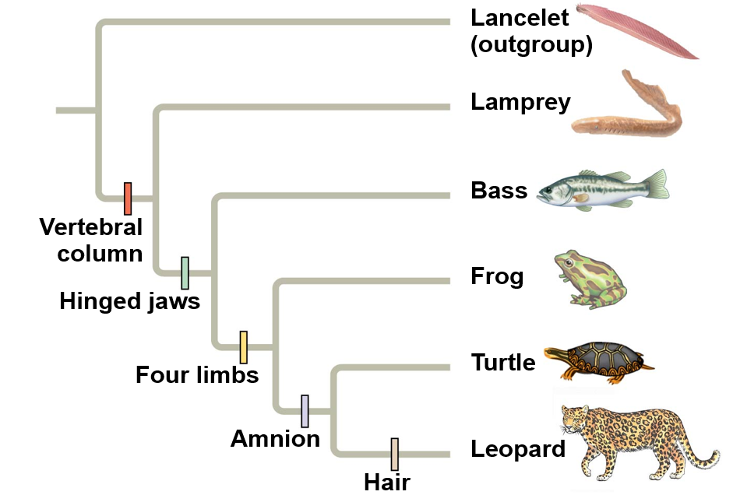
Building phylogenetic trees
These are shared derived characters
They are novel characters that separate groups of organisms
Can you think of one shared ancestral character shared by all of these organisms except the outgroup?

Slide 10
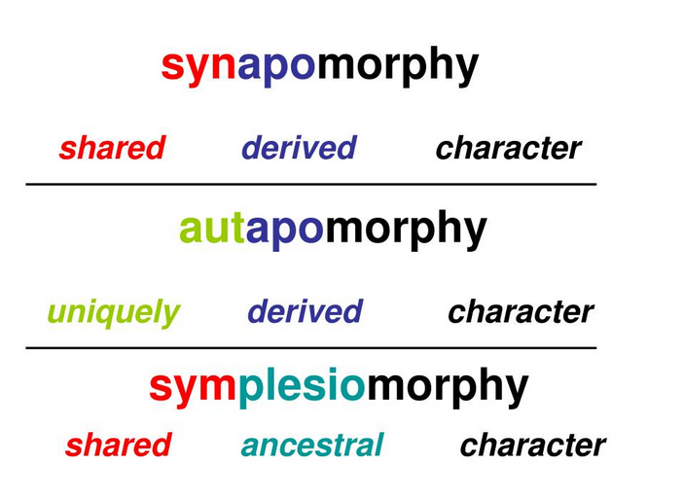
Phylogenetic terms
Apomorphy – a novel derived character
Synapomorphy – shared derived
Character shared by last common ancestor and descendants
Autapomorphy – unique derived
Novel character present in only one group
Not present in most recent common ancester
Plesiomorphy - shared ancestral character
Present in ancestor and descendants

Slide 11
White spots are derived but not shared
Ancestral Traits:
Red body color
Black spots
6 legs
Yellow color is shared derived character
Antennae are derived but not shared
Novel character

Slide 12
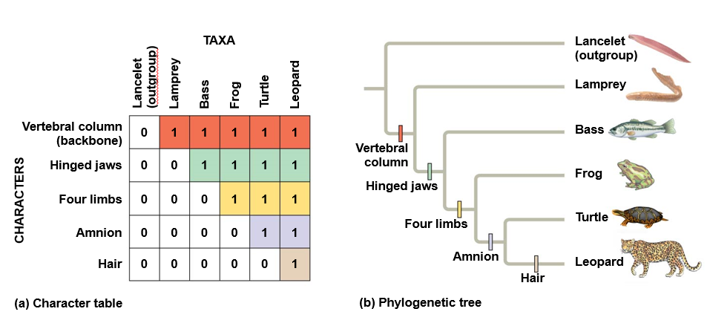
Building phylogenetic trees
Scientists use synapomorphies (shared derived characters) to build phylogenetic trees
Outgroup has ancestral traits
Novel traits are noted in individual species/groups using character table
Character tables are binary, using 0 and 1
0 = ancestral character
1 = derived character

Slide 13
Building phylogenetic trees
For this group (and only this group), are four walking legs shared ancestral or shared derived?
What about amniotic eggs?

Slide 14
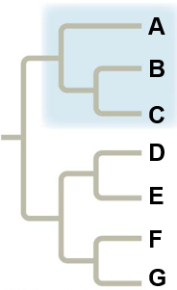
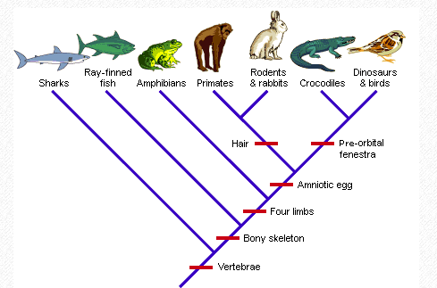
phylogenetic tree Groups: Monophyletic
Monophyletic group consists of a common ancestor and all descendants
Each tree can be one large monophyletic group or several small monophyletic groups
Clades – organisms that descended from a common ancestor

Slide 15
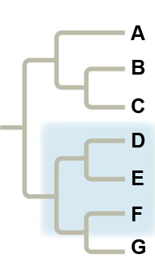
phylogenetic tree Groups: paraphyletic
Paraphyletic group consists of an ancestral species and some, but not all, of the descendants
This is a paraphyletic group because it contains the common ancestor that had four limbs and it includes amphibians, primates, rabbits & rodents, and crocodiles but it does NOT include dinosaurs & birds

Slide 16
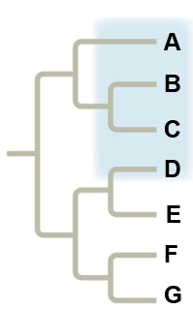
phylogenetic tree Groups: polyphyletic
Polyphyletic group includes distantly related species but does not include their most recent common ancestor
This is a polyphyletic group because it groups rodents & rabbits with crocodiles but it does not include their most recent common ancestor

Slide 17
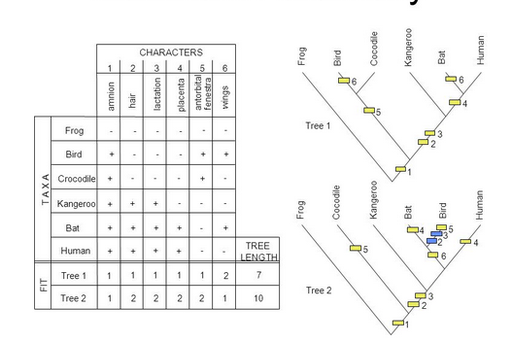
Maximum parsimony
Maximum parsimony states that events will occur in the simplest way
The phylogenetic tree with the fewest evolutionary steps is likely the correct one

