Slide 1
Organizing Life on Earth
Chapter 20.1

Slide 2
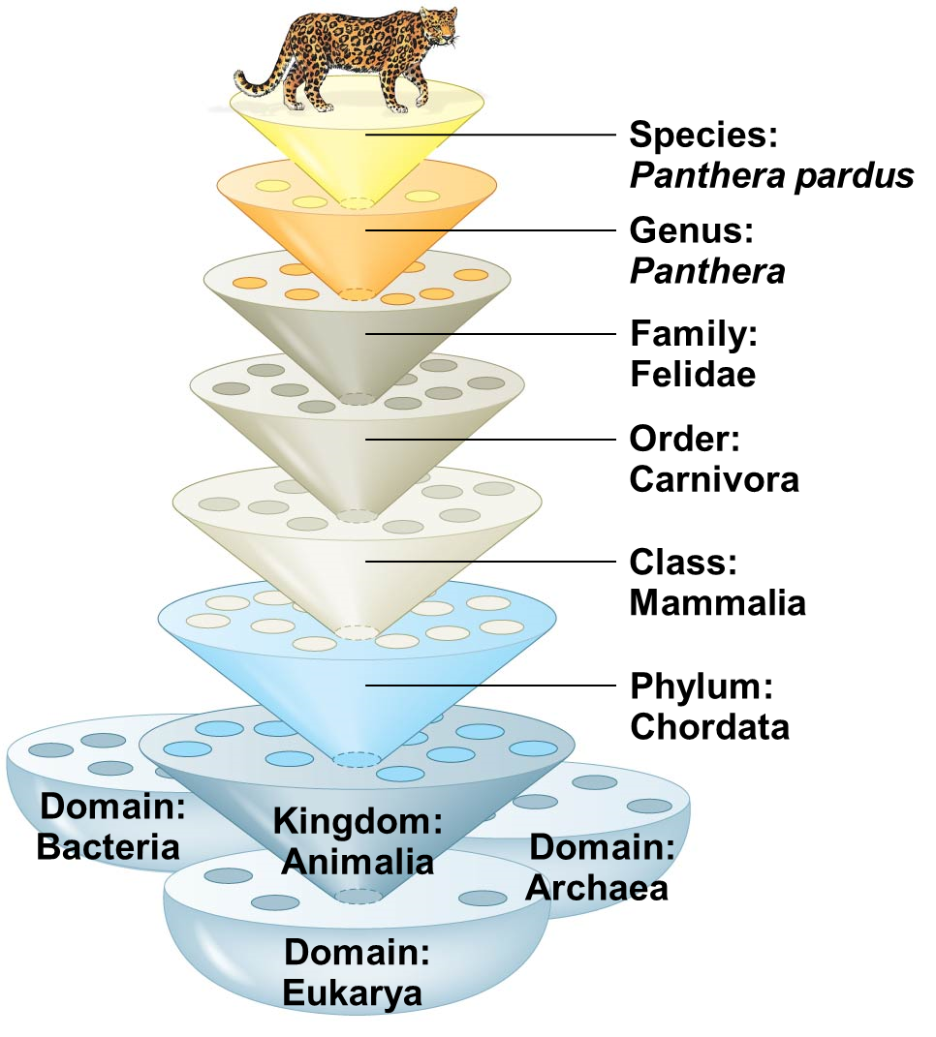
Taxonomy
Taxonomy is the international classification system used to name organisms in a hierarchical manner
Called Linnaean System after Carl Linneaus
Taxonomic groups move from more inclusive to less inclusive
Moves from less relatedness to more relatedness
Each taxonomic group is called a Taxon
Binomial nomenclature system: Genus species
Italicized
Genus capitalized
species lowercase
Leopard’s true scientific name is Eukarya, Chordata, Mammalia, Carnivora, Felidae, Panthera pardus
We would simplify this to Panthera pardus

Slide 3
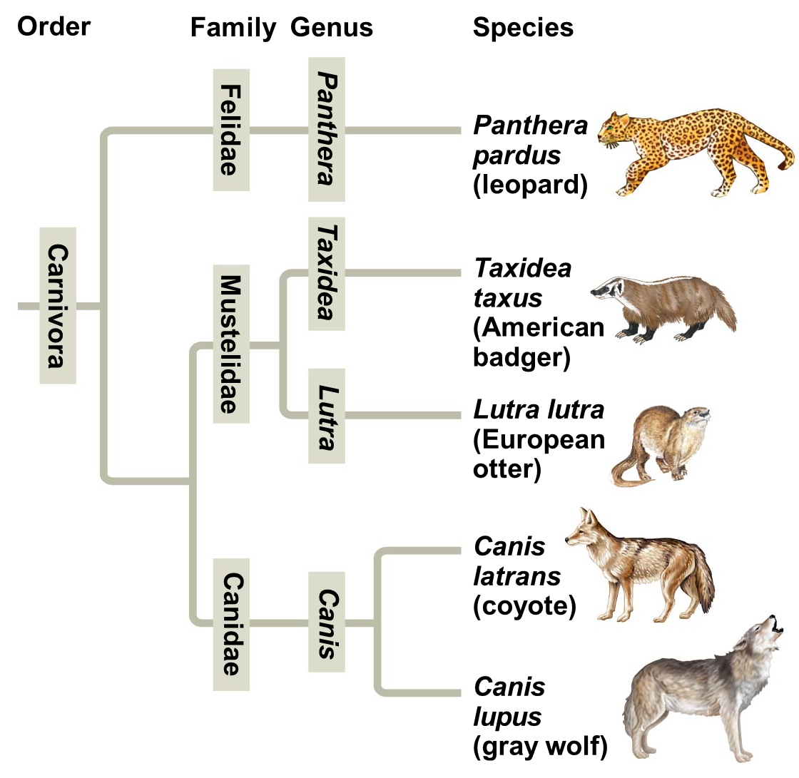
Systematics and Phylogeny
Systematics classifies organisms based on their evolutionary relationships
Analyze fossil data
Analyze homologous structures
Analyze biomolecular data
Analyze DNA
Phylogeny is evolutionary history of organisms and their relationships to other organisms
Phylogenetic Tree uses systematics and phylogeny to reflect evolutionary relationships and history
Phylogenetic trees are hypotheses of the past

Slide 4
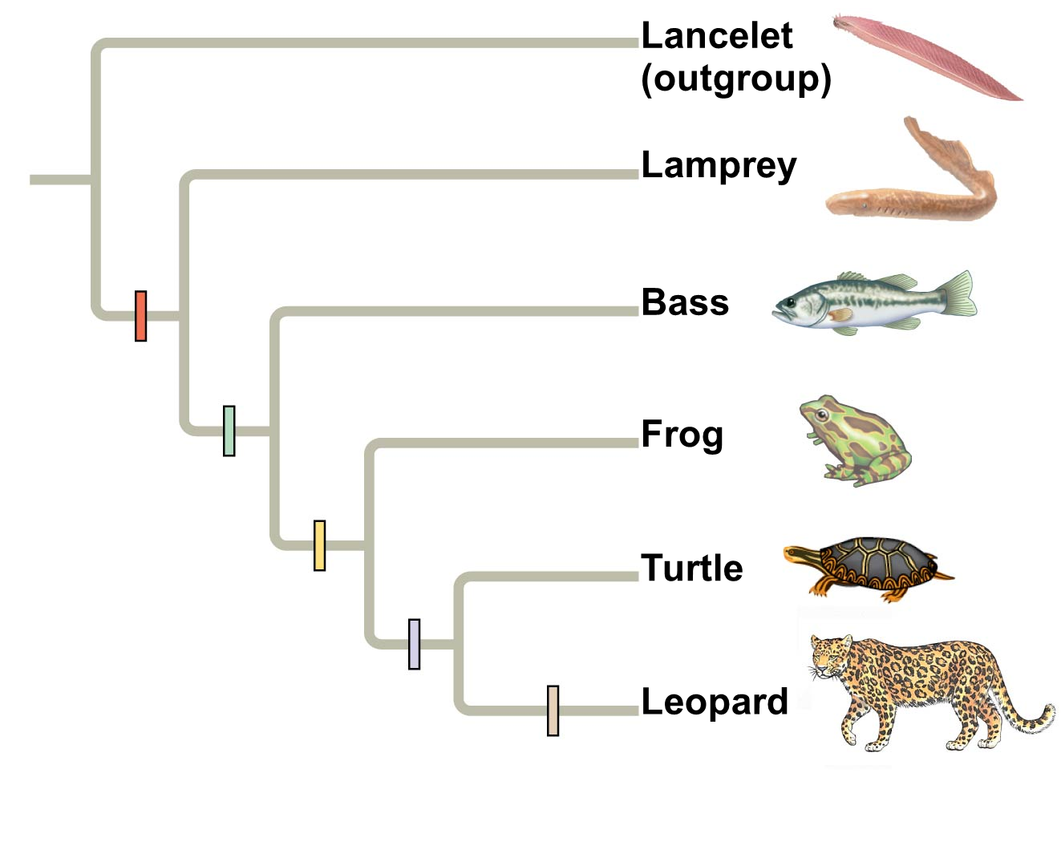
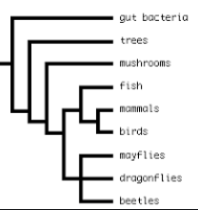
Phylogenetic Trees
Phylogenetic trees are map of evolutionary history
Trees are typically rooted (single common ancestor)
Branch point indicates a single lineage splitting into two
The node of the branch point indicates a common ancestor to those sub taxa
Evolution of novel trait
Basal taxon is an unbranched lineage that evolved from the common ancestor
These are often used as the outgroup
Sister taxa are two lineages stemming from same branch point (node)
Polytomy is a branch with two or more lineages
Undetermined relationships
Time

Slide 5
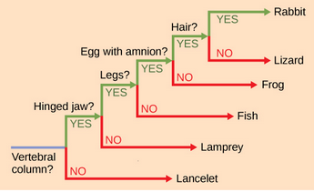
Tree limitations
Branch length does not indicate length of time
Long branches ≠ more time has passed
Short branches ≠ less time has passed
Trees show evolutionary patterns not phenotypic patterns
Does not account for further change after a branch point
Does not imply that sister taxa evolved from each other
They evolved from a common ancestor

Slide 6
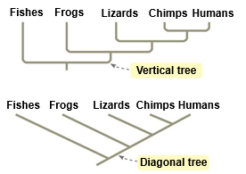
Alternative Tree diagrams
Both trees have:
common ancestor (root)
branch points (nodes)
Sister taxa
Basal taxon (outgroup)

Slide 7
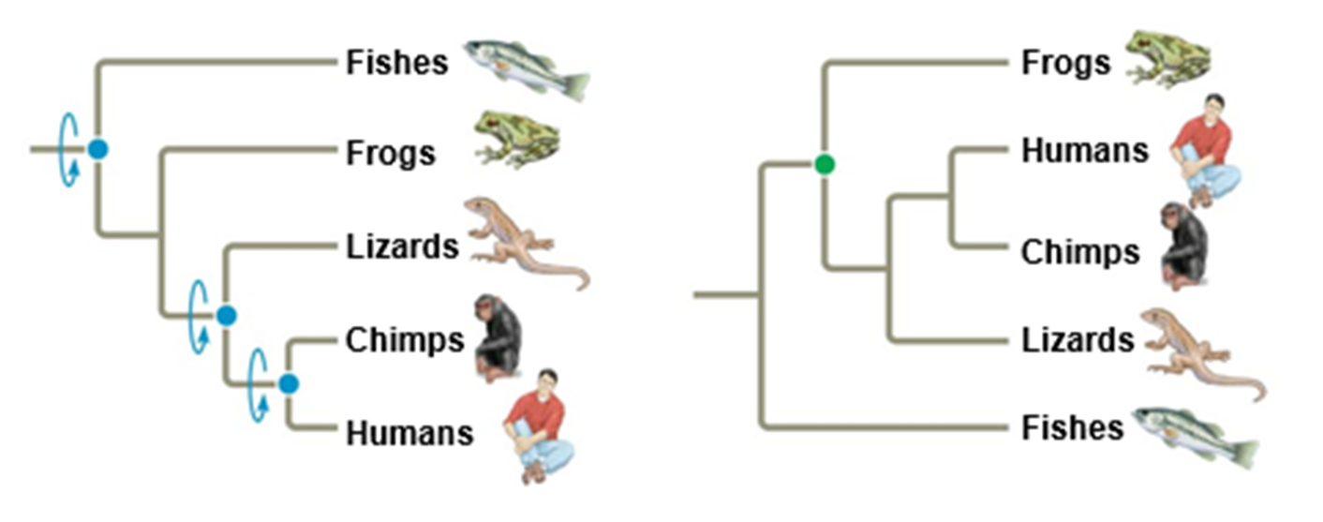
Rotation around nodes
Rotation around nodes does NOT change evolutionary relationships
Change in branching ORDER changes relationships
Lizards
Frogs
Chimps
Humans

Slide 8
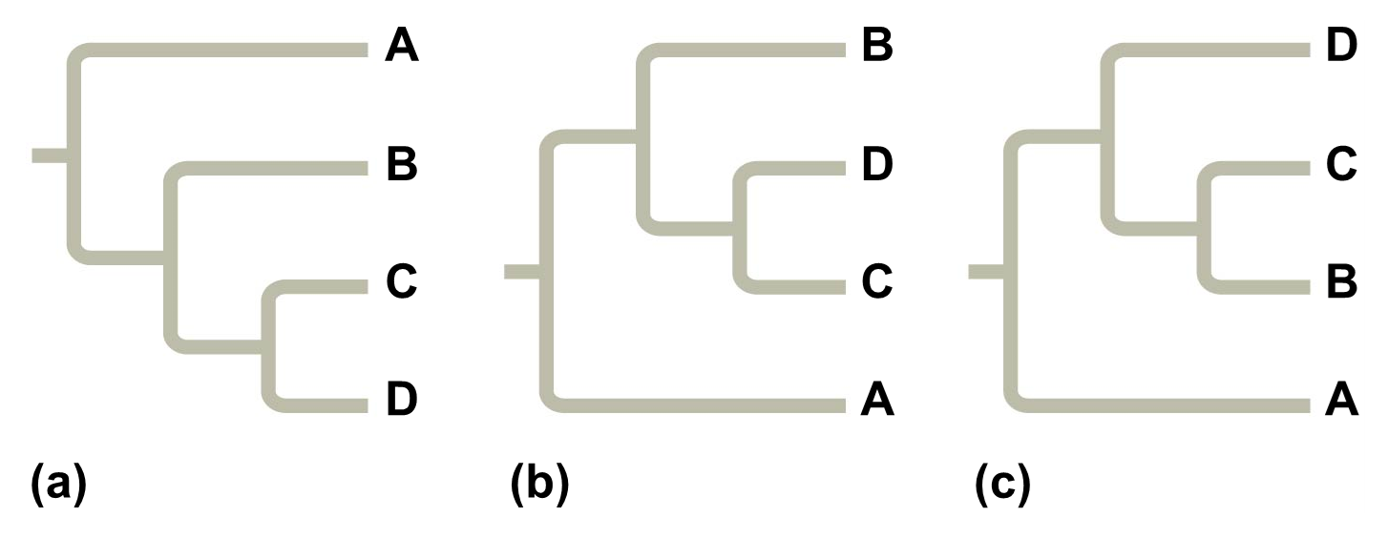
Comparing phylogenetic trees
Which of these trees shows a different evolutionary relationship?

