Slide 1
BSC 2011C
General Biology II
MWF 12:30 – 1:20 pm
Instructor: Ms. Michele Yeargain

Slide 2
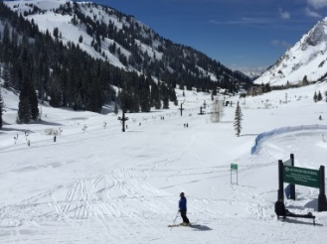
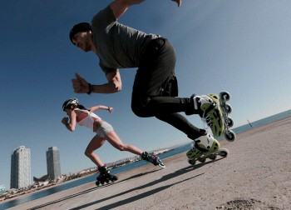
Contact Information
Ms. Yeargain
Email: michele.yeargain@ucf.edu
Office: BIO 201B
Office hours:
Monday: 2 – 3 pm
Tuesday: 12:30 – 2:30 pm
Wednesday: 1:30 – 2:30 pm
Friday: 10:30 – 11:30 am
and by appointment

Slide 3
Email communication
Email is the preferred method of communication
Email format:
Subject line should include topic of email
Body of email must include:
Salutation
Your first and last name
That you are enrolled in my Biology II
Your question/concern
Proper ending
I teach multiple courses – failure to provide this information may result in no response

Slide 4
Required textbook and material
OpenStax Biology 2e
Free open source textbook – no textbook fee!
Expert TA
Costs approximately $35 if purchased in Webcourses
Costs $44 if purchased from bookstore
iClicker
Physical iClicker2 device
Register through iClicker tab in Webcourses
Or, REEF access (uses your phone as clicker)
Use REEF app, create account, add a course,
BSC2011.0003_Yeargain
Must use your UCF NID and roster name

Slide 5
Webcourses for course material
Lecture Syllabus
Unit Modules
Pre-lecture reading
Pre-lecture Expert TA quizzes
Lecture PowerPoints
Weekly Post-quizzes
Study guides
Announcements
Make sure your announcement setting is on!
You are responsible for information sent via announcement
Discussion Board
Communicate with other students in the course
Course grades
Certain settings will not be active until necessary
Check your grades weekly
Personal responsibility/accountability

Slide 6
Attendance Verification Quiz
An absolute MUST for financial aid students!!
Your funds will be delayed/suspended if not completed by Jan 10!
Complete “Attendance Quiz” in Webcourses
Closes Friday, January 10th, at 11:59 pm
Questions based on lecture syllabus
Answers do NOT matter
Does NOT count towards your semester grade
All students who complete the quiz by 11:59 pm on Jan 10, will receive 1 extra credit raw point towards exam 1 grade

Slide 7
Course Grades
You will receive one grade in BSC2011 that combines both lecture grades and lab grades.
Lecture Exams 40%
Five lecture exams, lowest score will be dropped
Highest 4 lecture exams (10%)
Laboratory 25%
Final Exam 10%
Post-Quizzes 10%
Pre-lecture quizzes 5%
iClickers 5%
Active Learning 5%

Slide 8
A friendly warning about this course
This is not Bio I
This is not an easy course!
This course is not as “forgiving”
Not as much extra credit
Not as many dropped assignments
More student responsibility
There are many concepts covered and they are all difficult and diverse
You cannot just memorize – you must learn and understand
Be prepared to spend at least an hour per day outside of lecture and lab

Slide 9
Chapter Reading and Pre-Lecture Quizzes
OpenStax textbook has been imported in Webcourses
In Modules
Pre-lecture quizzes are based on pre-lecture readings
Reading and Pre-Lecture Quizzes are to be completed prior to attending lecture on that chapter
Readings are always open
Pre-lecture quizzes are due at 12:30 pm on date of lecture
Open one week prior to due date
See Course Schedule in Webcourses
Unlimited attempts
Scored on correctness
No excused absences

Slide 10
Pre-Lecture Quizzes (5%)
Read OpenStax readings in Webcourses
Must completed pre-lecture quiz prior to lecture on that material
Are due at 12:30 pm on due date
Open one week prior to due date
Unlimited attempts
Scored on correctness
Can be completed late for 50% of earned score
BUT…must be completed prior to exam on associated material
No excused absences
No dropped assignments

Slide 11
iClicker Questions (5%)
In-class polling system
Need physical clicker or REEF subscription
Will have questions in lecture each day
Questions are graded 25% participation, 75% correctness
Practice iClicker questions this Wed. and Fri.
Starting January 13 points will count!
Scores will be uploaded to Webcourses
Lowest 6 scores will be dropped
Must bring your iclicker device or phone to lecture

Slide 12
Weekly Post-Quizzes (10%)
Based on material covered that week
Link can be found in Webcourses Modules
Assignment start/due dates are available in Webcourses
Assignments open at 1:30 pm on Fridays
Assignments close at 11:59 pm the following Friday
First post-quiz opens on January 17th
Do not wait until the last minute!
Homework will not be reopened or due date extended
8 post-quizzes
Lowest score will be dropped

Slide 13
Active Learning (5%)
In-lecture activities to promote understanding of difficult concepts
Material available in Webcourses prior to AL day
Read and prepare before lecture!
10 iClicker questions per AL day
6 Active Learning days:
January 17
January 27
February 7
February 24
March 23
April 10
Lowest score will be dropped

Slide 14
Lecture Exams
Five (5) lecture exams
50 minutes
30 questions each (plus 1 bonus question)
Based on material covered in lecture and on Webcourses
Lowest scoring exam will be dropped
unexcused absences, oversleeping, etc.
Exam dates:
January 29 (Wednesday)
February 10 (Monday)
February 26 (Wednesday)
March 25 (Wednesday)
April 13 (Monday)

Slide 15
Final Exam
Final Exam
Friday, April 24, 10 am – 12:50 pm
In this lecture hall
100 questions (plus 2 bonus questions)
Cumulative
Cannot be dropped

Slide 16
Laboratory
No labs this week – labs begin next week
Laboratories are face-to-face
Located in the Biological Sciences building
You must attend your lab section on the day, time, room that you are enrolled on your class schedule
Separate laboratory syllabus on the laboratory Webcourses
Additional information will be provided next week in the lab
If you have questions about the lab you need to communicate with your specific lab Tas.

Slide 17
Extra Credit Opportunity
Exams 1-5 will each have one extra question
31 questions but scored out of 30
The first missed question does not count against you
Seems small but gives you 1.5% EC overall!!!

Slide 18
So, here is how it works:
Unit modules will open approximately one week prior to lecture topic
Read content provided in module
Complete Pre-Lecture Quizzes prior to lecture
PowerPoints are posted in Webcourses
At end of week, complete Post-Quiz

Slide 19
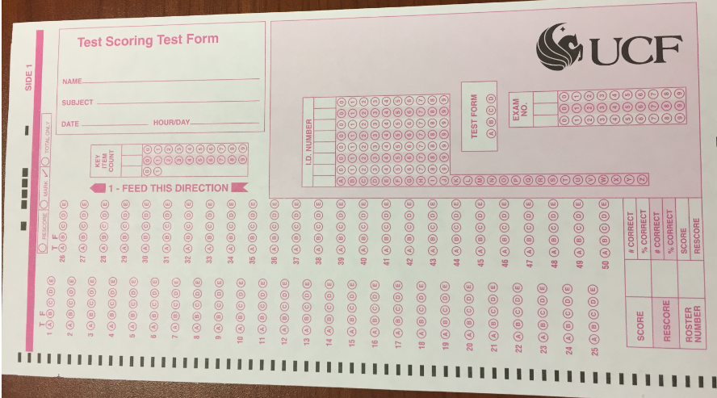
Scantron Requirement
Must submit 6 raspberry scantrons to your lab TAs no later than Friday, January 31st
SGA provides 1 free scantron/day with UCF ID
No scantrons submitted = 5 point reduction on each exam
Permanent reduction
Do not write on individual scantrons
Leave them in plastic and write your name on the plastic
Secure loose scantrons with post-in note with your name and paper clip (do not staple)

Slide 20
Classroom Safety
Familiarize yourself with all exits and the exit nearest to you
In the event of an emergency move quickly and orderly out of the building
If an alarm sounds, remain quiet so we can hear the instructions
Be aware of your surroundings and those around you
Get my attention immediately if something is wrong
If necessary, call 911 or campus police (407-823-5555)
Let them know that you are on the UCF campus in Classroom Building 2 (CB2)

Slide 21
Classroom Conduct
This is a safe classroom
Do not judge, criticize, bully, harass, repress, or stigmatize any individual student or group
Everyone is here to learn and should be able to do so in a judgement-free environment
If you ever need to discuss anything, my office has an open-door policy
Arrive on time and stay the entire time
No talking during lecture
No cell phone use during lecture (except for Learning Catalytics)
Tablets and laptops may be used for note-taking
There is no need to come to lecture just to sit here and watch Netflix

Slide 22
Classroom Conduct (continued)
Academic dishonesty and abusive behavior is not permitted and will be penalized based on the Course Sanctions and University Sanctions as outlined in the lecture syllabus
The most common types of offenses are:
Cheating
GroupMe can be cheating!
Course Hero and similar can be cheating!
Soliciting questions/answers and providing questions/answers is cheating
Abusive/Offensive behavior

Slide 23
Student Accessibility Services (SAS)
If you require accommodations for taking exams, you must register with SAS
If you are registered with SAS, you are required to schedule your exams within 5 days of the exam date
You should schedule all of your exams for this course now
The dates are listed in the syllabus
Please feel free to meet with me to discuss any concerns you have
This applies to all students, not just those registered with SAS

Slide 24
Academic Assistance
I am available during my office hours to assist with course content – take advantage of this!
Seek help if you have questions about course content
Seek help as soon as you realize you do not understand
Seek help if you perform poorly on an exam
Do not wait until 2 days before the final exam to seek help
Supplemental Instruction (SI)
Savannah Redfern is your SI leader
SI schedule will be announced and posted in Webcourses

Slide 25
How to be successful in this course:
Come to lecture!! This seems obvious but many students skip lecture
Before coming to lecture complete the associated chapter module and Materia Practice (reading the chapter in the text is helpful too)
Take notes in addition to the ones I provide
If you are confused about a topic, come see me!
The minute you are confused…not two days before the final exam
Complete the Chapter Homework assignments
After each exam, come to office hours to review your exam

Slide 26
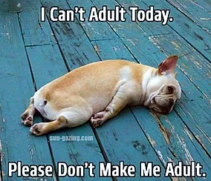
Warning/Reminder/Welcome to Adulting
Students on academic probation, with International requirements, on scholarship, etc.
You are responsible for your performance in this course
If you know that you need a C (or B, or A) in this course then you need to take appropriate steps to achieve this.
I am not responsible if you lose your scholarship, if your performance in this course means that you will be removed from UCF, etc.
You are responsible for your performance in this course.
I am here to help you! I want to help you! But I don’t know that you need help unless you come to see me.

Slide 27
“To do” list for this week:
Purchase Expert TA and iClicker/REEF
Wait on Expert TA until Wednesday or you get an announcement from me
There are no labs this week!
Read pre-lecture readings in Evolution and Natural Selection module
Complete pre-quizzes
Due dates for these are extended until Jan. 13
Attend lectures this week

Slide 28
Questions???

