Slide 1
The Impact of Social and Cultural Contexts on Users' Privacy Management
Yao Li
PhD Candidate
Department of Informatics, University of California, Irvine

Slide 2
About Me
Beijing Foreign Studies University
B.B.A.
E-commerce
Syracuse University
M.S.
Information Management
University of California, Irvine
Ph.D.
Information and Computer Sciences

Slide 3
About Me
Social
Cultural
Social
Cultural
Privacy

Slide 4
CONTENTS
Background
Social Context of Users’ Privacy Management
Cultural Context in Privacy Decision-Making
Future Direction
4

Slide 5
Background
/01
Privacy is context-dependent.
5

Slide 6
Privacy Is Context-Dependent
Context:
The circumstances that surround a situation or event.
Nissenbaum, H. 2009. Privacy in Context: Technology, Policy, and the Integrity of Social Life. Stanford University Press.

Slide 7
Privacy Is Context-Dependent
Technical
Context
Physical
Context
Social
Context
Privacy
Cultural
Context

Slide 8
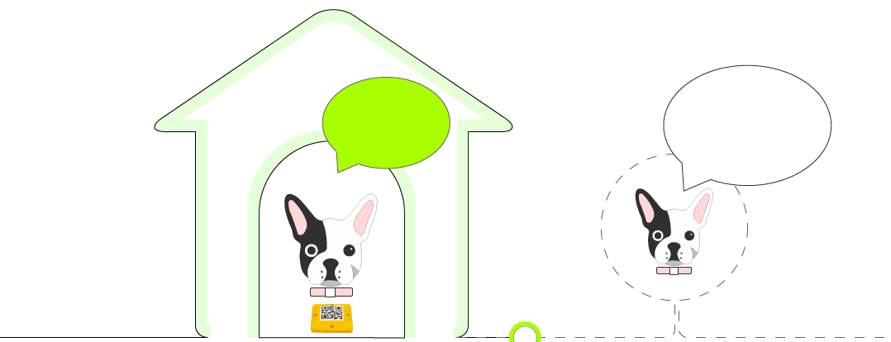
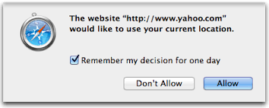
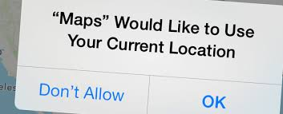
Physical Context in Privacy Management
I am at home. Turn off location tracking to protect my privacy.
I am outside.
OK with location tracking.
Naeini, P.E., Bhagavatula, S., Habib, H., Degeling, M., Bauer, L., Cranor, L. and Sadeh, N. 2017. Privacy Expectations and Preferences in an IoT World. Symposium on Usable Privacy and Security (SOUPS) (Santa Clara, CA, 2017).

Slide 9
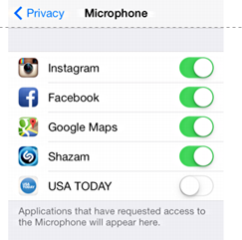
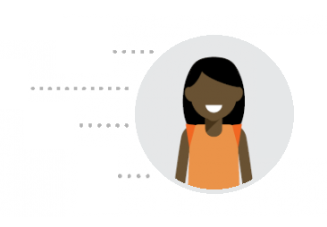
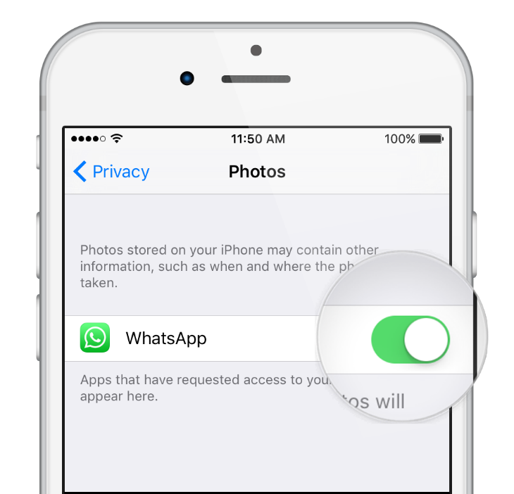
Technical Context in Privacy Management
Home Address
Browsing History
Audio
Photo
Leon, P.G., Ur, B., Wang, Y., Sleeper, M., Balebako, R., Shay, R., Bauer, L., Christodorescu, M. and Cranor, L.F. 2013. What matters to users?: factors that affect users’ willingness to share information with online advertisers. Proceedings of the Ninth Symposium on Usable Privacy and Security (New York, NY, USA, 2013), 7:1–7:12.

Slide 10
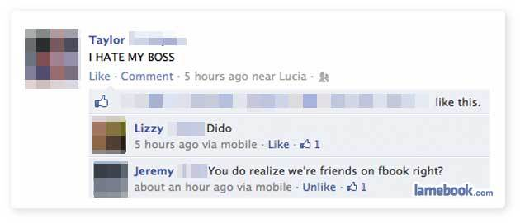
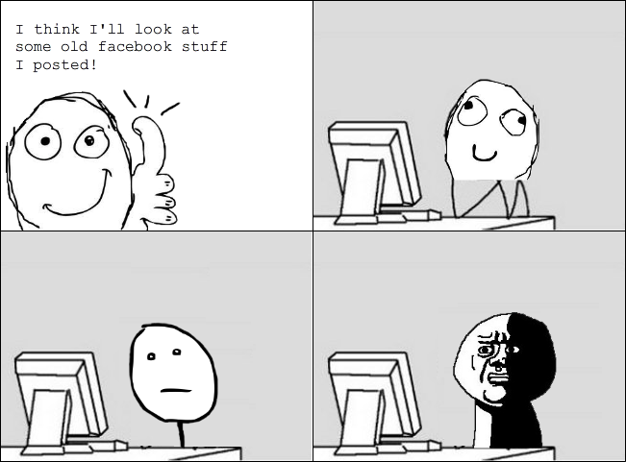
Social Context in Privacy Management
Social settings of information sharing
Content
Appropriateness
Social
Relationships
Environment
Mood
Trustworthiness
……
Marwick, A.E. and Boyd, D. 2011. I tweet honestly, I tweet passionately: Twitter users, context collapse, and the imagined audience. New Media & Society. 13, 1 (Jan. 2011), 114–133.
10

Slide 11
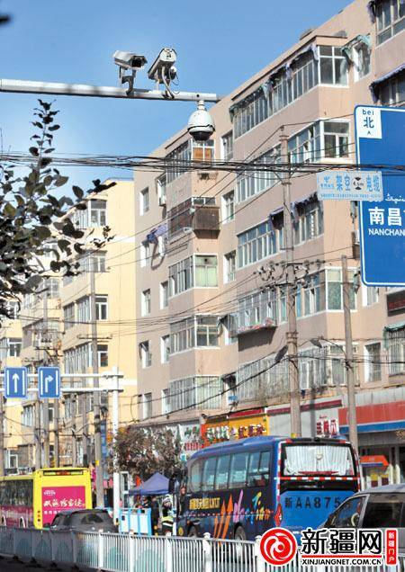
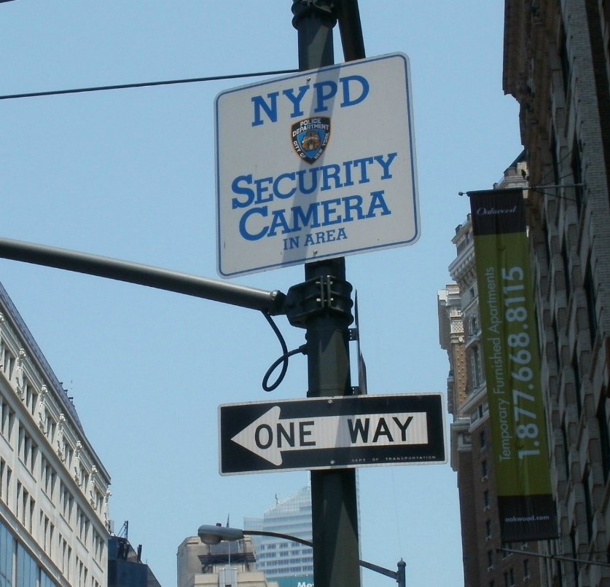
Cultural Context in Privacy Management
Norms of a society in information sharing
Altman, I. 1977. Privacy Regulation: Culturally Universal or Culturally Specific? Journal of Social Issues. 33, 3 (Jul. 1977), 66–84

Slide 12
Motivation
The social and cultural contexts play critical role in shaping users’ privacy attitudes and behaviors, but are less studied in privacy research, and less reflected in privacy settings.

Slide 13
Research Question
How do social and cultural contexts influence users’ privacy management?
Social
Cultural
Privacy

Slide 14
Social Context of Users’ Privacy Management
/02
Social
Cultural
Privacy
14

Slide 15
Publications
Li, Y., Kou, Y., Lee, J.S. and Kobsa, A. 2018. Tell Me Before You Stream Me: Managing Information Disclosure in Video Game Live Streaming. Proc. ACM Hum.-Comput. Interact. 2, CSCW (Nov. 2018), 107:1–107:18.
Li, Y., Gui, X., Chen, Y., Xu, H. and Kobsa, A. 2018. When SNS Privacy Settings Become Granular: Investigating Users’ Choices, Rationales, and Influences on Their Social Experience. Proc. ACM Hum.-Comput. Interact. 2, CSCW (Nov. 2018), 108:1–108:21.
Wang, Y., Li, Y., Semaan, B. and Tang, J. 2016. Space Collapse: Reinforcing, Reconfiguring and Enhancing Chinese Social Practices through WeChat. Tenth International AAAI Conference on Web and Social Media (Mar. 2016).

Slide 16
The Impact of Social Context On Privacy Management
Social
Privacy
16

Slide 17
A video game live streaming tool where users broadcast their gameplay to viewers in real time.

Slide 19
Motivations
Multiple social contexts collapse in video game live streaming.
The real-time nature of live streaming may give rise to new challenges in privacy management.

Slide 20
Research Questions
Is there any privacy issue when players are streamed in video game live streaming?
How does social context impact players’ privacy management in video game live streaming?

Slide 21
Methods
20 interviews with World of Warcraft (WoW) players who had experience with Twitch.
We asked participants about:
General experience with Twitch
Specific experience when being streamed by others in the team
Feelings and strategies when being streamed
Open and axial coding

Slide 22
Finding 1: Concern about bystanders’ privacy
P8: “There was actually a brief period that my baby was talking with my cat while we were going over the raid mechanics because I forgot to mute my mic. (Was it streamed?) Yes…I found it funny because it lightened the mood. But maybe a bit of invasion to privacy.”
22

Slide 23
Finding 2: Concern about norm conflicts
P2: “I sort've feel restricted with what I can say sometimes. My friends and I are used to using vulgar language with each other. We always call each other "faggots" jokingly and on Twitch I feel like we can't really say that in fear of offending someone. We're a clique of friends. Nothing we can say to each other can really offend one another because we all know each other personally. But on Twitch, you never know who's watching.”
23

Slide 24
Finding 3: Concern about group privacy
P7: “The main problem I have with people streaming raids is that guild drama can start with a turn of a switch. Yes, this might be entertaining to watch from a viewer’s view. But it brings un-needed pressure to the guild, if people aren't comfortable with it. Once someone streamed our raid. Two people just started to yell at each other through mic. The whole thing was streamed on Twitch. I felt bad because people were mocking our guild, saying things like “stupid guild”, “the guild is bad”, “the guild leaders suck”. Many people left the guild after that. So did I.”

Slide 25
Theoretical Implications: Two dimensions of the social context in live streaming
Whom the information is about
Who is in control of the information

Slide 26
Two Dimensions to Categorize the Social Context
The group controls whether to disclose about itself.
Whom the information is about
Y is in control of information about herself.
Group
X is in control of information about himself.
Individual Y
Individual X
Who is in control of the information
Individual X
Individual Y
Group

Slide 27
Two Dimensions to Categorize the Social Context
Whom the information is about
X is in control of information about Y.
Group
Individual Y
Y is in control of information about X.
Individual X
Who is in control of the information
Individual X
Individual Y
Group

Slide 28
Two Dimensions to Categorize the Social Context
Whom the information is about
Design Implications
Enhance notification in live streaming;
Indicators to inform bystanders
Different levels of notification
Grant information owners control over their disclosure.
Blur audios of sensitive information
Anonymize characters
X is in control of information about Y.
Group
Individual Y
Y is in control of information about X.
Individual X
Who is in control of the information
Individual X
Individual Y
Group

Slide 29
Two Dimensions to Categorize the Social Context
Whom the information is about
Y controls whether to disclose about the group .
Group
Individual Y
Individual X
Who is in control of the information
Individual X
Individual Y
Group

Slide 30
Two Dimensions to Categorize the Social Context
Whom the information is about
Y controls whether to disclose about Group Z.
Design Implications
Facilitate group collaboration and communication.
Reinforce the group norms
Assign tasks to protect group privacy
Communicate about privacy needs
Group
Individual Y
Individual X
Who is in control of the information
Individual X
Individual Y
Group

Slide 31
Summary
The multiple social contexts in video game live streaming impact users’ privacy management.
Privacy design of live streaming tools should support users’ privacy management in different social contexts.

Slide 32
The Impact of Privacy Configuration on Social Life
Social
Privacy

Slide 33
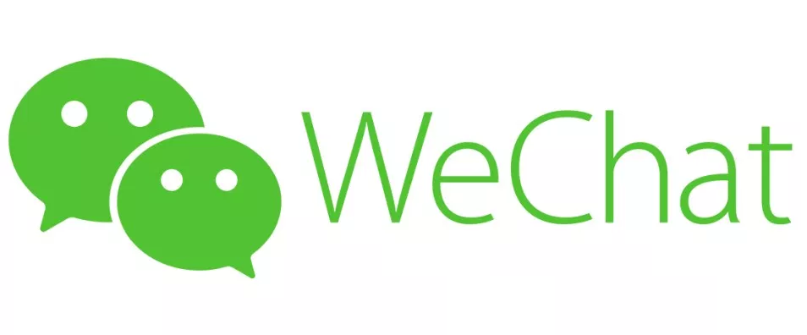
A social network application in China.

Slide 34
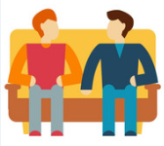
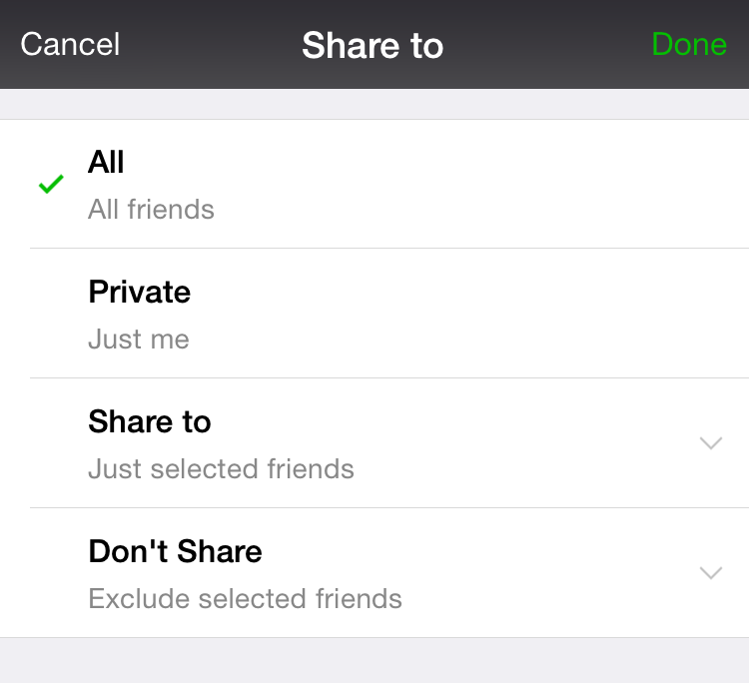
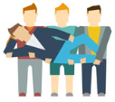
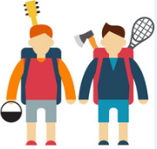
WeChat Privacy Settings
Family
School friend
Boy/Girlfriend
Close friend
Sports friend
Travel friend
Colleagues
Acquaintance
……

Slide 35
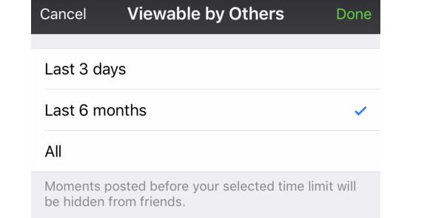
WeChat Privacy Settings

Slide 36
Motivations
Prior research focuses on how to make the privacy settings granular enough to protect privacy.
It is unknown how granular privacy settings impact users’ social interaction in the long run.

Slide 37
Research Question
How does granular privacy configuration impact their social life?

Slide 38
Methods
24 interviews with WeChat users.
We asked participants about:
Usage of WeChat, Moments, and WeChat privacy settings
How to control their audience using WeChat privacy settings when posting Moments
What to perceive as the impact of privacy settings
Thematic analysis in an inductive approach.

Slide 39
Finding 1
Users can find out whether they are the targets of someone’s privacy settings by:
Communicating with unimpacted users about someone’s information sharing;
Inferring from the interface.
P3: “I blocked a friend. This person could not see my posts. When he talked with one of my other friends, he found that he could not see my posts and felt like I blocked him.”

Slide 40
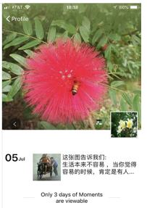
Finding 1
Users can find out whether they are the targets of someone’s privacy settings by:
Communicating with unimpacted users about someone’s information sharing;
Inferring from the interface.

Slide 41
Finding 2: Privacy Configuration Undermines Social Relationships
P11: “Someone blocked me. When I hang out with our mutual friends, they mentioned something he posted, but I could not see it. I know that I am blocked. I will keep my distance from him in future. It means that I am not that close to him, nor trusting to him. We probably have a lot of discrepancies. I will keep my distance from him.”

Slide 42
Finding 3: Privacy Configuration Restricts Information Flow
P17: “I found my boyfriend using a three-day limit. I asked him to change that, because people may not know he has a girlfriend.”

Slide 43
Theoretical Implications
Our study raises the caution that granular privacy configuration may cause unpleasant impact on users’ social interactions and information disclosure.

Slide 44
Design Implications
Systems should consider the negative social impact.
Remind users about the potential problems
Show something to the blocked audience.
Design for the privacy of chosen privacy settings.
Hide one’s privacy configuration from others.

Slide 45
Summary
SNS privacy configurations may cause negative impact on users’ social life, which brings new challenges to privacy design.

Slide 46
Summary of Research in Social Context
Users’ privacy management is influenced by multiple social contexts, suggesting that we should design privacy support for different social contexts.
Social
Cultural
Privacy
SNS privacy configurations may cause negative impact on users’ social life, which brings new challenges to privacy design.

Slide 47
Cultural Context in Privacy Decision-Making
/03
Social
Cultural

Slide 48
Publication
Li, Y., Kobsa, A., Knijnenburg, B.P. and Nguyen, M.-H.C. 2017. Cross-Cultural Privacy Prediction. Proceedings on Privacy Enhancing Technologies. 3, 2 (2017).
Cho, H., B. Knijnenburg, A Kobsa, Yao Li. 2018. Collective Privacy Management in Social Media: A Cross-Cultural Validation.
ACM Transactions on Computer-Human Interaction. Vol 25 Issue 3, June 2018. Article 17, 33 pages.

Slide 49
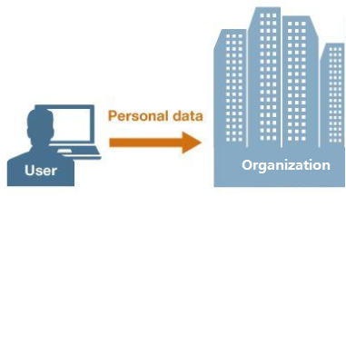
Personal Data Collection By Multinational Organizations

Slide 50
Motivations
More and more technologies are used at a global scale, but many privacy studies focus on a single country.
Little understanding about the concrete cultural differences of users’ privacy decision-making in various data collection scenarios.

Slide 51
Research Question
How does users’ national cultural backgrounds impact their privacy decision-making?

Slide 52
Culture
Collective programming of the mind that distinguishes the members of one group from others.
Hofstede, G.H. and Hofstede, G. 2001. Culture’s Consequences: Comparing Values, Behaviors, Institutions and Organizations Across Nations. SAGE.

Slide 53
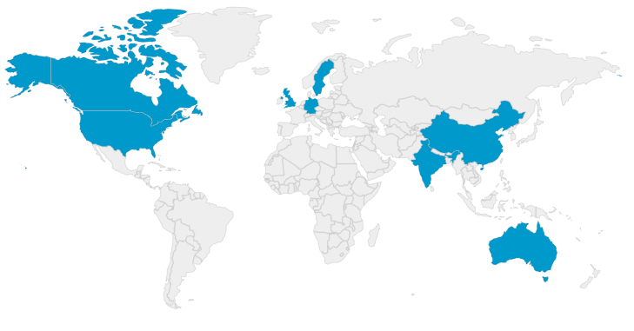
Methods
9625 scenario-based online survey responses from eight countries:
Canada
China
Germany
United States
United Kingdom
Sweden
Australia
India
12%
13%
12%
13%
13%
12%
12%
13%
Hofstede, G.H. and Hofstede, G. 2001. Culture’s Consequences: Comparing Values, Behaviors, Institutions and Organizations Across Nations. SAGE.

Slide 54
Methods
“From my mobile device, I will provide my current location and contact list to a service provider. The service provider is a company with no locations in my country. The service provider will use the information as I agreed. It will also save me time or money.”
Data Collection Method
Data Collection Entity
Data Collection Purpose
Value Exchange from Data Collection
Accept
No

Slide 55
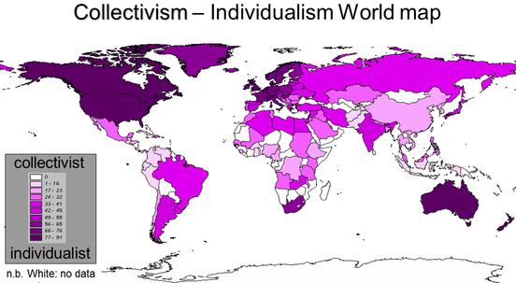
Hofstede’s Cultural Scores for Countries
Power distance
Individualism
Uncertainty avoidance
Indulgence
Masculinity
Pragmatism
Source: https://geerthofstede.com/culture-geert-hofstede-gert-jan-hofstede/6d-model-of-national-culture/

Slide 56
Methods
Supervised Machine Learning
Generalized linear mixed effects models

Slide 57
Finding 1: Cultural Factors Improve the Prediction
Baseline Feature | Cultural Feature | Acc. (%) | F
demographic + technical + attitudinal |  | 76.1580 | 0.722
 | +Hofstede | 76.7978 | 0.741
 | +Power Distance (PDI) | 76.7394 | 0.740
 | +Individualism (IND) | 76.7978 | 0.741
 | +Masculinity (MAS) | 76.1641 | 0.721
 | +Uncertainty Avoidance(UAI) | 76.5861 | 0.729
 | +Pragmatism (PRA) | 76.6104 | 0.734
 | +Indulgence (IDL) | 76.7978 | 0.741

Slide 58
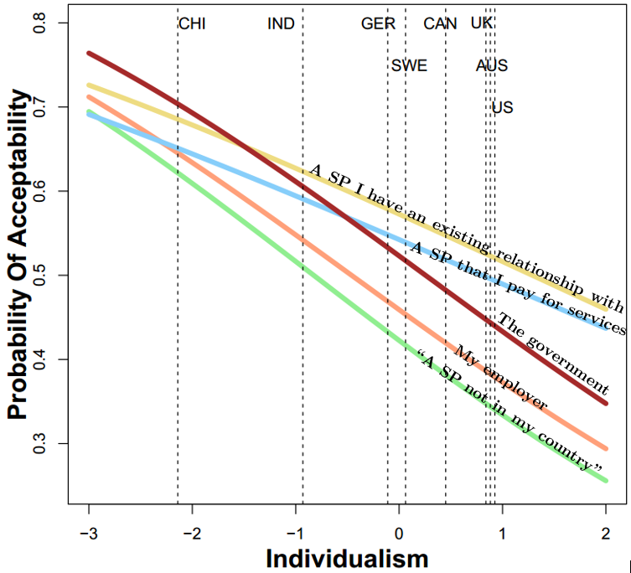
Finding 2: Cultural Differences in Data Collection Entities
Low-individualism countries:
Government
High-individualism countries:
Paid service providers
Service providers with an existing relationship

Slide 59
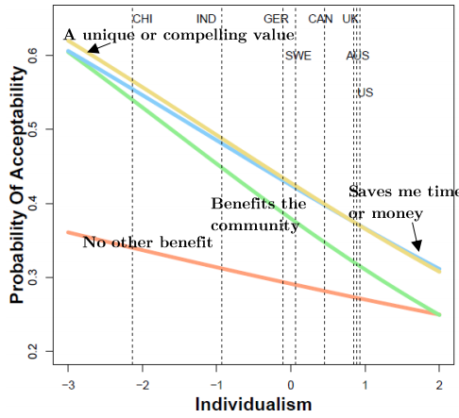
Finding 3: Cultural Differences in Value Exchange
Low-individualism countries:
Benefit the community
Compelling value
Save me time or money
High-individualism countries:
Compelling value
Save me time or money

Slide 60
Design Implications
Multinational organizations should customize data collection strategies in different countries.
Privacy design should consider the cultural backgrounds of users.
Privacy prediction and recommendation algorithms should consider the cultural features.

Slide 61
Summary
Adding cultural factors can improve privacy decision prediction.
Users’ privacy decision-making varies in different cultural contexts.

Slide 62
Summary Of My Research
Social
Cultural
Privacy
Users’ privacy management is influenced by multiple social contexts in video game live streaming.
SNS privacy configurations may cause negative impact on users’ social life.
Adding cultural factors can improve privacy decision prediction.
Users’ privacy decision-making varies in different cultural contexts.
Privacy design should support users’ privacy management in different social and cultural contexts.

Slide 63
Future Direction
/04

Slide 64
Future Directions
Better Support Users’ Privacy Management
Individual Differences in Contextual Impact
Improve the Prediction of Privacy Decision-Making
Propose Personalized Context-Aware Privacy Designs
Examine Contextual Factors in Emerging Technologies

Slide 65
Future Directions
Better Support Users’ Privacy Management
Individual Differences in Contextual Impact
Does contextual impact differ for individuals with varying levels of:
Privacy concerns
Privacy self-efficacy
…

Slide 66
Future Directions
Better Support Users’ Privacy Management
Improve the Prediction of Privacy Decision-Making
How to further improve the privacy decision prediction by:
Adding social and cultural factors
Adding individual differences
Adding other contextual factors
…

Slide 67
Future Directions
Better Support Users’ Privacy Management
Propose Personalized Context-Aware Privacy Designs
How to reflect social and cultural contexts in privacy settings?
How do users feel about such design?

Slide 68
Future Directions
Better Support Users’ Privacy Management
Examine Contextual Factors in Emerging Technologies
Smart home
Smart city
Internet of Things

Slide 69
I am grateful to:
Advisor:
Dr. Alfred Kobsa
Dissertation Committee:
Dr. Gloria Mark
Dr. Kai Zheng
Dr. Bart Knijnenburg
Collaborators:
Dr. Bart Knijnenburg
Dr. Hichang Cho
Dr. Yang Wang
Xinning Gui (PhD Candidate)
Dr. Yubo Kou
Eugenia Rho (PhD Candidate)
Jesoek Lee (PhD Candidate)
Dr. Yunan Chen
Dr. Heng Xu
Dr. Bryan Semaan
Dr. Jian Tang

Slide 70
Publications
Social Context:
Li, Y., Kou, Y., Lee, J.S. and Kobsa, A. 2018. Tell Me Before You Stream Me: Managing Information Disclosure in Video Game Live Streaming. Proc. ACM Hum.-Comput. Interact. 2, CSCW (Nov. 2018), 107:1–107:18.
Li, Y., Gui, X., Chen, Y., Xu, H. and Kobsa, A. 2018. When SNS Privacy Settings Become Granular: Investigating Users’ Choices, Rationales, and Influences on Their Social Experience. Proc. ACM Hum.-Comput. Interact. 2, CSCW (Nov. 2018), 108:1–108:21.
Wang, Y., Li, Y., Semaan, B. and Tang, J. 2016. Space Collapse: Reinforcing, Reconfiguring and Enhancing Chinese Social Practices through WeChat. Tenth International AAAI Conference on Web and Social Media (Mar. 2016).
Cultural Context:
Li, Y., Kobsa, A., Knijnenburg, B.P. and Nguyen, M.-H.C. 2017. Cross-Cultural Privacy Prediction. Proceedings on Privacy Enhancing Technologies. 3, 2 (2017).
Cho, H., B. Knijnenburg, A Kobsa, Yao Li. 2018. Collective Privacy Management in Social Media: A Cross-Cultural Validation. ACM Transactions on Computer-Human Interaction. Vol 25 Issue 3, June 2018. Article 17, 33 pages.

Slide 71
Thanks!

