Slide 1
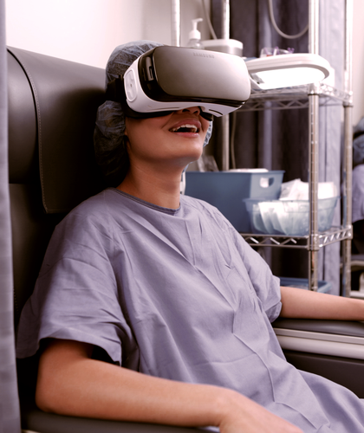
Virtual Reality for Cancer Patients: A Design Thinking Approach for a Sensory Experience to Reduce Stress and Pain
Diana Scates, Dr. Joan Dickinson, Profa. Kathleen Sullivan, Dr. Holly Cline, and Dr. Rama Balarama MD

Slide 2
PURPOSE OF THE RESEARCH STUDY:
Determine if the designed Virtual Reality nature video simulation will reduce stress and pain among cancer patients while the oncologist nurse is accessing the individual’s port or executing the IV procedure.

Slide 3
INTRODUCTION

Slide 4
INTRODUCTION:
One in two men and one in three women will be diagnosed with cancer in the United States per year (American Cancer Society, 2016)*1
Treatment of pain is generally with medication and non-drug therapies, but not with Virtual Reality
1- https://www.cancer.org/research/cancer-facts-statistics/all-cancer-facts-figures/cancer-facts-figures-2016.html

Slide 5
INTRODUCTION:
Virtual Reality immersion experience has the potential to:
Distraction factor by increasing pleasant stimuli thus reducing anxiety and pain.
Might trigger good memories and ease treatment session while at the cancer center.
Weber-Fechner Law states that “as we get “used to” a level of stimuli, we need a greater intensity of that stimulus in order for us to notice a change” (Kopec, 2012, p. 23).

Slide 6
LITERATURE REVIEW

Slide 7
LITERATURE REVIEW:
According to the American Cancer Society (2016), cancer is the second most common cause of death in the US, exceeded only by heart disease and accounts for nearly one of every four deaths.
The objective of this study is to use the Virtual Reality headset immersion experience with the purpose of refocusing cancer patients’ mindsets by enhancing their sensory vision and hearing into pleasant environmental views and sounds that ultimately will help the patient to alleviate pain and stress.

Slide 8
LITERATURE REVIEW:
Dr. Roger Ulrich (2013) stated that: There is a pattern of evidence that suggests that well-designed gardens can reduce stress, lower blood pressure, and relax people.
According to Kellert (2012, p. 21) “the contact with nature is vital to human intellectual development because the natural world is the most information-rich and sensory-stimulating environment people can ever encounter”.

Slide 9
LITERATURE REVIEW:
According to Dr. Hoffman, “the fact that you are getting such huge reductions in pain using something that is not a drug is a paradigm shift”
A published research about Virtual Reality as a distraction intervention for women receiving chemotherapy at the Oncology Nursing Forum (2004)3, shows that the distraction intervention tool decreased distress symptoms, and it was well received by the patients.

Slide 10
LITERATURE REVIEW:
Dr. Giordano has shown that immersing patients into Virtual Reality scenarios have helped patients to reduce their stress during cancer treatment.
“The Virtual Reality experience has improved patients’ emotional well-being as well as diminished their cancer-related psychological symptoms.”

Slide 11
METHODOLOGY

Slide 12
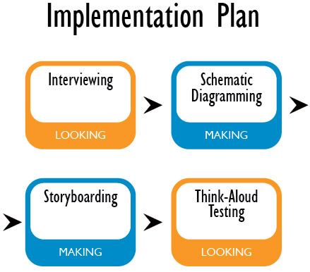
METHODOLOGY:
Part 1
DESIGN THINKING
STRATEGIES
The objective is to determine which content information (video) will be most suitable for the Virtual Reality experience in this study.

Slide 13
METHODOLOGY:
Part 2
Control Group
No VIRTUAL REALITY
Experimental Group
With VIRTUAL REALITY
Target population consists of 50 adults
EXPERIMENTAL DESIGN
Both groups were posttested on the dependent variables (stress and pain).

Slide 14
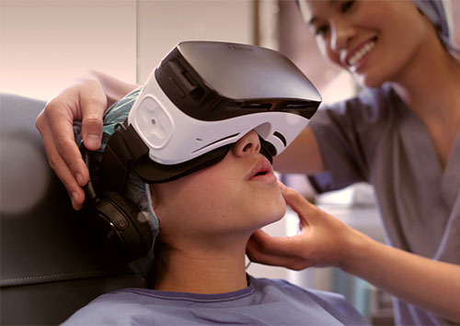
FINAL THOUGHTS

Slide 15
MEMORIES:
WHAT CAN I DO TO MAKE GOOD MEMORIES?
HOW CAN I CREATE MEMORIES THAT WILL LAST FOR THE REST OF MY LIFE?

Slide 16
MEMORIES:

Slide 17
QUESTIONS?
Diana Scates – dscates@email.radford.edu and diana.scates@gmail.com
Radford Univeristy – Spring 2018

