Slide 1
Training Perceptual-Cognitive Skills with Video Occlusion Technology
Dr. Len Zaichkowsky
Director of Sport Science
gameSense Sports LLC
M&S Seminar Series
17 October 2017

Slide 3
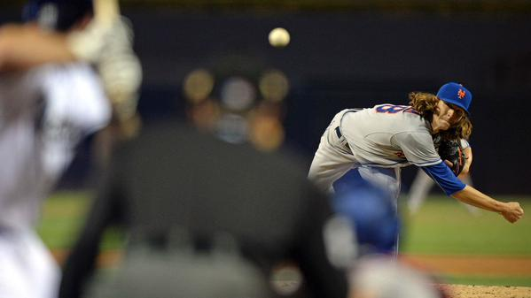

Slide 4
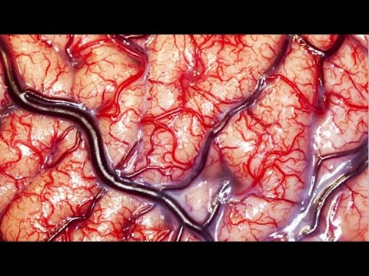

Slide 5
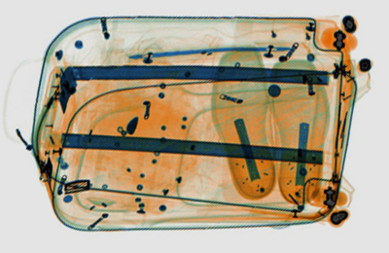

Slide 6
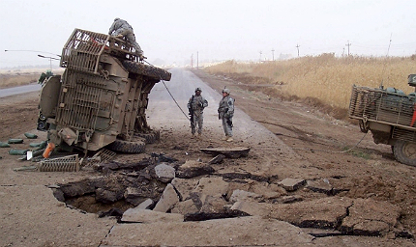

Slide 7
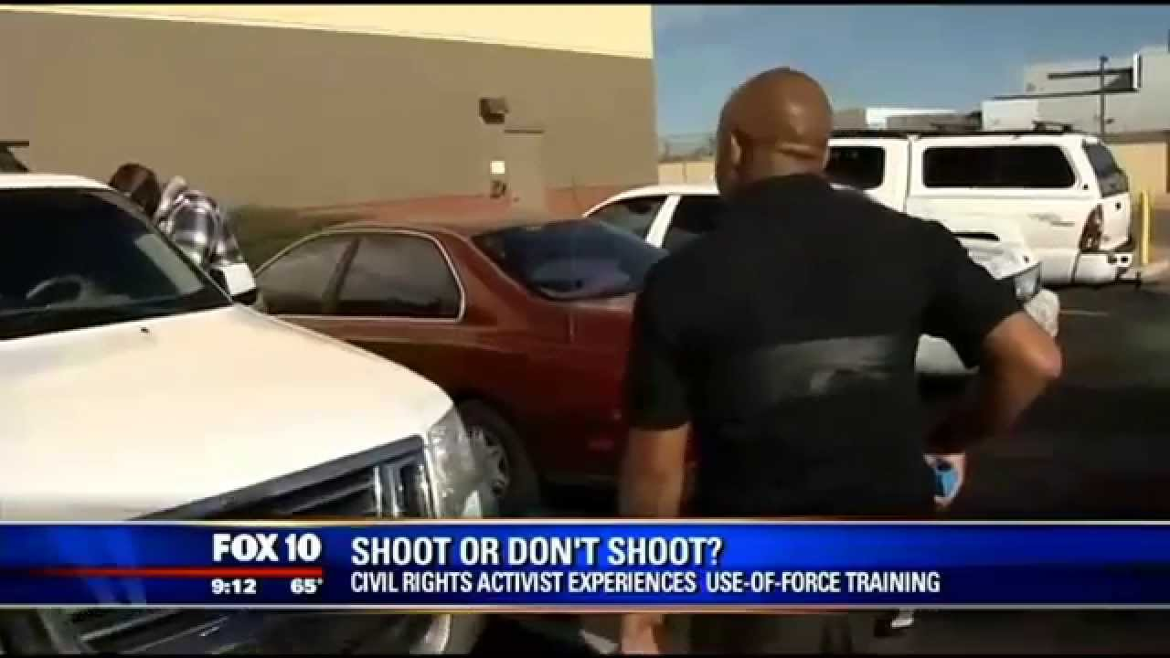

Slide 8
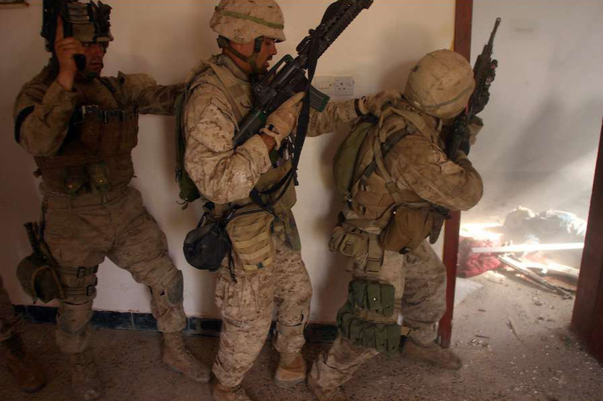

Slide 9
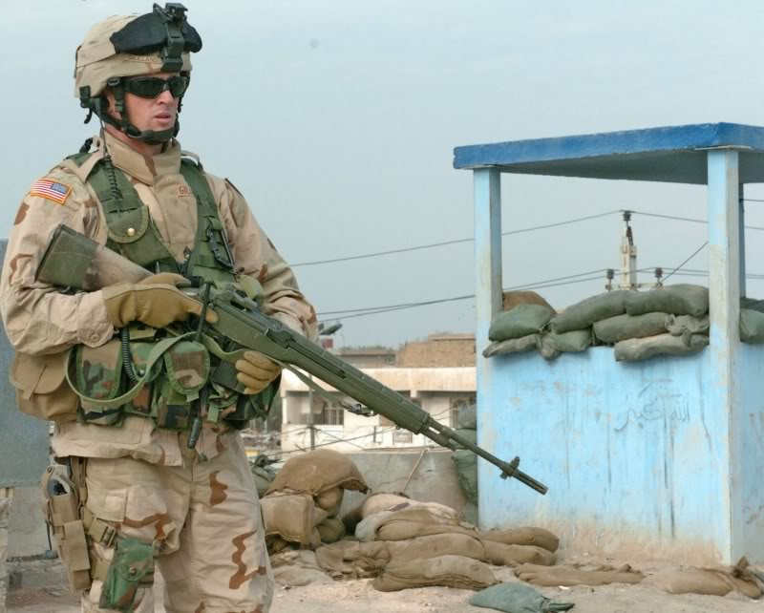

Slide 10
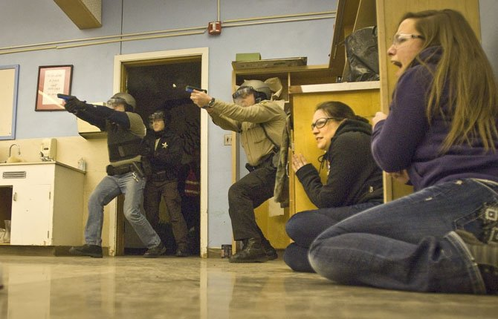

Slide 11
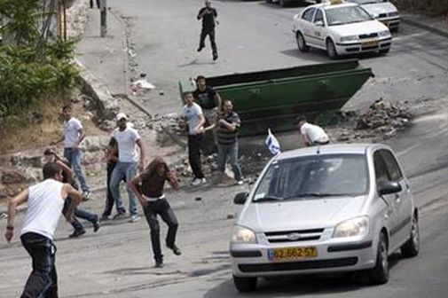
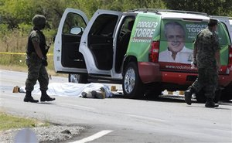

Slide 12
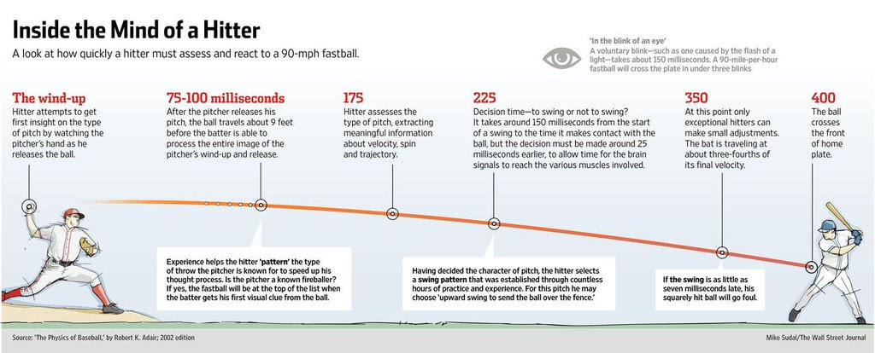

Slide 14
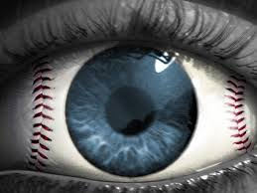

Slide 17
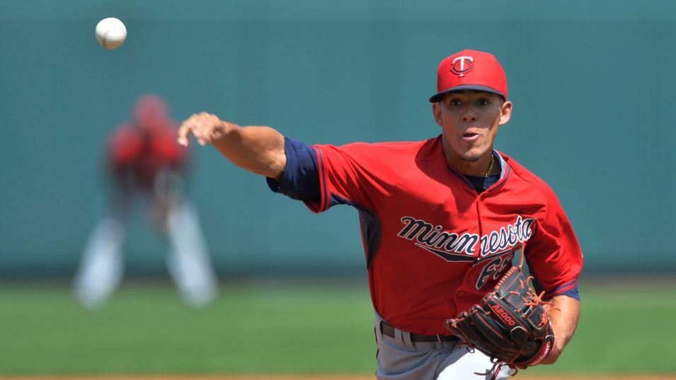

Slide 18
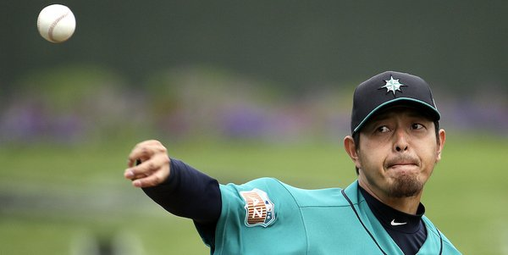

Slide 21
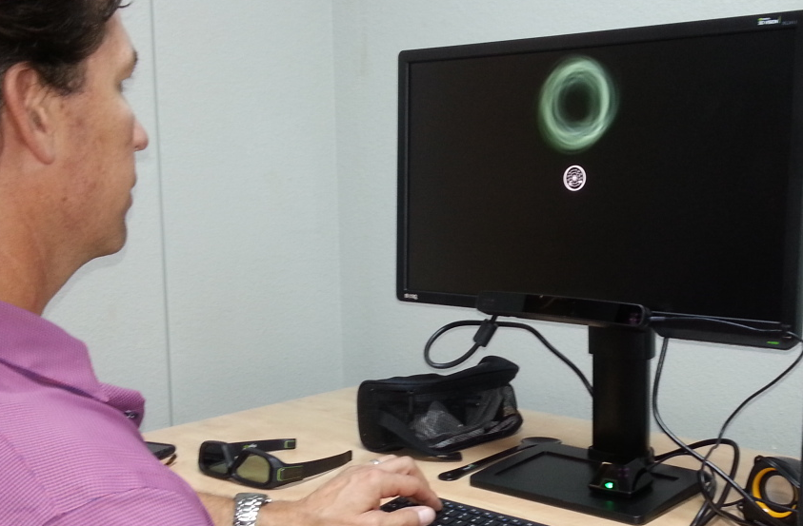

Slide 22
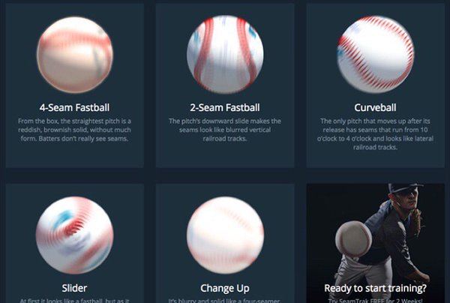

Slide 24
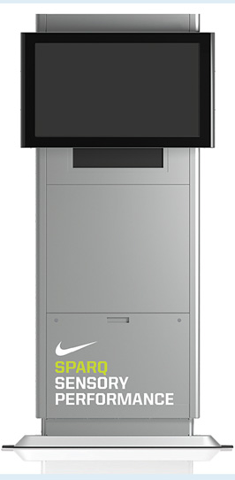
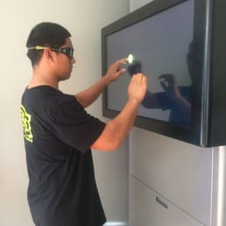

Slide 25
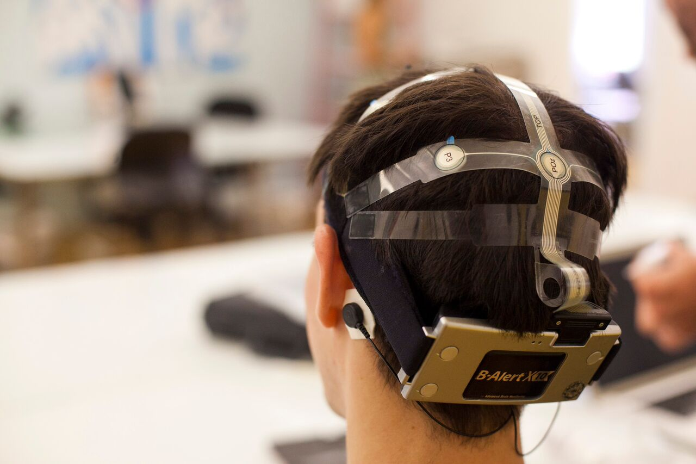

Slide 28
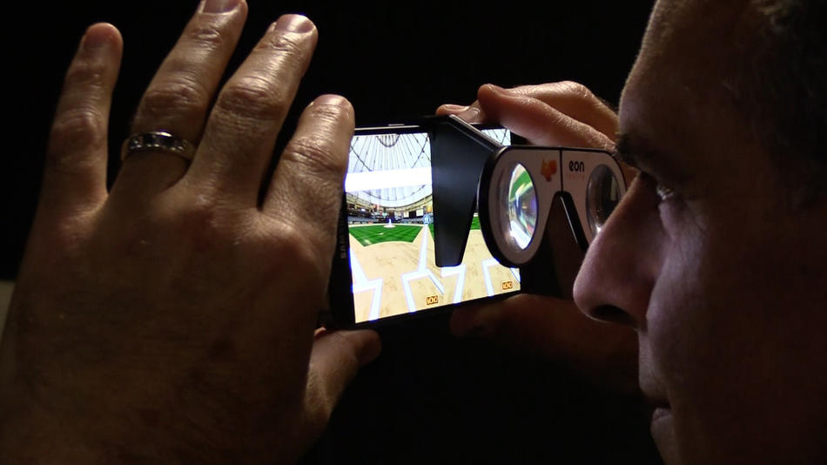
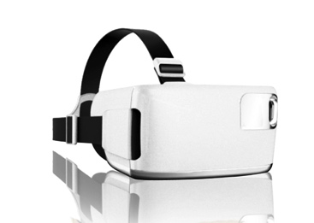
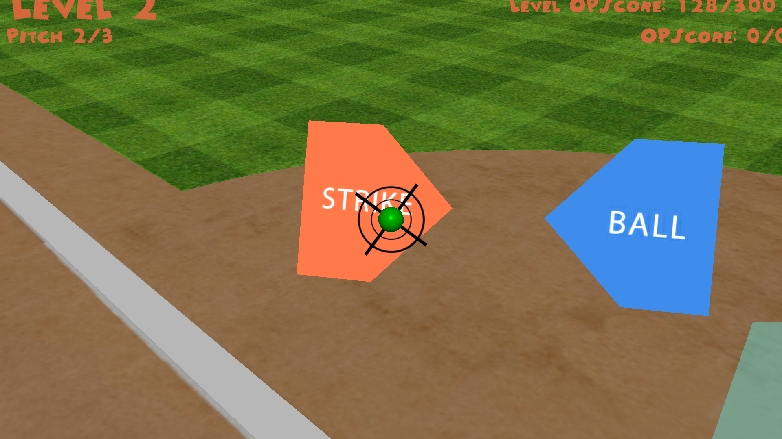

Slide 30
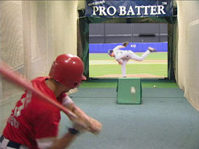

Slide 34
Video-Occlusion Test
1 – Curveball Strike
2 – Fastball Strike
3 – Fastball Strike
4 – Curveball Strike
5 – Curveball Strike

Slide 35
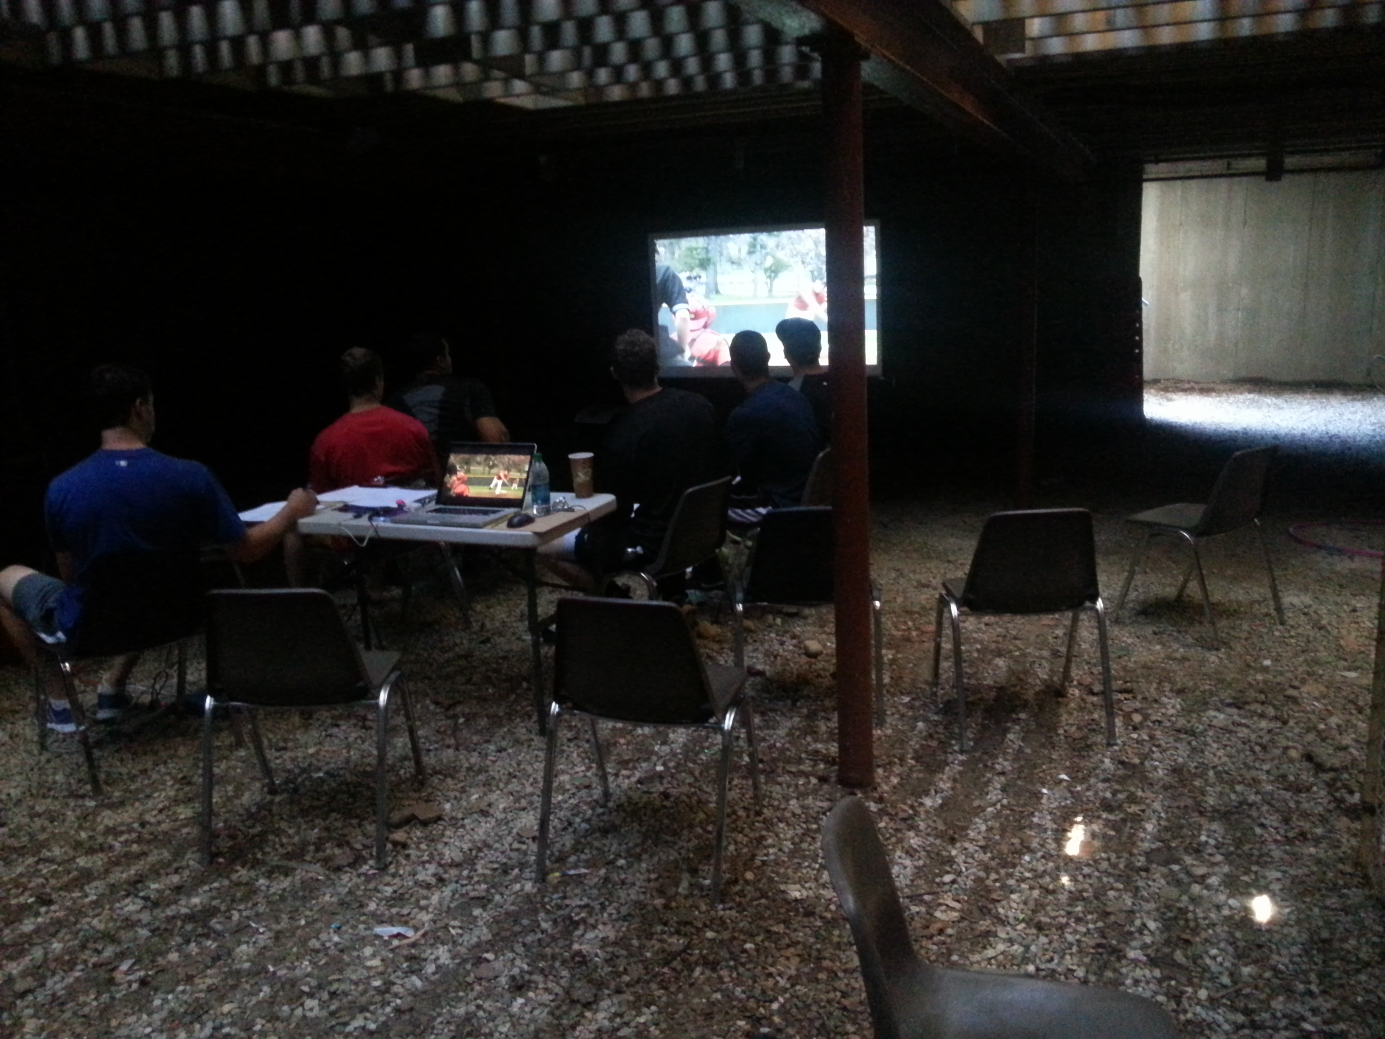
Video-Occlusion Research

Slide 36
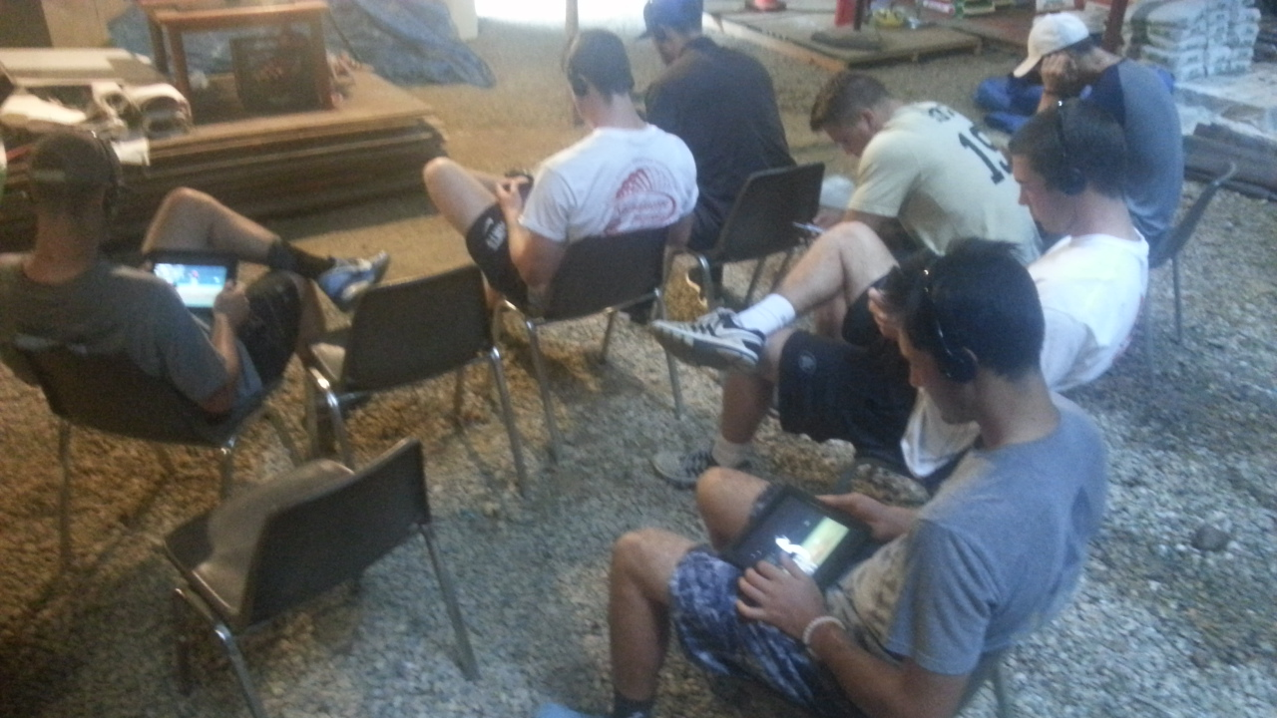

Slide 37
Morris-Binelli, Muller, & Fadde (2017) Use of Pitcher Game Footage to Measure Visual Anticipation and its Relationship to Baseball Batting Statistics

Slide 38
Morris-Binelli, Muller, & Fadde (2017) Use of Pitcher Game Footage to Measure Visual Anticipation and its Relationship to Baseball Batting Statistics

Slide 39
Morris-Binelli, Muller, & Fadde (2017) Use of Pitcher Game Footage to Measure Visual Anticipation and its Relationship to Baseball Batting Statistics

Slide 43
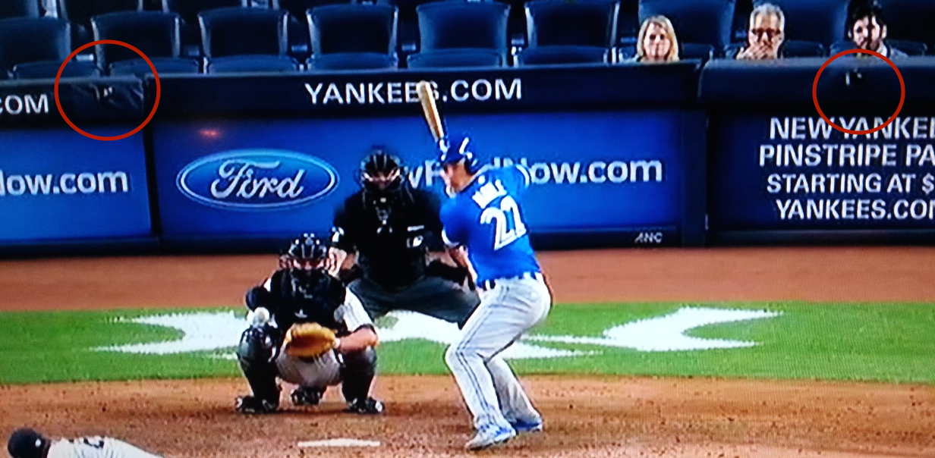

Slide 46
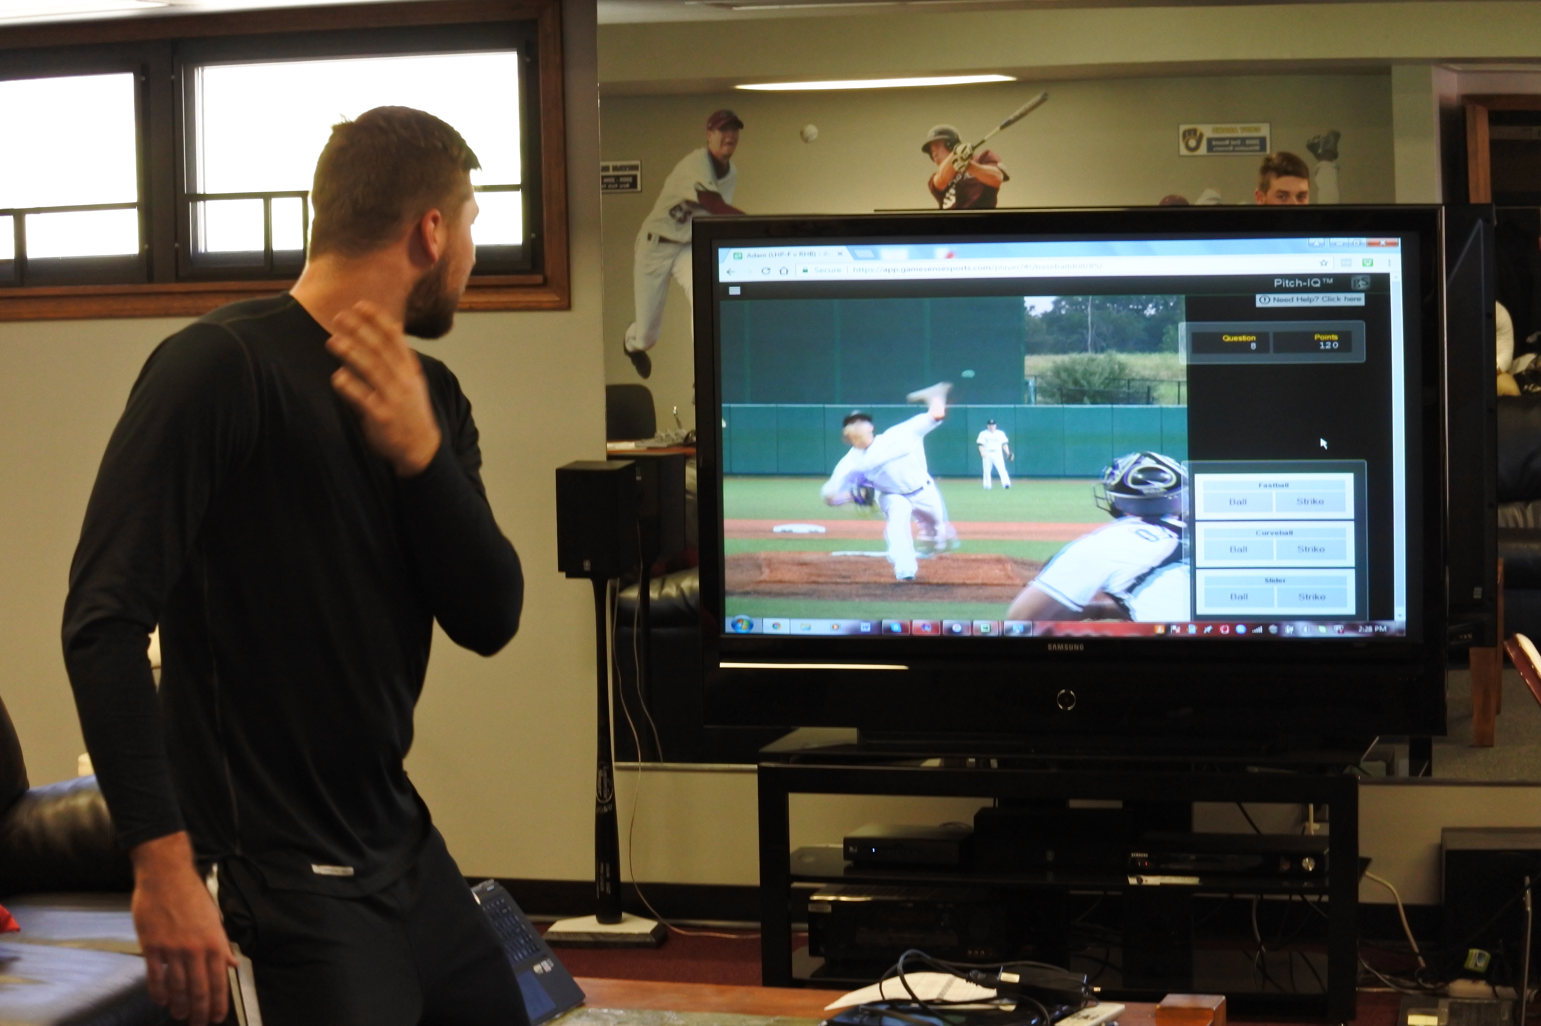

Slide 47
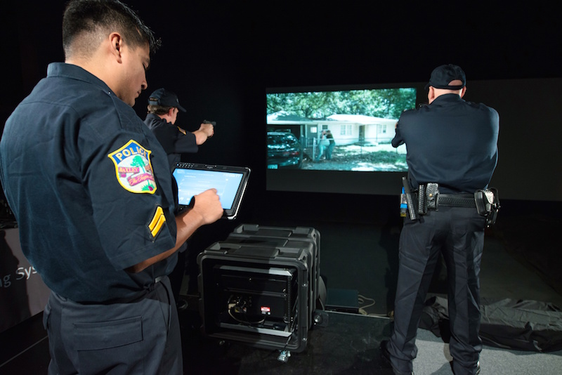

Slide 48
More Realistic
≠
More Learning

Slide 49
Entertaining
≠
Training

Slide 50
Research method
=
Testing method

Slide 51
Testing method
=
Training method

Slide 61
The gameSense roadmap
C
Research challenge 2010-2017
Medical
Threat Recognition
Use-of-Force
House Clearing
Checkpoint
Active Shooter
Vehicle Ambush
Commercial sports training solutions that are:
Effective with validated results
Convenient, deployable, scalable
Targeted, affordable
C
Next step: extension of sports technology & products to mission-critical domains:

Slide 62
BACKUP SLIDES
UCF 17Oct2017

Slide 63
Pitch Recognition Training: Results

Slide 64
5
A Offensive Adv. B Defensive Adv.
5
4
3
2
1
End

Slide 67
