Slide 1
Chris Kyle
Brieanna Ceto
Tyler Smith
Chad Robison
Samantha Doome
Andressa Faria

Slide 2
Who is Chris Kyle?
MILITARY MAN
United States Navy SEAL veteran and sniper
Served 4 tours in the Iraq war
Awarded 1 silver star medal; 4 bronze star medals
Skilled marksman
Killed around 160 people within military career

Slide 3
Who is Chris Kyle?
EARLY LIFE
Born April 8, 1974
Son of church deacon
Grew up on a ranch in Odessa, Texas
Hobbies: hunting, competing in bronco busting contests, other outdoor activities

Slide 4
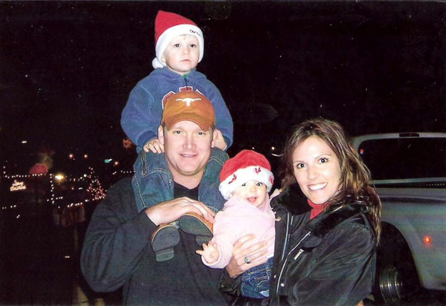
Who is Chris Kyle?
AFTER MILITARY LIFE
Left military in 2009
Lived in Midlothian, Texas with his wife and 2 children
Co-launched a non-profit group FIRCO Cares Foundation
Founded Craft International, a security company

Slide 5
Who is Chris Kyle?
AFTER DEATH
Murdered by Eddie Ray Routh on February 2, 2013
In 2014 Kyle’s book American Sniper was released

Slide 6
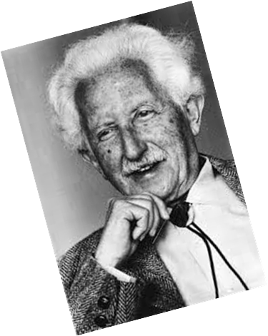
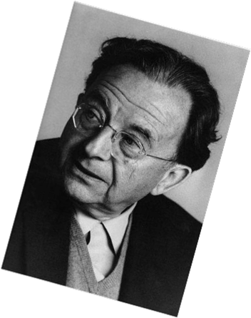
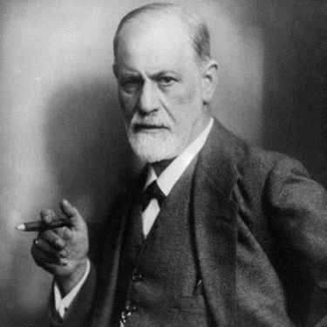
Three Theorists
Fromm
Human Needs
Mechanism of Escape
Erikson
Psychosocial Development
Freud
Levels of Mental Life
Structural Model of Personality
Defense Mechanisms

Slide 7
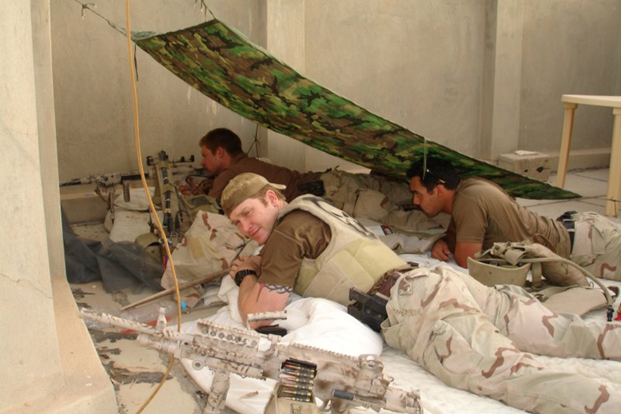
Chris Kyle Related to Fromm’s Human Needs
Relatedness – Chris portrayed relatedness of all three calibers (Submission, Power, and Love) when joining the military. The military is a relationship in which an individual is forced to be submissive, but yet allows them to express great power through their actions. Chris was able to experience the love of his fellow brother’s in arms. There is no greater bond than the bond developed during combat.
Transcendence – This is seen when Chris ends his military career and becomes a volunteer helping physically and emotionally injured vets. Chris tries to create life by expressing positive emotions and being readily available to the vets he is helping.

Slide 8
Chris Kyle Related to Fromm’s Human Needs (Continued)
Rootedness – Chris establishes his rootedness in a small town in Texas after his discharge from the military. This allowed him to establish a sense of roots and begin his volunteer work.
Sense of Identity – Chris battled with his sense of identity after his discharge. He was unable to say “I am…”. This lead Chris to finding the work with other veterans. The work helped Chris re-establish his sense of identity.
Frame Orientation – Chris struggled with frame orientation at many stages of life. Chris need to be able to have a purpose. When his career in the rodeo ended due to an injury, he had to find another destination, this became the military. After the military he struggled until becoming active with veterans.

Slide 9
Chris Kyle Related to Fromm’s Mechanism of Escape
Authoritarianism – Fromm’s definition of authoritarianism is portrayed by Chris in his devotion to the military. He gave up his independence and own individuality and sense of self to join a cause outside of himself. The military if extremely demanding in and of itself. Candidates of the BUD/S school are put through even more with various additional physically and emotionally demanding tasks.
Destructiveness – Chris portrays Fromm’s destructiveness in his action as a Navy Seal Sniper. Chris destroys objects and persons in an attempt at feelings of power. He is extremely successful in portraying this destructiveness and power with what is said to be 150 confirmed kills.

Slide 10
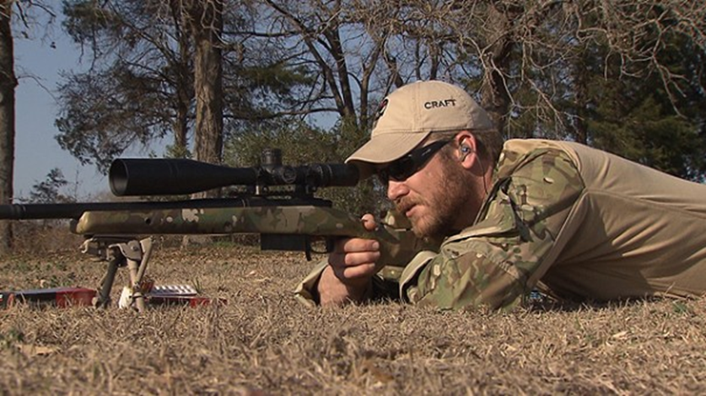
Chris Kyle Related to Fromm’s Mechanism of Escape (Continued)
Positive Freedom – Chris joined the Navy Seals on a whim when he was injured and could no longer ride in the rodeo. This shows Chris was acting in positive freedom with a spontaneous expression of rational and emotional decisions. Chris needed a sense of freedom. The select group Chris joined, the Navy SEALS, gave him the opportunity to be a part of something bigger than himself but still experience the freedom his spontaneous personality required.

Slide 11
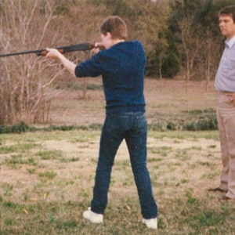
Chris Kyle Related to Erik Erikson’s Psychosocial Development
Industry vs Inferiority – This stage was very important for Chris because it is when the child feels the need to win approval by demonstrating specific competencies that are valued by society, and begin to develop a sense of pride in their accomplishments. Chris and his brother both grew up hunting with their father, who gave Chris his first rifle when he was 8 years old, which explains Chris’ need to win his father’s approval. That is when Chris started to develop his sense of pride for killing, which became his biggest accomplishments in the military. He must have hated the killing but he liked the sense of purpose and the outcome of it; protecting the innocent and fighting for justice. These were morals that his father taught him and made him who he was later on in life.
Notes:
Erikson believed that development is primarily qualitative because its stages are the same as changes in growth, but also quantitative as you will find your identity and that becomes stronger as well as your morals, values will solidify throughout the stages of development. He believed that nature determines the order of the stages and sets the limits within which nurture operates. However, in order for you to fulfill all the stages, you must pass one successfully in order to step to the next one.

Slide 12
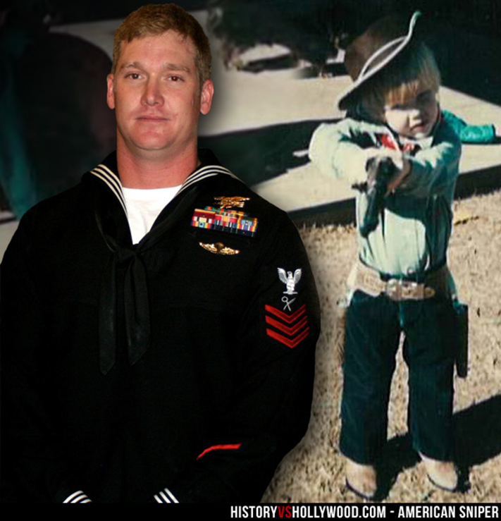
Identity vs Role Confusion – Chris became a professional bronco rodeo rider after graduating high school but his career ended due to an injury in his arm. He later became interested in joining the U.S Marine Corps Special Operations but decided to try the Navy SEALs instead. This stage of development is crucial for the adolescent since it is the transition between childhood to adulthood, this is where the child will learn different roles that he will occupy as an adult. This certainly shaped Chris Kyle into eventually becoming what he is identified now as the best sniper in history. He was trying to find his identity through different activities with the morals his father taught him.
Notes:
Erik would say that this stage is important for social interactions and developing that sense of morality, distinguishing right from wrong.

Slide 13
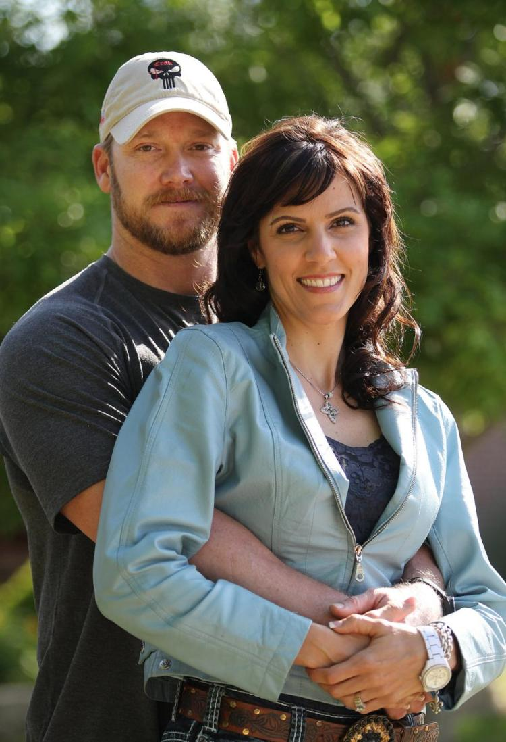
Intimacy vs Isolation – Chris was in need to fulfill that intimacy stage, this is when he met his wife, Taya Kyle. Erikson described a successful completion of this stage to lead to comfortable relationships, a sense of commitment, safety, and care within a relationship. Avoiding intimacy and fearing commitment can lead to isolation, loneliness, and sometimes depression. This is when Chris started to develop early signs of PTSD; every time he would come back home to his wife and children he would struggle with the transition to the civilian life. Chris also struggled with his roles as husband and father to his two young children. Chris experienced isolation by being away from his family for a long time, causing him to mentally go “crazy” as his wife described him. Taya Kyle said that “He left the war but the war never left him”, in other words, he was physically present but not mentally. Chris Kyle’s mind wondered around for that sense of commitment and intimacy.

Slide 14
Generativity vs Stagnation - Kyle never reached the appropriate age for this stage but we could clearly see that his brain had developed early. When Chris decided to quit being a snipper, he was already suffering from PTSD and had problems readjusting to his family life. This stage is about establishing careers, settling down in a relationship, starting a family, and developing a sense of being a part of the bigger picture. By failing to achieve these objectives, we become stagnant and feel unproductive.
Notes:
This describes a lot about what was happening in Chris’ life, especially psychologically, because he had trouble identifying himself after leaving the SEALs and trying to establish a new identity off the battlefield. He tried different ways to feel and be better before having the idea to help other veterans with similar struggles and problems, like suffering from PTSD and other disabilities. Chris provided life-coaching and personal training. This is where he found himself being part of the bigger picture and had the feeling of being complete, this is the first step to overcoming stagnation which make us feel incomplete and that we don’t do anything “right”.

Slide 15
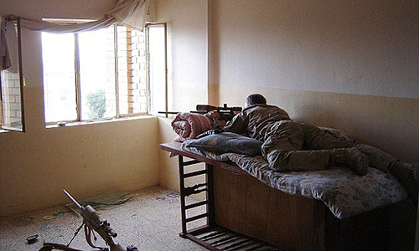
Chris Kyle related to Freud’s levels of mental life
Unconscious mind:
Freud found that some events and desires were too frightening or painful for people and believed that information was locked away in the unconscious mind. Chris Kyle stated in his interview “you don’t think of the people you kill as people, they’re just targets. You can’t think of them as people with families and jobs. They rule by putting terror in the hearts of innocent people. The things they would do—beheadings, dragging Americans through the streets alive. the things they would do to little boys and women just to keep them terrified and quiet. That part is easy. I definitely don’t have any regrets about that.”
Notes:
The unconscious contains all sorts of important and disturbing material which we need to keep out awareness because they are too threatening to acknowledge fully (McLeod).

Slide 16
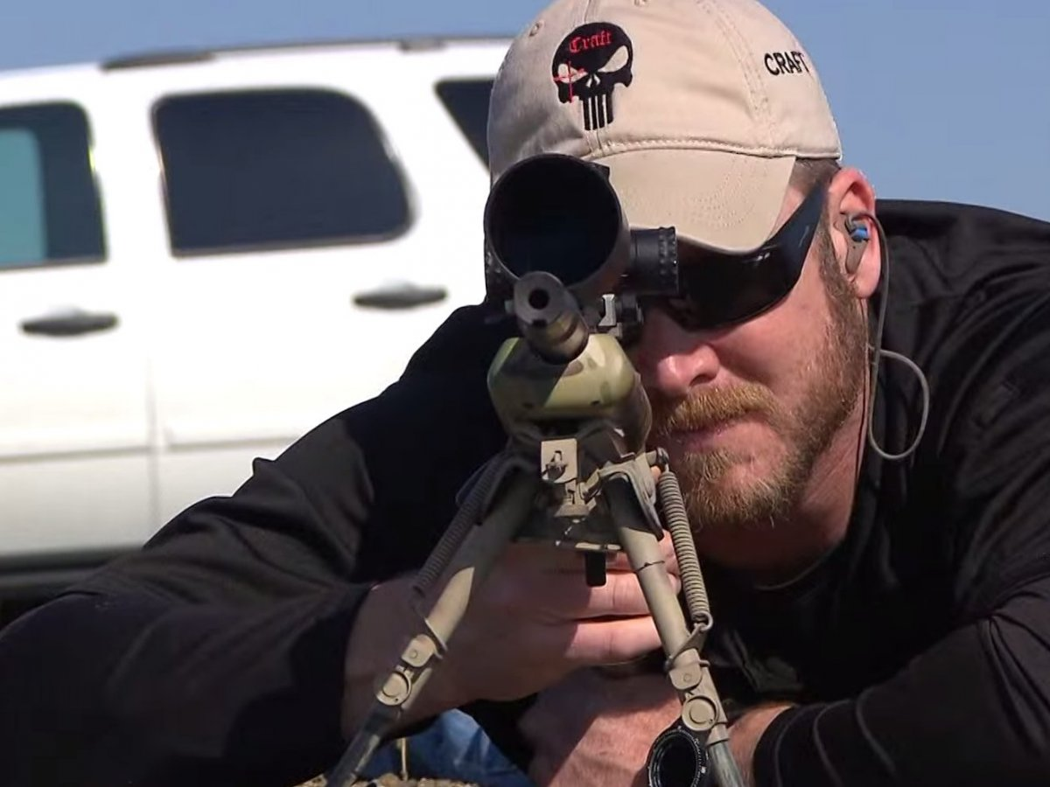
Chris Kyle related to Freud’s levels of mental life continued…
Pre conscious and conscious mind:
The preconscious mind contains thoughts and feelings that a person is not currently aware of, but which can easily be brought to consciousness. Chris had 160 confirmed kills, and many near death experiences. After leaving the navy, he started drinking, and letting himself go. when he was interviewed for a book, he became aware . Reporter DeFelice says, “He was not naturally loquacious, nor did he particularly like to talk about himself. When we first started working together, telling me what happened in the war put an enormous strain on him. He was reliving battles in great detail for the first time since he’d gotten out of the service. He could have been killed any number of the situations he’d been in”.

Slide 17
Chris Kyle related to Freud’s.. Structural model of personality
-Ego: The ego considers social realities and norms, etiquette, and rules in deciding how to behave. Chris Kyle was born to protect. After an interview with his wife Taya Kyle, she said “Chris was out there fighting for his brothers because he loved them. He wanted to protect them and make sure they all got to go home to their families.”
-Id: The id is the impulsive (unconscious) part of our psyche which responds immediately to instincts. For example, two men approached Chris at gunpoint, and his immediate response was to fake getting his keys and to reach back for his gun. Chris shot the men in the chest, killing them.
-Superego: The superego’s function is to control the id’s impulses. It consists of two systems: The conscience and the ideal self. Society looks down on aggression. Chris Kyle wanted and desired to go back on deployment and protect the country. His superego told him it was time to leave the Navy because his marriage was falling apart.

Slide 18
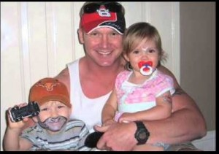
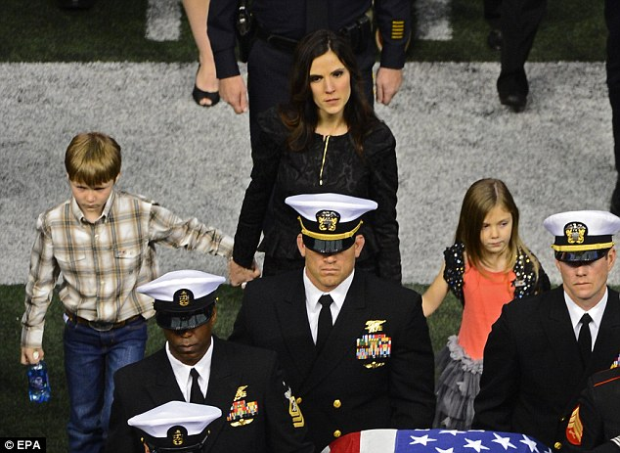
Chris Kyle related to Freud’s..
Defense mechanisms:
-We use defense mechanisms to protect ourselves from feelings of anxiety or guilt, which arise when we feel threatened.
-Repression: All throughout life, Chris Kyle used defense mechanisms in the Navy Seals. He has said he does not see the people he kills as people, he sees them as targets. He does not think of them as having a family or job. He does that to protect himself of guilt.
-Displacement: Chris Kyle feels guilty about leaving the navy and all his buddies so he began drinking and letting himself go.
-Sublimation: Chris Kyle’s aggression about missing his children growing up made him focus on killing the target and protecting his own brothers on his team.

Slide 19
In Conclusion
Freud’s theories explain Kyle’s drive to join the military and the use of defense mechanisms:
His desire to join the military was driven by his need to protect
His superego driving him to return to his life in the states
The use of defense mechanisms to cope with his life as a Navy SEAL
Erikson’s theories help explain Kyle’s connection to his role in the military, husband and father, and his struggle with transitioning to civilian life:
Industry vs. Inferiority
Identity vs. Role Confusion
Fromm’s theories give us a brief overview of Kyle’s major life decisions and his struggle to maintain his sense of identity within the military:
Human Needs
Mechanism of Escape

Slide 20
References Used
Alderich, I. (2016, November 16). Chris Kyle Biography. Retrieved from Biography.com: http://www.biography.com/people/chris-kyle
Klein, C. (2015, January 21). The Real-Life Story Behind “American Sniper”. Retrieved from History.com: http://www.history.com/news/the-real-life-story-behind-american-sniper
McLeod, S. A. (2015). Unconscious Mind. Retrieved from www.simplypsychology.org/unconscious-mind.html

